Slide 1


Slide 2





What is
Wider World Second Edition
5 levels
CEFR: <A1 – B1+​
GSE: 10 – 55​
3 – 5 hrs/week
72 – 120 hrs/year
Five level mid secondary course developed in partnership between Pearson and the BBC
STUDENT
TEACHER
INSTITUTION
Teenage learners,
age 11/12 to 15/16
English Language Teachers teaching
in-class and online
State, private full curriculum and private language schools
Notes:
Wider World Second Edition is a new version of Pearson’s best-selling mid secondary course.
It's a five-level secondary course developed in partnership between Pearson and the BBC,
aimed at teenagers between approximatelly 12 and 16 years old, learning 2-5 hours of English per week
for every English Language Teacher looking for motivating, authentic ELL Resources and a course to be easily adapter for in-class, online or hybrid context
for state and private language schools

Slide 3





Wider World Second Edition levels
GSE: 10 – 25
CEFR: <A1 - A1
GSE: 24 – 34
CEFR: A1/A2
GSE: 32 – 42
CEFR: A2/A2+
GSE: 40 – 50
CEFR: A2+/ B1
GSE: 45-55
CEFR: B1/B1+
Notes:
The course covers five levels, from 10 to 55 on the GSE scale and <A1 up to B1+ on CEFR.

Slide 4






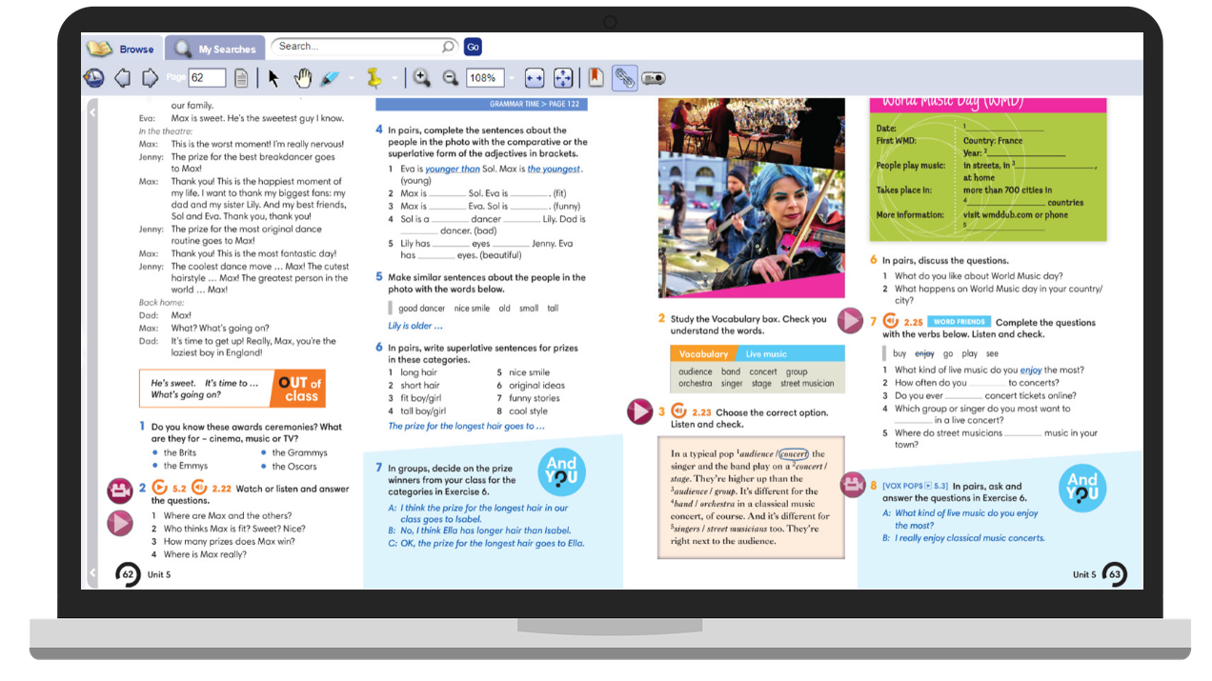
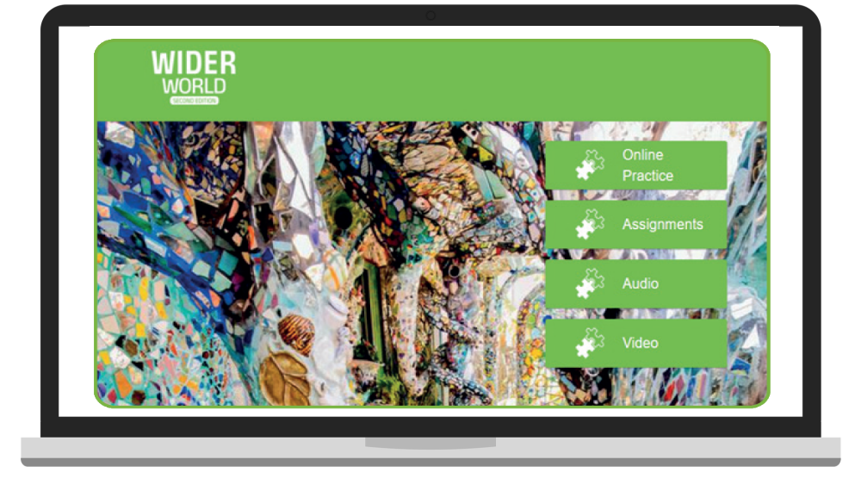




Student's components
IN CLASS
ONLINE & Homework
Student's eBook
Online Practice
Student's Book
Workbook
Online Practice = Interactive WB and Extra Practice Activities)
Notes:
Student's components include:
paper-based Student's Book and Workbook, to be used in-class, during face-to-face lessons
online components – Student's eBook, App and rich in resources and functionalities – Online Practice
The Student's eBook brings Student’s Book to life with interactive activities, video and audio. It has all Student’s Book content and includes everything you need to actively participate in an online lesson.
The App includes Online Practice and eBook content.
The Online Practice includes Workbook tasks and Extra Activities with instant feedback and marking. You will also find homework tasks and tests assigned by your teacher there

Slide 5
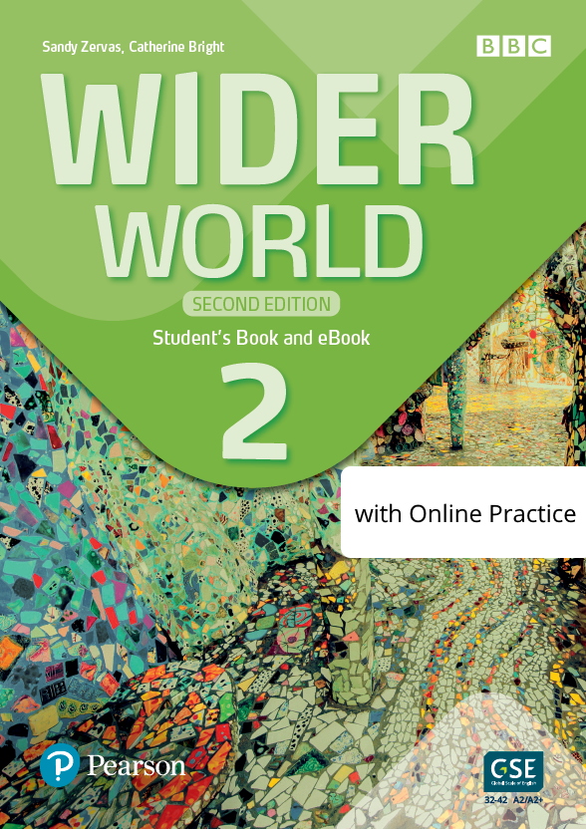

Student's Book packs
Student's Book & eBook
Student's Book with Online Practice
Notes:
There are two versions of the Student's Book available:
- a Student Book with a code, which gives access to the App and Student's eBook
- a Student Book with a code, which gives access to the App and Student's eBook as well as Online Practice.

Slide 6

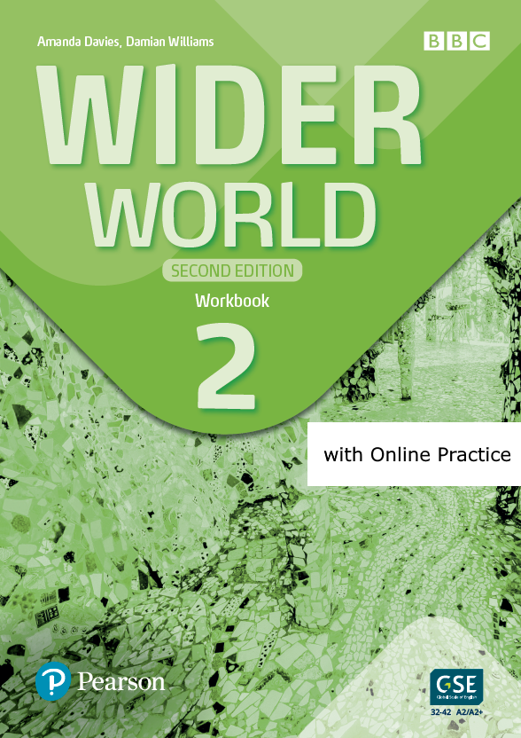
Workbook packs
Workbook (with access to Ss resources)
Online Practice (Interactive WB and Extra Practice Activities)
Notes:
There are two versions of the Workbook available as well:
- a Workbook with a code, which gives access to the App
- a Workbook with a code, which gives access to the App and Online Practice.

Slide 7

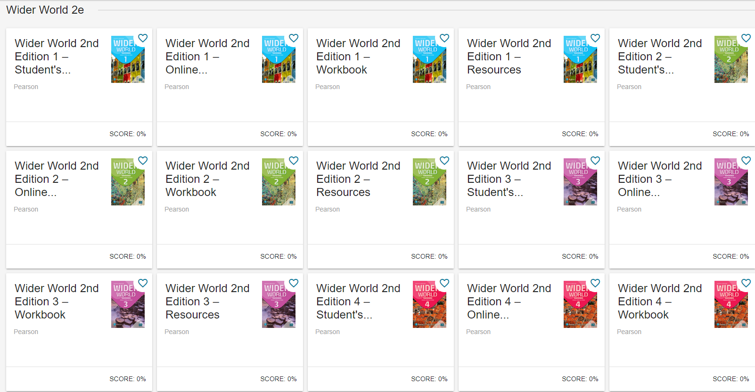
Teacher components
Teacher's Portal Access Code:
SB & WB Presentation Tool with lesson notes, video and interactive exercises
Online Practice (WB and EPA)
Teacher Resources
Gradebook with student results from the activities in the SB and Online Practice
Test Generator
Virtual classroom with live video and sharable interactive whiteboard
Teacher's Book with Teacher's Portal Access Code
Notes:
Teacher's components include:
- a printed version of the Teacher's Book with full lessons notes overwritten on Student's Book bakes
- Teacher's Digital resources including:
*access to Student's eBook
*access to Online Practice
cess to Student's App
* Test Generator
- Front-of-Class presentation tool

Slide 8
All components
Student's Book & eBook
Student's Book with Online Practice & eBook
Student's eBook Access Code
Student's eBook with Online Practice Access Code
Workbook (with Ss’ resources)
Workbook with Online Practice Access Code
Teacher's Book & Teacher's Portal Access Code
Teacher's Portal Access Code
Teacher's Portal All Levels Access Code

Slide 9

What’s NEW

Slide 10
What's NEW
New modern design
70% new content in levels 1-4
Updated BBC content and new drama videos
More interaction with Vox Pop videos
Integrated Set for Life future-skills programme
Extended reading and writing programme
More tools to respond to SEN Ss needs
Support for effective distance teaching
Diversity and Inclusion principles covered
New digital environment (PEC)
Notes:
Wider World Second Edition integrates feedback we have received from current users, with local needs identified by sales and marketing teams.
The changes cover design, upgraded digital environment, new content and features that respond to current trends in education.

Slide 11
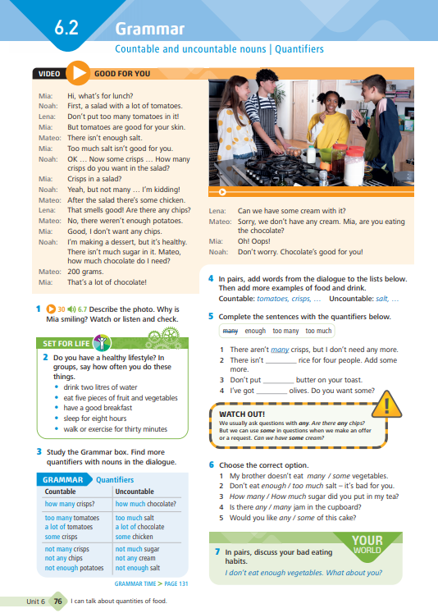
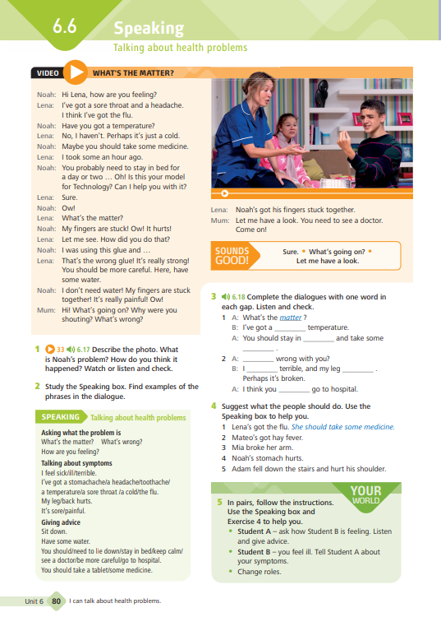
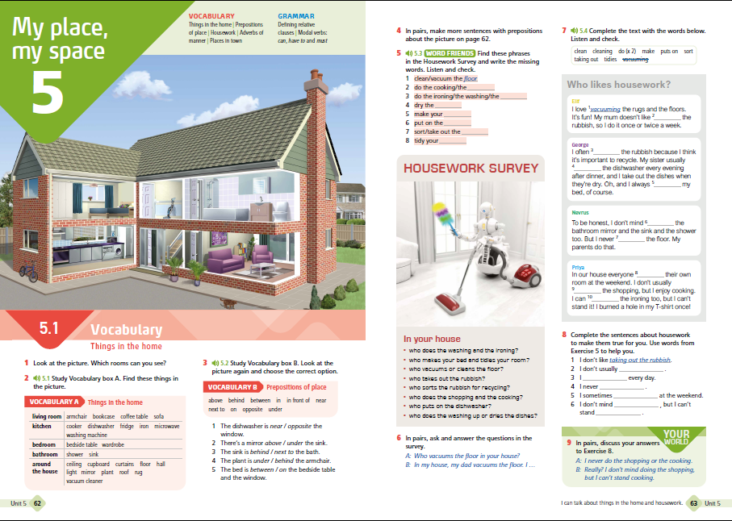
NEW modern design
New, fresh and modern design across all components
Clear colour-coded lessons
Notes:
The course has been completely redesigned to look new, fresh and modern; however it retains the Wider World identity with clear colour-coded sections that allow teachers and learners to follow regular unit structure effortlessly.

Slide 12

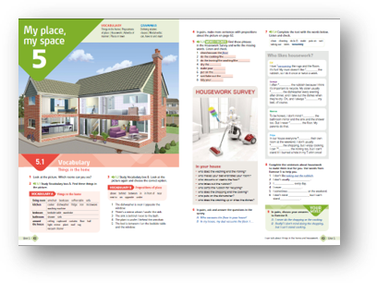
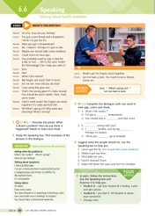
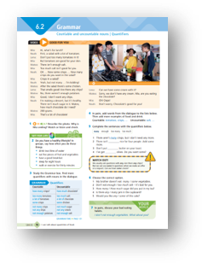
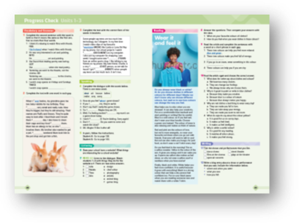
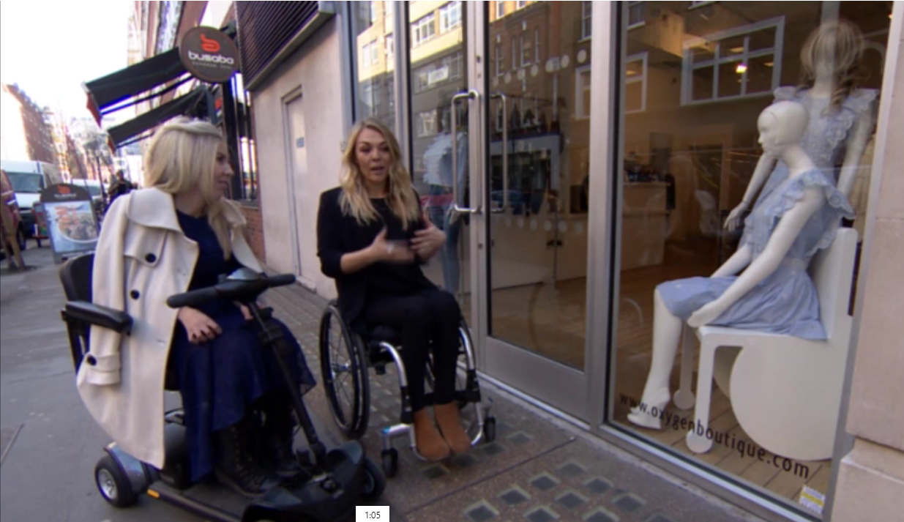
NEW content:
Student’s Book
70% of new content
New opening spreads
New drama video in levels 1-4
New drama video-based grammar and communication lessons
New reading texts and lessons
Extended practice for Vox Pops clips
Integrated Set for life programme
Cummulative exam-oriented Progress Checks
New Review sections
Notes:
Let's have a closer look at all the new features represented in the Student's Book:
New opening spreads
Eye-catchy, new opening spreads including activating unit opener and vocabulary
New drama videos
New drama videos bridging future skills content.
New drama video-based grammar and communication lessons
New BBC videos
New reading texts and lessons
All reading texts and reading lesson strand has been replaced with engaging, up-to-date content.
Extended practice for Vox Pops clips
In response to Teacher's feedback Vox Pops extend the personalisation section "Wider World" where a student has a chance to relate his environments to the voices of people around teh world.
They are now accompanied by extended practice worksheets available in Techers's Book.
Integrated Set for life programme
Cummulative exam-oriented Progress Checks
Cumulative progress check after lessons 1-3, 1-6 and 1-9 include many exam tasks for Pearson English International Certificate and Cambridge Exam.
Teacher's Book includes extensive description of every exam task in relation to exam requirenments.
New Review sections

Slide 13
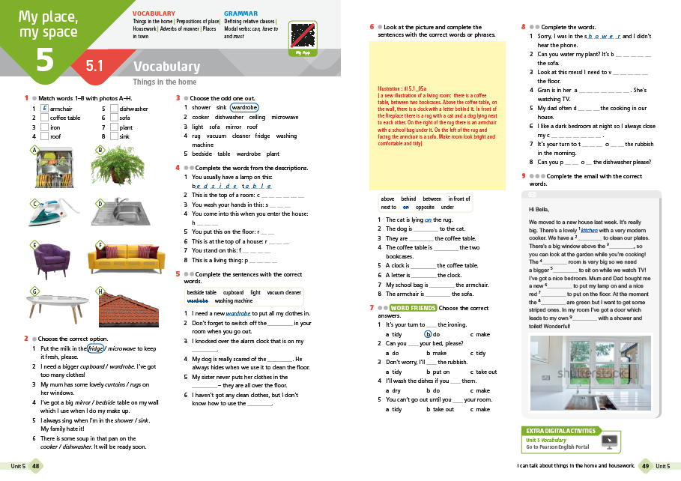
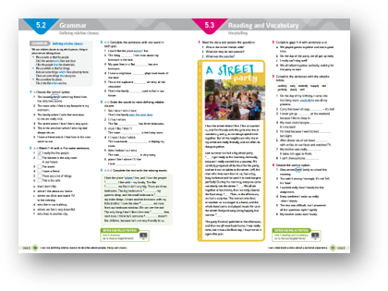
NEW content:
Workbook Book
70% of new content
New opening spreads
New reading texts
New Readers-based Reading Time sections
New Self-check sections
New My Language File sections
New Exam Time section with exam study tips at the back of the book
Sign-posted additional online practice
Notes:
In the Workbook, you will observe the following changes
New opening spreads
New reading texts
New Readers-based Reading Time sections
New Self-check sections
New My Language File sections
New Exam Time section with exam study tips at the back of the book
Sign-posted additional online practice

Slide 14
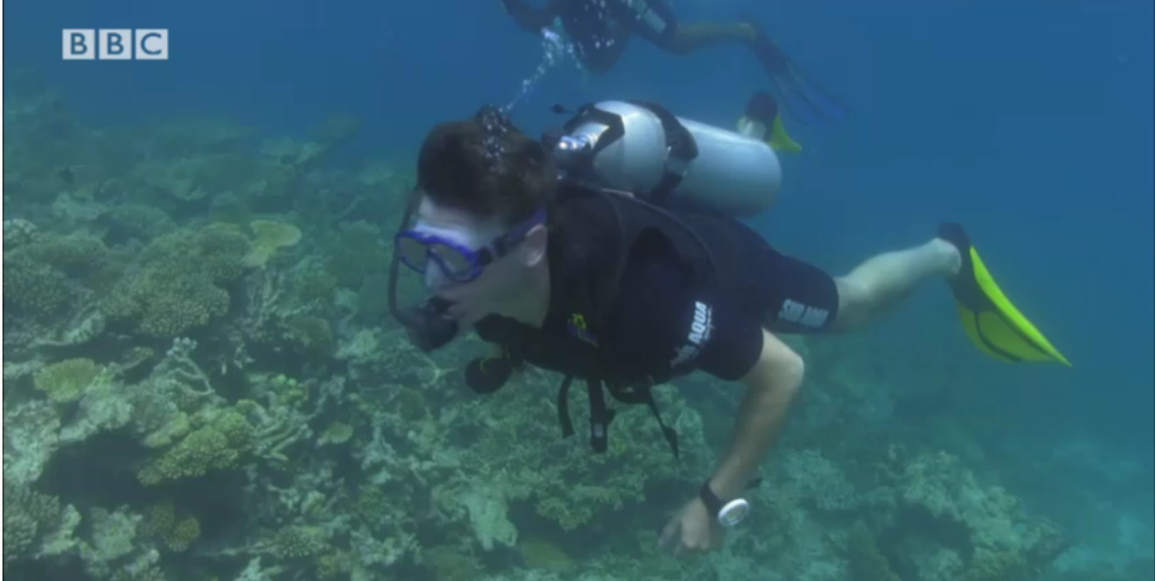

BBC content
New BBC documentaries for:
Culture
Global citizens
Cross curricular
BBC Vox Pops for:
Edited to allign with Editorial Policy
More interaction with target language and structures in real context
Notes:
Pearson English is a unique partner for BBC Studios in creating ELT courses to source the BBC authentic content and integrate it with the course.
Wider World Second Edition continues providing authentic video content which for the second edition has been replaced to better reflect on the important themes such as culture, global citizenship or cross curricular topics, promoting diversity and inclusion.
The improvements includes
The BBC authentic content is better signposted in the Second Edition.
Student worksheets for BBC Vox Pops including step-by-step guidance for project work
Each level 1-4 includes:
5 BBC Culture Videos per level (original BBC footage)
36 BBC Vox Pops per level (street interviews)
18 drama videos to contextualize and present new grammar structures and speaking functions

Slide 15


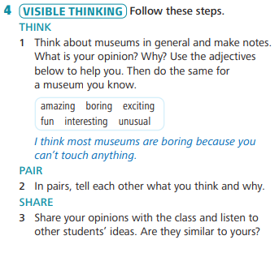
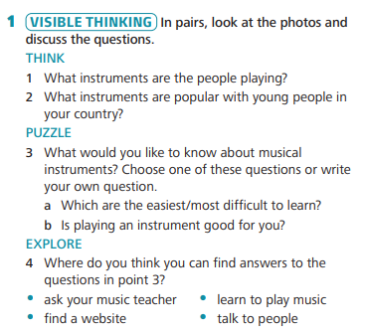
Visible thinking
Elements of Visible Thinking integrated in BBC Culture sestions. Tasks orgainised to follow the „thinking routines”.
Notes:
Visual thinking is one of the strategies used to promote thinking skills and employ short, easy-to-learn strategies that help extend and deepen students' thinking.
Wider World Second Edition helps students “learn to learn”, supports them to better understand, remember and present their knowledge. They have a chance to develop their critical thinking skills.
This feature has been implemented into BBC Culture lessons

Slide 16


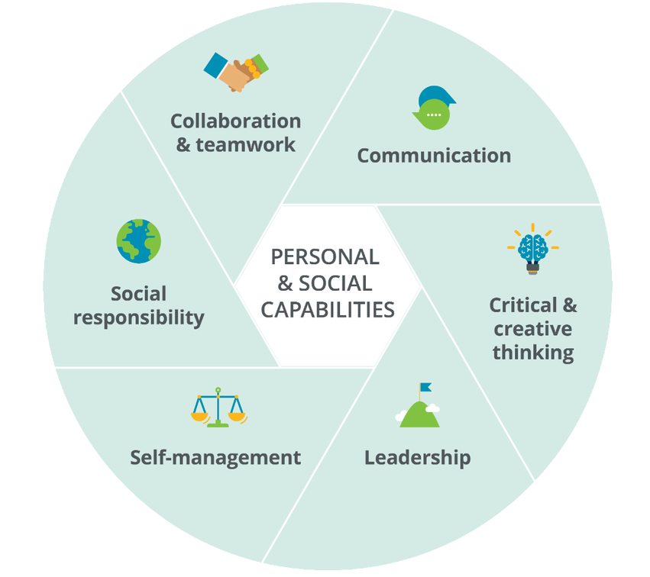
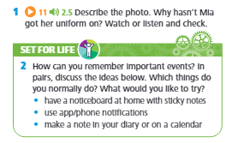
NEW integrated future skills programme
PEARSON PERSONAL AND SOCIAL CAPABILITIES FRAMEWORK
Critical Thinking and Creativity
Communication
Collaboration
Self-management
Leadership
Social Responsibility
Notes:
Wider World Second Edition provides an integrated programme of teaching future skills, which is a part of Pearson's personal and social capabilities framework.
It is currently a "must-have" feature in ELT courses.
The syllabus covers a variety of key skills across the level, including:
Critical Thinking and Creativity
Communication
Collaboration
Self-management
Leadership
Social Responsibility

Slide 17
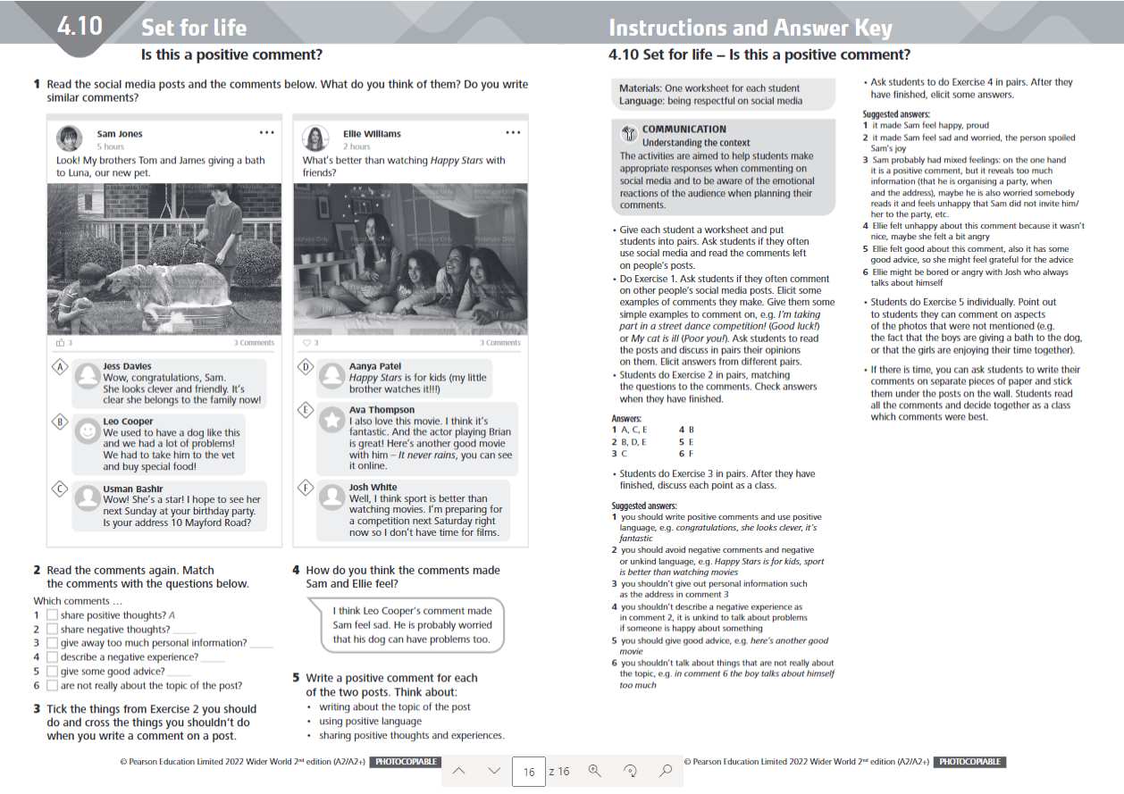

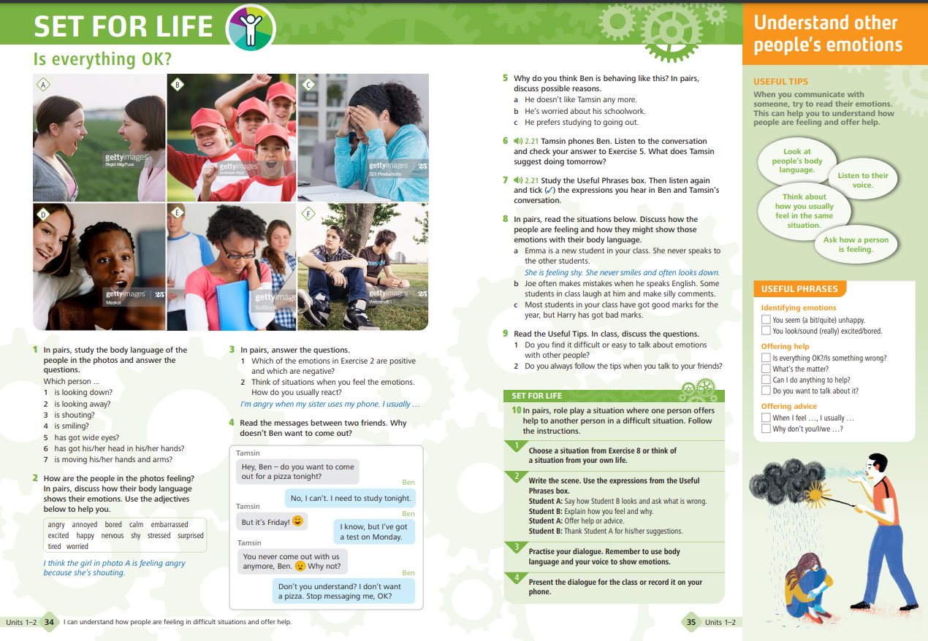
NEW integrated future skills programme
Four Set for Life lessons per level
Set for Life 'bookmarks' with useful tips and phrases
Photocopiable worksheets
Set for Life tasks in core lessons integrated with video story
Teacher Training reference content on future skills development framework on Teacher’s Portal
Notes:
The new future skills strand has been carefully implemented throughout the course, in both student and teacher materials.
Student's Book includes:
A Set for Life lesson after every two units (4 per level) – it aims to equip students with transferable skills for life beyond the classroom. The lessons are built around usual lesson stages: presentation – interaction – free practice. Free practice includes broader context where the students are asked for opinion or take part in a debate, being taught how to solve a particular problem.
A Set for life task in every unit integrated with video story
A Set for Life cheatsheet with useful tips and phrases
A Photocopiable worksheet to accompany each set for life lesson: explore the topic of SB lesson in more detail

Slide 18
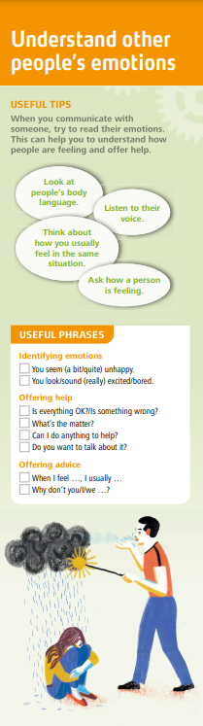
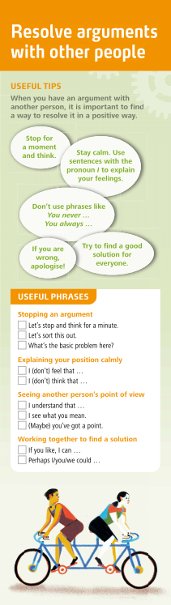
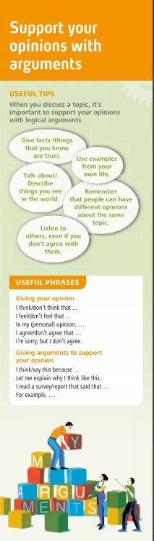
NEW integrated future skills programme
Printable Set for Life ‘bookmarks’ provide tips on how to successfully apply the skills in real life, and serve as a quick reference to key language areas introduced in the lessons.
Notes:
Teachers’ Resources include (on the Portal)
• Correlation tables: future skills taught across levels
• Set for life bookmarks
• Quick quide: teaching future skills

Slide 19
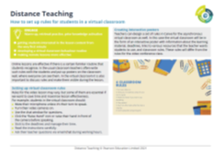
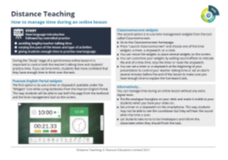
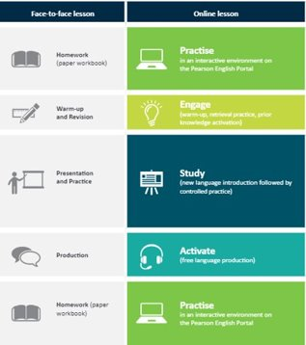
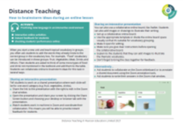
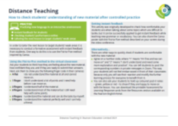
NEW
Virtual classroom support pack
Bank of ideas for online lessons
Power Point Grammar Presentations for every grammar lesson
Notes:
Wider World Second Edition provides great support for Teachers to teach online.
It includes guidelines on integrating ESAP – Engage, Study, Activate, Practice – methodology, which follows similar principles to face-to-face teaching, and adjusts them to fit the online lesson scenarios.
Teachers not only can follow the general guidelines, but will also have access to specific ideas for each stage of the online lesson.

Slide 20
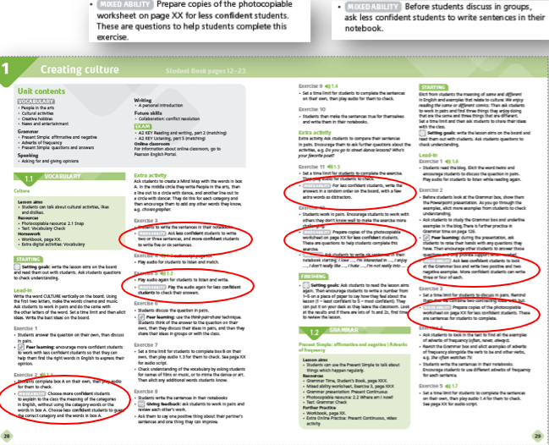
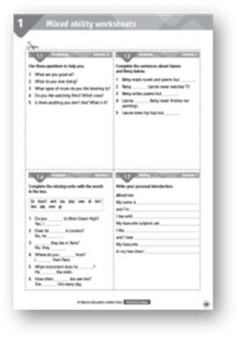
MORE support for
SEN students
Technical upgrades in digital components in terms of font, size, visibility, alternative text
Student’s Book
Grammar Time section with grammar explanation and additional practice
Teacher's Book:
Teaching notes on how to support less/more confident students integrated in every lesson
Worksheets with adapted versions of more difficult tasks to make it more manageable for less confident students
Notes:
Wider World Second Edition recognizes that student vary in many different ways, including their language ability.
The wide range of support materials enable teachers to respond to the needs of all students, whatever their ability, so that every student can achieve their potential. They include:
Student’s Book
Grammar Time section with grammar explanation and additional practice on new structures
Teacher's Book:
Teaching notes on how to support less/more confident students integrated in every lesson
Worksheets with adapted versions of more difficult tasks to make it more manageable for less confident students
Workbook
My Language File in the WB for storing new language with an option to translate into Ss L1
On the Portal
Additional grammar and vocabulary practice for further practice on the language and structure from each lesson
Additional remediation and stretch grammar tasks on the Portal

Slide 21
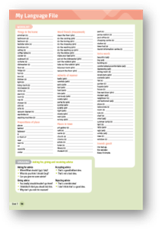
MORE support for
SEN students
Workbook
Graded exercises
My Language File in the Workbook to help Ss build their own bilingual dictionary as well as memorise and revise new words
On the Portal
Additional grammar and vocabulary practice on the language and structures from each lesson
Additional remediation tasks
Notes:
Workbook
My Language File in the WB for storing new language with an option to translate into Ss L1
On the Portal
Additional grammar and vocabulary practice for further practice on the language and structure from each lesson
Additional remediation and stretch grammar tasks on the Portal

Slide 22
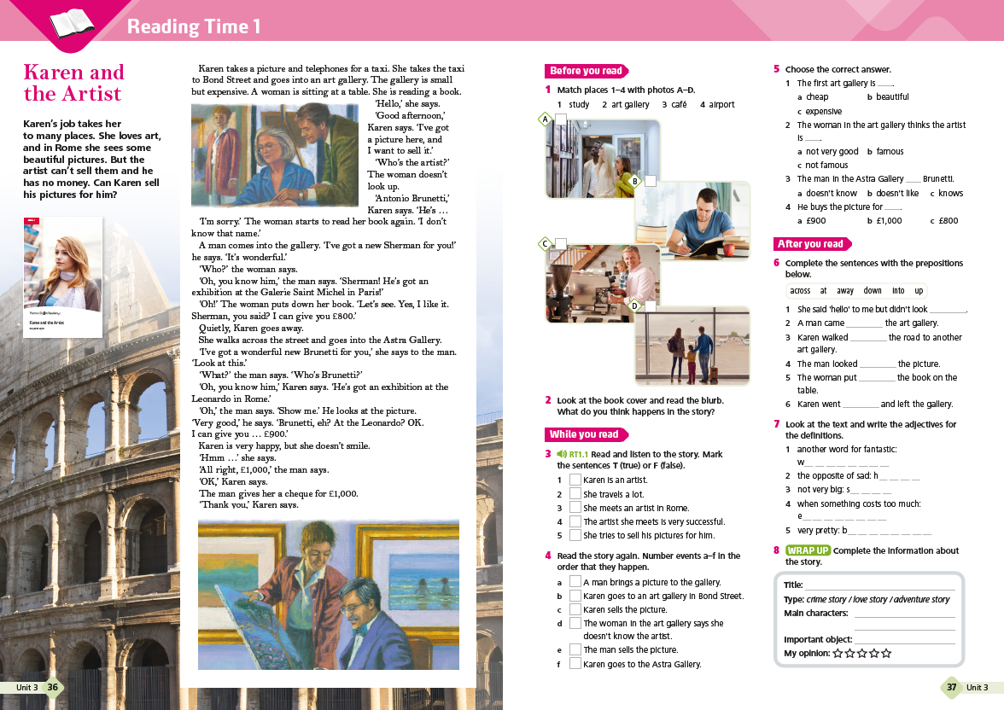
EXTENDED reading and writting programme
Reading
Reading Skills lessons in each unit with manageable texts on up-to-date, engaging topics relevant to students’ age to motivate them to read.
Selected grammar presentations based on shorter reading passages.
Culture topic in BBC Culture spreads introduced through inspiring texts
Reading Time sections in Workbook promoting reading for pleasure
Writing
Writing skills lessons after every unit, with model text, Language boxes for key language and step by step guidelines for free writing tasks

Slide 23
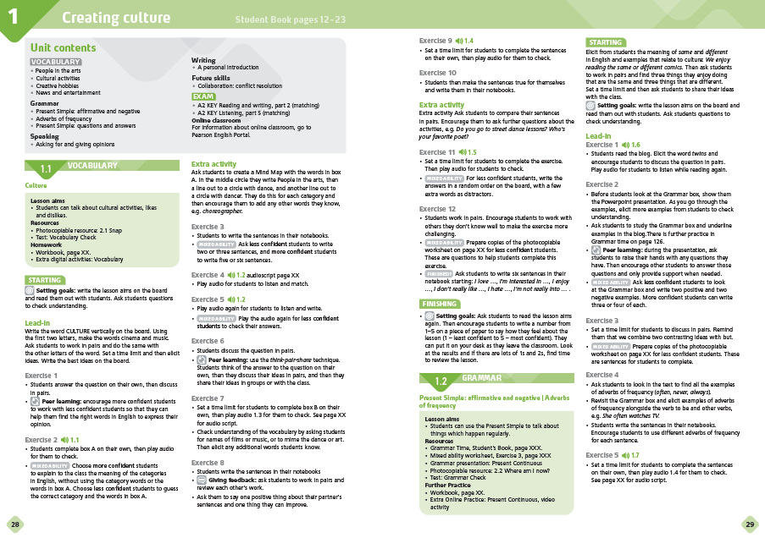

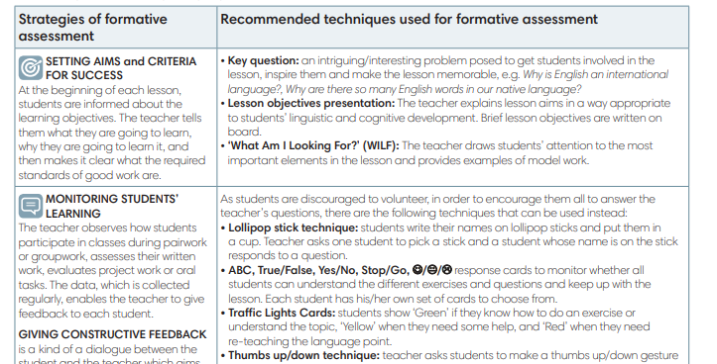
NEW, INTEGRATED
Assessment for Learning guidelines
Teaching notes in every lesson with guidelines on how to integrate elements of Assessment for learning in every lesson
Printable Assessment for learning response cards on the Portal
Content Slide Bulleted Text Only with Color Accents
Notes:
The most common AfL strategies are included into Teacher’s notes for every lesson to become a part of every lesson routine
Learners
Learners build their own strategies to evaluate their progress. They become more autonomous and responsible for their own learning.
Teachers
Teachers receive continues support to incorporate AFL into every day teaching: Teaching notes offer quick and easy to use AFL techniques for various lesson stages - clearly signposted with symbols. Assessment for learning Response Cards are available on the Portal

Slide 24


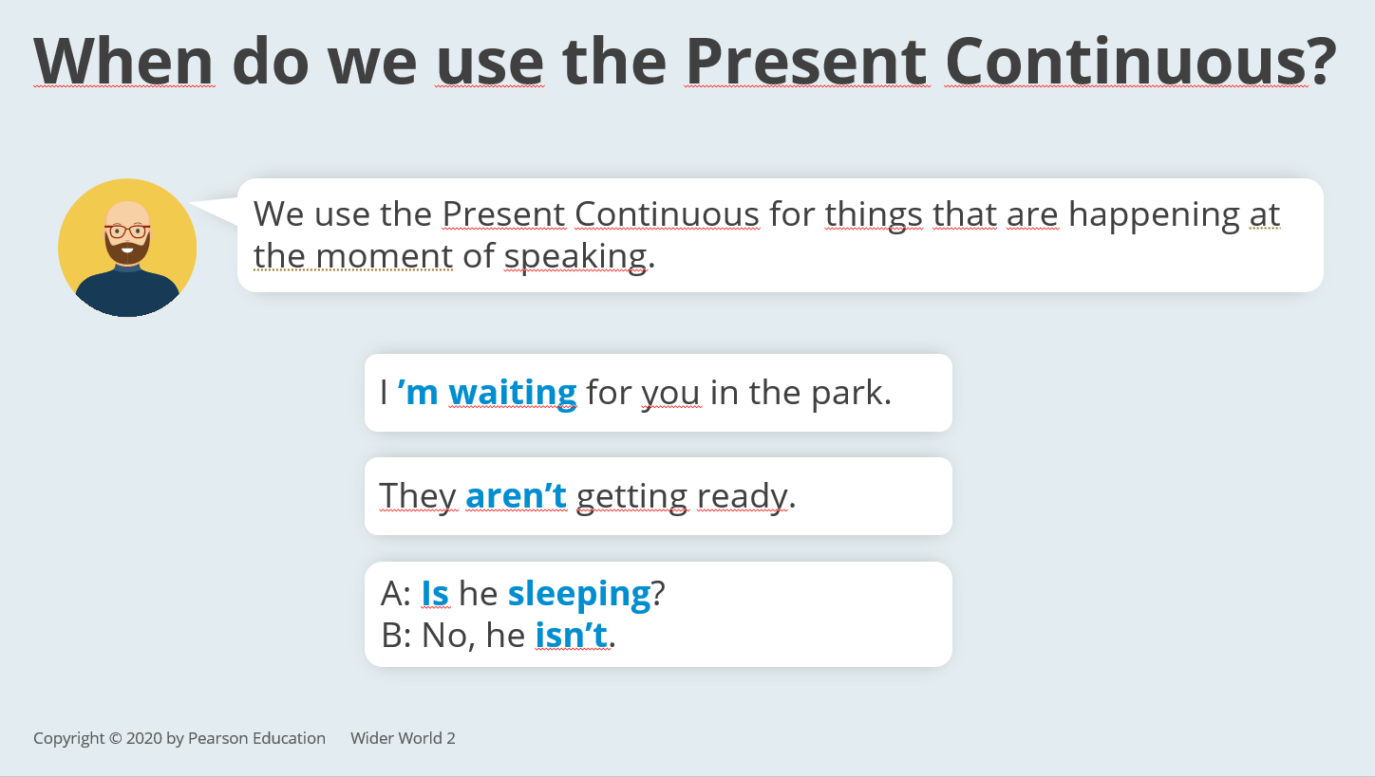
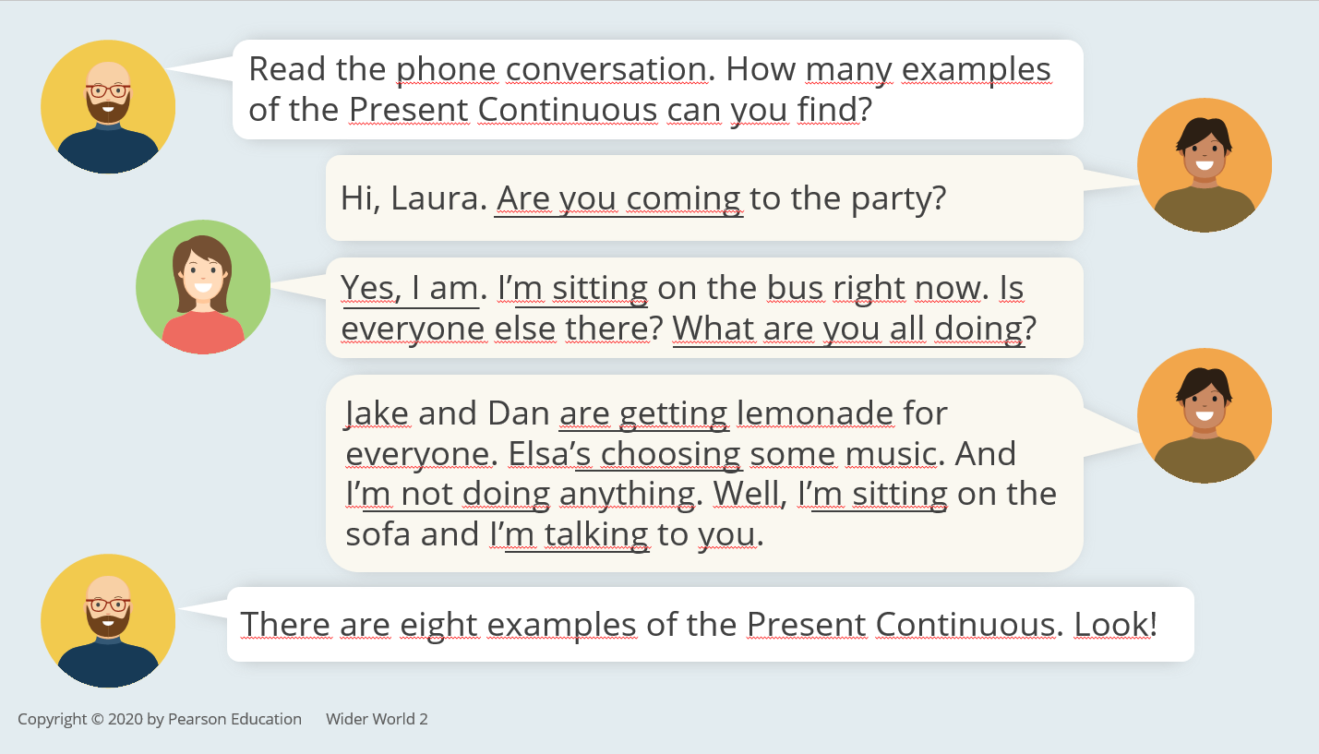
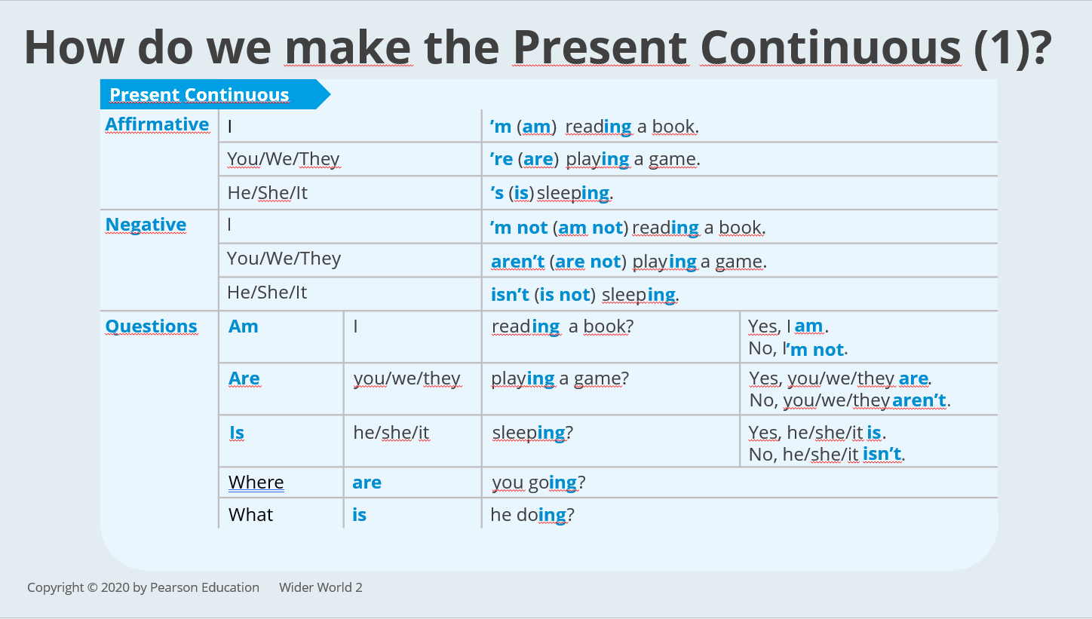
NEW Interactive Grammar presentations for every grammar lesson

Slide 25

NEW Digital Environment
All digital components sit on Pearson English Connect platform
All digital content is fully accessible on mobile devises
Notes:
Teacher's components include:
- a printed version of the Teacher's Book with full lessons notes overwritten on Student's Book bakes
- Teacher's Digital resources including:
*access to Student's eBook
*access to Online Practice
cess to Student's App
* Test Generator
- Front-of-Class presentation tool

Slide 26
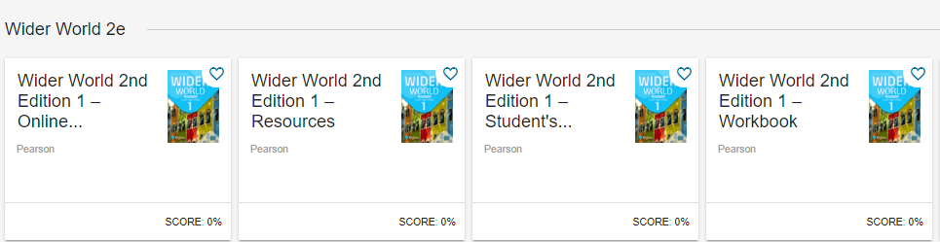
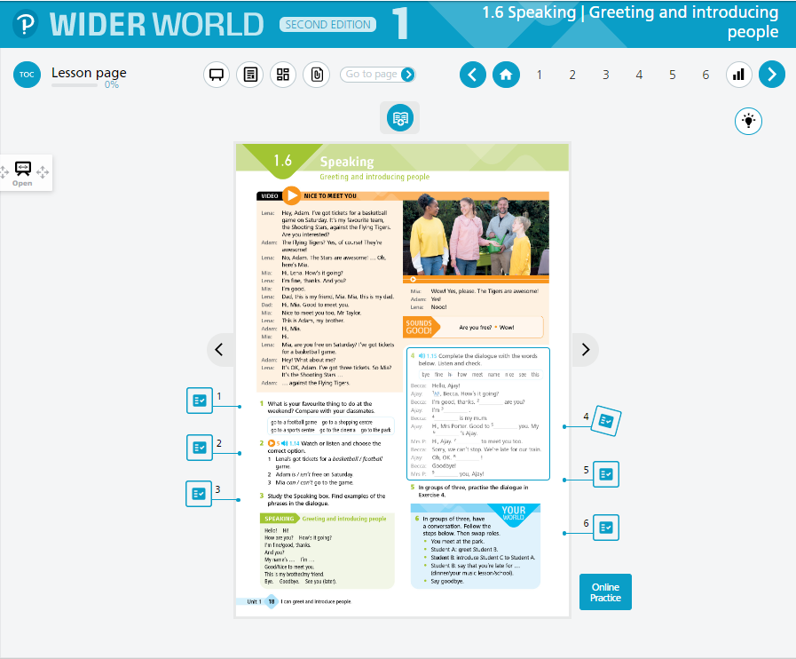
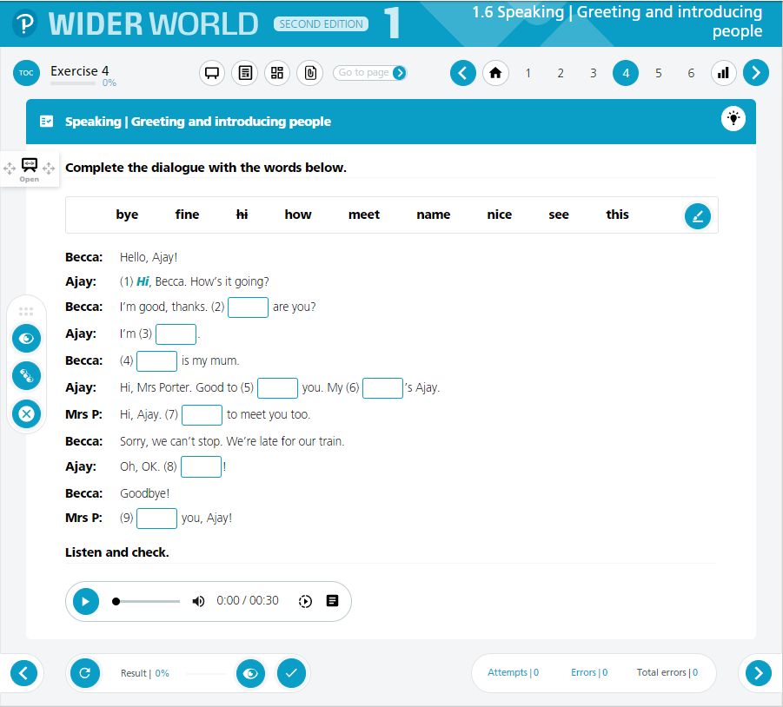
Student's Book
Presentation Tool
Notes:
Teacher's components include:
- a printed version of the Teacher's Book with full lessons notes overwritten on Student's Book bakes
- Teacher's Digital resources including:
*access to Student's eBook
*access to Online Practice
cess to Student's App
* Test Generator
- Front-of-Class presentation tool

Slide 27
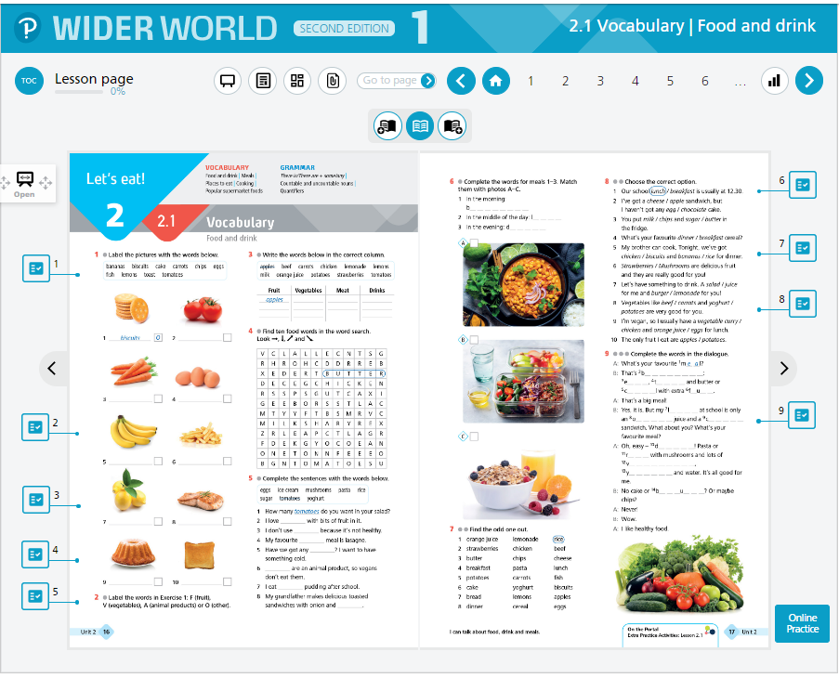
Workbook presentation tool
Notes:
Teacher's components include:
- a printed version of the Teacher's Book with full lessons notes overwritten on Student's Book bakes
- Teacher's Digital resources including:
*access to Student's eBook
*access to Online Practice
cess to Student's App
* Test Generator
- Front-of-Class presentation tool

Slide 28
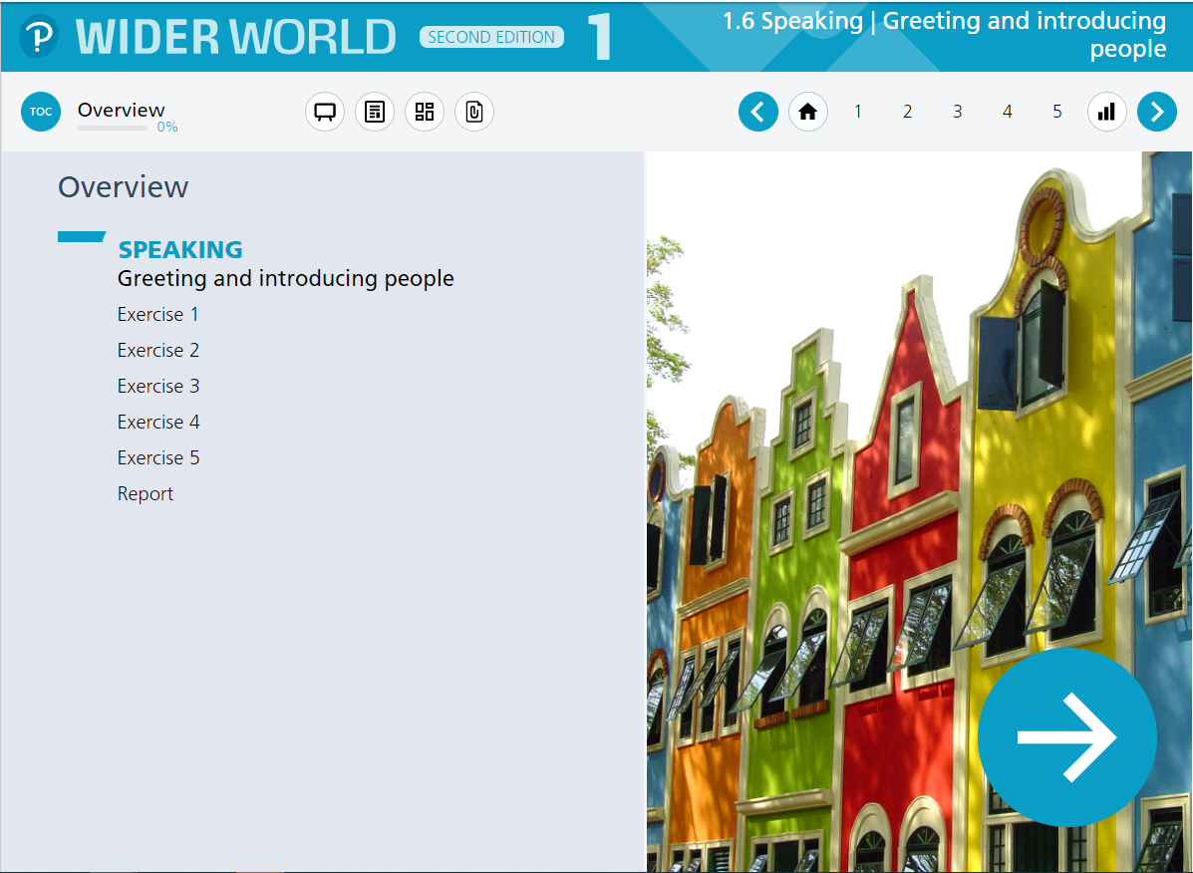
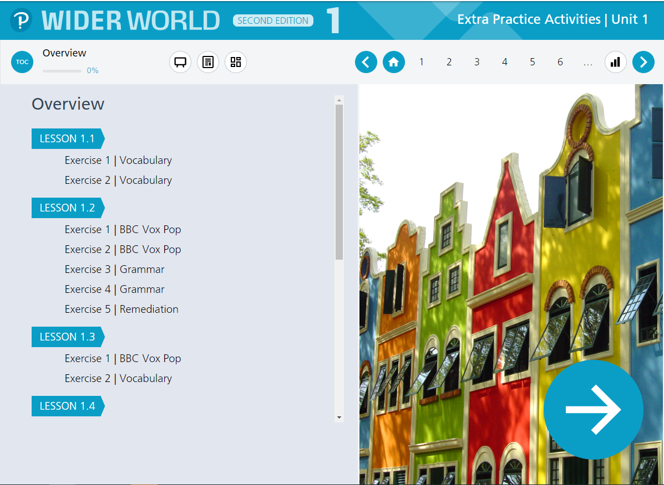
Online Practice
Interactive WB
Extra Practice Activities
Notes:
Teacher's components include:
- a printed version of the Teacher's Book with full lessons notes overwritten on Student's Book bakes
- Teacher's Digital resources including:
*access to Student's eBook
*access to Online Practice
cess to Student's App
* Test Generator
- Front-of-Class presentation tool

Slide 29
Extra Practice Activities
About 240 additional tasks per level:
4 video based activities for each unit (36 per level)
2-3 activities for each BBC Vox Pops (about 27 per level)
4 grammar activities for each unit (36 per level)
4 vocabulary activities for each unit (36 per level)
2 remediation tasks for each unit (18 per level)
3 Self-Check tasks (unit test prep) for each unit (27 per level)
All Grammar Time tasks from the Student’s Books (approx. 30 per level)
10 additional Use of English activities (10 per level)
Vocabulary Memory Games (20 per level)
Notes:
Wider World Second Edition integrates feedback we have received from current users, with local needs identified by sales and marketing teams.
The changes cover design, upgraded digital environment, new content and features that respond to current trends in education.

Slide 30
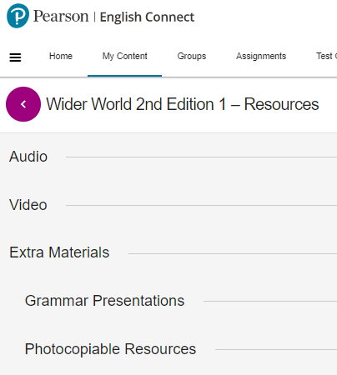
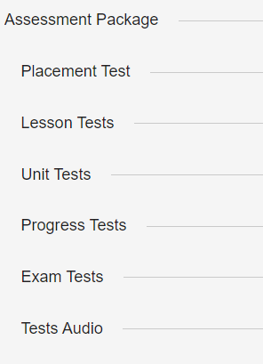
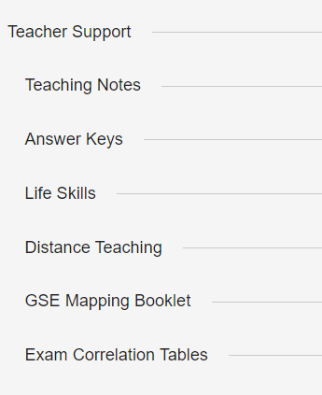
Teacher's resources
Notes:
Teacher's components include:
- a printed version of the Teacher's Book with full lessons notes overwritten on Student's Book bakes
- Teacher's Digital resources including:
*access to Student's eBook
*access to Online Practice
cess to Student's App
* Test Generator
- Front-of-Class presentation tool

Slide 31

What’s great and unique about
Wider World
Second Edition

Slide 32
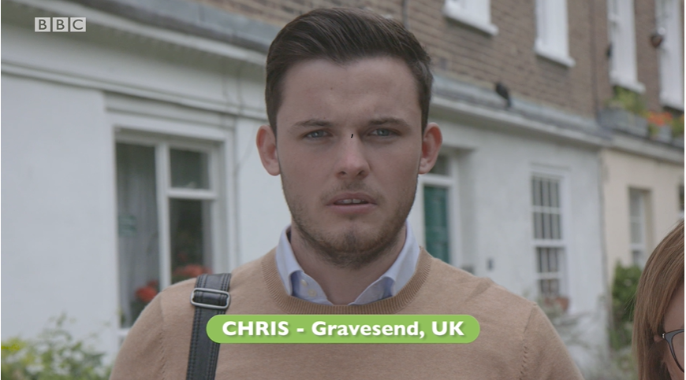



BBC Partnership
New BBC videos explore the diversity of life
and culture and arouse students' curiosity
to discover, explore and enter
the wider world
Notes:
New BBC videos explore the diversity of life and culture and arouse curiosity of the wider world
BBC videos expose learners to authentic English, motivating them to develop their language skills and communicative competence to engage with the wider world.
Teachers receive high-quality, authentic video content embedded and integrated with their course. They can showcase working the content partnership for their course.

Slide 33
Global citizenship and future skills programme
Wider World Second Edition
prepares teenagers for their life ahead
Notes:
Wider World Second Edition prepares teenagers for their life ahead
Tasks and activities help students develop the ‘future skills’ they need to pursue their studies, enjoy their social lives and succeed in their careers as citizens of the world.
Teachers can be certain they are equipping their learners with invaluable skills they will need in theIr future lives.

Slide 34

Methodology
Based on tried and tested ELT methodology (scaffolded/step-by-step approach to teaching grammar and skills with a lot of revision and recycling, open-and-teach formula that makes teaching easy!)
Visible Thinking integrated in BBC Culture sestions.
Practical integration of Assessment for Learning with tools and pratical tips to implement it in every lesson
Support for SEN students
Notes:
Visual thinking is one of the strategies used to promote thinking skills and employ short, easy-to-learn strategies that help extend and deepen students' thinking.
Wider World Second Edition helps students “learn to learn”, supports them to better understand, remember and present their knowledge. They have a chance to develop their critical thinking skills.
This feature has been implemented into BBC Culture lessons

Slide 35



Global Scale of English
Wider World Second Edition has been created using GSE Learning Objectives for Young and Adult Learners and is mapped to Benchamark
Notes:
Wider World Secnd Edition has been created using the GSE Learning Objectives for Young Learners. These have been used to ensure that the content and activities are at the correct level and have informed the lesson goals given at the start of each unit.
The Global Scale of English (GSE) is a numerical scale which measures English language proficiency. It is also a framework of learning objectives which describe what a learner can do at each level of proficiency on the scale for each of the four skills: listening, reading, speaking and writing.

Slide 36
Digital environment
New, advanced digital components provide best learning and teaching experience in class and online
Clasroom lessons
Online lessons
Interactive online Homework
Notes:
Comprehensive resources enable teachers to adapt to any teaching situation - with minimal preparation, teachers can adapt Wider World Second Edition for use in class or online

Slide 37
Interactive Grammar presentations for every grammar lesson

Slide 38


Diversity, accessibility and Inclusion
Wider World Second Edition
follows Pearson's comittment to
equality, diversity and inclusion.
Caters for different students needs and abilities
Supports neurodivergent students
Recognises cultural diversity
Supports tolerance and respect
Notes:
Wider World Second Edition follows Pearson's comittment to equality, diversity and inclusion.
Caters for differnt students needs and abilities
Supports neurodivergent students
Recognises cultural diversity
Supports tolerance and respect
The wide range of support materials enable teachers to respond to the needs of all students, whatever their ability, so that every student can achieve their potential.

Slide 39

Components features

Slide 40
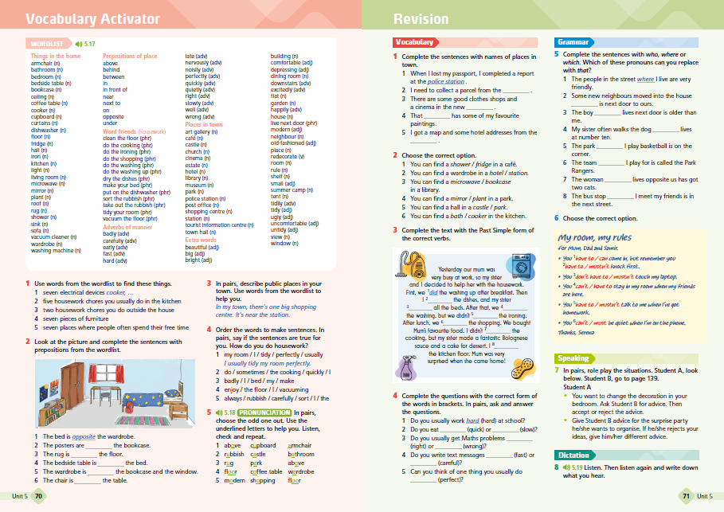




Student's Book: Unit plan
Vocabulary
Grammar
Reading & Vocabulary
Grammar
Listening & Vocabulary
Speaking
Writing
Vocabulary activator
Revision
BBC Culture
Set for Life
Cumulative progress check

Slide 41

Unit 2 Student's Book walkthrough

Slide 42



Lesson 1: Vocabulary
1. Summary of unit vocabulary and grammar content
4. Teaching collocations and vocabulary chunks
2. Real-life context and visuals
5. Integrated skills practice
6. Personalised speaking practice
3. Recorded
lexical items
7. Learning objectives
Notes:
Clear summary of units contents in terms of vocabulary and grammar
Vocabulary presented in a real-life context with engaging visuals.
All lexical items are recorded for students to listen and repeat
Special focus on teaching collocations and vocabulary chunks
Integrated skills practice to help students consolidate new vocabulary successfully
Personalised speaking practice to help students achieve the learning objective
Learning objective (Can-do statement) for every lesson based on the Global Scale of English

Slide 43





Lesson 2: Grammar
3. Grammar PPT Presentation
1.Text based grammar presentation
2. Grammar tables
4. Reference to Grammar Time sections
5. BBC Vox Pop videos
6. Speaking task
Notes:
Grammar is contextualized and presented through an engaging context
Clear grammar tables highlight target structures.
Detailed grammar PowerPoint presentation for each unit’s grammar points.
References to Grammar Time section: full grammar practice in the back of the book.
BBC Vox Pop videos expose students to real-life examples of language from the lesson.
Final productive task to encourage students to use grammar in a personalized context

Slide 44

Lesson 3:
Reading and vocabulary
2. Step-by-step reading practice
1. Managable texts
3. Recorded texts
4. Exam-type task
5. Contextualised vocabulary set
Notes:
Manageable texts about contemporary issues to engage students’ attention.
Step-by-step reading practice to develop students' reading skills
Recorded versions of all reading texts
Comprehension tasks in exam-like format to prepare students for exams
Vocabulary set contextualized in the reading text and recorded

Slide 45

Lesson 4: Grammar
1. Grammar presented through video
2. Full grammar tables
4. Step-by-step practice
3. Grammar Time section for more practice
Notes:
Grammar is presented through videos. Real-life dialogues provide a natural context and help students memorise the language. The lesson can also be run using the audio track of the presentation dialogue only.
Full grammar tables and more practice in the back of the book to give students extra practice
Step-by-step grammar practice to build students' confidence and improve accuracy

Slide 46

Lesson 5:
Listening and vocabulary
1. Step-by-step listening practice
2. Vocabulary set
4. Authentic listening texts
3. Exam-style listening tasks
Notes:
1. Step-by-step listening practice to build students' confidence
2. Vocabulary sets contextualized in the listening text
3. Exam style listening tasks to prepare students for international exams.
4. Variety of authentic listening texts to develop and improve listening skills.

Slide 47

Lesson 6: Speaking
1. Functional dialogues presented through video
5. Everyday expressions pulled out
of the presentation
2. Audio version of the dialogue
3. Set for Life tasks
6. Staged practice for final soeaking task
4. Key functional language
Notes:
Functional dialogues are presented through video. Real-life dialogues provide natural and memorable language models.
The lesson can also be run by just using the audio track of the presentation dialogue
Set for life tasks focusing on future skills linked to video episodes
Key functional language from the dialogues organized in speaking boxes
Sounds good! boxes present everyday phrases and expressions pulled out of the presentation
Staged practice of expressions to prepare students for the final speaking task

Slide 48

Lesson 7: Writing
1. Example texts with model to follow
3. Language boxes
4. Writing Time guidelines
2. Writing boxes
Notes:
Example texts to provide students with a model for free writing task
Writing boxes to highlight key functional language for writing
Language boxes with useful language points
Step-by-step Writing Time guidelines to help students write their own texts.

Slide 49


Lesson 8:
Vocabulary Activator and Revision
1. Worldlist with audio recordings
3.. Revision activities for vocabulary, grammar and functional language
2. Vocabulary practice activities
4. Dictation
Notes:
1. Banks of all vocabulary sets followed by engaging practice activities (2) to consolidate vocabulary from the unit
3. Effective and engaging revision of grammar, vocabulary and functional language from the units
4. Dictation activities to help students focus on word order and spelling.

Slide 50

Extra Lesson:
Progress check (1-3, 1-6, 1-9)
1. Cumulative revision of grammar, vocabulary and skills
3. Exam- style practice tasks
2. Use of English tasks
Notes:
The Progress Check sections consolidate grammar, vocabulary, and skills from the preceding unit in a summative way.
Use of English tasks to revise vocabulary and grammar in context
Practice tasks in exam-style format to prepare students for exams - Pearson International Certificate and Cambridge A2 Key exam

Slide 51


Extra Lesson: Set for Life
7. A guided final task
3. Useful tips
1. Thought-provoking, authentic contexts
4. Useful phrases
5. Collaborative activities
2. Practical tasks
6. Guided final task
Notes:
Set for Life lessons (every two units) to equip students with the future skills they need to enjoy their social lives, and succeed in their studies and career.
Thought provoking and authentic contexts which reflect situations and problems from students’ livee.
Practical tasks to help students develop specific skills
Useful tips to help students remember key takeaways
Useful Phrases linked to specific life skill
Activities which encourage working collaborativelly (pairwork and group work)
Gguided final tasks to reinforce the skill taught in the lesson
A supplementary worksheet available as a part of Teacher's Resources for every Set for Life lesson

Slide 52

Extra Lesson: BBC Culture
4. BBC documentaries
1. Reading texts presents culture topics
2. Activities based on Visible Thinking routines
4. Step-by-step digital project
plan
3. Glossary
Notes:
BBC lessons (every two units) provide opportunity to work with authentic videos and real-life content
1. Culture topics linked to unit themes introduced in reading texts
2. Activities based on Visible Thinking routines to help students understand the topics
3. Glossary of the most difficult words in the texts
4. BBC documentaries providing fascinating real world information
5. Step-by-step digital projects to allow learners to follow their own interests while developing team work and ICT skills

Slide 53


Extra section:
Grammar time
1. One page with two grammar issues per unit
Notes:
Grammar Time section with additional grammar practice for each grammar lesson

Slide 54

Extra section:
Irregular verbs
Irregular verbs list at the end of the book

Slide 55




Extra section:
CLIL
4 CLIL lessons per level

Slide 56

Extra section:
Student activities

Slide 57
Unit 2 Workbook walkthrough

Slide 58





Core lessons
Workbook lessons correlated with core lessons from the Student's Book
Lessons colour coding in Student's Book and Worbook align, for easy navigation
Workbook in colour for improved attention and motivation
Signposted additional online practice

Slide 59

Core lessons:
My language file
A unit wordlist with recording and space for translation

Slide 60


Core lessons:
Self-check
A self-check section at the end of each unit
Answer key provided at the back of the Workbook

Slide 61


Extra section:
Reading Time
3 spreads per level
Reading text from Pearson English Readers
Accompynying audio recordings
Before, While and After Reading activities

Slide 62





Extra section:
Exam Time
Exam Time sections in the Workbook provide exam practice in a format which mirrors the real tests.
Exam Tips familiarise students with typical exam task types and help them overcome common exam difficulties.
There are three spreads per level covering units 1-3, 1-6, 1-12

Slide 63
Teacher's Book and Teacher's Resources

Slide 64
Teacher's Book and Resources
Teacher's Book:
Student's Book pages with overwritten answers
Teaching notes
Need support? Worksheets for lower achieving students
Student's Book audio scripts
Student's Book video scripts
Workbook audioscripts
Workbook answer key
Teacher's Portal (Pearson English Connect)
SB & WB Presentation Tool with lesson notes, video and interactive exercises
Online Practice of the WB and Extra Practice Activities
Teacher Resources
Gradebook with student results from the activities in the SB and Online Practice
Test Generator
Virtual classroom with live video and sharable interactive whiteboard
Notes:
Teacher's Book:
Student's Book pages with overwritten answers
Teaching notes
Need support? Worksheets for lower achieving students (easier versions of selected activities from Student's Book, 4 per unit)
SB audio/videoscripts
WB audioscripts
WB answer ke
On the Portal:

Slide 65


Teacher's Book
Notes:
Teacher's Book:
Student's Book pages with overwritten answers
Teaching notes
Need support? Worksheets for lower achieving students (easier versions of selected activities from Student's Book, 4 per unit)
SB audio/videoscripts
WB audioscripts
WB answer ke
On the Portal:

Slide 66

Support for lower achieving students
Notes:
Teacher's Book:
Student's Book pages with overwritten answers
Teaching notes
Need support? Worksheets for lower achieving students (easier versions of selected activities from Student's Book, 4 per unit)
SB audio/videoscripts
WB audioscripts
WB answer ke
On the Portal:

Slide 67



Assessment for learning support
A list of assessment4learning strategies and techniques for every lesson in the TB Introduction
Asseement4learning response cards (printable or to display)
Tips on how to integrate assessment4learning techniques in every lesson
Notes:
Teacher's Book:
Student's Book pages with overwritten answers
Teaching notes
Need support? Worksheets for lower achieving students (easier versions of selected activities from Student's Book, 4 per unit)
SB audio/videoscripts
WB audioscripts
WB answer ke
On the Portal:

