Slide 2
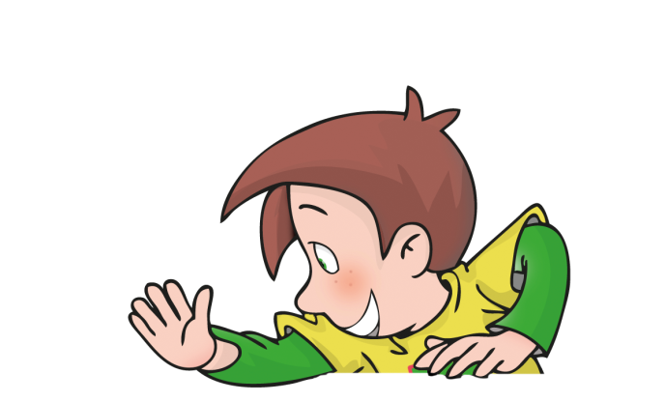
Become a Team
Work together
Respect each other
Learn together
Help each other
Celebrate success together

Slide 3
Steps to successful collaboration
Work together: Collaborative classroom projects and wall displays show the results of the collective efforts of the students.
Respect each other: Show and Tell encourages students to listen to and observe their peers’ presentations.
Learn together: Cooperative learning activities and songs ensure whole-class participation in a positive environment.
Help each other: Talk Partners gives students the opportunity to discuss and express their opinions with their classmates
Celebrate success together: The “Well Done, Give Me Five” song has the whole class celebrating their achievement as a team.

Slide 4
Collaborate, Communicate and Celebrate Success
motivates children to use creative and logical thinking, increasing their use of English.
develops cooperative skills, helping students take initiative and gain confidence.
allows students to take pride in their achievements and develop valuable presentation skills.
provides positive reinforcement and an encouraging learning environment.
personalises language practice, increasing communicative competence.

Slide 5
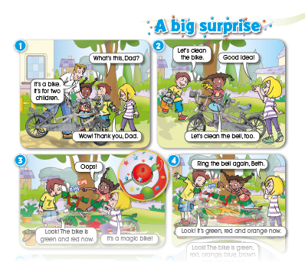
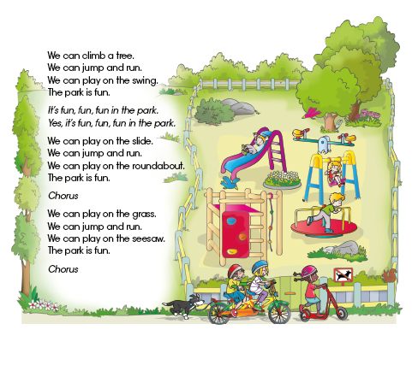
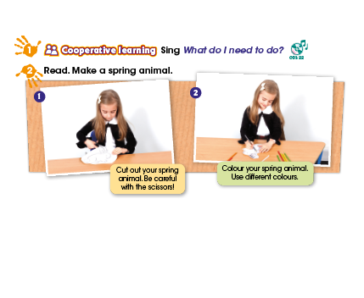
Maximising Learner Engagement
Stories
engage students with
lively adventures and animated videos.
Songs
make language memorable and learning more enjoyable.
Projects
promote creativity and working collaboratively.

Slide 6
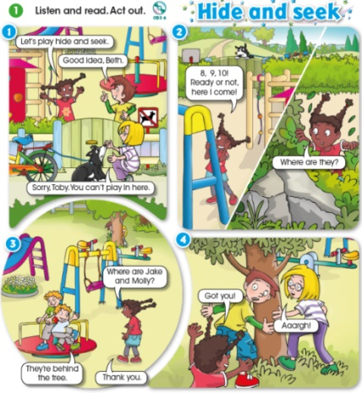
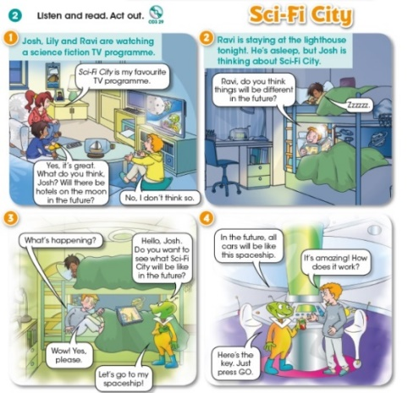
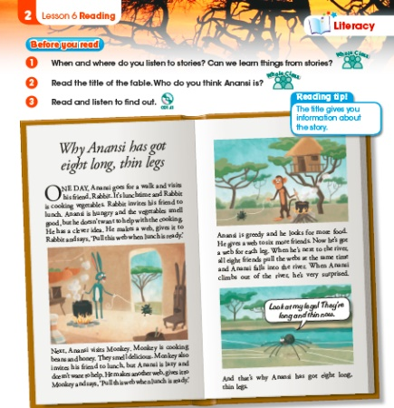
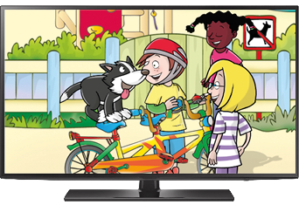
Stories
Story lessons
reflect the interests of the students in authentic and engaging ways.
Accompanying animated videos
help learners visualise the language in context and create a personalised response.

Slide 7
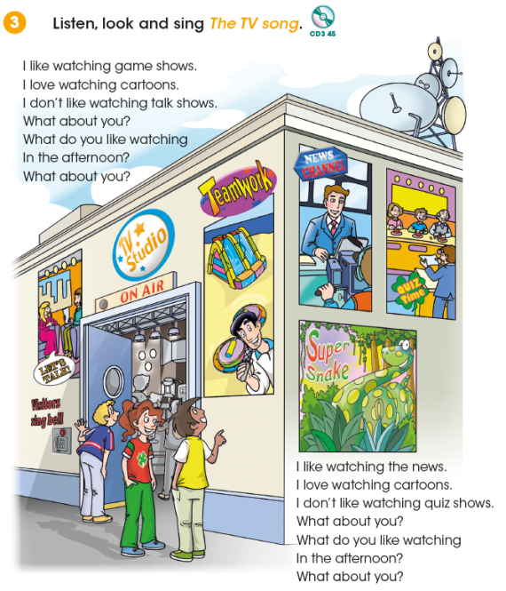
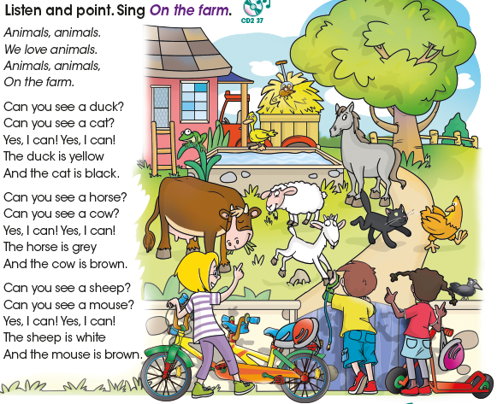
Songs
A bank of cooperative learning songs ensure participation, builds fluency and produces natural sounding rhythm, stress and intonation.

Slide 8
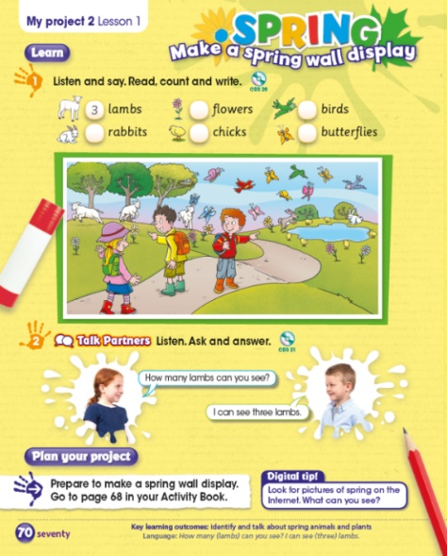
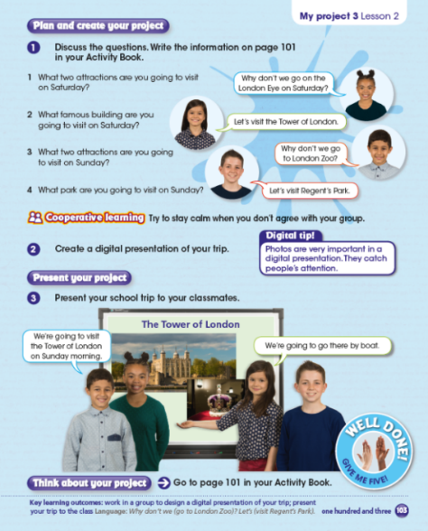
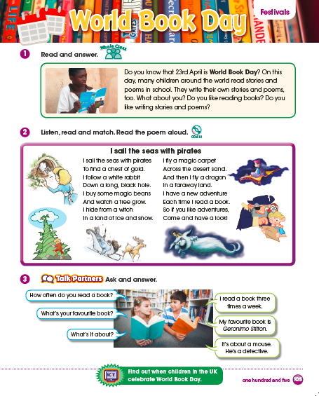
Projects
Projects help students work collaboratively and develop their speaking skills in a structured way, building autonomy and promoting creativity.
Interconnect with festivals from around the globe.
Plan your project, Talk Partners, and Show and Tell features create a positive, collaborative environment
in the classroom.

Slide 9
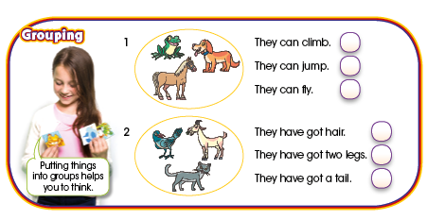
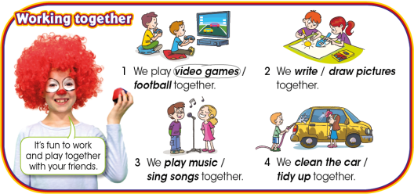
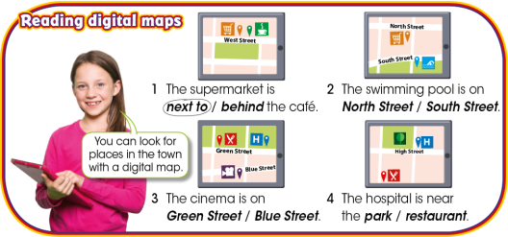
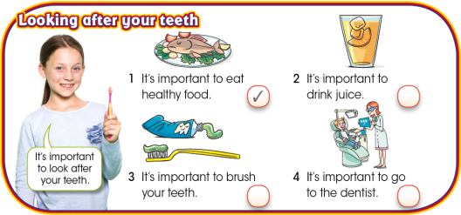
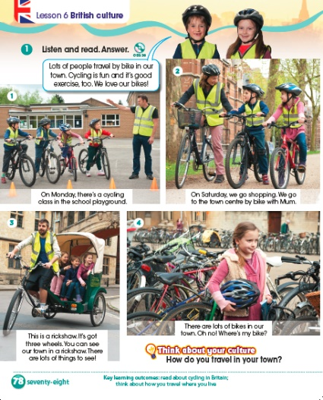
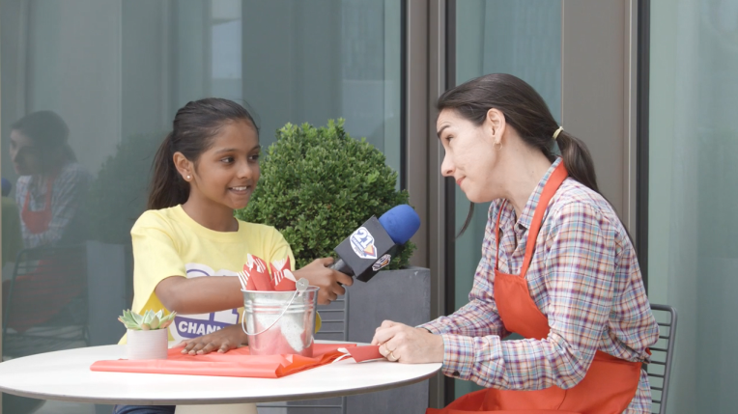
21st Century Skills
There is a comprehensive 21st century skills development programme.
Each unit features a Channel 21 page that introduces one of four different themes:
Channel 21 videos
are presented by children,
build visual literacy,
British culture lessons encourage students to think about their own culture.
provide authentic communication,
contextualise the 21st Century skills with topics and themes.

Slide 10
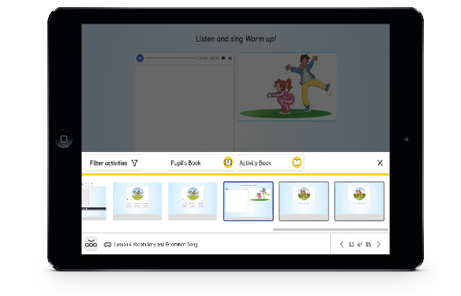
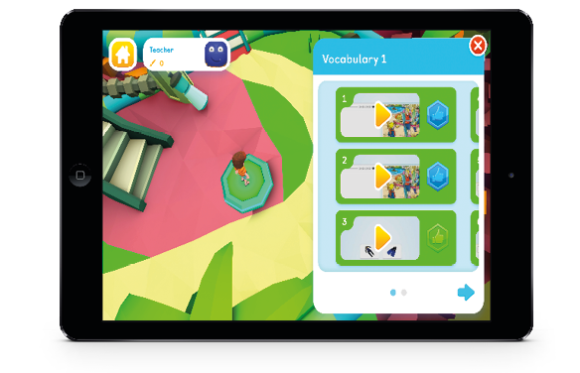
Learning powered by NAVIO
Transition seamlessly between the print materials and the digital teaching and learning platform, Navio.
For students:
For teachers:
For students:
It is simple, easy-to-use and works offline
Tap & Teach lesson plans for each unit save time.
Seamless transition between print and digital.
Activities can be filtered with materials from all resources.
Built-in rewards system and assessment tools, including a progress tracker and test generator.
Extra course-based practice in the game-based 3D worlds.
Rewards system allows students to track their progress and advance to higher levels.
Better language acquisition is achieved through repeated practice
Student’s always experience the right level of challenge

Slide 11
Levels

Slide 12
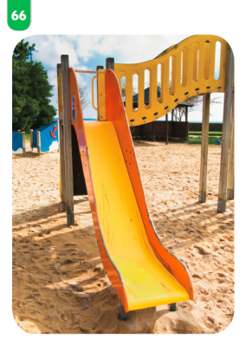
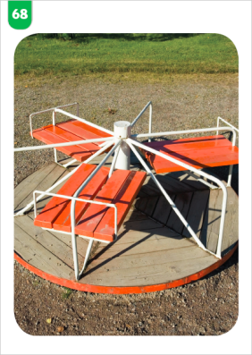
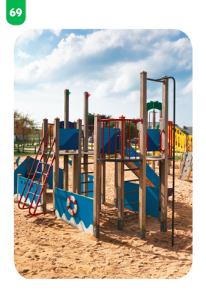
Teacher’s Resources
Teacher’s Book
Audio CDs
Flashcards
with access to Navio App including
Tap & Teach lessons
Integrated audio and video
Integrated classroom management tool
Pupil progress tracker
Test Generator
Resource Bank

Slide 13
Pupil’s Resources
Pupil’s Book
Activity Book
with access to Navio App including
Game-based language and literacy practice activities
Immersive 3D worlds
Build-in rewards system

Slide 14
Thank you!

