Slide 2
Scholarships
Since 2012, Unique Learning has been implementing scholarship programs for the A Levels program in the UK.

Slide 3
A Levels
A Level is recognized worldwide. A Levels Approaches and programs are often used outside the UK.
In the A Level program, students study only the three or four subjects they need for their future profession.

Slide 4
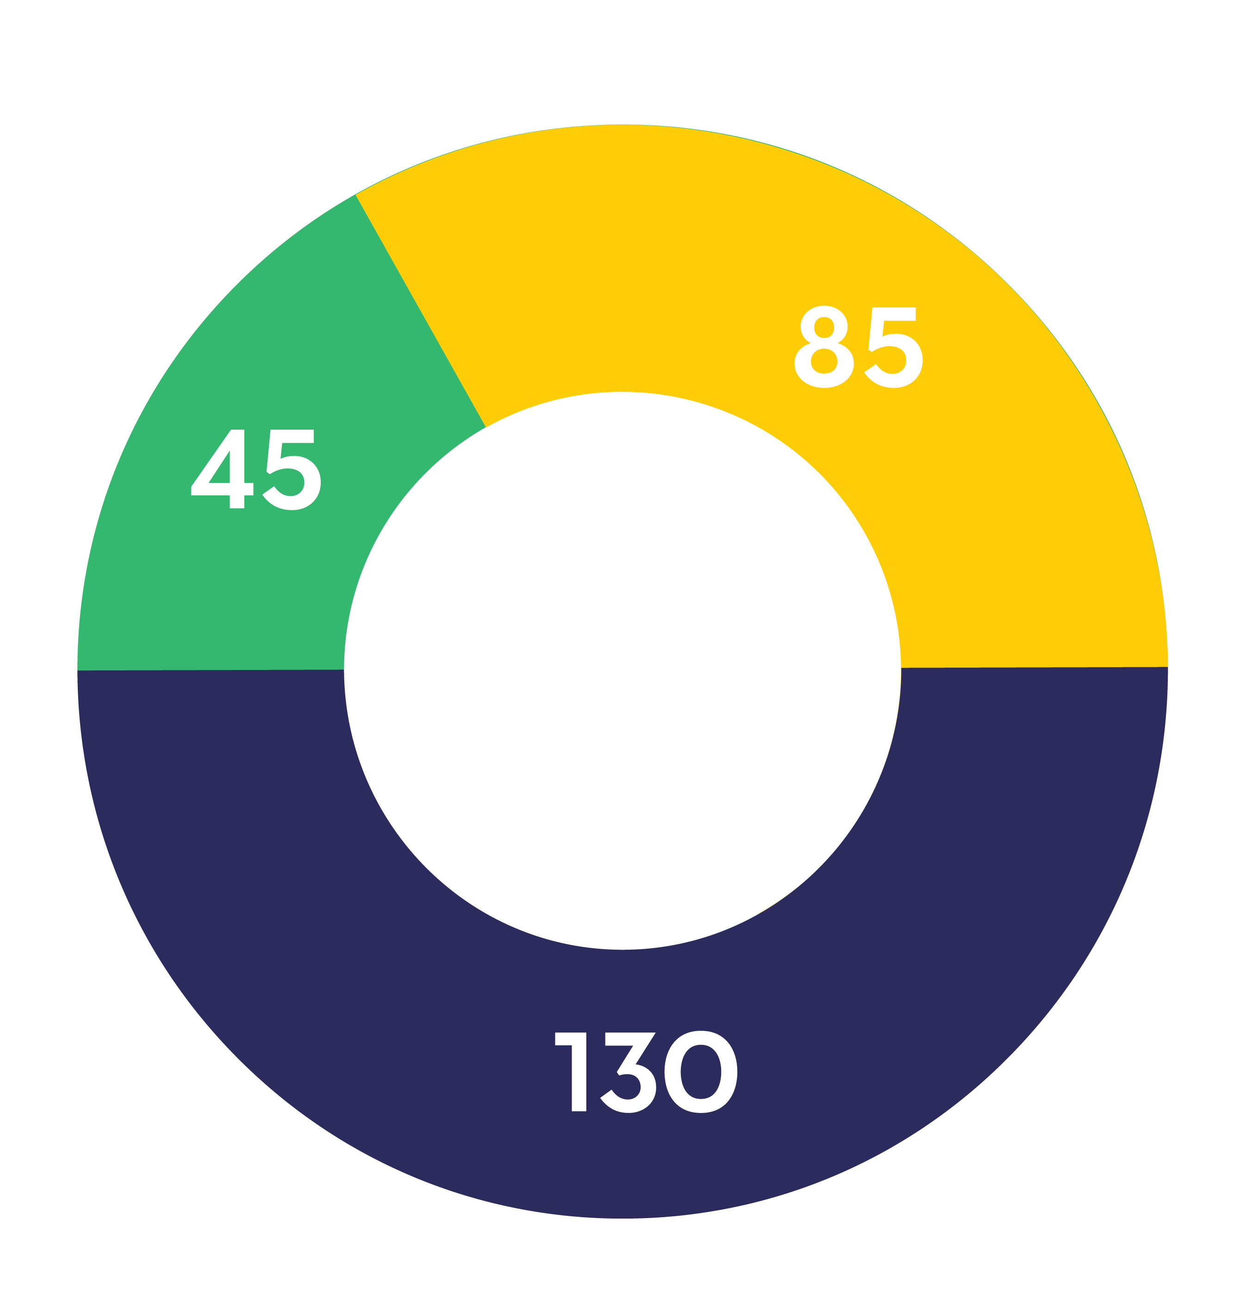
Scholars
Total scholarship
Full scholarship
Reduced fee scholarship

Slide 5
Eligibility and finances
To participate in the project, a student has to be minimum 16 years old and not more than 17 years and 6 months old by September 1, 2022.
The scholarship project does not cover administrative, visa and travel expenses.

Slide 6
ASSIST
Since 1969, 5,385 fellows have been selected from 52 countries to study in American independent schools involved in the ASSIST Scholarship Program.

Slide 7
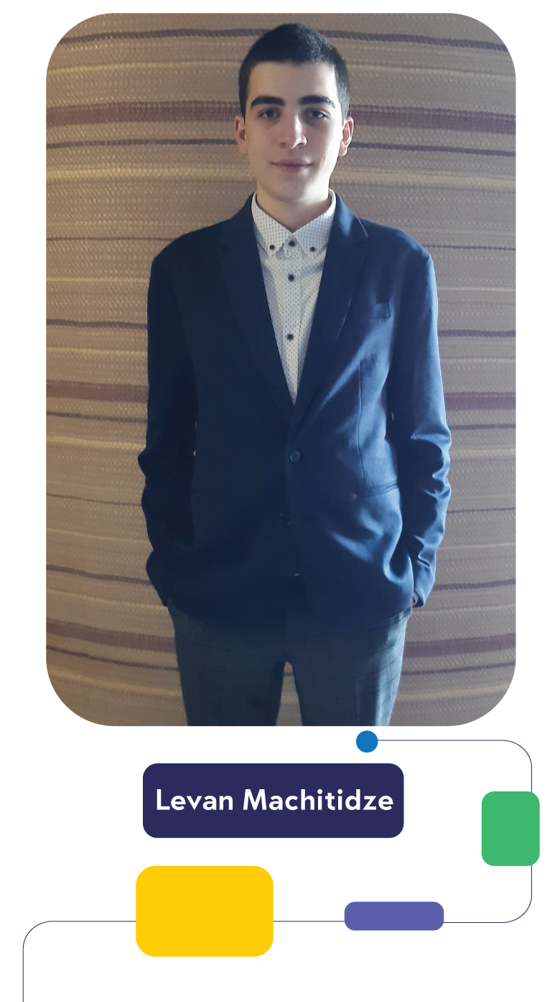
Scholars
Three Georgian students won 1 year full scholarship in 2020 who started studying in American boarding schools.
In 2021, 1 Georgian student will leave the county to study in US.

Slide 8
Finances
The scholarship covers tuition and living expenses for 1 year.
The scholarship does not cover administrative, visa, travel and insurance costs.

Slide 9
How to apply?
Examination
Interview with the board
Contact Unique Learning
Address: 33a, Ilia Chavchavadze Avenue
Tel: 032 2 00 12 43
E-mail:
Info@uniquelearning.co.uk
hmc@uniquelearning.co.uk
Registration
To collect all the required documents

