Slide 1
Teona Demetrashvili

Slide 2
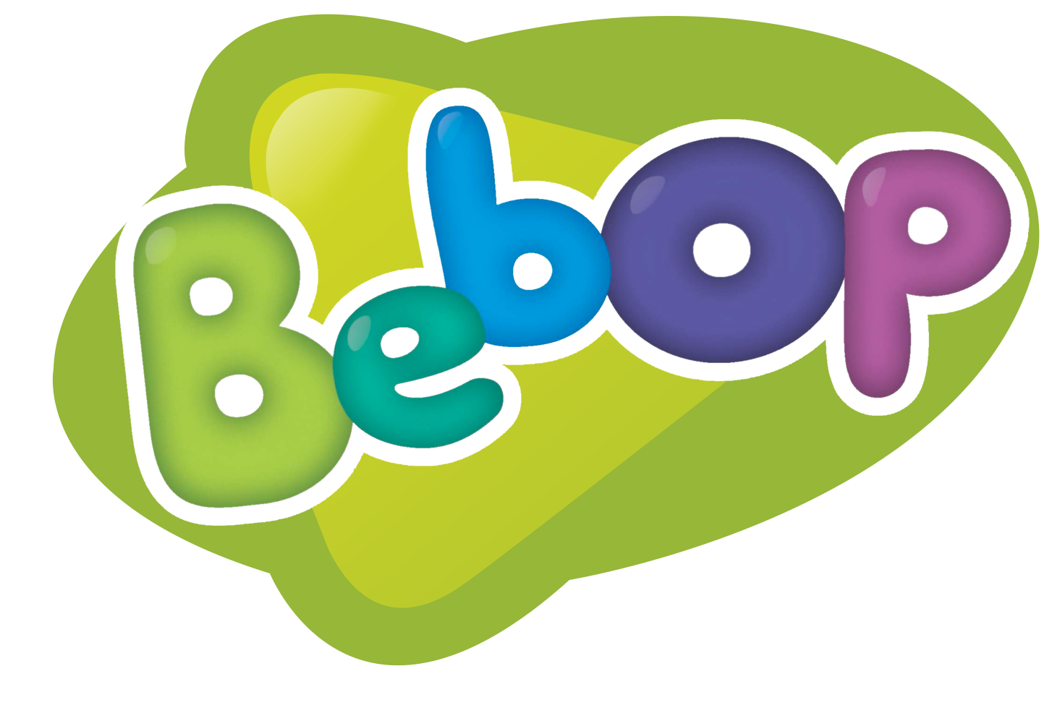
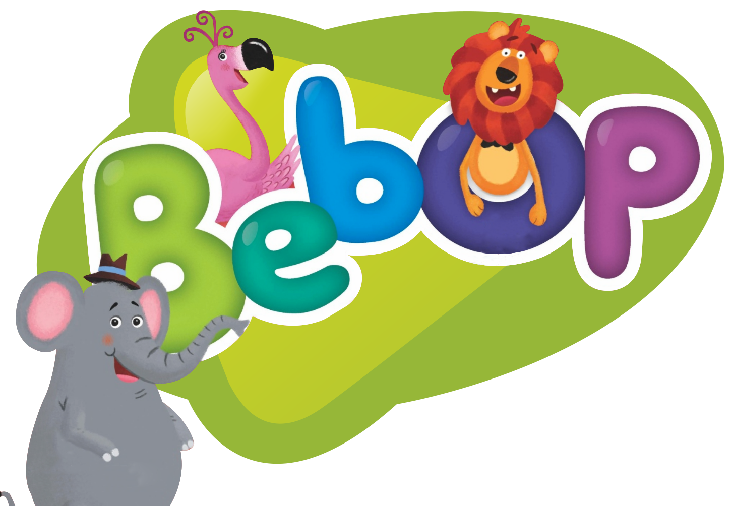
Notes:
Bebop: and everything plays together!
I am happy to welcome you at the session for teachers working with the youngest learners. In a moment I will give the floor to... <click>

Slide 3
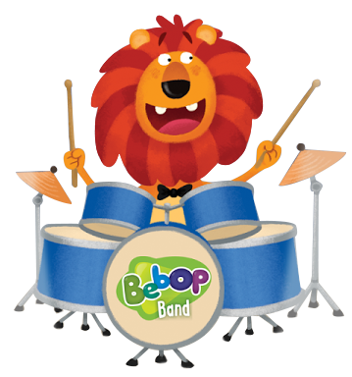
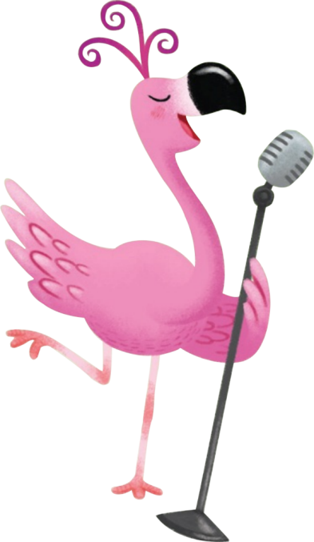
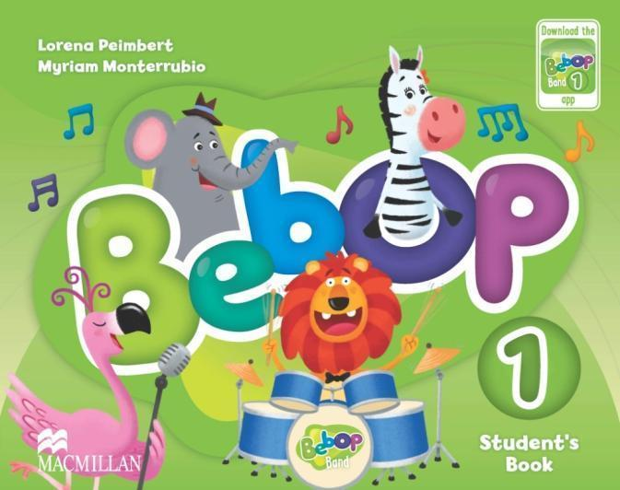
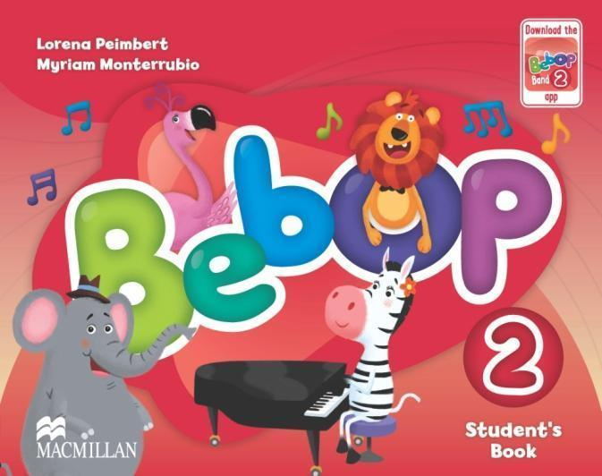
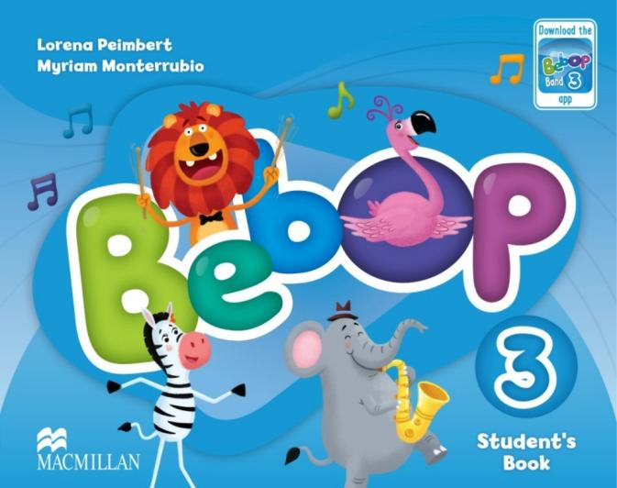
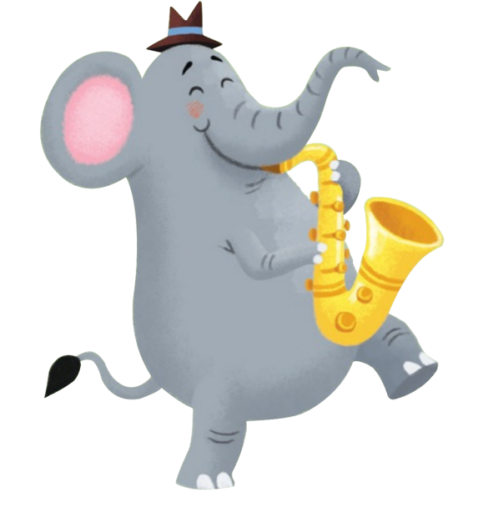
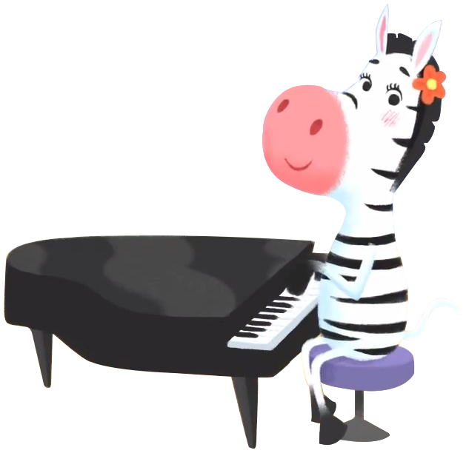
Notes:
But before that, I would like to tell you a bit about the latest proposal of Macmillan for preschoolers, the Bebop series, in which ... everything simply plays together! <click> And literally, as you will see in a minute! <click>

Slide 4
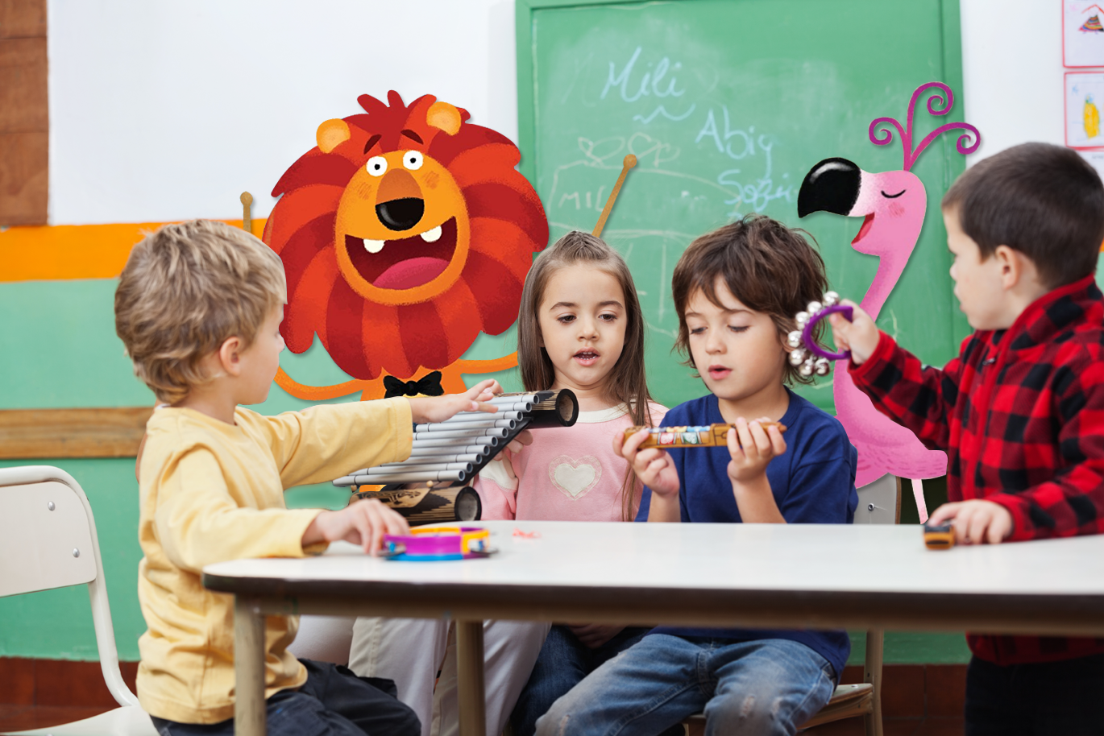
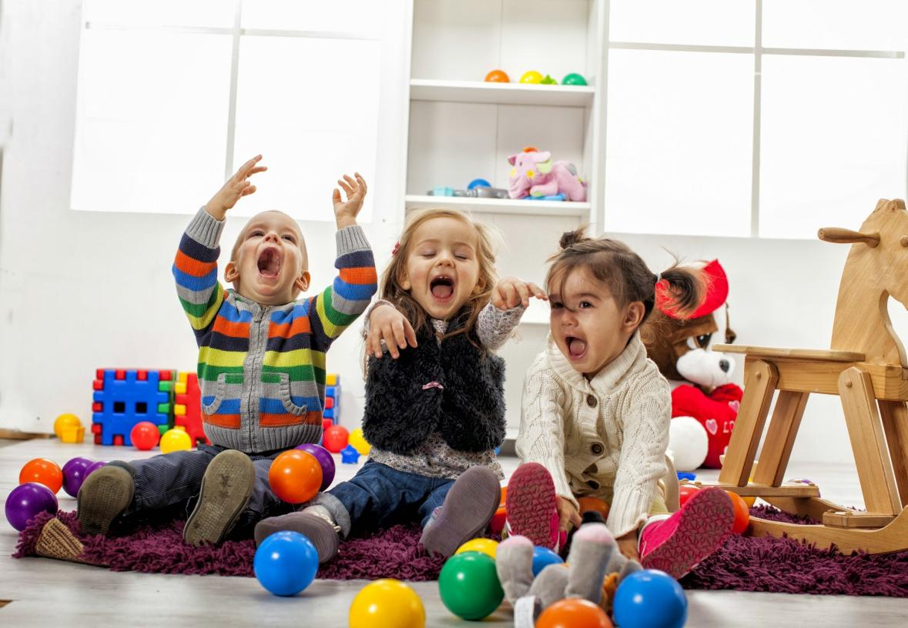
Notes:
Ladies and gentlemen, let's start from what actually is the difference between a group of a dozen or so children and a class? First of all, a well-functioning class is a bit like <click> a well-tuned band. Children work together like in the picture that you see here, and every child has a chance to exploit their potential which, as we know, is not the same for everybody. <click>

Slide 5
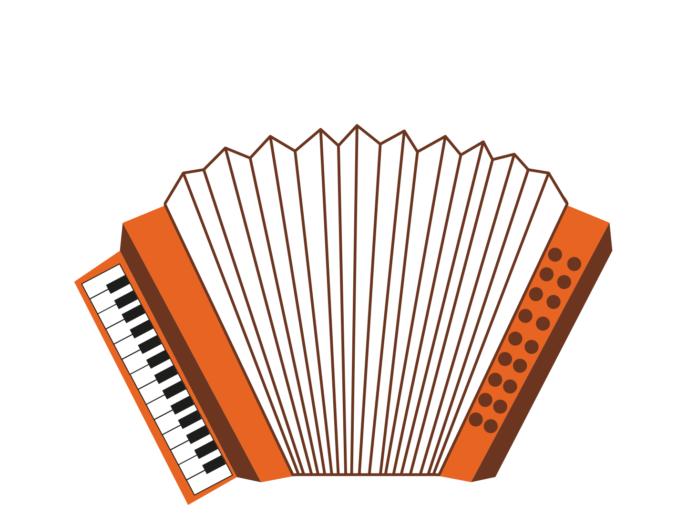
Notes:
Some kids like to move, <click> others – to sing, <click> and yet another group of kids responds best to pictures. <click> There are of course also those who need a collage (☺) of all these things. <click> And exactly at this point the question arises: How to harmonize <click> all this? How to make a group of children, who are often very different from one another, "play" together like the best band? <click>

Slide 6
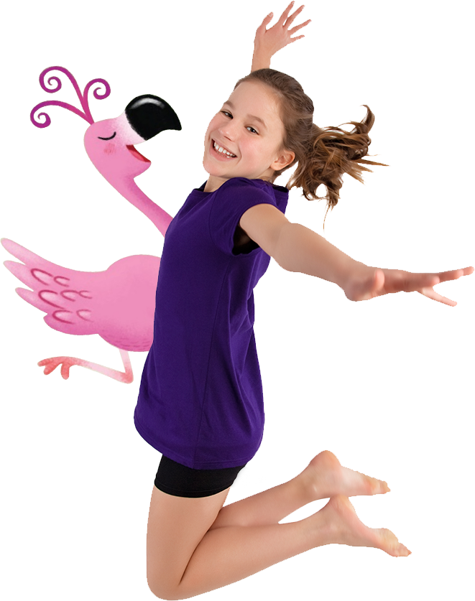
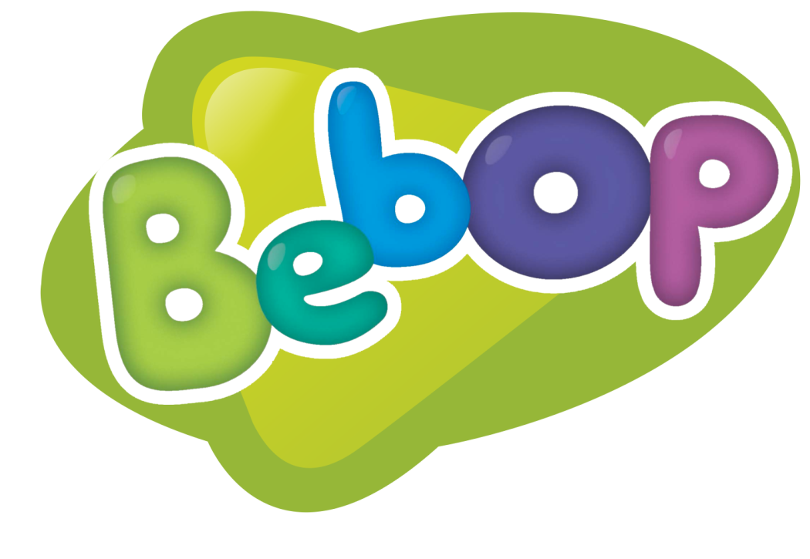
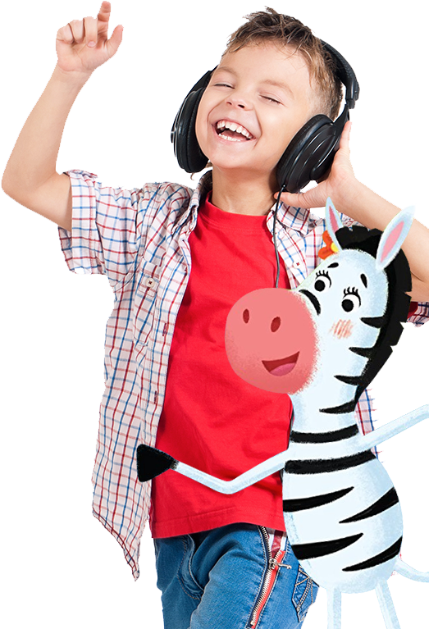
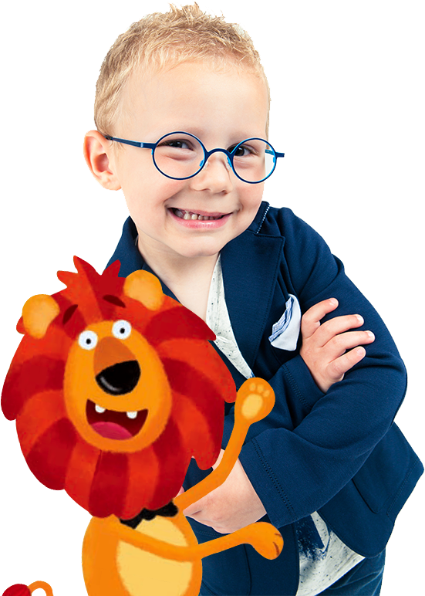
Notes:
The perfect solution to this problem is our latest pre-school series: Bebop. Why? Because it provides teachers with instruments good for working both with <click> visual, auditory and <click> kinaesthetic learners <click> – in a word, everyone will find something for themselves. <click>

Slide 7
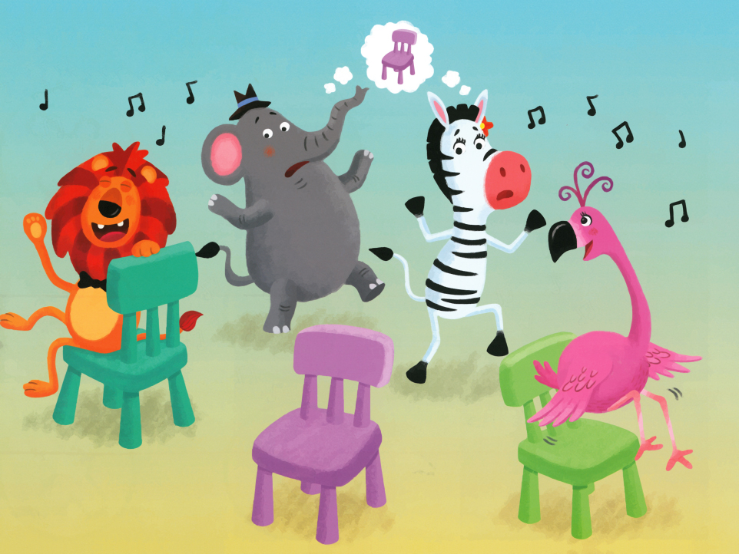
Notes:
Each chapter and each lesson in the Bebop series contains materials which activate sight <click>, hearing <click> and movement <click>. And of course, as befits the perfect course for students at this age, <click> fun is also beyond measure! <click>

Slide 8
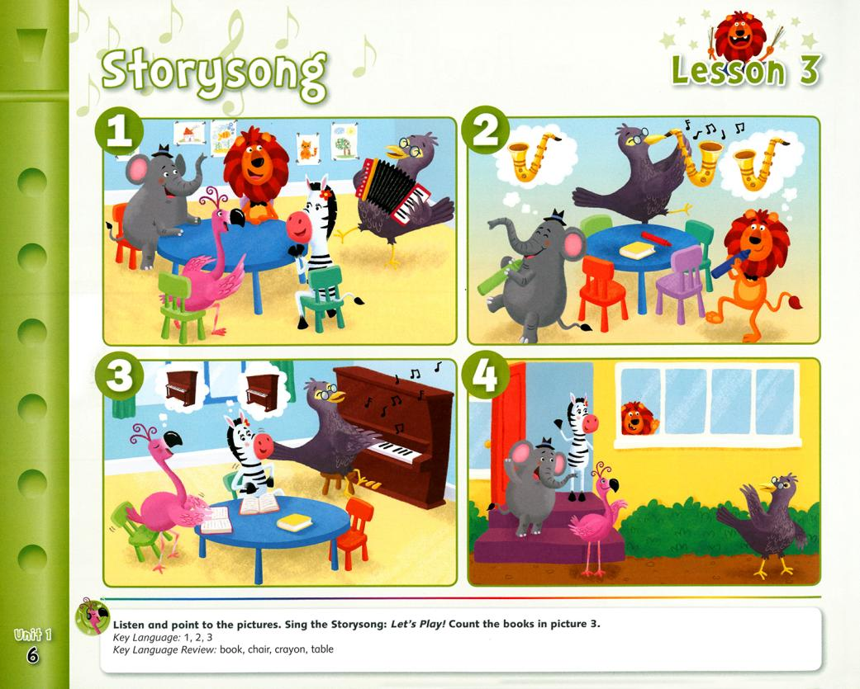
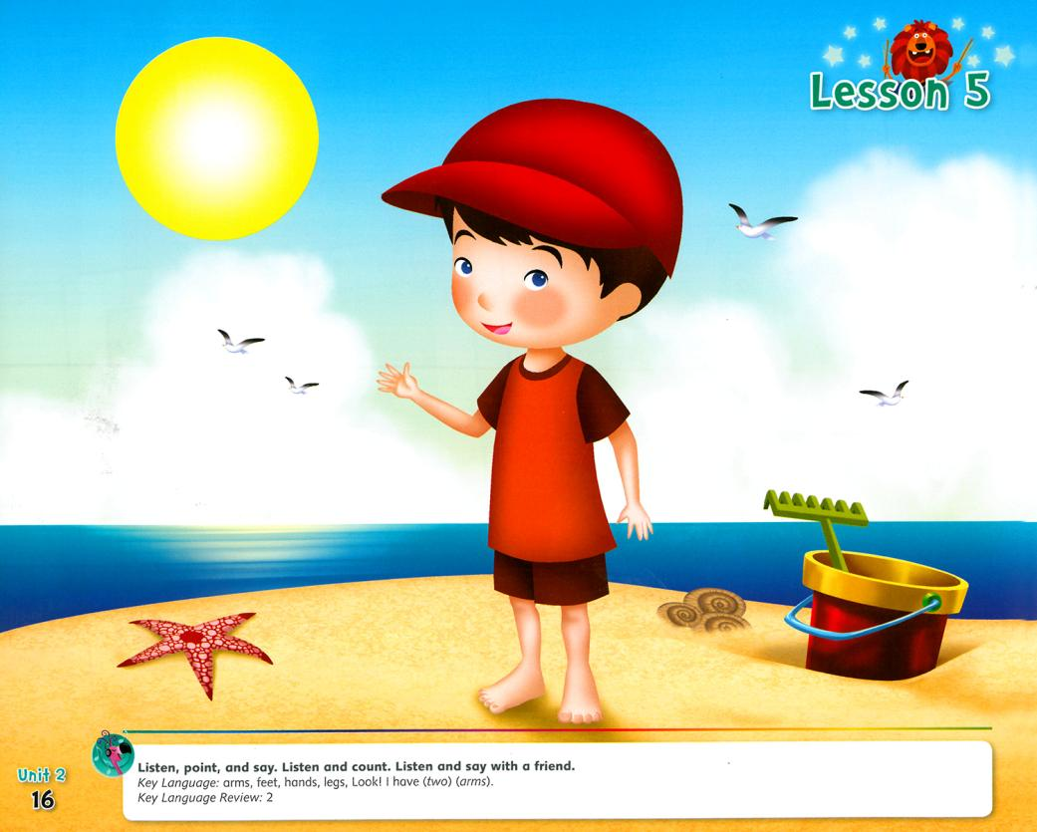
Notes:
The instruments that will help visual learners are fantastic <click> illustrations in the textbook. <click> Ladies and gentlemen, attractive layout is of course always a huge advantage of a textbook <click> but it is exactly at this stage of development of our students when the sense of sight plays an extremely important role in learning vocabulary. Therefore, in the Bebop series we also have... <click>

Slide 9
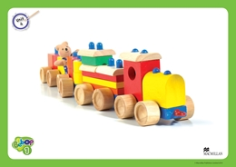
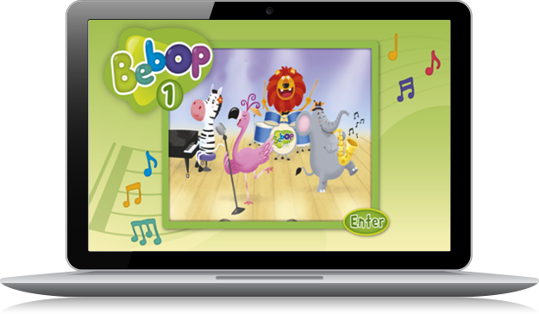
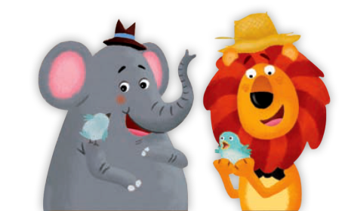
KARTY OBRAZKOWE
ANIMOWANE WERSJE PIOSENEK
73 VIDEO FLASHCARDS
Notes:
beautiful flash cards and related videos <click>, as well as animated versions of songs from the audio CD. Speaking of songs ... <click>

Slide 10
Notes:
… let's get to the instruments that will help you in working with auditory learners. Not without reason the motto of our presentation is: "and everything plays together". In Bebop, indeed, everything is actually playing because music is omnipresent in this series ... <click>

Slide 11
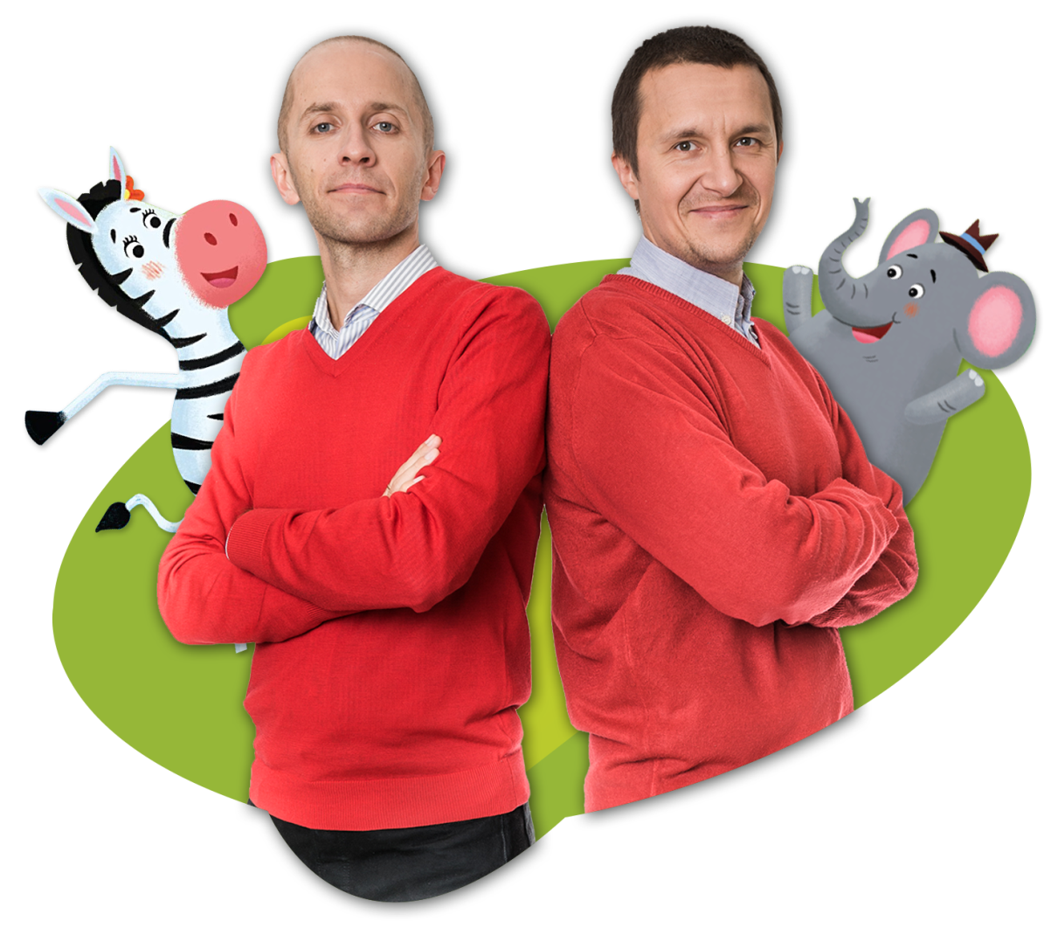
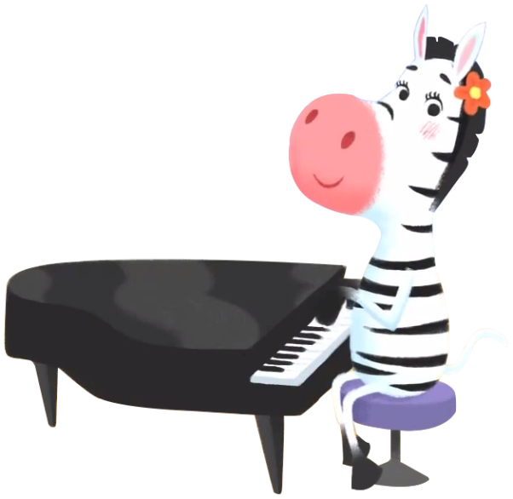
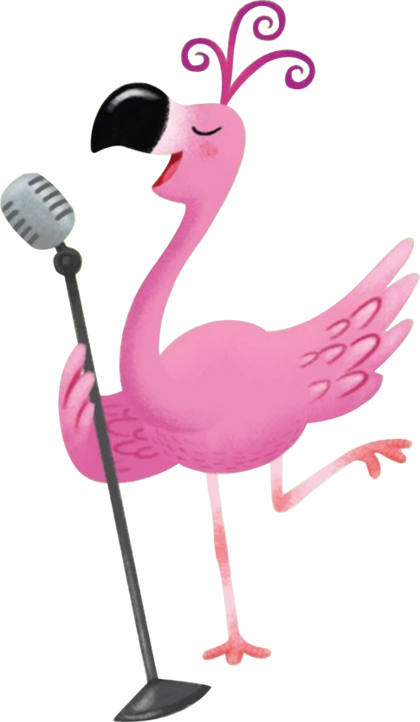
Notes:
Each page of the students’ book has a musical setting, and songs accompany children from the first to the last lesson of each chapter. <click> The musical side is the work of the Bebop Band which consists of 4 very friendly animals. <click> The coach will tell you more about in just a few moments ...

Slide 12
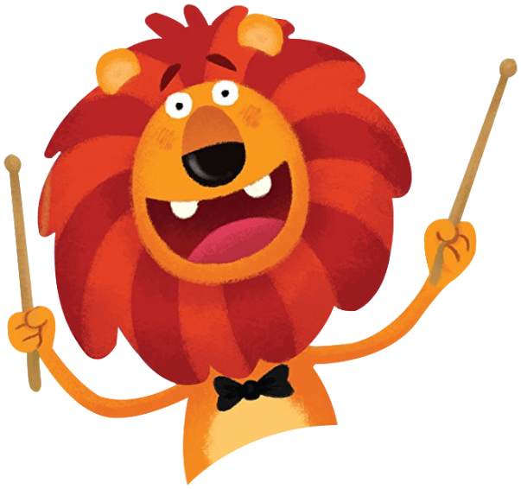
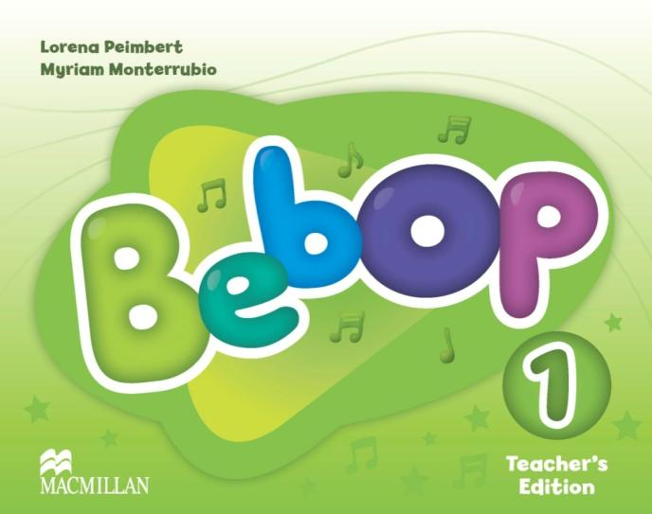
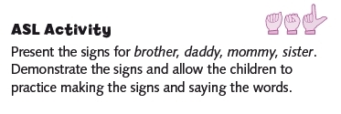
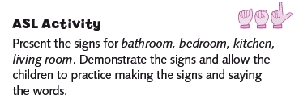
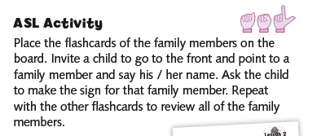
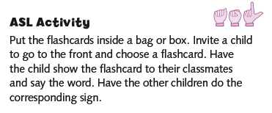
Notes:
And what instruments have we prepared for class kinaesthetic learners? First of all, in Bebop you will find <click> Action Songs, in which children learn verbs through songs and related movements. <click> The teacher's book, in turn, offers a lot of ideas for attractive exercises using movement. <click>

Slide 13
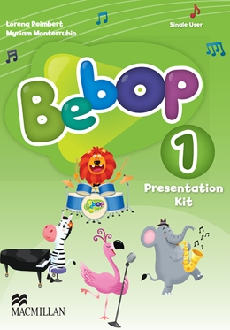
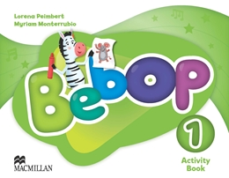
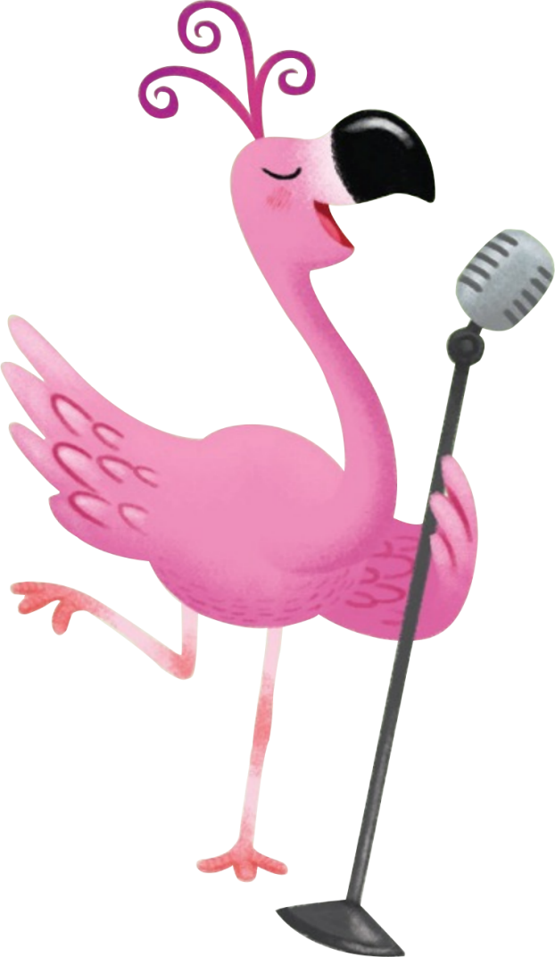
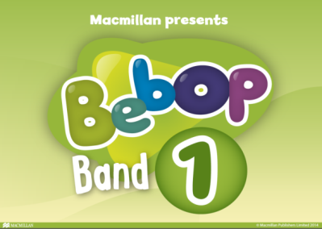
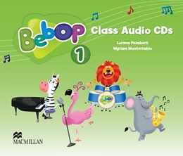
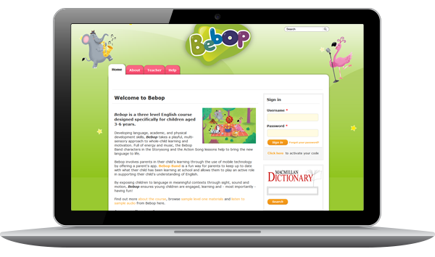
Notes:
Ladies and gentlemen, all of the elements mentioned so far form a coherent lesson structure thanks to the instruments which we have prepared for the teacher. They will allow you to quickly and easily plan your lessons with Bebop so <click> that they are a great success! <click>

Slide 14
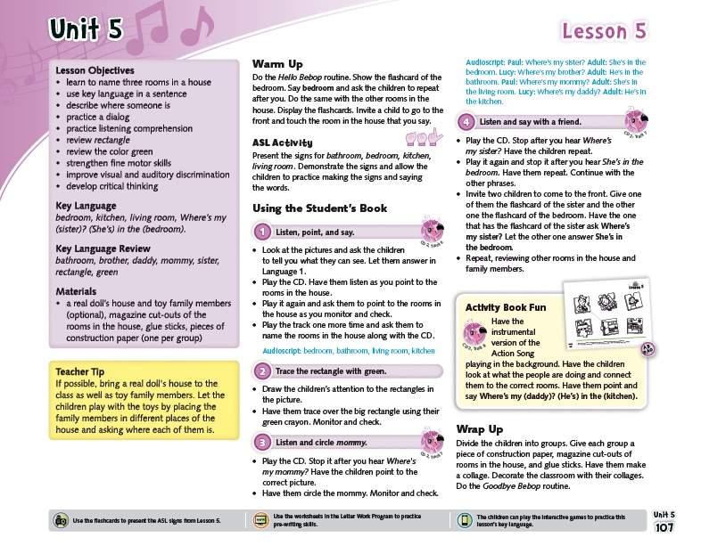
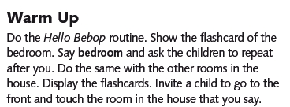
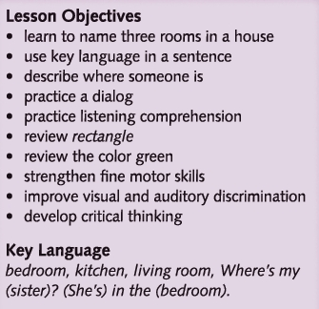
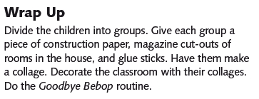
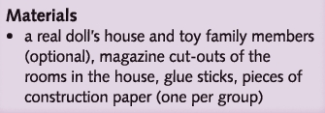
Notes:
In the teacher's book you will find <click> detailed notes on lesson planning, taking into account all the components of the course, including supplementary materials. And in Bebop there are plenty of these. ☺ <click>

Slide 15
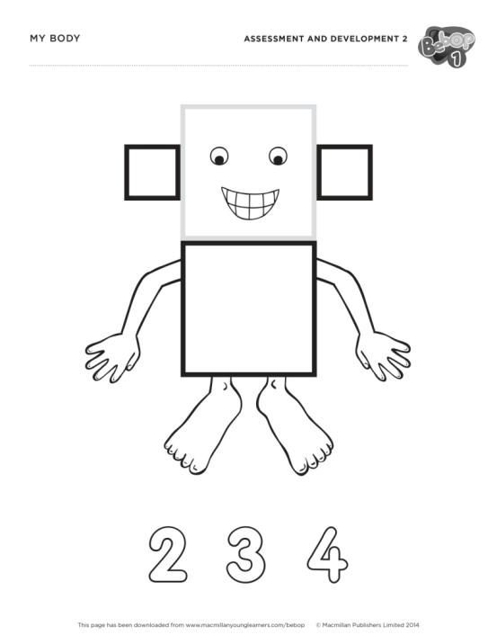
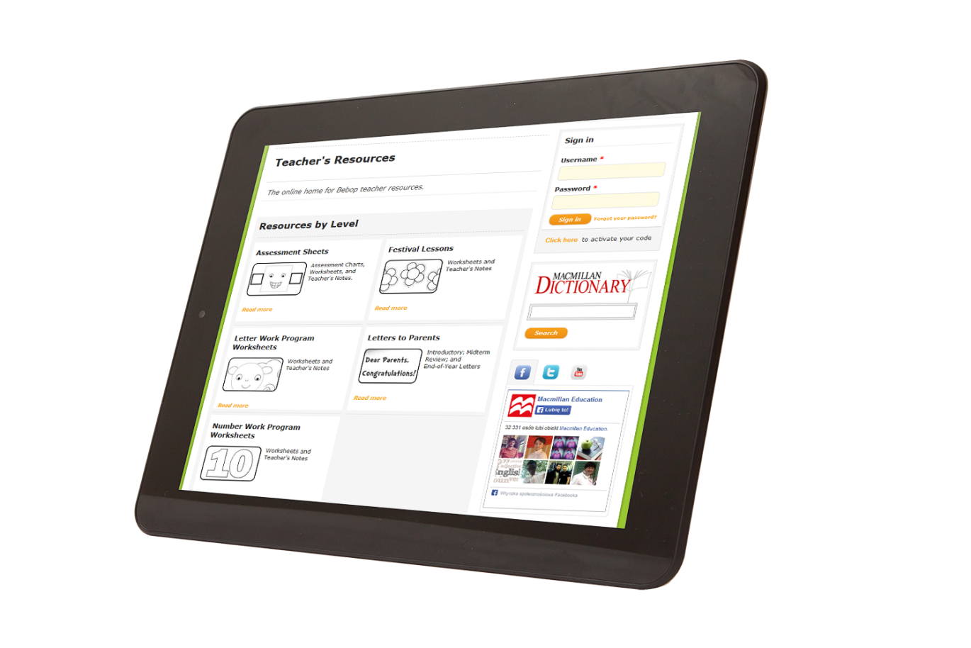
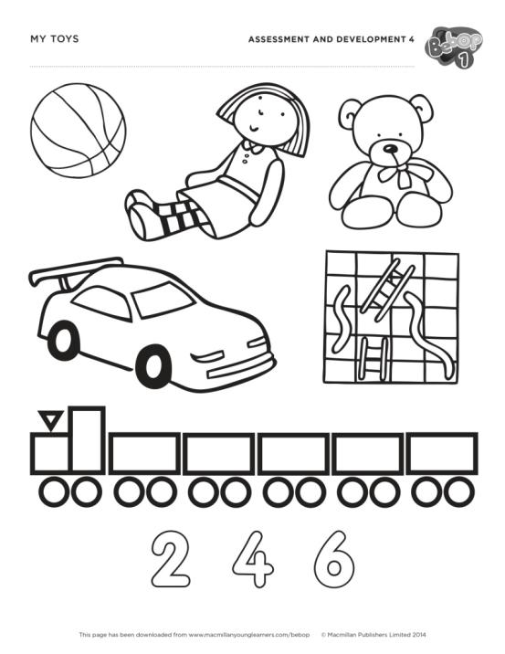
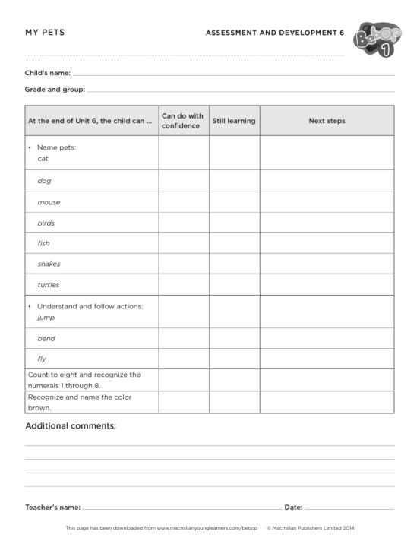
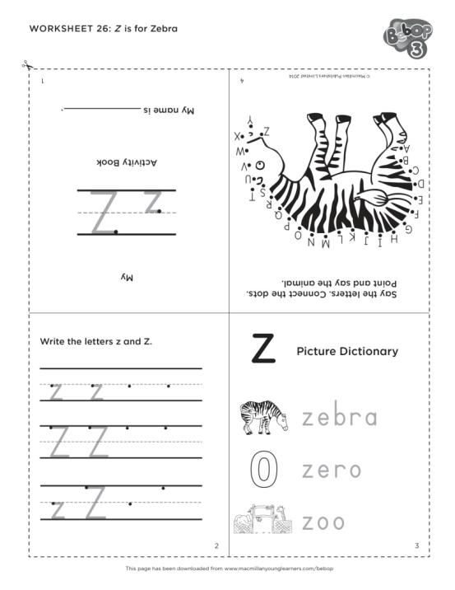
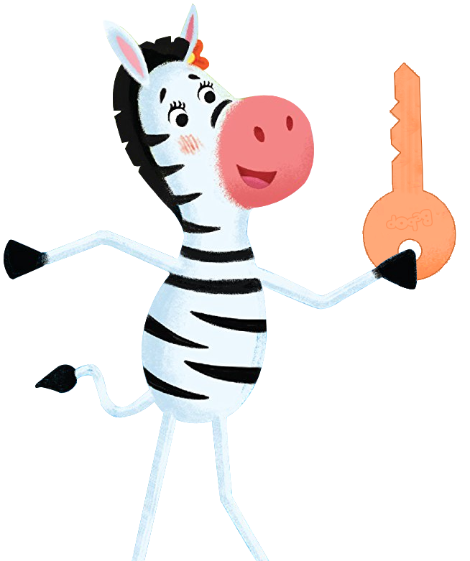
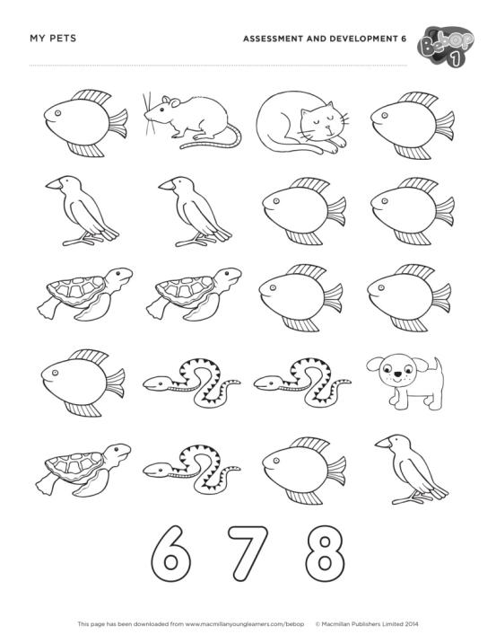
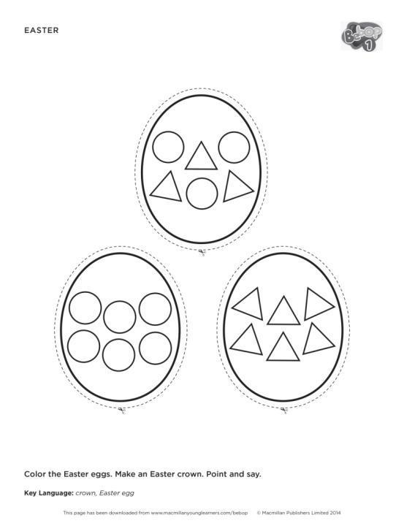
Notes:
Along with the teacher's book you receive <click> access to a huge number of additional resources available <click> on the website, among other things, <click> printable exercises preparing for teaching literacy, numeracy, materials helping in assessing progress and cultural lessons. <click>

Slide 16
Notes:
Moving with the digital times, we have prepared yet another new solution which will work well as unconventional homework. <click> What I'm talking about is the Bebop Band app available on mobile devices <click> and containing videos for all the songs, all the course vocabulary and as many as 32 language games. <click> With this app, parents can keep up to date with what has been taught at school and actively support their child in learning through playing at home. <click>

Slide 17
Notes:
So, in the Bebop course we have in total as many as 8 components that will help prepare interesting, playful and effective language lessons for children. <click>

