Slide 2
Improving academic performance
Building language skills
Developing critical thinking
Expressing ideas and opinions
Notes:
Ask the audience: What are the core skill-sets that students today need to achieve success in the university and beyond and how can teachers help them develop these skills? We can break these down to four key competencies.
Empowering them with skills to improve their academic performance
Strengthening their language skills
Developing their critical thinking skills
Helping them to confidently express ideas and opinions
Now let’s look at each one of these skills in detail to see how we can develop these in the classroom.

Slide 3
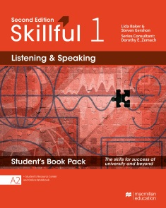
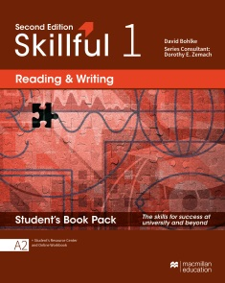
Building language skills
Dual skills approach: Pairing a receptive skill with a productive one helps students to gain language proficiency more thoroughly.
Notes:
Using a dual skills approach gives students the language expertise needed for high-level academic success, as students master all four language skills more thoroughly.
Following a shared topic syllabus, the Skillful Second Edition Student’s Books can be combined seamlessly or used independently. Reading and Writing Student’s Books introduces core grammar and vocabulary concepts and Listening and Speaking Student’s Books expand on them.
Note for sales-rep’s information: In each of the Skillful Student Books, for all levels, one receptive skill is paired with a productive skill – reading with writing; listening with speaking.

Slide 4
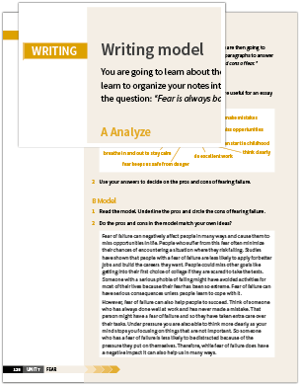
Reading and Writing
Notes:
In each unit of the Skillful Second Edition Reading and Writing Student’s Books, students are presented with two reading lessons which cover different aspects of the topic. These are paired with writing model tasks so that the students can organise ideas and language in preparation for their final task at the end of the unit.
Reading Sections: Every Reading section helps develop new reading skills. Vocabulary sections that come before every reading text prepare students for the reading activities.
Glossary: Mini glossaries, in addition to vocabulary previews and vocabulary pages throughout the unit, help students to easily understand and go through the texts.
Writing Model: The Analyze sections introduce additional scaffolding to help teach productive skills by providing a model answer. Students get to discuss their ideas. Then they can brainstorm and plan their final writing task, which is usually a paragraph or an essay.

Slide 5
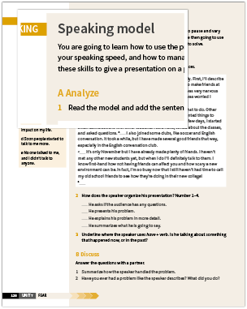
Listening and Speaking
Notes:
Similar to the Reading and Writing Student’s Books, in each unit of the Listening and Speaking Student’s Book students are presented with two listening lessons that are paired with speaking model tasks. This allows students to first analyse a model, which then helps them to prepare for the final speaking task at the end of the unit.
Wordlists (Vocabulary preview): The vocabulary syllabus closely follows the Macmillan Dictionary’s most frequently used words to help students recognise common words and phrases from real-life situations.
Before you listen: Graded vocabulary selected from forthcoming listening activities supports students’ understanding of the audio, while providing a context for future language use.
Speaking model: Model text, presented as a dialogue, provides useful practice and engagement with the relevant language structures.

Slide 6
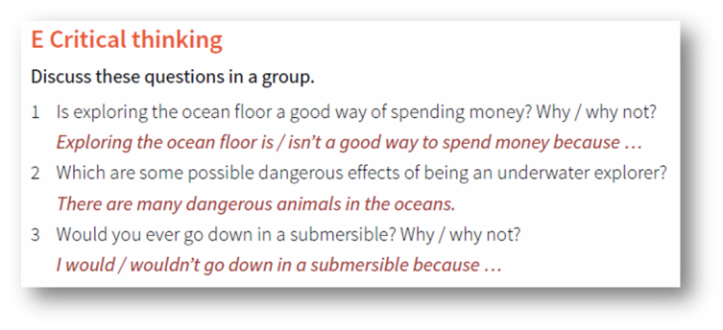
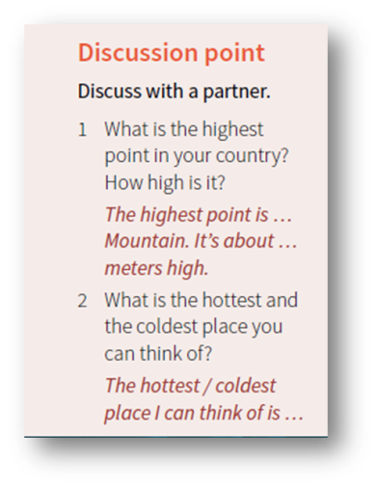
Developing Critical Thinking
Critical thinking sections: Students learn how to evaluate information and apply existing knowledge
Reuters Videos: Dynamic, current content engages students critically
Infographics and Discussion Points: Analysis and discussions in class based on topic of study helps students to develop critical thinking and become independent learners
Notes:
Students need particular skills for critically examining issues presented by a speaker or writer. This is very useful for academic success regardless of which academic discipline the student is specialising in, and also important for their success in the workplace.
Point to the Reuters Videos point on the slide: Students find learning more interesting if they get to engage with real-life content that is relevant to them. Authentic video material from REUTERS® news agency is used throughout the Skillful course and is easy to access and use. This dynamic content creates an engaging way to present real-world topics, encourages ideas and debate, introduces key language and vocabulary, and stimulates discussion.
Point to the Critical thinking sections point on the slide: Students need to develop the ’sub-skills’ of critical thinking and are encouraged to apply existing knowledge and read between the lines, weigh up the positive and negative sides of a situation in order to reach a decision, rank and evaluate ideas from what they read and hear. Critical Thinking Skills are integrated with the themes and topics in each Skillful unit with clear guidance for teachers on how to teach them in class.
Point to the Infographics and Discussion Points on the slide: Analysis and discussions are important for students to develop critical thinking skills as well as useful to make them independent learners and solve real-life problems in their future workplaces. Skillful Second Edition has beautiful infographics to open each unit to capture attention and engage them. These infographics and discussion points guide teachers to encourage students to use analysis and critical thinking skills in the classroom.

Slide 7
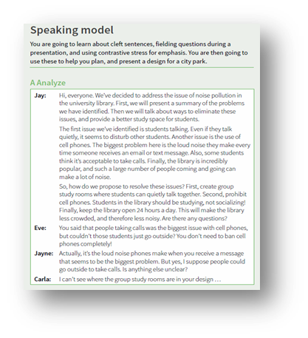
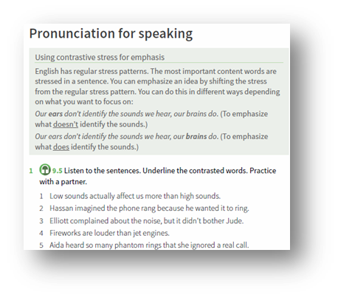
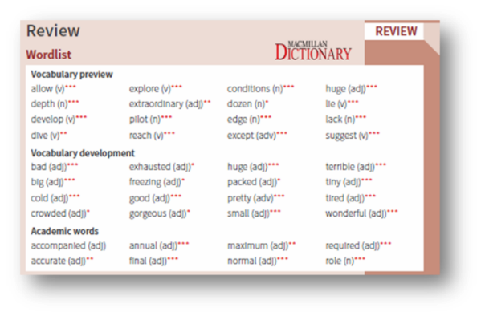
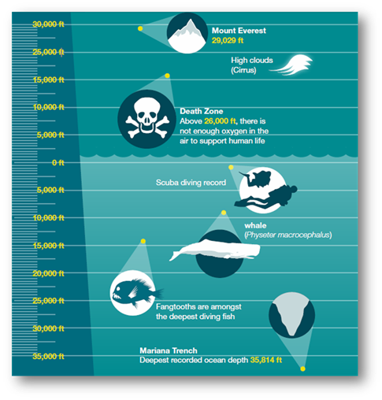
Expressing ideas and opinions
Speaking and writing models: Guides students into developing their speaking and writing
Increase in pronunciation focus: Helps students express themselves clearly
Vocabulary sections, mini glossaries, academic word lists:
Students extend their vocabulary
Discussion points in unit-openers and throughout units: Students develop their own ideas and express them
Notes:
Point towards Speaking and writing models point on the slide: Scaffolded learning helps learners gain confidence in developing their productive English language skills (writing and speaking). Skillful Second Edition supports step-by-step learning in every unit for all levels with vocabulary previews and glossaries for the topic, grammar sections, followed by a model writing and speaking text – all of these elements prepare the student for the end-of-the-unit writing or speaking task.
Point towards pronunciation point on the slide: Increased focus on pronunciation in speaking activities helps students express themselves more clearly when speaking and provides them with a better understanding of spoken English.
Point towards the Vocabulary sections, mini glossaries, academic word lists point on the slide: Students need to learn the vocabulary they need to communicate their ideas clearly and effectively throughout their career. The Skillful syllabus features an Academic Word List of the 570 most frequently used words for students and academics.
Point towards Discussion points in unit-openers point on the slide: It is helpful for teachers to have idea-developing questions to support an active discussion between students in the classroom. Infographics is one way of doing this. These help develop ideas and get learners thinking about the topic using their existing knowledge or based on what they can see in the infographic.

Slide 8
New in Second Edition
Notes:
Based on the success of the first edition, Skillful Second Edition maintains the core elements while innovating to keep up with changing learner and teacher needs. Here’s an overview of what is new:
100% increase in skills based tasks: The skills-based tasks and activities create an even stronger focus on developing students’ use of English and expertise in written and spoken communication.
100% increase in pronunciation focus: Increased focus on pronunciation in speaking activities helps students express themselves more clearly when speaking and provides them with a better understanding of spoken English.
570 academic words: The syllabus features an Academic Word List of the 570 most frequently used words for students and academics. This ensures students learn the vocabulary they need to communicate their ideas clearly and effectively throughout their academic career.
Authentic video from Reuters: The authentic video material from Reuters news agency is integrated throughout the course. Presenting real-world topics in an interesting way that encourages ideas and debate whilst introducing key language and vocabulary.
Stella Cottrell Study Skills Expert: Study Skills sections are based on the work of the pioneer researcher and expert in the field, Stella Cottrell. Students can use the invaluable critical thinking tips and activities taken from her Study Skills Handbook to improve their academic performance.
Over 80% Brand New Content: Over 80% of the material in Skillful Second Edition is completely new. This includes all-new reading texts and articles, video material, as well as practice activities and tasks.

Slide 9
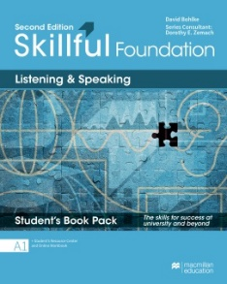
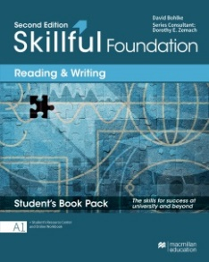
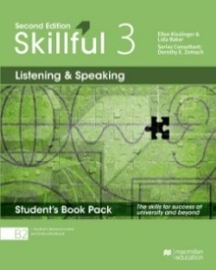
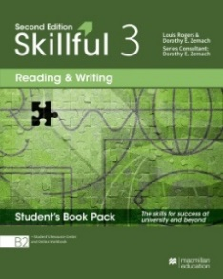
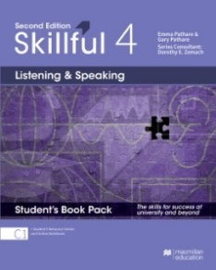
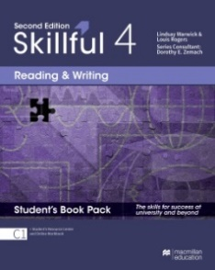
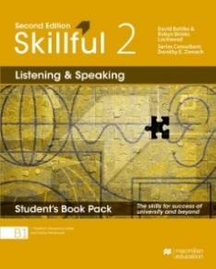
Learning with the complete solution
Student’s Resource Centre
The Student’s Resource Centre provides audio, video, audio script and video script
Online Workbook- Student’s Access
The Online Workbook provides additional practice activities with automated marking and instant feedback.
Notes:
Skillful provides students with the tools to become independent learners. With the option of learning using the Digital Students Book pack or the Student’s Book Pack (print book) both with access to the Online Workbook and Resource Centre.

Slide 10
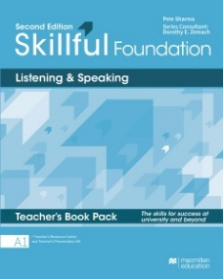
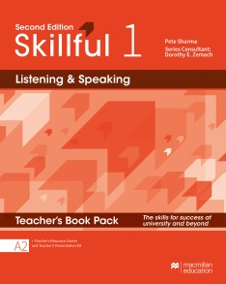
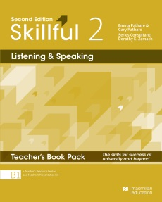
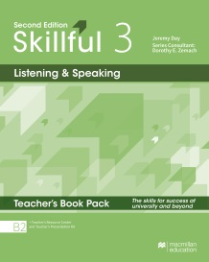
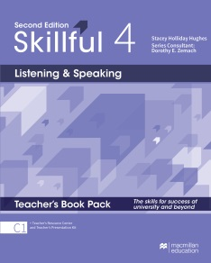
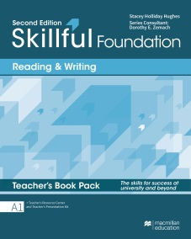
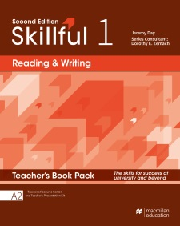
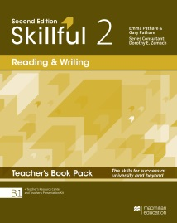
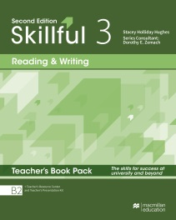
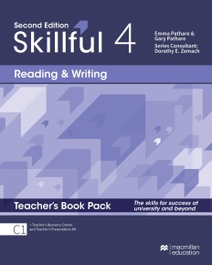
Teaching with the complete solution
Teacher’s Presentation Kit
The Presentation Kit provides a page-faithful version of the Student’s Book, activities with answer key, complete with audio and video.
Online Workbook – Teacher’s Access
Teachers have access to the Online Workbook, with added access to the gradebook feature that allows them to view and compare automatically collated scores for individual students.
Teacher’s Resource Centre
The Teacher’s Resource Centre provides audio, video, worksheets, wordlists and a Test Generator to support teachers in the classroom with delivering dynamic lessons
Notes:
Skillful similarly provides tools that teachers can use to prepare for their classes and to monitor their students’ progress – alongside the components on the slide, the teacher’s pack also includes a copy of digital student’s book.

Slide 11
Thank You

