Slide 1

Zviad Dekanoidze
Head of Sales

Slide 2

Higher Education & Professional
Image by Photographer’s Name (Credit in black type) or
Image by Christof Van Der Walt
Discover Pearson
products and services
www.pearsoned.co.uk
2019
Presentation Title Arial Bold 7 pt
2

Slide 3
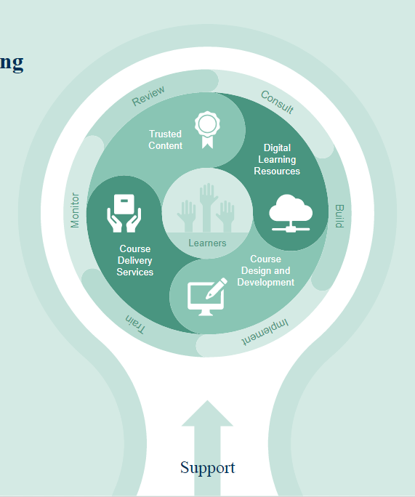
Like you, we want to help learners succeed.
Everything we do enables learners to achieve more.
From online teaching and learning tools
to personalised learning, and from online
and blended course design to trusted and
engaging content, we help you help your
students be the best they can possibly be.
Our resources and services support you
to do what you do best:
facilitate excellence
in teaching and learning.

Slide 4






Trusted Content
Pearson has been a leading content provider for over 100 years.
Discipline experts including:
Neil Campbell
    Philip Kotler
    Eric Mazur
are among the many experienced educators
who have partnered
with us to publish their bestselling books.
Paul Krugman
Henry Mintzberg
Philip Zimbardo
Krugman was awarded the Nobel Memorial Prize
in Economic Sciences
4

Slide 5
Print textbooks and eBooks

Slide 6
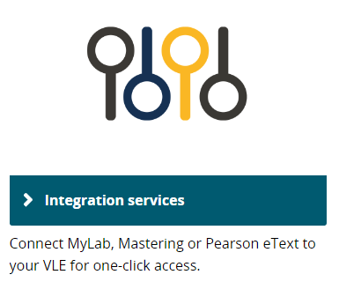
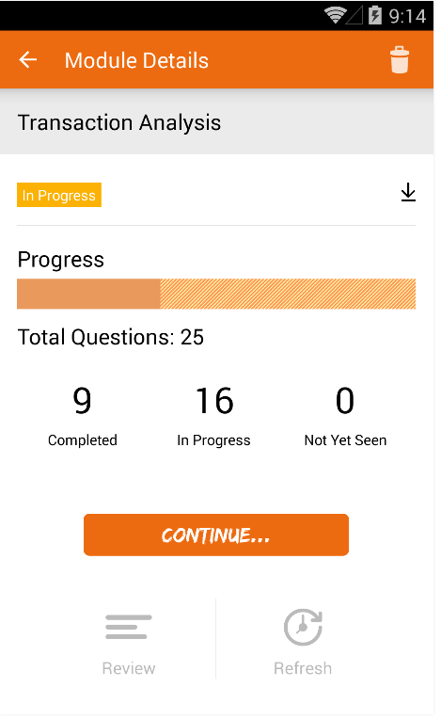
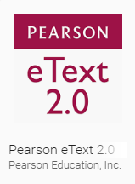
We design our products to work across a range of devices so our learners can learn anywhere, anytime and on any device.
Learner Design
Learner Data
Learner Experience
6
Notes:
Learners want a simple, mobile experience.
MOBILE: Learning doesn't stop when you walk out of class or step off campus. We design our products to work across a range of devices, and with our suite of mobile apps (e.g. eText 2.0, Dynamic Study Modules, REVEL), our learners can learn anywhere, anytime, on any device
SIMPLICITY: Learners don’t want to be accessing digital content from multiple places: once they’re comfortable using one technology, that’s what they want to stick to.
We can link from your LMS platform to MyLab & Mastering and REVEL. Access assignments and rosters, transfer grades with ease, and link to MyLab & Mastering content from within Blackboard, Brightspace by D2L, Canvas, or Moodle [NB: REVEL / Blackboard integration only for 2016/2017]
For students, single sign-on provides access to all the adaptive and personalized learning resources that make studying more efficient and effective.

Slide 7
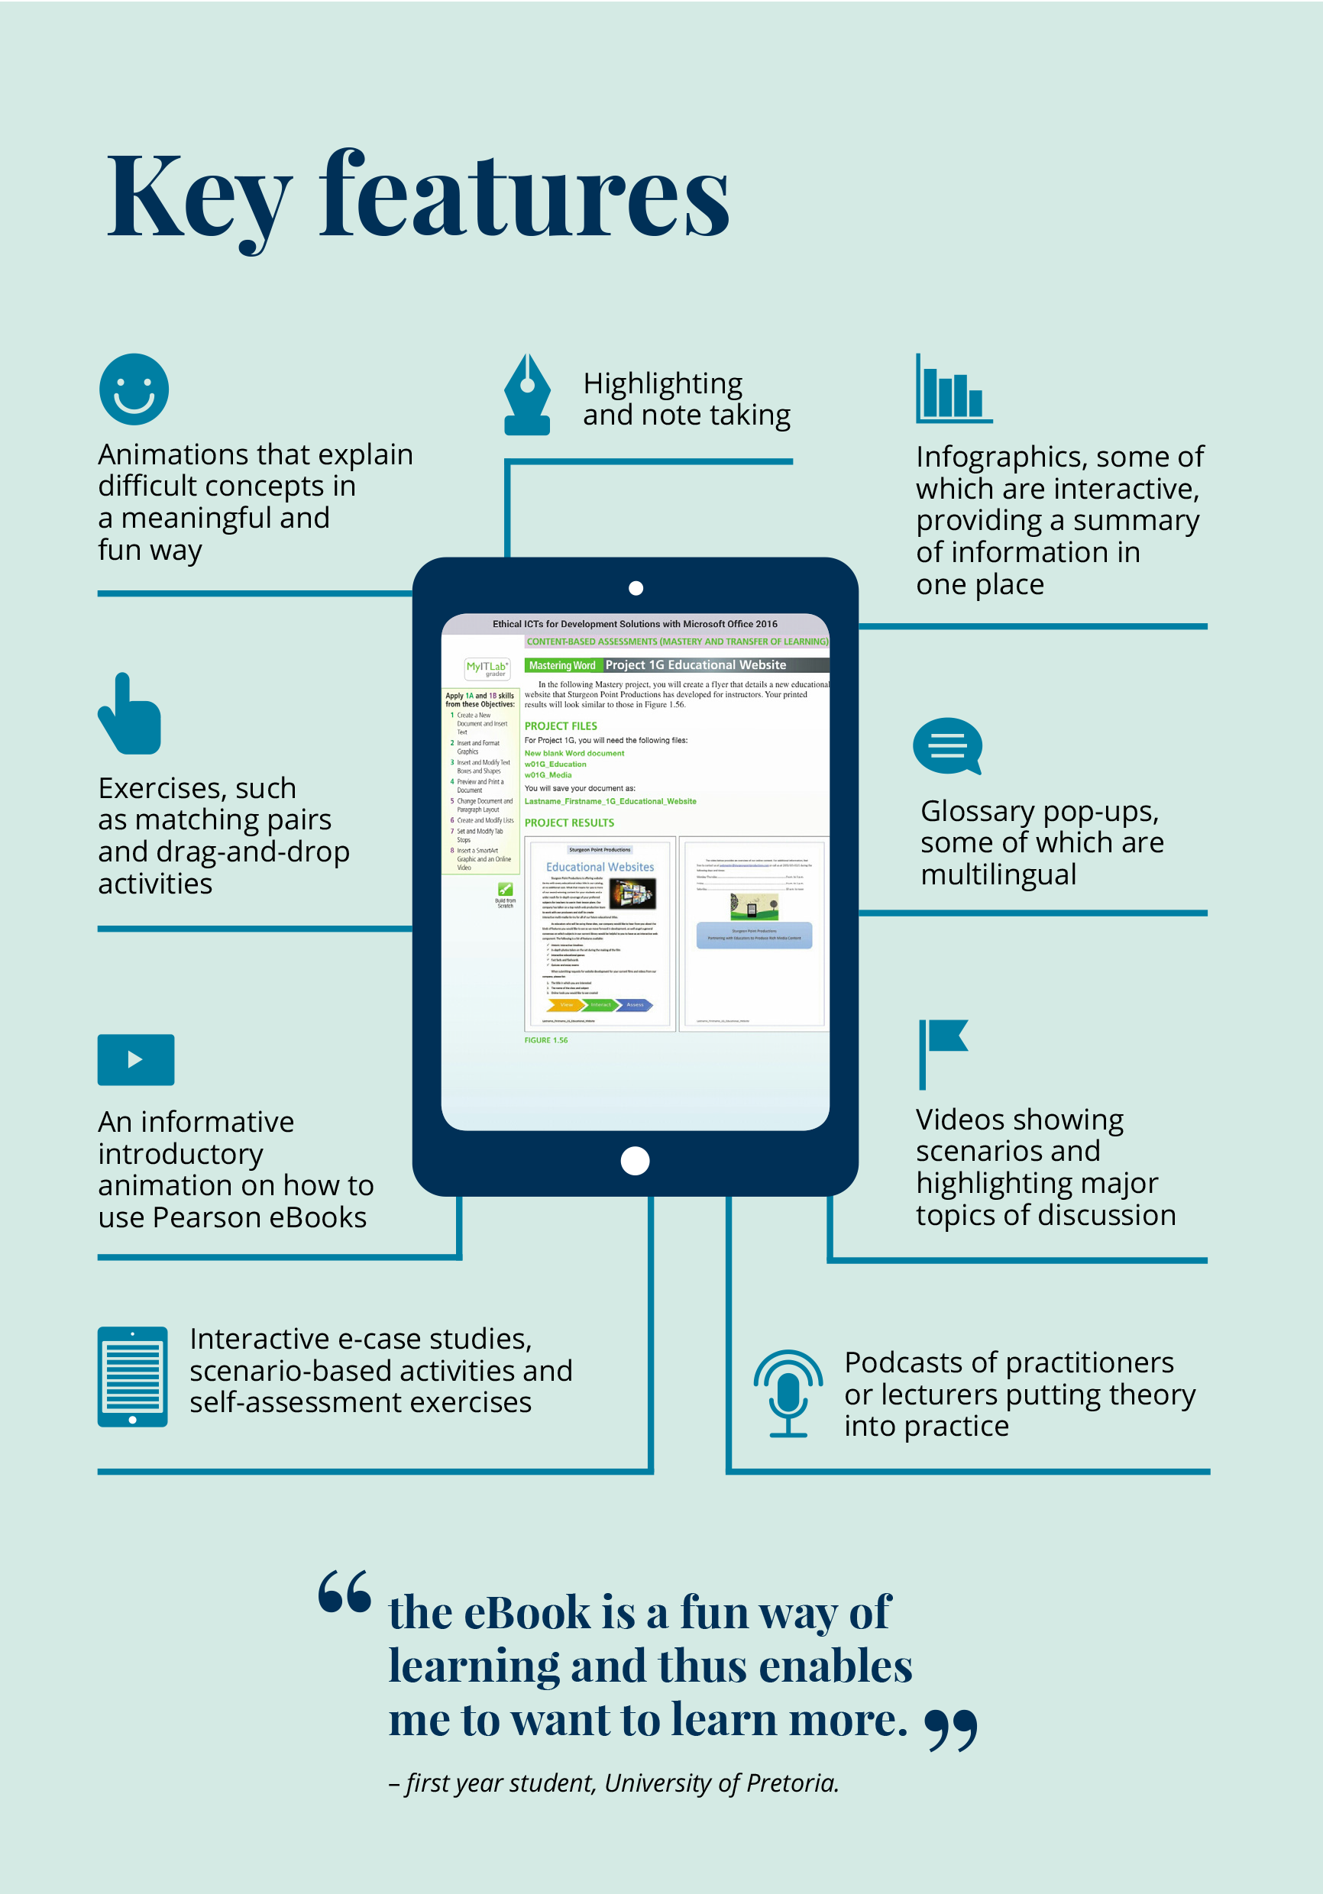
Interactive eBooks
Depending on the format,
e-books from Pearson can:
  Increase engagement with interactive features
    Lecturers can add and share notes with the class
    Students can make notes and highlights
    Easy to search and navigate
  Improve accessibility
    Access from most devices
    Integrate with most learning management
    systems
    Online and offline delivery
7

Slide 8
Enhanced e-books

Slide 9
Enhanced eBooks with embedded interactive resources
Enhanced eBooks disciplines:
Business | Law | Psychology
Enhanced eBooks are standalone digital versions of our world class textbooks with embedded interactive resources, such as self-assessment multiple choice questions and feedback, designed to aid learning and engagement and delivered via 3rd party eBook providers such as Kortext
or VitalSource.
Further to all the benefits of eBooks:
Embedded self-assessment questions
Reflowable text and page fidelity
Selected enhanced eBooks also include:
Annotated deep links
Videos
Notes:
They allow students to read and interact with their textbook content, with regular opportunities for self-assessment.
These resources are ideal for lecturers who want to improve student engagement with the course material without the complexity of graded assignments.

Slide 10
The response so far
“
The print text is good but this is far more interactive and exciting.
I think the enhanced
eBook is excellent!
The layout of the text
is clear and the
interactive elements
are very beneficial.
Great source of learning and preparing for your modules!
Easy to test yourself and see where you are!
It's interactive, it’s easy, it's considerably better.
”
Law lecturer
Students, Swansea University

Slide 11
MyLab & Mastering

Slide 12
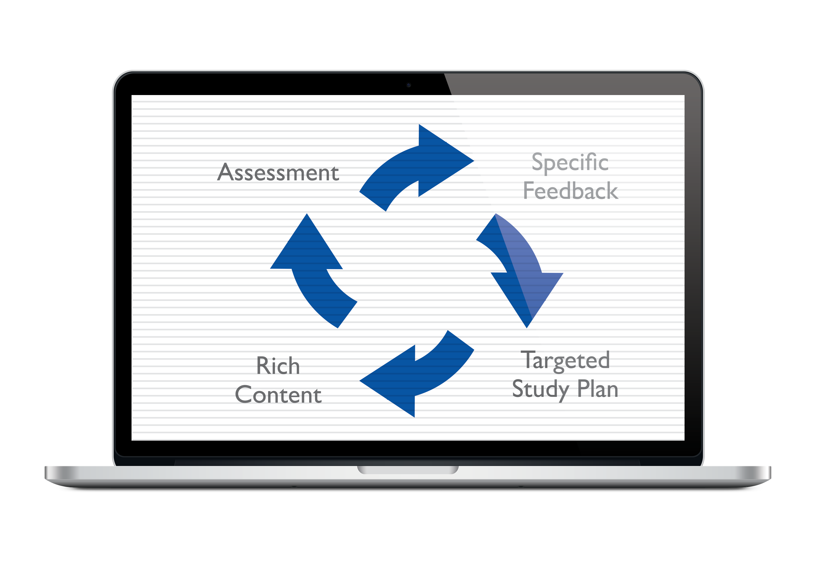
MyLab & Mastering
  Suite of online homework, tutorial
  and assessment systems that
  complement classroom activity.
  Customisable content
  Practice exercises and homework
  Rich media and interactive
  tutorials
  Personalized study plans made
  possible by real-time assessments
  Integrates with most LMS
  Integrated grade book
Sold with
printed textbook
or as standalone
codes plus e-Text

Slide 13

MyLab & Mastering
  Over 11 million student users globally
  Proven results: over 500 case studies, reports and white papers
  Good student feedback

Slide 14









Variety of disciplines

Slide 15





They embed seamlessly into a variety of platforms, allowing for a single sign on message
Engage Students
Improve Results
:
Time efficiency
Notes:
Pearson MyLabs and Mastering can all be integrated into the systems featured here. They enable single sign-on for your students so when they have access to your VLE they have access to the systems you have chosen too.
If you are interested in seeing a demonstration of how a test in one of our labs can be integrated into your course we can set up named individuals with access to one of our most popular products, MyMathLab Global.
If you are interested in seeing a demonstration of how a test in one of our labs can be integrated into your course we can set up named individuals with access to one of our most popular products, MyMathLab Global.

Slide 16
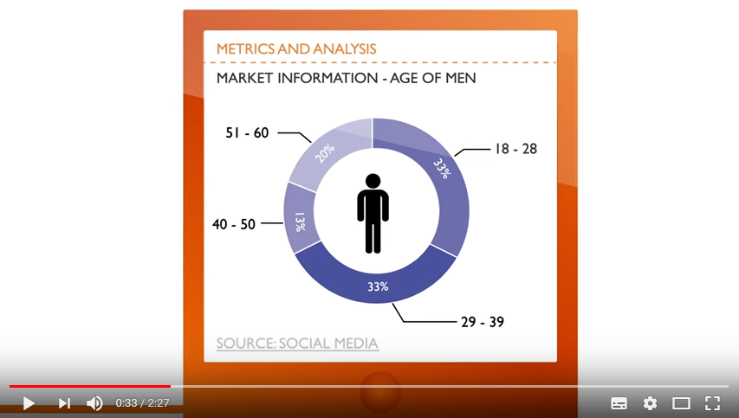

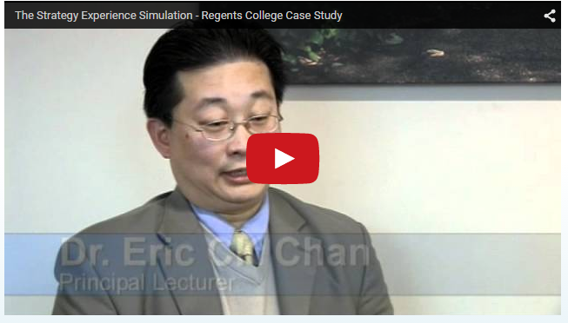
Experiential Learning: Online simulations
“Learning by Doing”
Let students put theory into practice by forming their own companies
Learn soft-skills - communication, problem solving, critical thinking, and analysis of both verbal and financial data - improving employability
Make better use of contact time

Slide 17
Learning Catalytics

Slide 18

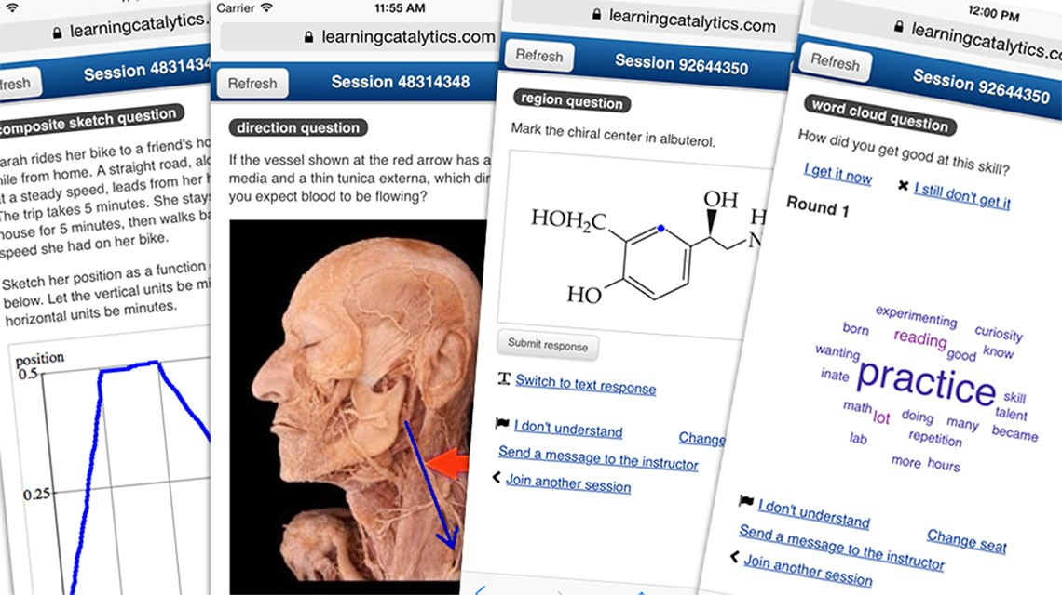
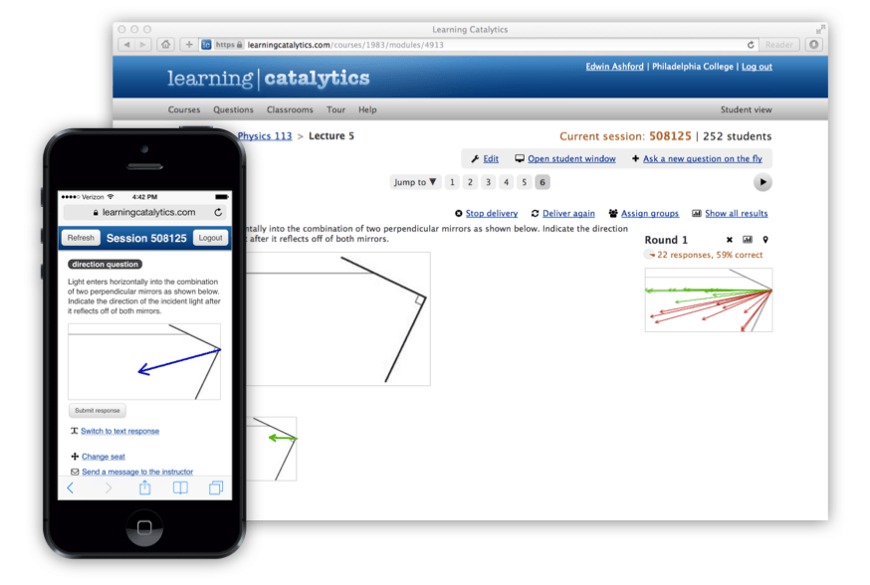
A bring-your-own-device classroom response system
Founded by Eric Mazur, a guru in peer
instruction, and enables peer instruction
18 different question types including open-ended questions to develop critical thinking skills
Gradebook gives lecturers insight into individual and course level performance
Lecturers write their own questions, use Pearson’s bank, or the community bank
Allows lecturers to flip the classroom
Avoids the administrative load of using physical clickers

Slide 19
Custom Publishing

Slide 20

We give you the freedom to design your chosen course materials based on exactly what and how you want to teach.
Here are some examples of customised resources:
• A print textbook or eBook with content specific to your course needs
• A study skills textbook or eBook to support your students’ academic skills
Personalised Print and Online Resources
– CUSTOM PUBLISHING

Slide 21
There’s so much more to learn
Find out more about us at
www.pearsoned.co.uk
or write to
z.dekanoidze@englishbook.ge

