Slide 1
Ani Demetrashvili
Head of Examinations

Slide 2
Why should we pass TOEFL® Tests?
It measures the English language knowledge;
It is fair and open;
It promotes good education;
It has the most trustful score information;
It is grounded in research.

Slide 3
ETS Global
In 2017, ETS refocused its research agenda around some of the most significant, global education challenges facing societies today.

Slide 4
Foundational Research
Based on:
Statistical methodology;
Psychometric methodology;

Slide 5
The aim of the research
Improving teaching and learning;
Expanding opportunities for individual learners;
Improving education policy and assessment.

Slide 6
Educational Challenges
I
Increase sustainable access to a diverse and high-quality teaching pool;
Support English learners’ development of language proficiency;
Raise global English language proficiency;
Promote assessment and development of critical competencies in a global context;
Support understand learners and those who teach them.

Slide 7
Macmillan English
Six-level best-selling series in British English;
Native – speaker classroom;
Language Book (Digital Student’s Book)
Practice Book with Working with Words CD-ROM
Fluency Book

Slide 8
Macmillan English & TOEFL Primary ® Tests
Textbook:
Various topics;
Promotes independent study;
Provides extra resources;
Good storyline.
TOEFL Primary ® Tests
Familiar contexts (school, home, playground)
Formulaic expressions;
Content-based texts;
Unfamiliar words with contextual clues.

Slide 9
Skills to Tests
start on all 4 skills – includi
the start on all 4 skills – including writing
Focus from the start on all 4 skills – including writing
Reading texts increases in complexity;
Deeper understanding of the text;
More non-fiction/cross – curricular texts

Slide 10
Skills to Tests
‘Radio Programme’ format;
Listening activities;
Lively speaking activities including giving opinions.

Slide 11
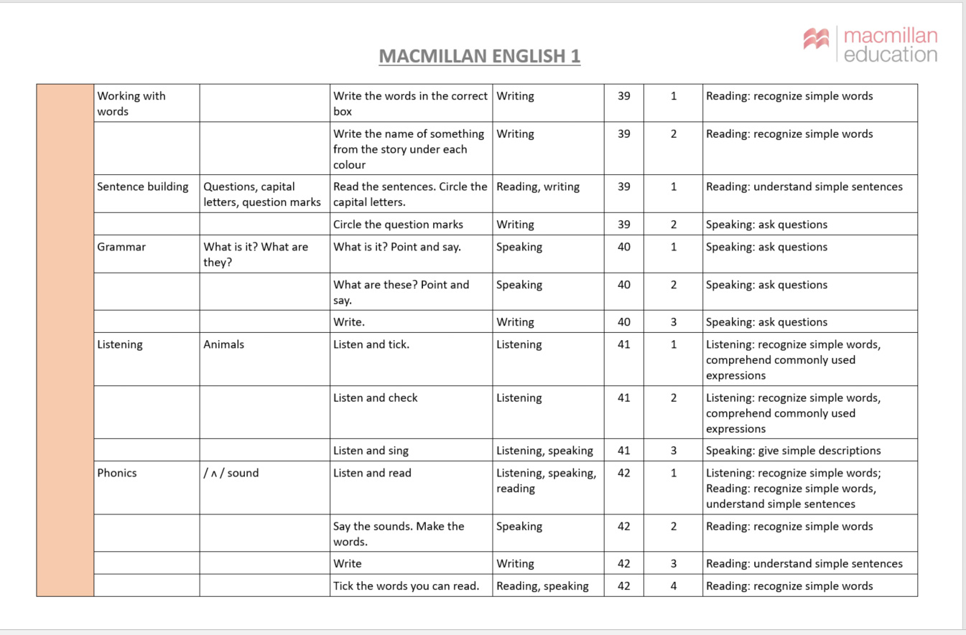
Mapping to TOEFL Primary Test

Slide 12
Theory of Actions
TOEFL Test Components
Hypothesized Actions
Intended Effects
Test content and results
Independent measures;
Constructs based on core communication goals derived from EFL curricula and textbooks;
Test tasks focused on communication and meanings;
Linkage of scores to CEFR and Lexile levels;
Score report with meaningful feedback.
Students
Understand their strengths and weaknesses;
Understand their ability according to an international standard.
For students
Improved attitudes, higher motivation, and greater value attached to language learning.
Parents
Understand their child’s strengths and weaknesses;
Understand their child’s ability according to an international standard;
Provide resources and support needed for their child’s English learning.
For parents
Improvement in their child’s English ability.

Slide 13
Theory of Actions
TOEFL Test Components
Hypothesized Actions
Intended Effects
Teachers Professional Development
Professional support for teachers in the form of instructional workshops (e.g. Propell).
Teachers and schools
Understand students’ strengths and weaknesses;
Understand students; abilities according to an international standard ;
Use scores to inform teaching;
Identify gaps between their curricula and the test content and address gaps by modifying their curricula;
Gain a better understanding of TOEFL Tests.
For teachers and schools
Improved English instruction through better knowledge of students’ current abilities;
Increased appreciation of the value of communicative language skills.

Slide 14
Teachers from Partner Organizations
‘Texts are interesting with lots of new words, creative lessons and learning environment and children have fun while doing exercises’; - Nana Baghaturia
‘Toefl Primary Tests and Macmillan English work effectively together, students get great experience of using their English.’ – Magda Dalakishvili

Slide 15
Thank you for attention

