Slide 1
Main heading goes here
TEXT PAGE STANDARD
This page will manage your text using the standard PPT text functions on your tool bar.
The minimum size for presentations that will be projected to an audience should be 18.
The minimum size for slide decks that will be read should be 10
Activating Literacy Skills for Young Learners
Notes:
Activating Literacy Skills for Young Learners (workshop) – 60 min
It is often unclear how we as language teachers fit into the literacy development process of our young learners. In this workshop we will have a closer look at literacy and what it means before we will explore the literacy journey in the context of language learning and our role. We will focus on how teachers can take advantage of young learners’ characteristics and interests by choosing a developmentally appropriate approach to literacy teaching, enhancing literacy through the use of visuals, TPR and stories

Slide 2
PLAIN COVER
Use this cover where you do not want to use and image. Add the Macmillan Education logo and a single sub brand or lock up to the base logo strip as required
Anna Hasper
ELT Consultant for Macmillan

Slide 3
Over to
you…
Over to you
Literacy is…
The journey
Upgrading …
Comment & questions
What
&
why?
Session
The
journey-
How?
Notes:
It is often unclear how we as language teachers fit into the literacy development process of our young learners. In this workshop we will have a closer look at literacy and what it means before we will explore the literacy journey in the context of language learning and our role. We will focus on how teachers can take advantage of young learners’ characteristics and interests by choosing a developmentally appropriate approach to literacy teaching.

Slide 4
Over to you…
TEXT PAGE STANDARD
This page will manage your text using the standard PPT text functions on your tool bar.
The minimum size for presentations that will be projected to an audience should be 18.
The minimum size for slide decks that will be read should be 10
How many words can you make?
You’ve got 2 minutes!
Literacy Journey
Notes:
Activity 1

Slide 5
Did you find any of these?
TEXT PAGE STANDARD
This page will manage your text using the standard PPT text functions on your tool bar.
The minimum size for presentations that will be projected to an audience should be 18.
The minimum size for slide decks that will be read should be 10
it to at no cat not rat joy try unit one joey July reaction client juicer truly currently loner curly terrace create article certain oracle you your retry injury journey literacy eater eatery juicy notice tire icy enrol cutlery trial trail celery lecture niece nice enjoy true race join irony …
Notes:
fb
Reflect: what level useful for?
Prerequisite: have vocab knowledge; can read and write.

Slide 6
What is literacy?

Slide 7
Literacy is…
Complete the sentence
Check with a partner
Can you combine your definitions?
Notes:
Activity 2- Stem Sentence/ Sentence starter:
-Alone
-Pair combine
-Check next slide – feedback

Slide 8
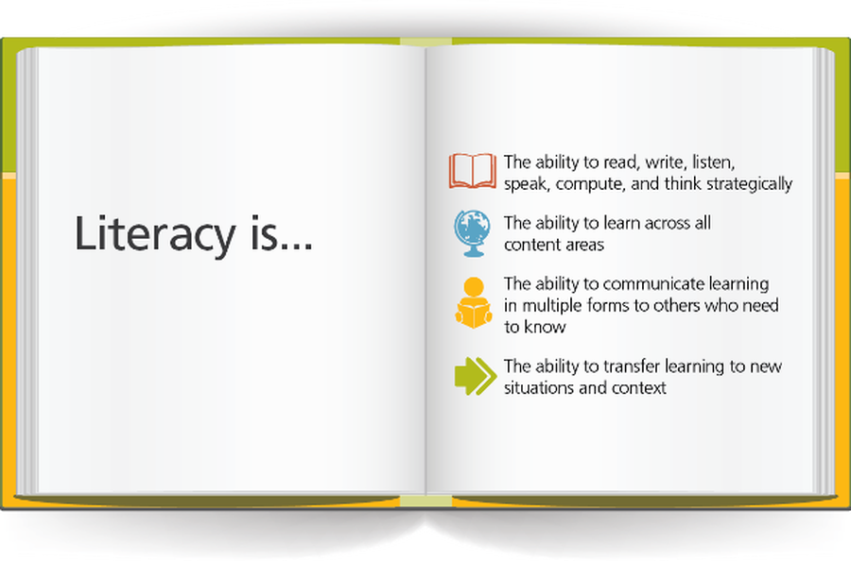
…” the ability to identify, understand, interpret, create, communicate and compute, using printed and written materials associated with varying contexts.” (UNESCO)
Literacy is the ability to read and write.
Notes:
CHECK- similar?
So the term “literacy” refers to the ability to read and write and covers a range of skills. A literate person can understand printed words, numbers, and images, and can also create these to communicate a message. Another equally important ability is to express thoughts, feelings, and ideas. So a literate person, as well as being able to read and write, also has listening skills, can discuss what they have read, seen, and heard, and is able to interpret the information using their own experiences and knowledge. Children learn to speak their mother tongue quickly, but acquiring reading and writing skills is a slower process, taking years of practice and effort. Being able to interpret texts and communicate ideas effectively is even more demanding.
How long it takes varies greatly among children, depending largely on their age and previous experiences.
Literacy is arguably the most important part of education because without it, children could not acquire or communicate knowledge. Reading, writing, listening, and speaking are essential skills regardless of the topic, so literacy development is crucial for all subjects, not just English.
Literacy skills for the majority of learners start developing first in L1 but they are transferable, in general you can say kids only need to get literate once but the ease of transferability depends greatly on the nature of the L1 (similarities in written systems eg.) As you already know, learning is not a liniar process so even though writing is often the last skill to address in our weekly literacy plan, it’s usually not the last skill we teach YLs. With very young learners reading and writing are often taught in parallel as they seem to enjoy playing with letters and playing pretend writing when they are very young. With older young learners before writing to communicate their ideas & opinions it helps if you teach the others skills on the topic before, just to ensure they are scaffoled with content and ideas and that comprehension proceeds production. Regardless of the age group though, writing definitely seems to be the most neglected skill in the YL and even adult language classroom!
REFLECT ON TASK: Would you bea ble to use an activity like “Sentence stems/ starters” in your class? Why useful? because it can sometimes be difficult to start a sentence to express and idea so this helps them start/ think and provides a framework/ scaffolding.
Level? for learners who’ve got some vocab and grammar skills as they need to think about it all - appropr vocab, grammar to link, letter formation, directionality, words order ad correct structures.
UNESCO
Literacy is the ability to read, view, write, design, speak and listen in a way that allows you to communicate effectively. The power of literacy lies not just in the ability to read and write, but rather in a person’s capacity to apply these skills to effectively connect, interpret and discern the intricacies of the world in which they live.

Slide 9
So….literacy has changed
It has gone far beyond
reading & writing
Listen to
Read
View
Write
Create
Speak
Express
Notes:
Literacy is the ability to read, view, write, design, speak and listen in a way that allows you to communicate effectively. The power of literacy lies not just in the ability to read and write, but rather in a person’s capacity to apply these skills to effectively connect, interpret and discern the intricacies of the world in which they live.
The world is changing and education is changing with it. The past decade alone has seen students’ literacy repertoire extend to include visual, digital, media and interactive applications.
The changes that the English language has undergone over the course of history is staggering. Reading information on websites, typing an email, and receiving and replying to text messages are just some examples of different literacy skills in today’s digital world. Developing children’s MEDIA, DITIGAL and VISUAL literacy is a crucial part of their education in our social-age to ensure that they can understand and interpret the texts that they are exposed to. And maybe as important as literacy is the need to develops young learners ability to evaluate the information they receive and develop their critical thinking if they are to become independent and creative individuals… and…

Slide 10
Why is literacy key?
Notes:
Because language is power : it enables learners to communicate effectively and develop their knowledge of the world around them.

Slide 11
Writing was once seen as a skill primarily taught to reinforce other language skills. However, in many settings writing has now moved to a more central place in the curriculum.’
(Reid, 2001)
‘
Notes:
And interestingly, writing is back! Kids are growing up in an increasingly print-dominated worlds I mean we are writing more nowadays than we used to, there is facebook, twitter the internet, blogs etc so helping them develop solid literacy skills is key in providing them with competence in writing to succeed in life.
writing is now possibly more important than ever for learners; blogging, facebook, linked-in articles, twitter, whatsapp, online courses like Coursera, Moodles, Future Learn etc. etc. Writing has the same basic building blocks of language as speaking, vocab and grammar but it requires different linguistic structures and functions than speaking.

Slide 12
So what does this mean for us?
Notes:
So what’s the impact of this for us teachers?
We teachers need to ensure focus on Laying solid foundations in literacy. As Carol Read says, we would be doing them a disservice if we are not laying solid foundations in early foreign language teaching at primary and pre-primary level. Because language is power : it enables learners to communicate effectively and develop their knowledge of the world around them.
So we need to deliver effective and inspiring lessons that kids respond to so they want to participate fully and develop their skills along the way.
So before we look in more detail at the literacy journey it would be good to find out your beliefs about children & literacy….

Slide 13
A child is a blank slate
L1 literacy skills are transferable to L2
L2 literacy development follows the same patterns as L1 literacy development
YLs need plenty of practice opportunities
YLs learn best through direct teaching
Notes:
Activity 4
True/ False - Stand up- Sit down or Magic Line

Slide 14
A child is a blank slate
L1 literacy skills are transferable to L2
L2 learning development follows the same patterns as L1 literacy development.
YLs need plenty of practice opportunities
YLs learn best through direct teaching
Notes:
Feedback
1 NO they come to class with heaps of ideas, imagination and knowledge of their own world and play but yes with lots more to learn however they are not empty vessels.. .the message for us is to build on what they already know/ prior learning
2 T/F there are indeed some transferable skills and Joan Kang Shin & Joanne Crandall (2014) are even going so far as to say that kids only need to become literate one. I’d say the idea is correct however if learners like here are coming from a different alphabet they need in a way to relearn word recognition and letter sounds correlation, even though the principles might be the same they do need to relearn reading in a very different script… so that can take time.
4 NO L2 learners don’t have the exact same patterns of development as L1 learners. They do indeed have typical patters and some similarities with L1 but eg vocab & pron development is way different. And the process is very much depending on the L1 and its differences. It is KEYs that you keep in mind that Language is developmental so concentrate on what learners are ready for and this can be different per learner/ class.
5 YES - is learned tru imitation, repetition, practice and reinforcement, so by providing various activity in which learners get the chance to repeat and engage with the language we can help them learn
6-NO; indirect best way to introduce L2 and I’m sure I do not need to tell you is through songs, stories, chants, rhymes, games etc fun activities. Of course it’s not all about the fun, they need to be pedagogically underpinned and have an educational aim but kids learn L1 through play and particular VYLs and young YL playfulness is a natural and invaluable way of learning.
REFLECTION ON ACTIVITY
Do you already use this in your class? Does it develop literacy? Yes Listening skills : low literacy demand though you can get learners to read the sentences but by getting up/sitting down there is no written output needed. they hear it – input- and need to create meaning. Which is for Yls one of the most important skills because it it the main language acquisition tool. The more children listen to English they faster they will learn to speak. So and can show understanding through Physical Response -TPR no need to read or write themselves, great activity to use in their Silent Period or just to have some low demanding fun :-0
LEVEL? any depending in the lge input/ sentences

Slide 15
Stepping in their shoes
Stepping in their shoes
Notes:
Often I think as teachers we forget what it was like to learn how to write in another language… it’s important that once in while we step back into the learners’ shoes and remind ourselves of what it was like…So here’s one for you!
All you need is a pen/pencil
You’ve got 30 sec/ 1 minute to copy 2 words
Ready ?
Let’s go…
Reflect how was that ☺ ?What did this show us?

Slide 16
hear
say
read
write
Notes:
Activity 5
Based on previous experience
How do you think these 4 words are related? Don’t tell me but tell you partners
1 minute
Next slide

Slide 17
Young learners need to…
____ a word before they can ___ it.
____ a word before they can ___ it.
____ a word before they can ___ it.
Hear a word before they can say it.
Say a word before they can read it.
Read a word before they can write it. (Linse, 1995)
Literacy is the ability read and write.
Notes:
Activity 5 – Write & Copy
Now predict which word goes where COPY the word in (HO?)
PS Can use each word more than once
1 minute
Ready?
Hear Say read write
The primacy of Listening dictates that Listening skills are the most important outcomes of early language teaching (Demirel 2004). Thru listening (reception), they slowly work on saying/ repeating/ producing English language. Listening is the initial stage in first and second language acquisition. According to Sharpe (2001), the promotion of children’s speaking and listening skills lies at the heart of effective learning.
Highlight Sound- letter phonics/ decode r encode w

Slide 18
Young learners need a firm foundation and understanding of the spoken language before they can become proficient readers and writers of any language.
younglearnersneedafirmfoundationandunderstandingofthespokenlanguagebeforetheycanbecomeproficientreadersandwritersofanylanguage
Notes:
Do you Agree/ disagree? Why?
Indeed Closely linked, as Linse (1995) stated before; the natural journey is for kids to be taught how to read before we formally start to instruct writing.
The division, in particular of the 4 skills, seems inappropriate when we think about Young Learners and the holistic way in which they learn, very young learners/ pre-primary may encounter only spoken language for many years. Listening and speaking are interrelated and we often teaching reading parallel to this, through for example story telling/ reading and once younger learners see words.. well you know what happens, they like to pretend write. BUT It’s important to remember that written literacy skills are a whole new skill set. Cameron (2001) proposes literacy learning more as an organic processes in a child’s mind . Through listening and speaking young learners develop their vocabulary as well as gain an understanding of discourse; the difference between conversations 1-2-1 and eg extended talk, story telling etc. and a feeling for grammar
L and S are natural processes, our brain is hard wired to do, look at storytelling and songs in more cultures that way to communicate
R and W are for the brain unnatural process that need to be taught explicitly in L1 and L2. but Reading and writing you could say are two sides of the same coin. The more children read, the better writers they are likely to become.
Reflection:
What level of learners would you be able to do this with? SS that can read and have basic writing skills
Aims? A sentence level task which Focuses on word recognition and therefore spelling and the features of discourse – punctuation and capitalization, word boundaries . Ss enjoy this kind of task.
Have you done this before Snake texts are another really good way to help students with writing
To easy for some; get them to make one for their buddy : https://www.teachingenglish.org.uk/article/snake-word

Slide 19
How to teach literacy?
Notes:
Right, I think you’ve already collected some ideas;
Responding to text with TPR
Copy words
Snake senteces
Jumbled letters
Sentence completion

Slide 20
A structured approach
Supported
2
Gradual
Small
Notes:
Key is a structured scaffolded approach
Tell teachers that when it comes to writing students will need to start small, with gradual steps up from lettter to word to sentence & paragraph level. And they need to be supported based on their current level/ you need to start where tey are and yes that might mean giving them more support then the CB/TB gives.
Let’s have a look at how. …

Slide 21
Notes:
It’s important to remember that written literacy skills are a whole new skill set. Whereas learning the oral skills is more or less a natural process; which kids pick up through exposure, observation / noticing, imitation, repetition and prax, the journey through the written landscape of language is more dynamic and needs formal instruction in L2 but also in L1.
pencil control, fine tuning key motor skills, as well as wrting on the lines can be challenging. I like to start with awareness if this before they start writing and to remind them eg like on this page of where we write, as there are no lines etc here kids might need to be supported
One actvity I like is..

Slide 22
Letter gym
Notes:
Activity 6 – My way of engaging SS with writing, in particulary when we just start of.. End level 3, start 4… Many fav Activities; air-writing, playdough, back writing but I LOVE Spelling gym
Explain short letter cross arm, tall letter hand above head and letter with tails/ hanging letters under the line, hand arm hanging down.
-cat: cross cross up
-Apple; cross , down down up cross
- Or the whole alphabet A- Z ☺
Notice the different types of lines on your paper. Each row has a thick line on the top and the bottom, and a dotted line in the middle. Different letters have different heights - some will reach from the bottom line to the top, and some will be only between the bottom and middle lines.
Write out the alphabet in capital letters. All uppercase letters are "tall" - that is, they reach all the way up to the top line of each row. Some letters, like A,B, E, H, and K, have lines or angles about halfway down, and you can use the middle line as a guide.
Write out the alphabet again, this time in lowercase letters. You should notice most lowercase letters are "short," reaching only to the dotted line in the middle or each row. The only exceptions are b, d, f, h, k, l and t, which are just as tall as uppercase letters. (sticks)
P Letters with tails are g, j, p,q and y - you can see the features they have hanging down, like an animal's tail. The main part of the letter still sits on the bottom line like all the others.
Then back writing/ sand salt/ air writing etc

Slide 23
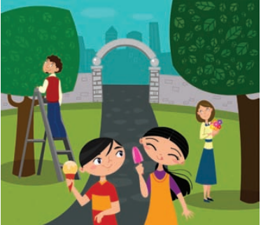
They are eating apples
She’s standing on a ladder
She’s picking flowers.
She’s got a green pen.
She’s got a red pencil.
Notes:
30 sec describe what you can see
Look at my sentences- correct?
Level of writing; word … simplified
Or next click to simple get ss to write 3 incorrect sentences for others about image in the book…
Eg
We are used to these categorisations of different types of learner – I assume you are all familiar with visual, auditory and Kinaesthetic learning styles.. Or tendencies as I prefer to call them because I don’t think these are 1) set in stone 2) that easily separable. Nowadays they are more and more recognised as an oversimplification . Even though young learners are mostly kinaesthetic we are all a mixture but in fact over 50% of our mental activity is given to the processing of visual images
Students love visual images, In particular Yls, they like colourful and real people images they can identify with are best, the use of images can trigger ss lge ( activating what they already know) or create a need for lge, which you can then teach. So instead of explicitly giving the lge we get it from the Ss. So we are using images to negotiate meaning… and as well to support ss understanding/
We are intensely visual animals, Vision trumps the other senses. Because our minds and memories work in images. It’s how we store experiences . “In our mind, our life is a trail of images, one leading to another to another. Our brain senses the world, but our mind comprehends it, and the vehicle that carries us along this journey is the image.” Professor James E. Zull
The picture superiority effect, or pictorial superiority effect is a term that resulted from experiments that have shown that in human memory recall, pictures outperform text dramatically. When information is presented orally, after 3 days, people will only remember 10% of it. Using image with the words we remember 65 % of it after 3 days so, 6x more powerful!!!!
.

Slide 24
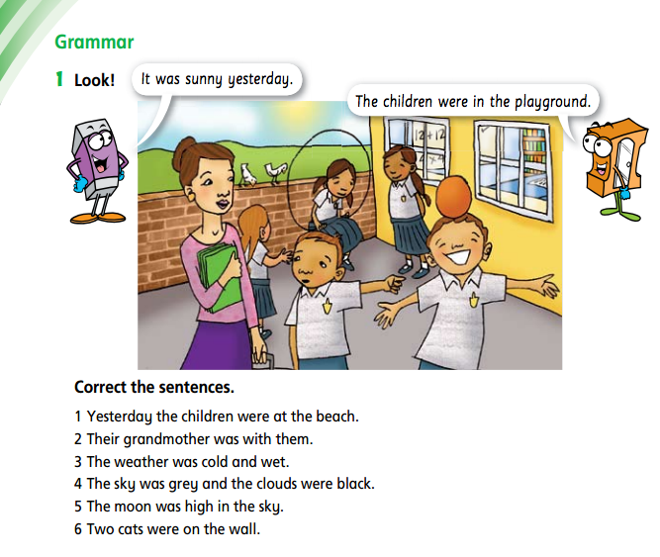
Story Dictation
Say/ wear/ go/ have/ see
Notes:
Remember the steps?
How would you adapt the activity?
Get CPs up maybe 3 flipcharts///// dictate sentences and get them to draw……
Write date- draw….
Children
Grandma
Weather
Sky
Now use verbs to give more sentences to draw 2 or 3-
Then retell to partner
And rewrite story alone or together ☺

Slide 25
Dictogloss
Young learners should write about what they have talked or read about; listening, speaking and reading activities can be used to prepare for writing. It is also key to develop writing skills to express ideas rather than just using writing to reinforce language points.
Read the text aloud at normal speed – students only listen
Read the text again – students write down key words
In pairs students reconstruct the text
Give them 30 seconds to ‘glance’ if needed
Elicit the text back & feedback
Notes:
HIGHLGIHT that this could be a grest kdoel for a writing task…. !!
Talk about the power of an integrated approach - S on the topic to personalise at start, share ideas and at the end present to others. 21 CE useful skills
Then a model text; exploit this, ask comprehension Q reg the context so the learners have to read it and the text become meaning full
Then analyse the mentor text/ model- make them notice the typical lge feautures/ lay-out etc. Make the implicit explicit. Then model the writing task as needed, do some shared W with the learners where you write one as a whole class so yo think aloud and make the writing process visible or a guided writing one where Ss only complete sentence starters THEN time for independent writing.
After deconstructing a model text for typical features, interactive writing is a useful dynamic instructional method to guide students. Teacher and students work together and co-construct a meaningful text while discussing the writing process.
OR: You should expect that the learners will go through a period of being exposed to new language and internalizing it before they can produce. They will be able to understand, but will not be able to produce.
Choose developmentally appropriate task
Demystify the product – MTV/ deconstruct/ Think aloud when coconstructing
Set clear expectation
early on, children often enjoy the beginning stages of writing. Yet writing can be a challenging skill for children to learn. Age plays a crucial role in what we teach and how we teach it. But all learners need encouragement and guidance from us.
Interactive writing is a dynamic instructional method during which the teacher and students work together to construct a meaningful text while discussing the details of the writing process. In a short lesson each day, students gather as a class alongside their expert writer (the teacher) to craft and write text in a variety of genres. The “interactive” piece involves both group collaboration in composing the writing through guided conversation and a unique “sharing the pen” technique where students do the actual writing.
After deconstructing a model text for typical features, interactive writing is a useful dynamic instructional method to guide students. Teacher and students work together and co-construct a meaningful text while discussing the writing process.
To take it even another step further so students get even more change to express meaning is a dictogloss. It’s a kind of structured but really focused on conveying the message: communicative writing more about expressing ideas, which is essential to empower our learners to use language effective and to create a love for writing!
Dictogloss’s are great activities, it’s an intergrated skills activity which uses multiple skills and systems - listening, speaking, writing, plus vocabulary, spelling, grammar and discourse in text reconstruction.
Show instructions
Read the text listen only
Read again write down key words
in teams of 4 reconstruct meaning
Okay find HO and read XX for 30 sec
Keep going ☺
Exact same needed? No/
4 minutes
Do; SHOW FLAME SLIDE
FB; show vblue text
REFLECTION:
Could you use this with your SS
What sort of text? Any , can be great for reading prediction or dicussion topic
Level: stage 3 writers, can do para’s have enough vocab and grammar to write

Slide 26
Scaffolding
Notes:
-Scaffolding is a temporary construct which can be put up, taken down, reinforced and strengthened, or dismantled piece by piece once it is no longer needed, and as children develop language and skills which enable them to act in an increasingly competent, confident and independent way. So It is tuned to the needs of the learners and adapted to them…
Keep developmental levels and motor skills in mind as games have different demand, cognitive but also physical, interactional and motor skills etc. So adapt tasks as needed. Supporting a learner in carrying out an activity. This can be done by simplifying a task, using images, modelling or breaking tasks down into manageable steps, or providing alternative ways of carrying out tasks
Bruner believed that when children start to learn new concepts, they need help from teachers and other adults in the form of active support. To begin with, they are dependent on their adult support, but as they become more independent in their thinking and acquire new skills and knowledge, the support can be gradually faded. This form of structured interaction between the child and the adult is reminiscent of the scaffolding that supports the construction of a building. It is gradually dismantled as the work is completed.
If not? Ss cannot participate, get frustrated, lose motivation and attitude towards English learning and maybe even all learning changes….
Good scaffolding is tuned to the needs of the child and adjusted as the child becomes more competent.

Slide 27
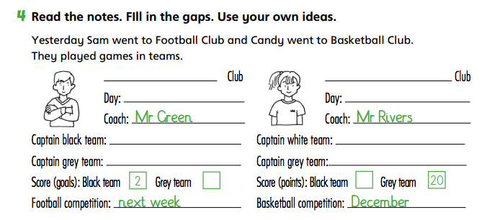
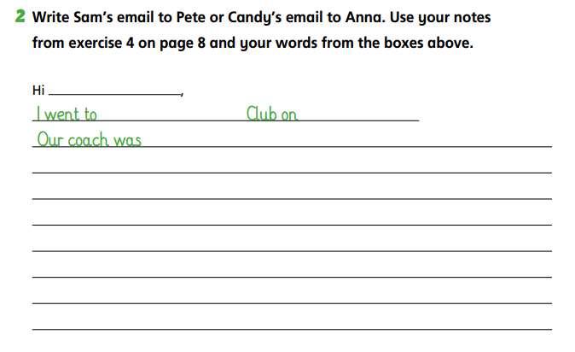

Slide 28
Text structure & genres
concepts of print
spelling, word study
sounds, letters, phonics
oral literacy
&
Processes & Strategies
Notes:
Writing is a difficult skill and, as most of us would readily agree, not only for children. The development of children’s writing takes place gradually over time. Young learners need a firm foundation and understanding of the spoken language before they can become proficient readers and writers of any language.
Let me use a visual to support what we are talking about and visualize the literacy journey, see not only for kids a visuals useful also for us ☺
Know enough about the bottom one.. but indeed we move from oral to print related skills
Then you can clearly see that the learning process moves from receptive to productive ; recognising letters and sounds before sounding them out and forming them; the basic mechanisms of handwriting
Then one of the main differences vs L1 literacy development is that we need to focus more of word study; building vocabulary as learners need to have words to express their ideas, orally and in written form in particular spelling practice.
Concepts of print is where learners get an awareness that successful writing depends on effective communication. Clear hand writing, sentences. Here writing is mainly for personal pleasure and for an immediate audience e.g. parents and teachers.
Text :Children develop a greater sense of audience. Structures of writing become more distinct; writing begins to be better organized and to become more formal. They develop an increasing awareness of audience, purpose, genre and appropriateness.
When children learn to write in their first language (L1), it is widely acknowledged that they go through a number of general stages; but there are not discrete or age-bound and vary in different cultural and educational contexts. They may be briefly characterized as follows:IMPACTED BY
Physical factors
Psychological factors
Linguistic factors
Cognitive factors
Cultural factors
Getting ready: Children acquire manual skills and learn the basic mechanisms of handwriting and spelling. They may also be taught synthetic phonics as part of a systematic initiation into reading and writing.
Writing for me: Writing is personal, colloquial, situational, linear and context-bound. Children may be willing to alter spelling but not to revise, re-draft or edit their work. Writing is mainly for personal pleasure and for an immediate audience e.g. parents and teachers.
Writing for others: Children develop a greater sense of audience. This raises awareness that successful writing depends on effective communication rather than satisfaction with self. Structures of writing and speech become more distinct; writing begins to be better organized and to become more formal. Children’s writing e.g. early attempts at stories, begins to reflect what they are reading.
A world of writing: Children are exposed to, and learn to use, an ever-expanding range of writing styles. They develop an increasing awareness of audience, purpose, genre and appropriateness.

Slide 29
Effective teachers of literacy
Give it plenty of Time
Select appropriate Texts
Teach reading & writing explicitly
Use Talk to think aloud & model
Are selective with Tasks: less can be more
Test for progress and to identify next steps
Notes:
Now before we finish our journey I believe it’s worth it to point out 6ts

Slide 30
Notes:
The initial stages of learning to write might be basic, as basic as copying. However even at this early stage is important that writing activities are made meaningful, and are cognitively engaging As learners progress and start writing short text provide them with the guidance needed for creating. Make the implicit explicit; make visible what they need to do to meet the expectation/ tasks. Only if they feel enable and can succeed they will build confidence and enthusiasm for writing.. These are essentials to empower our learners to use language effective in real life and…create love for writing!
The writing journey from copying to creating is of utmost important but it is where it can take them that counts the most!!

Slide 31
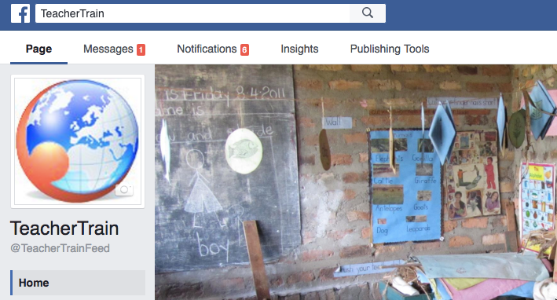
BACK PAGE
Please add the Macmillan Education logo and any additional logos to the logo strip at the bottom of this page as required.
NAME PERSON
Job Title
M +44 (0) 000 000 000
T +44 (0) 000 000 000
E name.person@macmillan.com
Thank you for your active participation!
anna@teachertrain.org

Slide 32
PLAIN COVER
Use this cover where you do not want to use and image. Add the Macmillan Education logo and a single sub brand or lock up to the base logo strip as required
One idea I’d like to try out after this session is …
Notes:
Exams are set.. Even though that mgiht be far from ideal qo what we can have an impact on is what we doin our daily practice, the informal assessment.
So as rewmeber ost of you states that dfamilairy with the exam helped you and that’s also a major factoer in reudting anxiety in young learners wghen taking exams..
We can look at using practice mateirals that are similar to the test format but only use

