Slide 1


Teacher Training Conference
July 2016

Slide 2
SPICE UP YOUR LESSONS
Daniela Clarke

Slide 3

Spice up
VOCABULARY

Slide 4
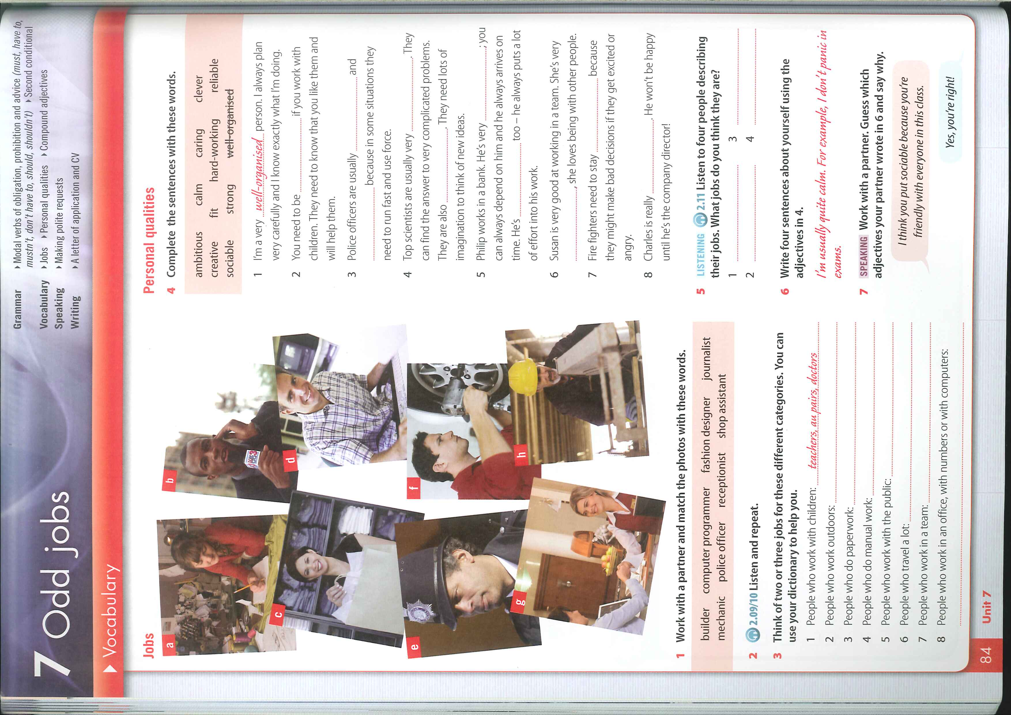
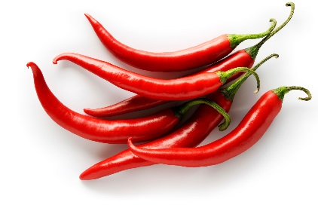

Slide 5
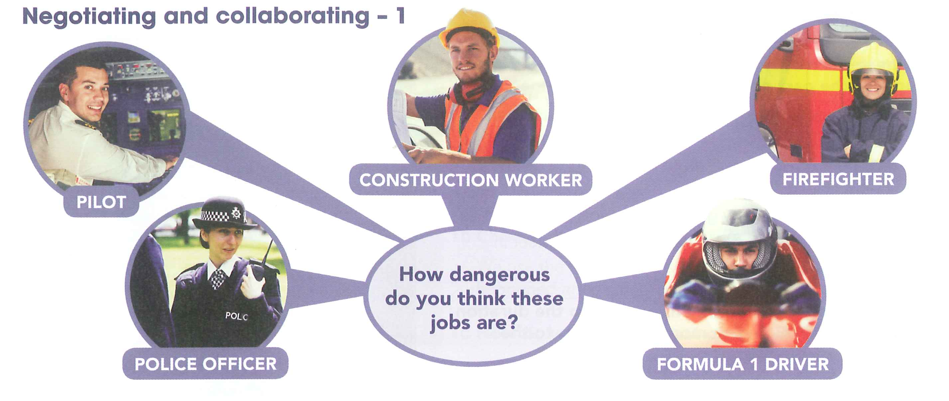

Slide 6


Slide 7
PHRASAL VERBS

Slide 8
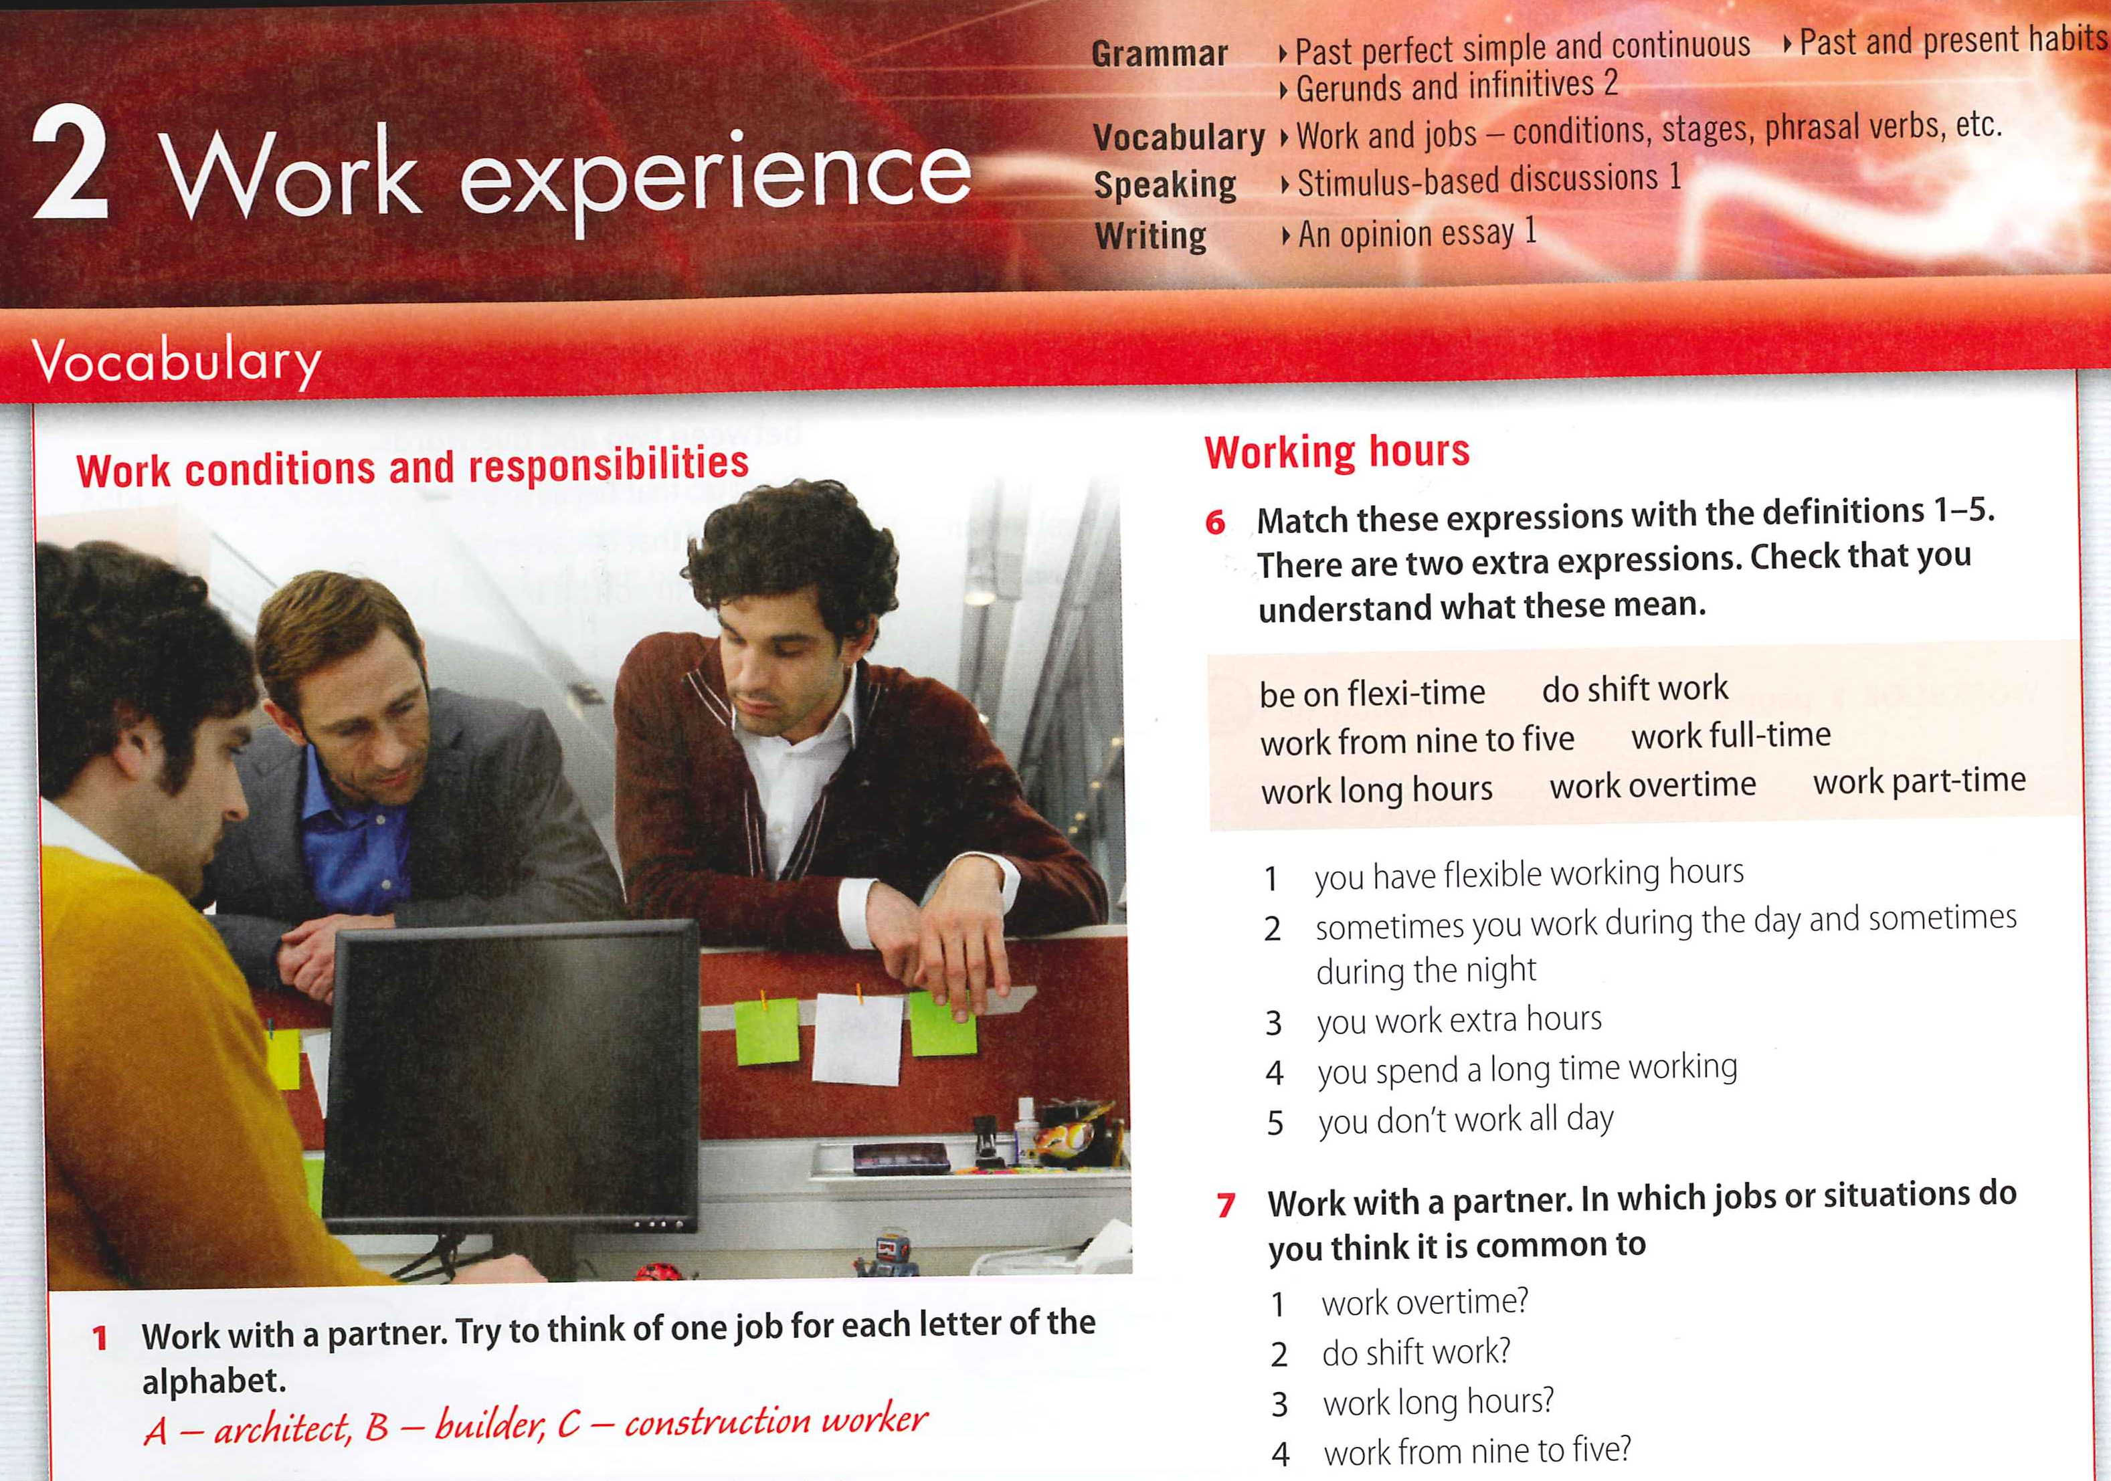
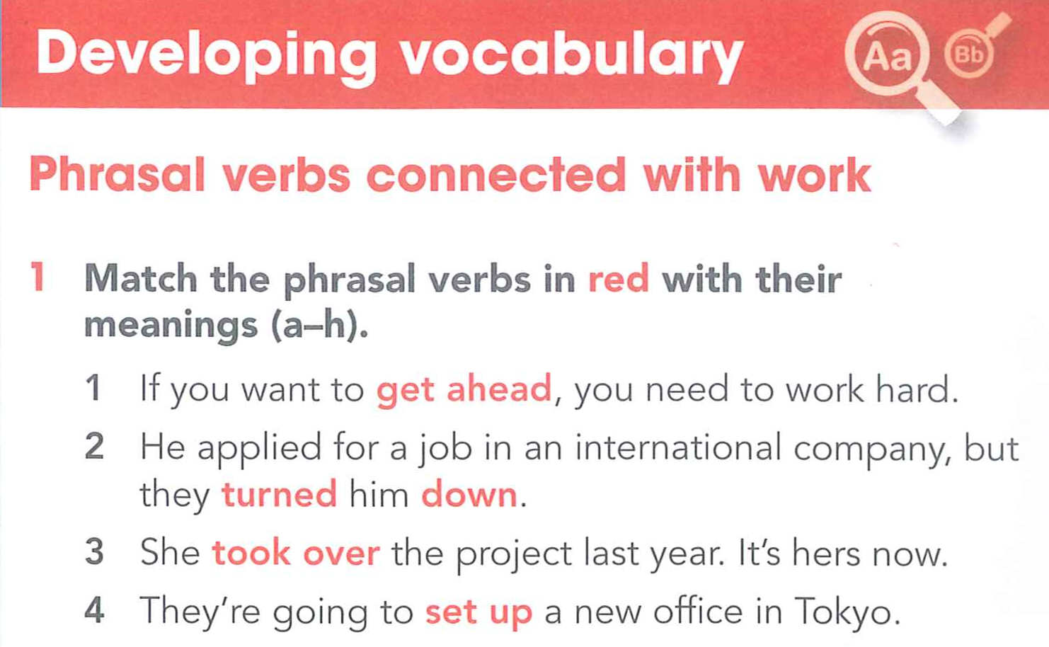

Slide 9
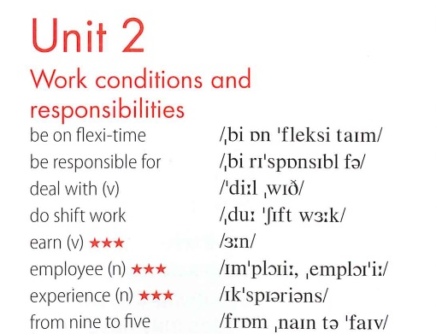

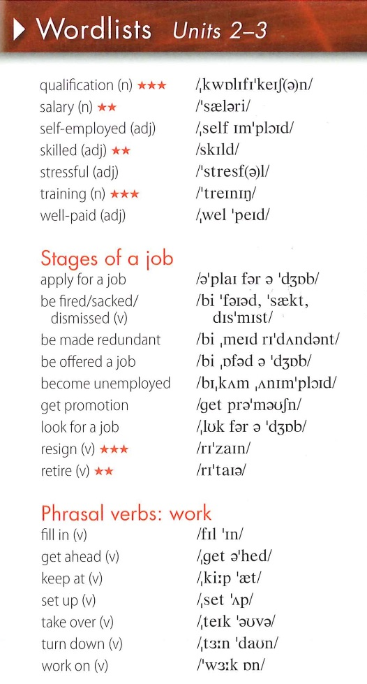

Slide 10
Spice up
GRAMMAR

Slide 11
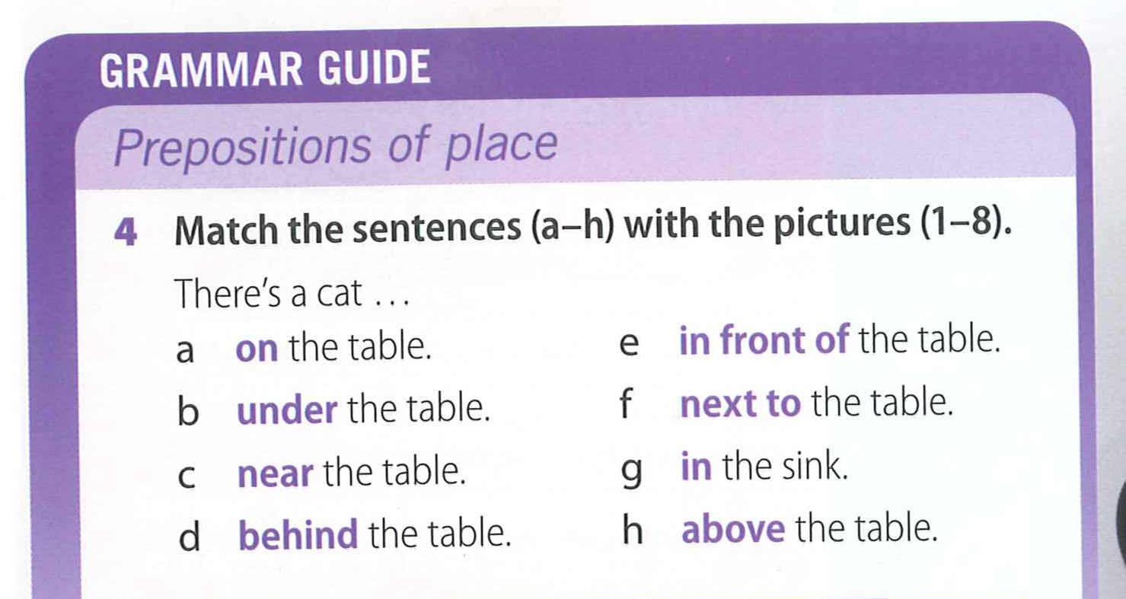
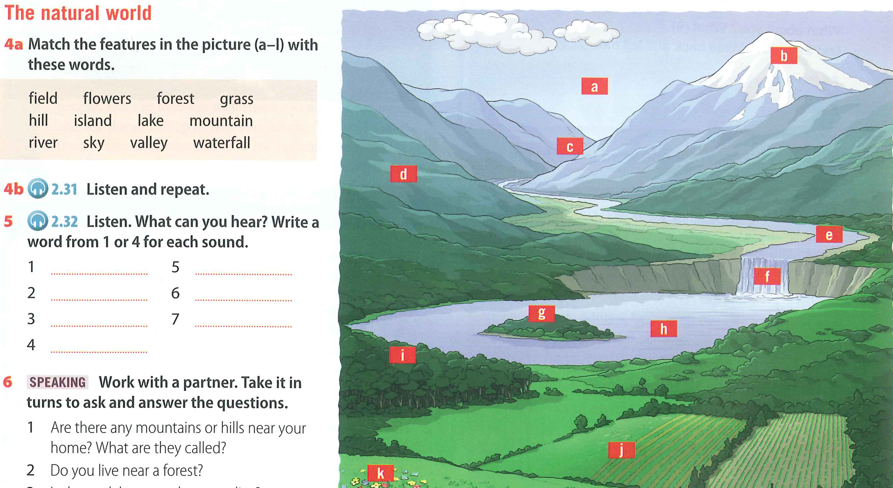

Slide 12
Spice up
PRONUNCIATION

Slide 13
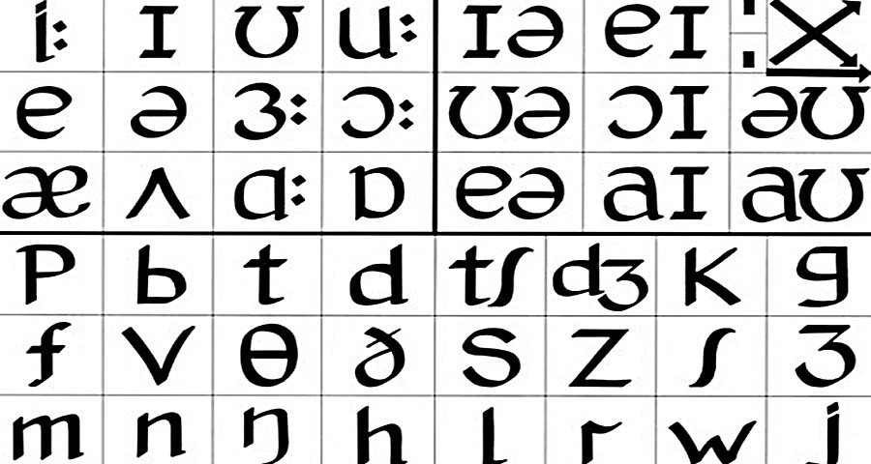
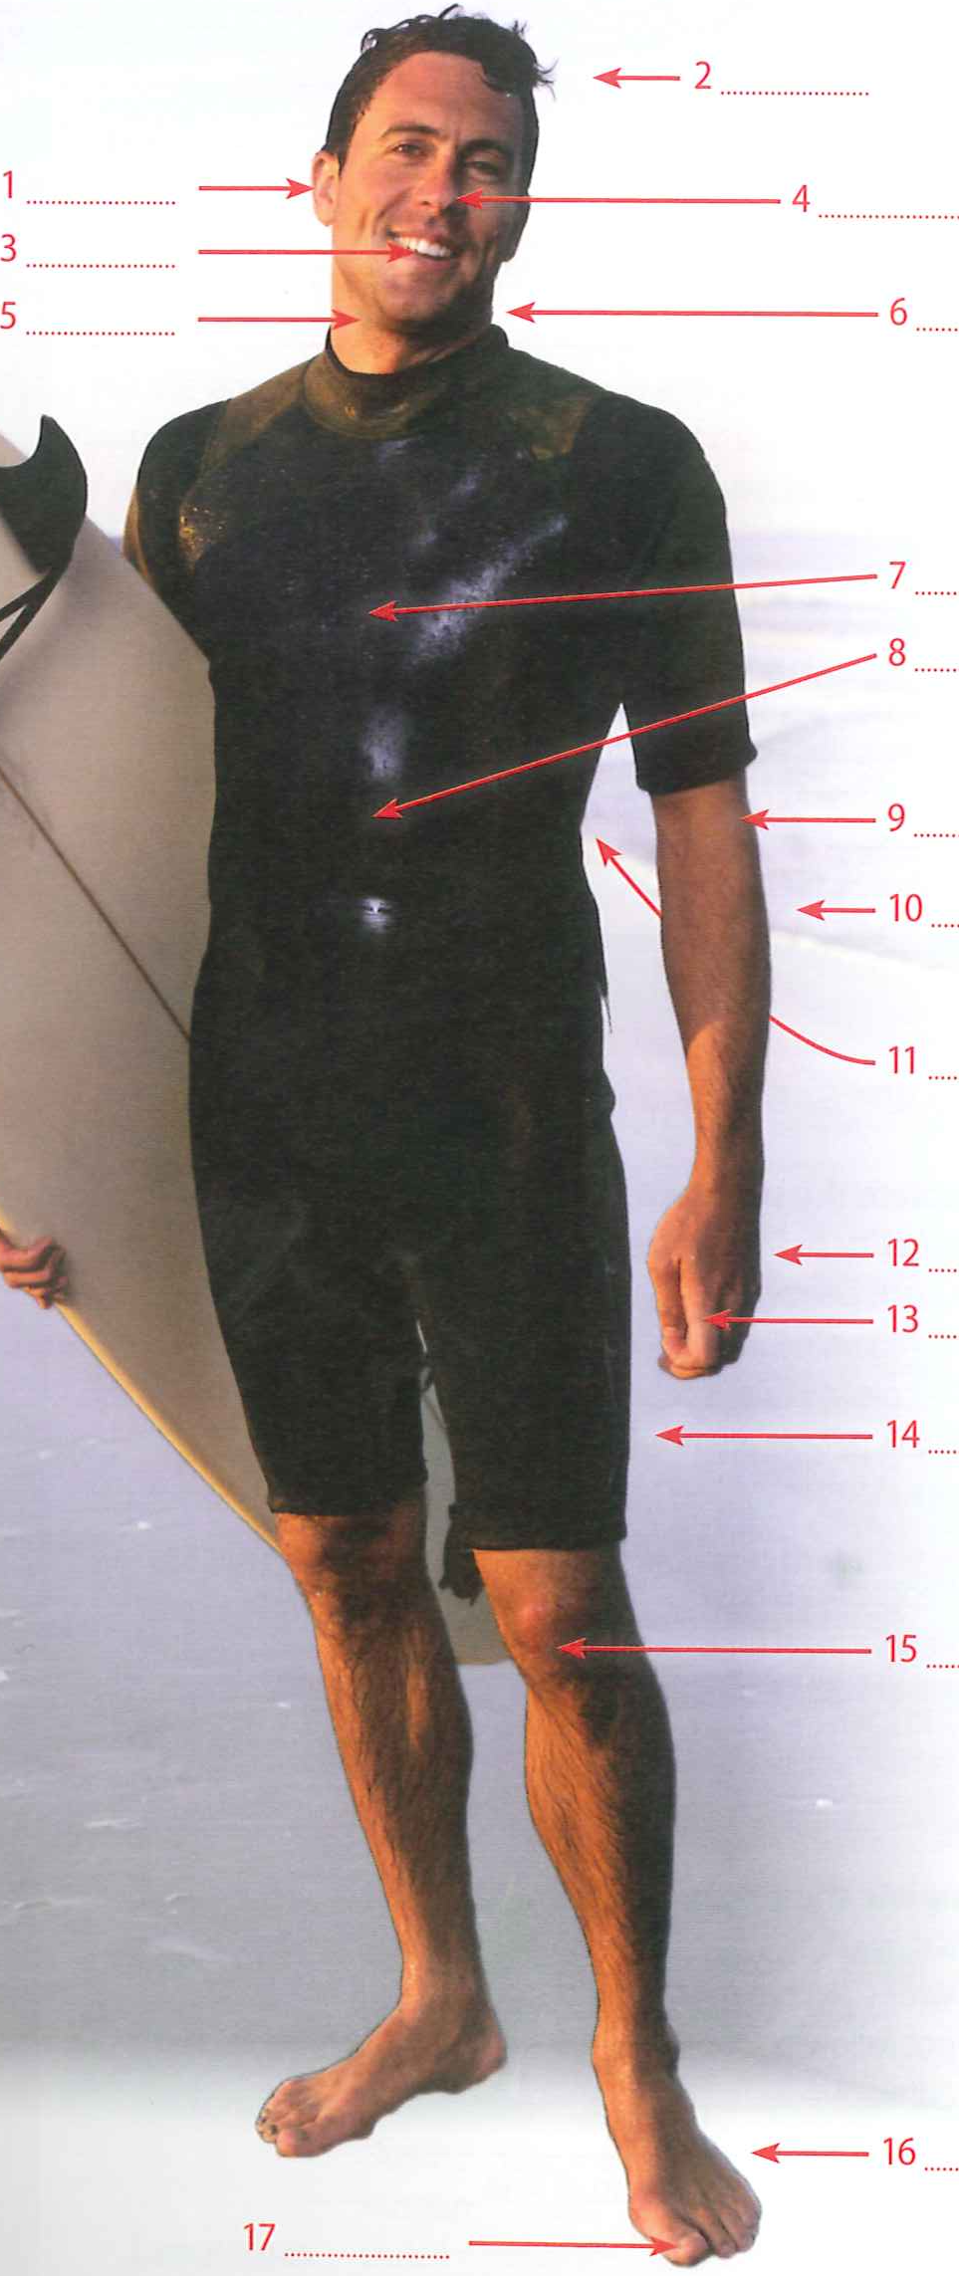

Slide 14
Spice up
LISTENING

Slide 15
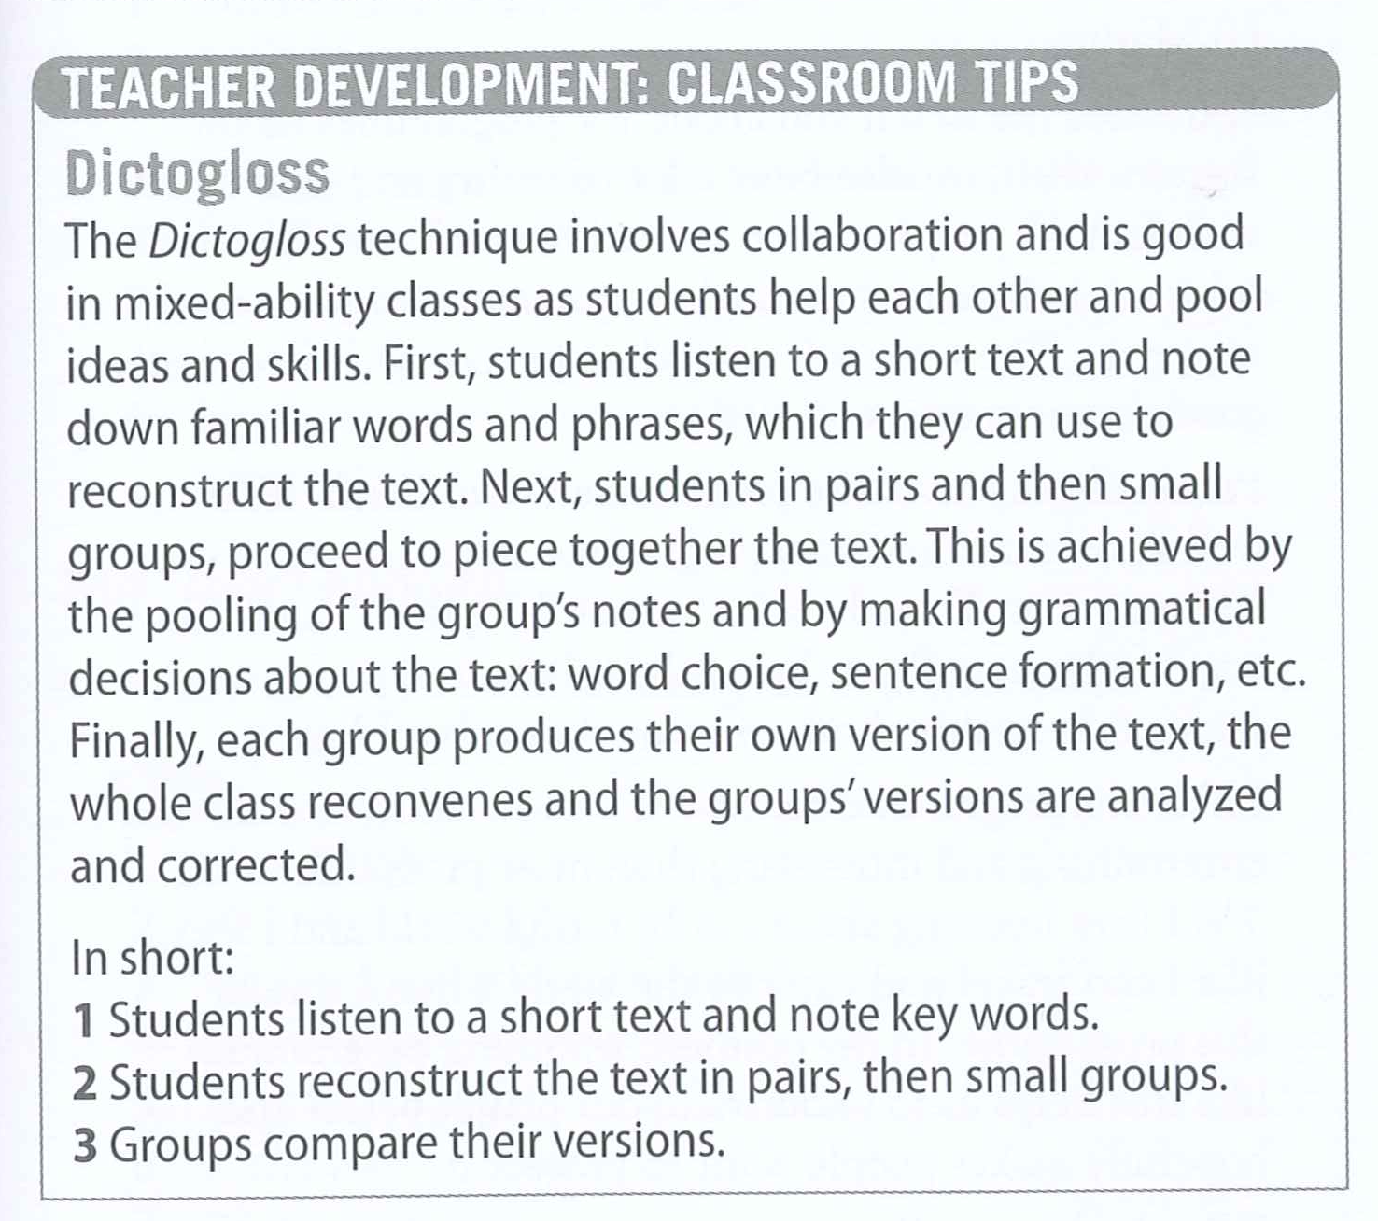


Dictogloss

Slide 16
Spice up
WRITING

Slide 17
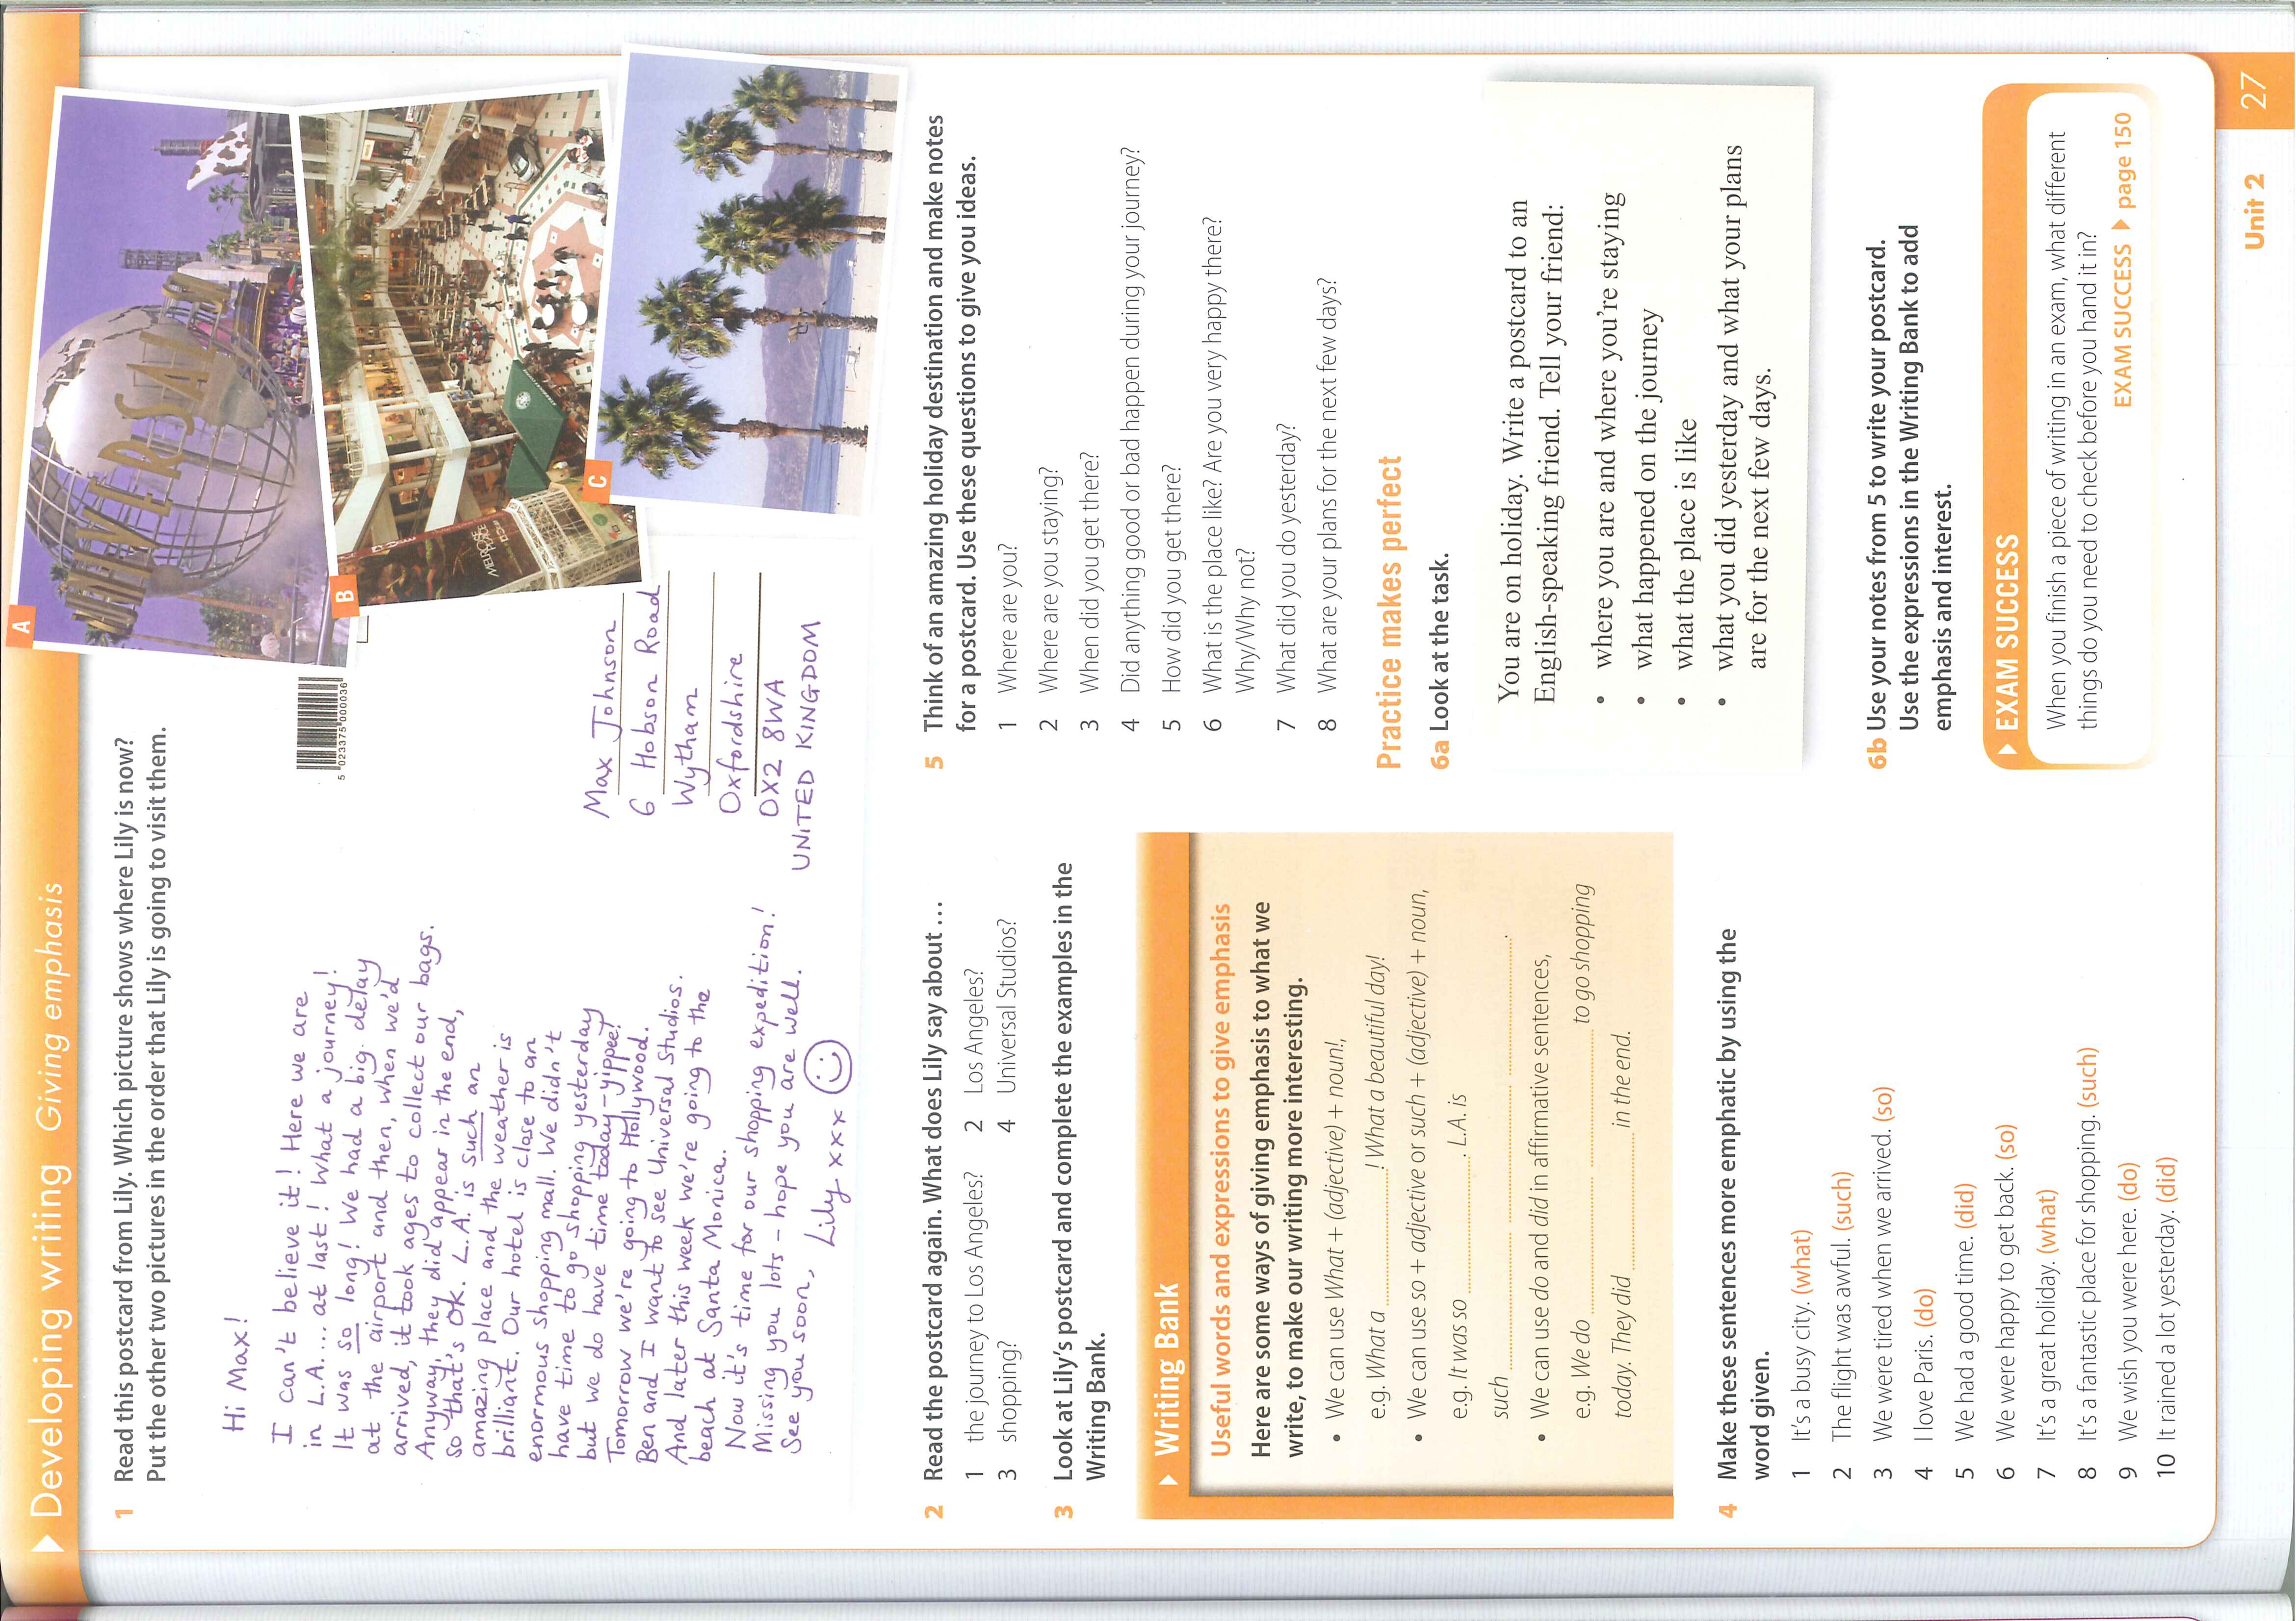
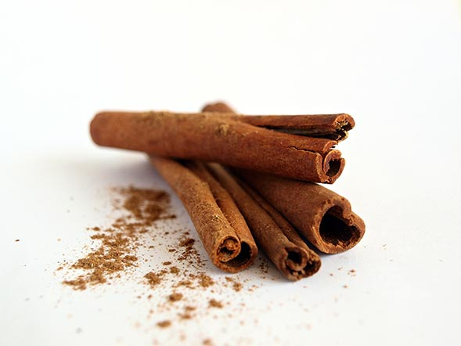
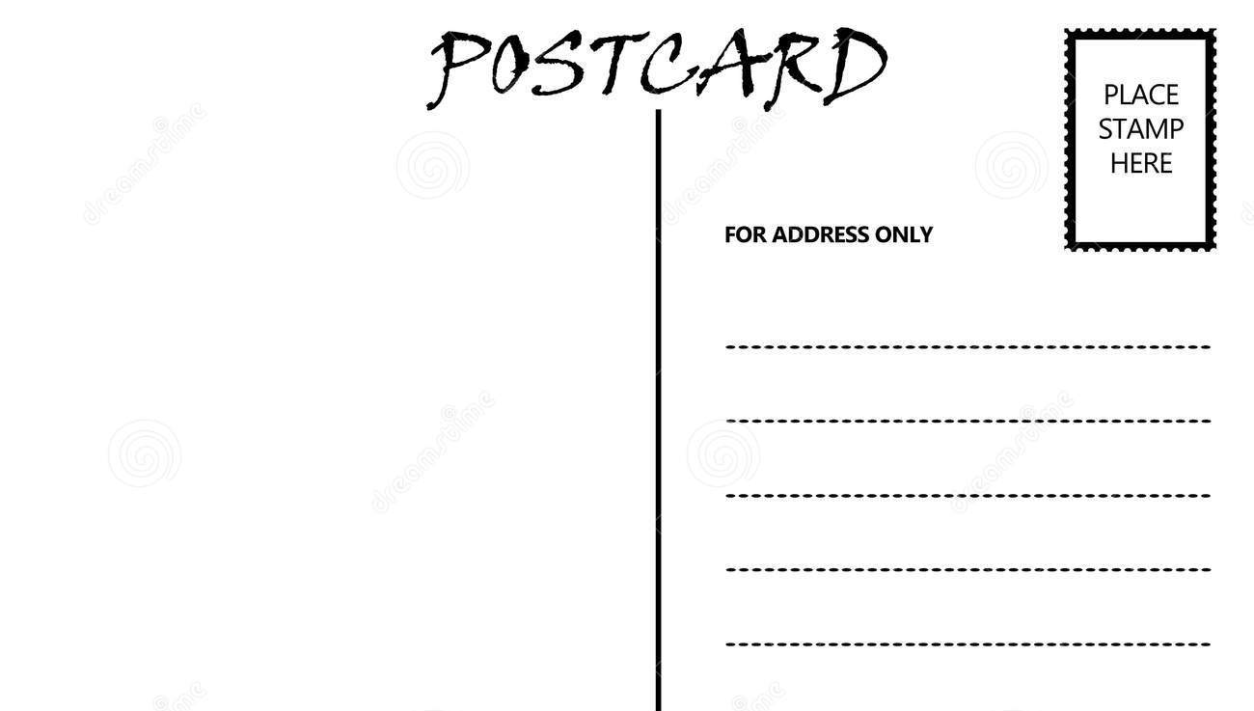

Slide 18

Spice up with
www.englishbookingeorgia.com

