Slide 1
PLAIN COVER
Use this cover where you do not want to use and image. Add the Macmillan Education logo and a single sub brand or lock up to the base logo strip as required
Sizzlıng grammar; embracıng change and teachıng wıth spark
Sarah Oskay
July 2016

Slide 2
First thoughts of grammar?

Slide 3
English grammar can affect us at any time!

Slide 4
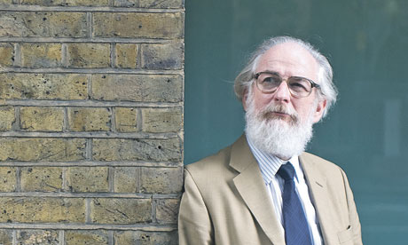
At the very least…grammar is still popular!
David Crystal gave a plenary session at IATEFL (2016) and said
''The most difficult jobs in the world are language-related jobs.'‘
Grammatically speaking: What has changed?
1. The frequency of certain modal verbs is declining, such as shall, must and may, both in spoken and written English (especially in American English), in all text categories, and have been replaced by semi-modals, such as have to, be going to, want to = hafta, gonna, wanna (colloquially)
2. The progressive aspect is on the increase, e.g. I'm lovin' it.
Stative verbs have been used dynamically, once only in simple form (I'm needing a new coat, I'm wanting a new fridge, It's mattering to me greatly, I'm knowing the answer);
3. Change in the use of relative pronouns - that and which. That is used much more than which, and the use of which is greatly decreasing.

Slide 5
Why do we need grammar?

Slide 6
Aim of grammar should be to help us to….?
Connect and communicate….

Slide 7
What are your concerns about teachıng grammar?

Slide 8
How I feel about grammar…..

Slide 9
Grammar Lesson?

Slide 10
What are the positive things about teaching grammar?

Slide 11
On the positive side….
A child who has developed early grammar skills in his or her first language will find it easier to develop those same skills in English

Slide 12
What kind of things are primary children most stimulated by?
Let’s try to use characteristics of a primary student to make our grammar lessons more sucessful and fun…
Let’s think how we can add aspects of this into the lesson…

Slide 13
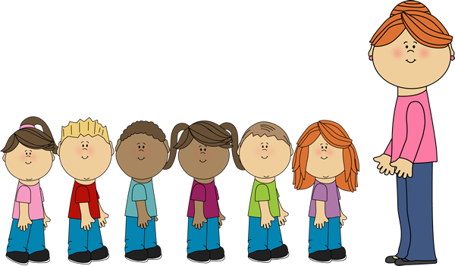
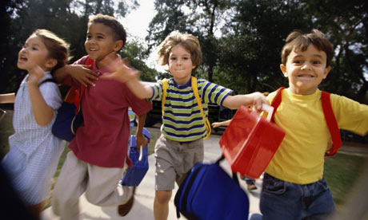
Typical primary school student

Slide 14
How can we add some of these characteristics into the lesson?
Have some activities that are not teacher centred, that can be done in small groups or pairs, rather than as a whole class (independent, fun)
Have some of the more repetitive (yet important) practise activities done as teams. Allow children to choose a team name.(competitive, exciting)
Exploit the aspects of the lesson that will be most appealing to this age group (so for example; it is more likely that the students will be interested in sports as opposed to food types) (interests/hobbies).

Slide 15
Let’s play!
You can create some simple games to play and encourage and support grammar teaching
Provide outlines of games that can be used over and over and provide updates of grammatical points that can be used with the games. The games can be very basic with repeated questions and answers.
It could be a game to play with picture or word cards, such as concentration/pairs or using traditional board games such as snakes and ladders. As the child advances, activities could include slightly more complex board games for practising.

Slide 16
Board games to review grammar

Slide 17
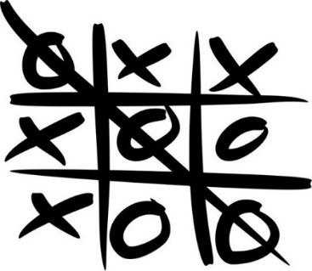
Noughts and Crosses
Tic Tac Toe is another versatile game, one that can be adapted to suit a wide variety of needs. What you need to decide first is which grammar your students need to review for the test.
Then, write the topics on nine index cards or large enough pieces of paper. Arrange the cards face down on a table or stick them on the board, in the classic Tic Tac Toe 3 x 3 grid.
Next, teams take turns choosing a square (you can add letters across and numbers down to make it easier to call out the squares).
You turn over the card and reveal to your students the tense/structure/grammar point written on it. Students must then either provide an example or ask a question that another team member must answer correctly to get their X or O on that square. Of course, the first team that gets three Xs or Os across, down or diagonally wins.

Slide 18
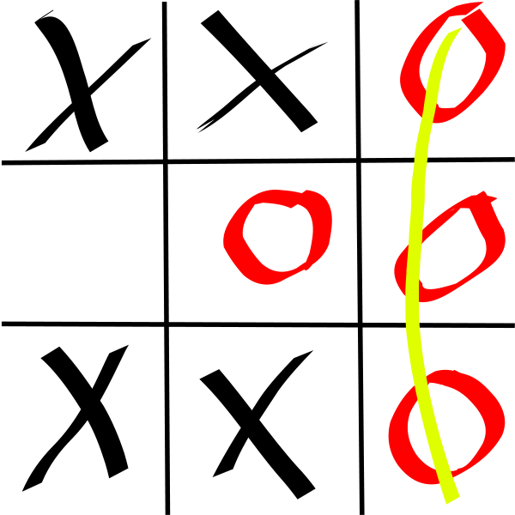
Tell me the opposite….

Slide 19
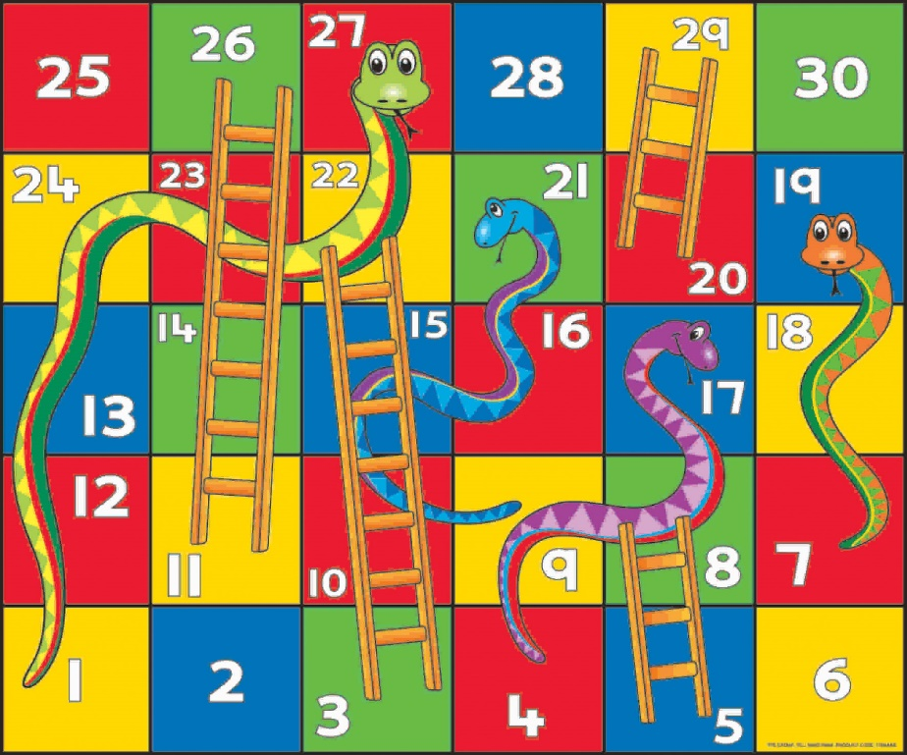
Snakes and Ladders
1. Talk about your hometown.
2. Talk about your family.
3. What time is it?
4. What's your favorite kind of weather?
5. Introduce yourself.
6. Introduce a classmate.
7. What do you do in your free time?
8. When is your birthday?
9. How do you spell your last name?
10. Say the alphabet.
11. Which sports are popular in your country?
12. What's your name?
13. What country do you want to visit?
14. What do you like to do when it rains?

Slide 20
But…how can the teacher check the errors?
The idea is to allow peer correction
Teacher can move around the classroom and check on the groups
Aim is to encourage the students to produce-not everything needs to be corrected

Slide 21
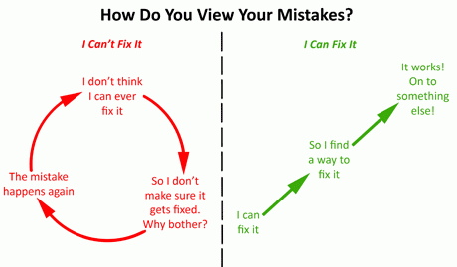
We can change the student’s point of view

Slide 22
Verb/adverb charades

Slide 23
Verb list
argue | attack | carry | celebrate
clean | climb | count | cry
cut | dig | drink | drive
drop | eat | enjoy | examine
fall | fight | fold | grab
jump | kick | kiss | knock
laugh | lead | leave | listen
open | paint | perform | play
point | pray | run | scream
search | shout | shake | shut
sing | sleep | speak | step
study | sweep | talk | taste
teach | think | threaten | throw
touch | walk | wash | wave
wipe | work | worry | write

Slide 24
Adverbs
accidentally | angrily | anxiously | badly
blindly | bravely | briefly | busily
calmly | carelessly | cautiously | courageously
doubtfully | easily | elegantly | enthusiastically
fiercely | foolishly | frantically | gently
gladly | gracefully | greedily | happily
hastily | hungrily | innocently | inquisitively
lazily | loudly | madly | merrily
mysteriously | neatly | nervously | noisily
obnoxiously | politely | quickly | quietly
rapidly | recklessly | reluctantly | rudely
sadly | selfishly | seriously | shyly
silently | sleepily | slowly | solemnly
speedily | suspiciously | swiftly | thoughtfully
victoriously | violently | wearily | wildly

Slide 25
Choose one of each…..
Act it out!
attack
climb
dig
eat
fight
kick
lead
paint
pray
shout
sleep
hungrily
loudly
neatly
politely
recklessly
selfishly
sleepily
suspiciously
violently

Slide 26
MadLibs (or Tall tales)

Slide 27
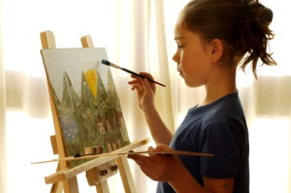
Self portraits!

Slide 28
Understand grammar for a purpose: Draw!
"Draw a rocket ship. Colour the top of the rocket ship one color. Color the rest of the rocket ship another color. Draw fire coming out of the back of rocket ship. Put ten stars in the sky. Make a moon in the sky. Draw a face on the moon."

Slide 30
Ideas for grammar songs
http://www.tefltunes.com/grammarsongs.aspx
http://www.fluentu.com/english/
https://www.britishcouncil.org/voices-magazine/how-use-songs-english-language-classroom
Songs for teaching present simple | Eric Clapton / Wonderful Tonight (lyrics) The Beatles / She Loves You (lyrics) Bette Middler / From A Distance (lyrics)
Songs for teaching present continuous | Fool's Garden / Lemon Tree (lyrics) Rod Stewart / Sailing (lyrics) Suzanne Vega / Tom's Diner (lyrics)
Songs for teaching past simple | The Beatles / Yellow Submarine (lyrics) Gloria Gaynor / I Will Survive (lyrics) Celine Dion / Because You Loved Me (lyrics)
Songs for teaching past continuous | John Lennon / Jealous Guy (lyrics) Oasis / Champagne Supernova (lyrics) Aerosmith / Cryin'
Songs for teaching present perfect | Michael Buble / Haven't Met You Yet (lyrics) U2 / Still Haven't Found What I'm Looking For (lyrics) Chris de Burgh / Lady In Red (lyrics) Sinead O'Connor / Nothing Compares To You (lyrics) Queen / We Are The Champions
Songs for teaching present perfect continuous | Anastacia / Left Outside Alone (lyrics) Led Zeppelin / Since I've Been Loving You (lyrics) Foreigner / Waiting For A Girl Like You (lyrics)

Slide 31
Grammar songs….

Slide 32
Let us try to think of a song/rap
happy
English book
smile
learn
rain
verb
action word

Slide 33
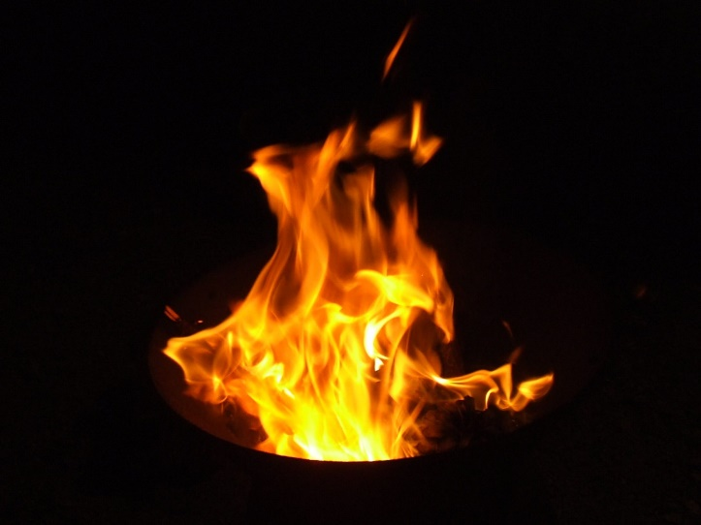
Nonsense rhyme….
English Book is worth a look
If there is rain, we have no pain
We are happy and so clappy
When we use actions words
Which are really verbs
It makes us smile all the while
Our brains will burn while we learn!

Slide 34
The child as peer teacher
It is very empowering for a child to take on the role of the teacher. The child can ‘teach’ simple grammar to peers.
You can also systematically give them grammar to take home– teaching or telling specific things to specific people.
A favourite activity to recall grammar is for the children in groups to teach the class to sing a song in English.
Children will enjoy this process and it will do wonders for consolidation.
As you already know, there’s nothing like having to teach something to make you learn it!

Slide 35
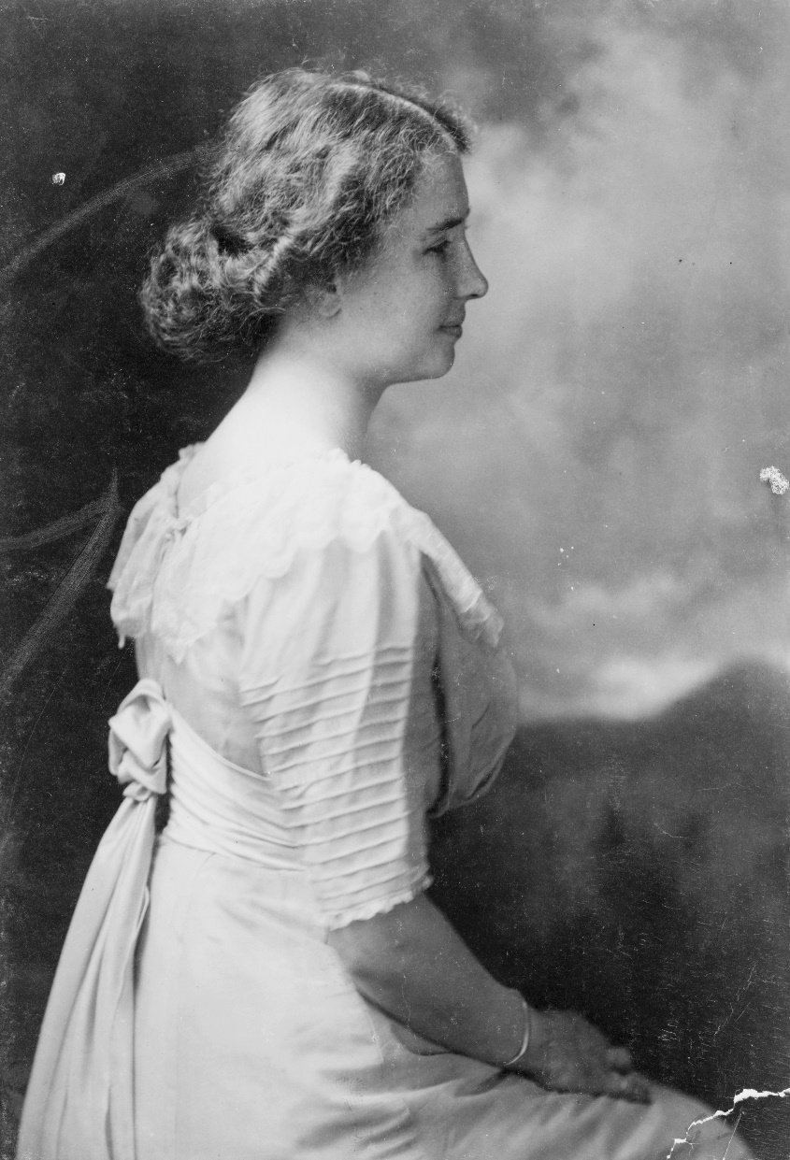
Self discovery with «mentor texts»
Find a text with examples of the grammar rule that you want to teach

Slide 36
The Story of Helen Keller: The Girl Who Could Not See, Hear or Speak
I’d like you to know the story of Helen Keller, who could neither see nor hear from the time she was a baby. Yet the brilliant girl was able to overcome all those handicaps, to graduate from college with honors and become a useful citizen. I must say there was nothing wrong with Helen Keller when she was born. Her father and mother were very proud of their pretty baby, who tried to say “pa-pa” and “ma-ma”. For nineteen months Helen grew bigger and stronger. She was able to walk when she was a year old and she could say a few words. But one day the child fell ill. She must have been very ill. For days she was laid up with a high fever and soon the parents learned that their infant would never be able to see and hear. The little child was now doomed to a life of silence and darkness. She could not hear what was said to her and did not know how to talk, she was unable to play with other children. When Helen was 6 years old her parents took her to Baltimore and then to Washington to famous doctors to find out if they could do something to make her hear and see again, but the doctors could do nothing. The child was hopelessly deaf. Dr. Bell said the Kellers should address the Perkins Institution for the blind in Boston and ask if they could send someone to help the child.

Slide 37
Get the students to find the grammatical points that you want to teach
The Story of Helen Keller, The Girl Who Could Not See, Hear or Speak
I’d like you to know the story of Helen Keller, who could neither see nor hear from the time she was a baby. Yet the brilliant girl was able to overcome all those handicaps, to graduate from a college with honors and become a useful citizen. I must say there was nothing wrong with Helen Keller when she was born. Her father and mother were very proud of their pretty baby, who tried to say “pa-pa” and “ma-ma”. For nineteen months Helen grew bigger and stronger. She was able to walk when she was a year old and she could say a few words. But one day the child fell ill. She must have been very ill. For days she was laid up with a high fever and soon the parents learned that their infant would never be able to see and hear. The little child was now doomed to a life of silence and darkness. She could not hear what was said to her and did not know how to talk, she was unable to play with other children. When Helen was 6 years old her parents took her to Baltimore and then to Washington to famous doctors to find out if they could do something to make her hear and see again, but the doctors could do nothing. The child was hopelessly deaf. Dr. Bell said the Kellers should address the Perkins Institution for the blind in Boston and ask if they could send someone to help the child.

Slide 38
Think of the rule….
Modals are often used to talk about abilities and possibilities or lack of them.
Some of the words you want to focus on in this section are can,could, may, and might.

Slide 39
Provide examples
Talk to your students about things they can do. We use «can»…..
Next you should talk about might because it is also commonly used when talking about present possibilities such as “We can’t play music in class because the other classes might be taking tests.” which nicely combines the two words in one sentence.
Building upon that, talk about how could and may are used to discuss future abilities and possibilities and also how could can be used to talk about the past in a sentence such as “When I was a child, I could climb trees

Slide 40
Practice…

Slide 41
Be Teachers:Correct Mistakes!

Slide 42
Correct!
Work sheet #1 -- What's Up? On Sunday morning, I sat down to breakfast with my mother. "You know, there's/there is something I've been thinking about," I told her. "I've been thinking about how much trouble one little word can cause." "What are you talking about?" my mother asked. "Well, think about it," I said. "It's easy to understand the word up when it means toward the sky or at the top of the list, but why do we wake up in the morning? In school, why does a topic come up? Why do I have to read up on the Civil War? Why is it up to me to remember to do my homework?" "I see what you mean," my mother said. "I just was reading that the mayor is up for election. When I get to work, I have to write up a report." "We call up our friends; we warm up the leftovers; and we clean up the kitchen," I laughed.[delete end quotation mark that was after laughed."] "We lock up the house. I hate getting dressed up. We open up a drain that is stopped up. It clouds up, then it clears up. Then we fix up the old car." "You sound really fed up," my mother chuckled. "Or are you just mixed up?" "I looked up the word up in Webster's Dictionary and it took up awhole column!" I said, almost ready to lose it. "I think it's time to speak up!" "Don't go and stir up trouble," my mother said. "You don't want to wind up with a bigger problem, do you?" "You're right," I said. "All this thinking has really helped me work up an appetite though. May I have some more eggs?" "Coming right up!" my mother said.
Work sheet #2 - Cold Water Clean

Slide 43
Don’t answer back!
1. Are you English? 2. Where are you from? 3. What colour are your eyes? 4. How many people are there in your family? 5. What's the weather like today? 6. What time do you have lunch? 7. How often do you go to the cinema? 8. What are you doing? 9. When were you born? 10. Have you ever been to England?
http://www.onestopenglish.com/community/lesson-share/extras/grammar/grammar-activities-dont-answer-back/145282.article

Slide 44
The Word game
Materials needed: none.
Divide the class into 2 or 3 equal groups.
Ask one player from the first group to come to the front of the class and sit facing his/her team with his/her back to the board.
Write a word on the board.
Tell the team that they can give the player hints about the word.
Give the player a point if he/she can guess the word within one minute (longer or shorter depending on the class level).
Additional rules:
The team must not say any part of the word that is written on the board.
The team can not use actions.

Slide 45
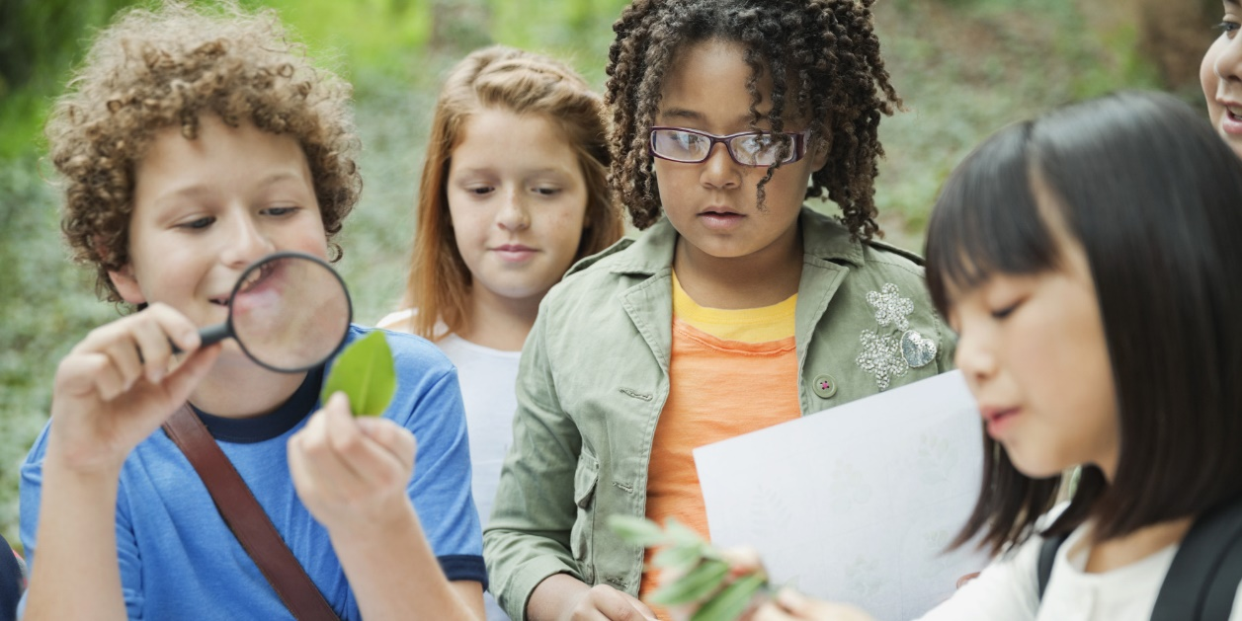
How can grammar be made even more exciting?
We all know that most learning goes on outside the classroom.
So grammar should be made relevant to students
Focus on their interests and embrace their way of learning!

Slide 46
Use the internet….
http://www.anglomaniacy.pl/
http://busyteacher.org/
http://learnenglishkids.britishcouncil.org/en/
https://www.pinterest.com/explore/mad-libs/

Slide 47
What are your suggestions?
Over to you…..

Slide 48
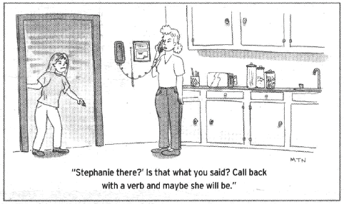
Sizzling Grammar…..

Slide 49
To sum up: As teachers

Slide 50
Remember…..

Slide 51
Thank you for listening!

Slide 52
BACK PAGE
Please add the Macmillan Education logo and any additional logos to the logo strip at the bottom of this page as required.
Sarah Oskay
soskay@Superonline.com

