Slide 1
Teacher Training Conference
July 2016

Slide 2
IMPROVE THEIR LISTENING SKILLS
Daniela Clarke
Daniela Clarke

Slide 3
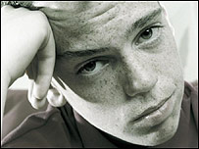
The LISTENING PROCESS
While listening in English, Giorgi is ...
Coping with speaker‘s accent
Predicting what might be said
Coping with speed and volume
Processing messages as they come
Focusing on questions to answer
Identifying relevant points
Giorgi
Guessing at unknown lexis
Coping with grammar, lexis and pronunciation used by speaker
Rejecting irrelevant information

Slide 4
Before they listen
Whilst they listen
After they listen

Slide 5
Before they listen

Slide 7
Preteach
relevant language

Slide 8
Personalise the topic
Activate existing knowledge

Slide 9
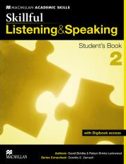
Make predictions

Slide 10
While they listen

Slide 11
Global listening
Close listening

Slide 12
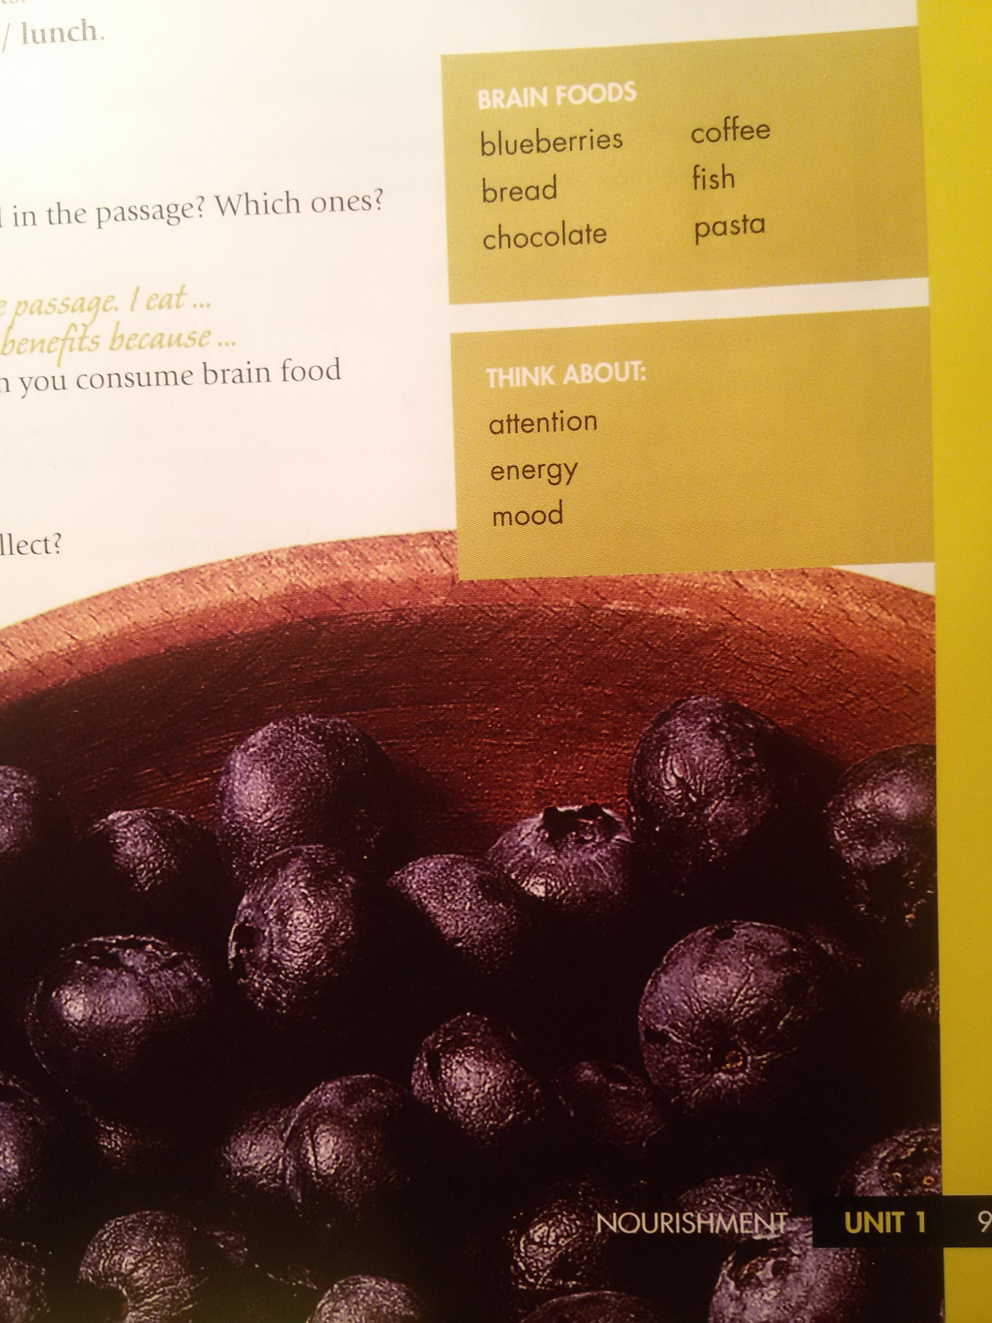
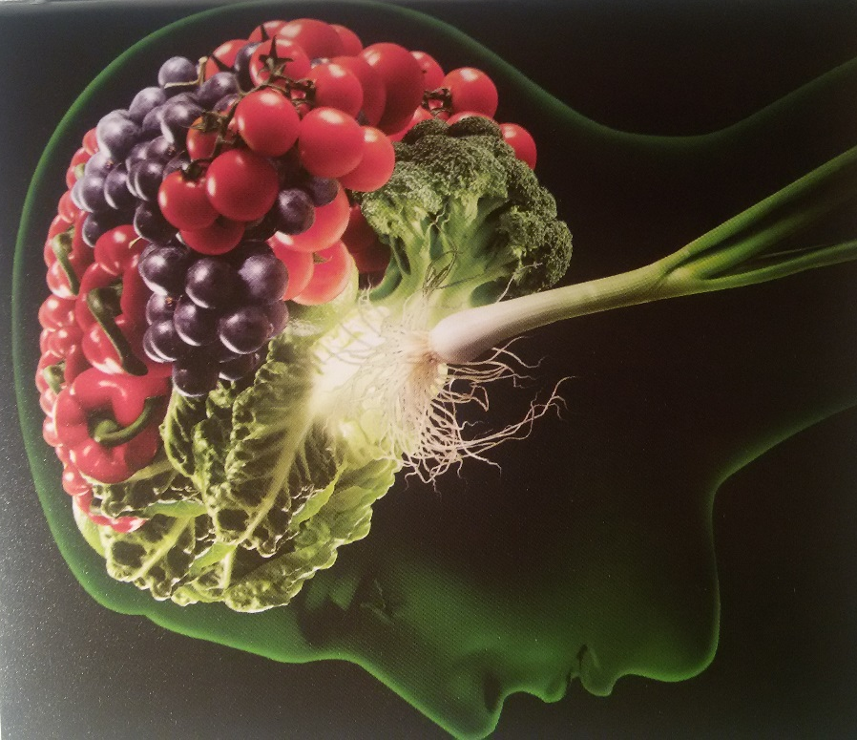

Slide 13
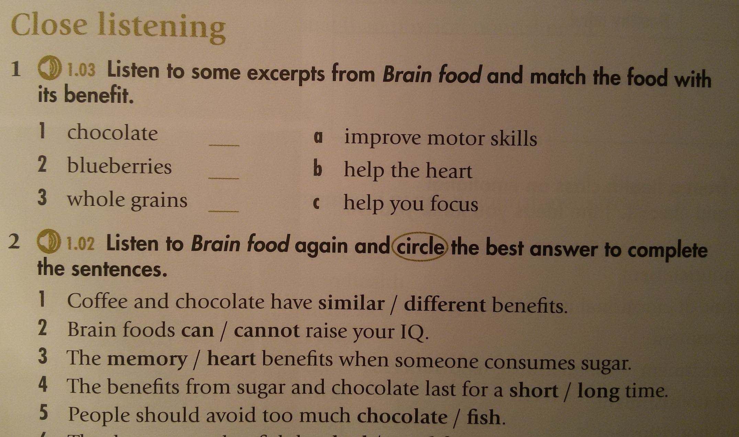
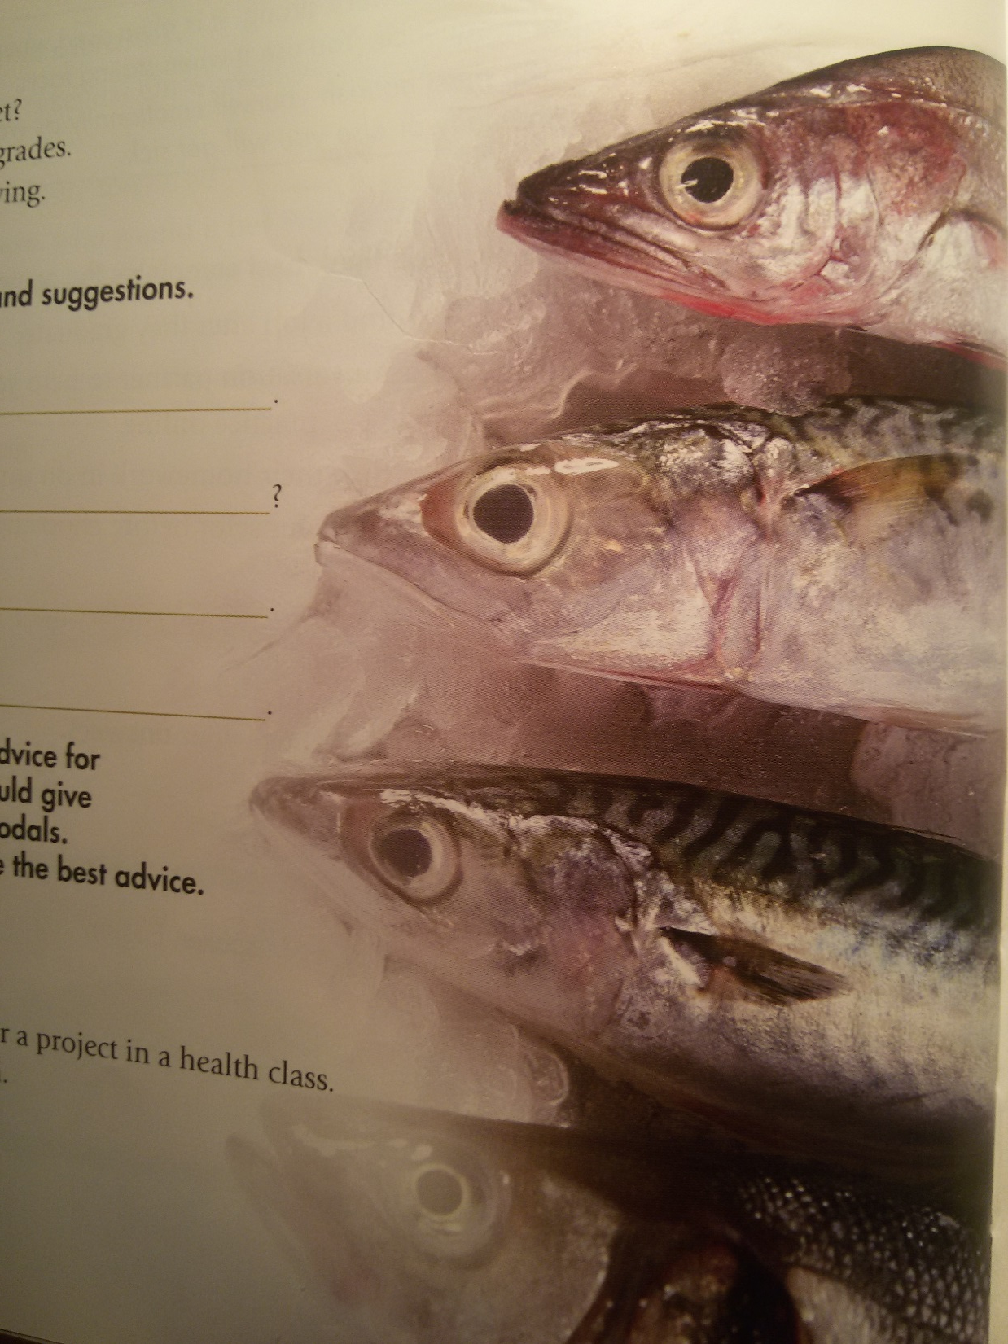

Slide 14
After they listen

Slide 16
How can I help?
SPEAKING: Accuracy
Martina
Promoting fuenc
Work in pairs.
A: Close your eyes. Listen to B and visualise what they are describing.
B: Describe the photos in as much detail as possible.

