Slide 1
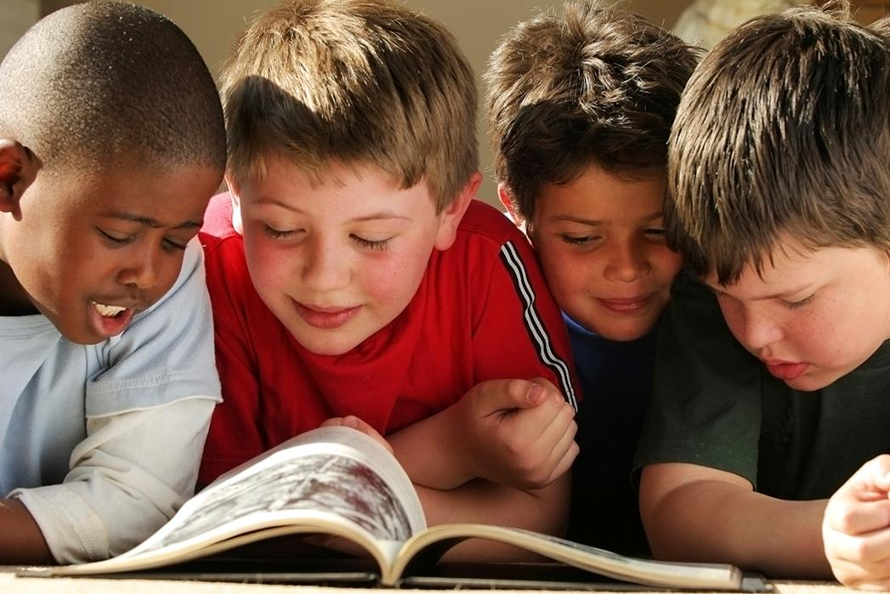
How to enhance reading and learning through games and activities
Macmillan Education

Slide 2
Change your place if……..

Slide 3
Warmer: Anagram
How many words can you make out of
‘Macmillan English’?
Notes:
10 minutes

Slide 4
Warmer: Anagram
How many words can you make out of Macmillan English?
malls machining clamshell mining naming elms small mechanism gall nag mini man scheming leaching clashing mine mill lame mans mens chilling mane mean meal male lamas males meals shell shelling inhaling cling clam clam smell lilac call icing chiming changes chase inching change malls lane lean gill name camel clam gleam game inn main
Notes:
10 minutes

Slide 5
Pre reading 1
Feathers
Beautiful
Swift footed
Plumage
Avistruthius
flightless

Slide 6
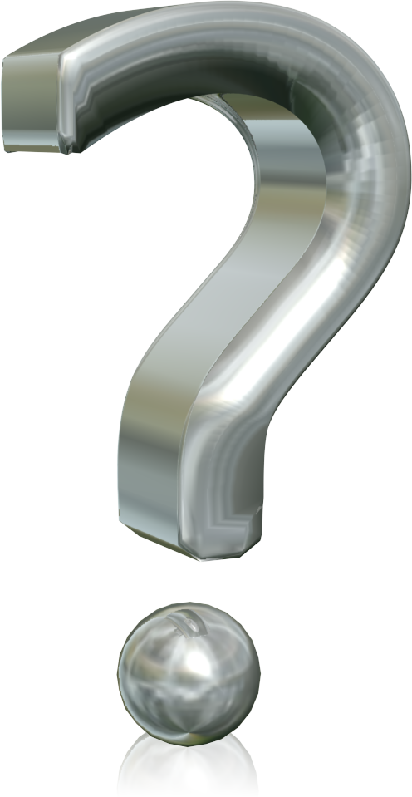
Pre reading 2
ostrich
biggest
Small
İntelligent
Dangerous
Teeth
eggs

Slide 7
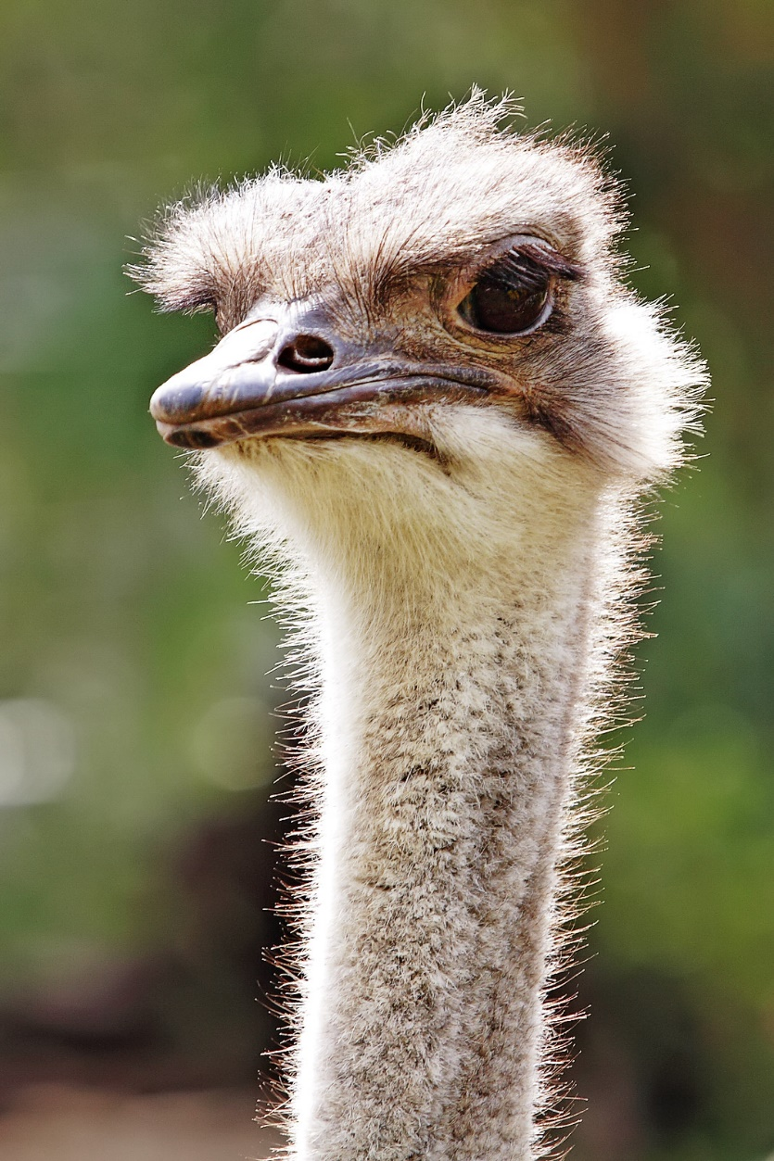
How to enhance reading through games and activities - The Amazing Ostrich

Slide 8
How to enhance reading through games and activities - The Amazing Ostrich
1. How high do ostriches grow?
2. How fast can ostriches run?
3. How many toes does an ostrich foot have?
4. What colour feathers does a male ostrich have?
5. What colour feathers does a female ostrich have?
6. Is the ostrich an intelligent bird?
7. Why are ostriches dangerous?
8. Why do ostriches eat small stones?
9. How many stomachs does an ostrich have?
10. Who sells the skin, feathers and eggs of ostriches?
11. How many eggs do female ostriches produce in a year?
12. How much does an average ostrich egg weigh?
13. What did someone write on an ostrich egg 500 years ago?
14. Who rode an ostrich 2,300 years ago in Ancient Egypt?
15. Where do people ride ostriches?
16. How long do ostriches live for?
17. When did ostriches in the Middle East die?
Notes:
30 mins with reflection
I’m going to put some questions on the board but I only want you to read them. When I give you the reading passage, I juts read through as individuals (remove questions from the board). Only answer questions in bold on your sheet; the letter on your reading passage should correspond with the letter on your answer sheet.
Then talk to the people on your table and swap answers with one another.
reorder to make it easier so questions are in order of text.
high level group would answer all the questions
all have same answer table, but with their respective answers highlighted in BLUE
abcd with triangles, abcd with flowers get together, fill in their answer tables
(can put all a’s, b’s, c’s together to share their answers)

Slide 9
The Amazing Ostrich
A & B Answers
1. How high do ostriches grow? | 2.5 metres
2. How fast can ostriches run? | 70 kilometres per hour
3. How many toes does an ostrich foot have? | two
4. What colour feathers does a male ostrich have? | black
5. What colour feathers does a female ostrich have? | brown
6. Is the ostrich an intelligent bird? | no
7. Why are ostriches dangerous? | They bite and kick
8. Why do ostriches eat small stones? | to break up their food

Slide 10
The Amazing Ostrich
C & D Answers
9. How many stomachs does an ostrich have? | three
10. Who sells the skin, feathers and eggs of ostriches? | farmers
11. How many eggs do female ostriches produce in a year? | 40-50 eggs
12. How much does an average ostrich egg weigh? | 1.5 kilograms
13. What did someone write on an ostrich egg 500 years ago? | Arabic poetry
14. Who rode an ostrich 2,300 years ago in Ancient Egypt? | Queen Arsinoe
15. Where do people ride ostriches? | South Africa & USA
16. How long do ostriches live for? | up to 75 years
17. When did ostriches in the Middle East die? | in the middle of the twentieth century

Slide 11
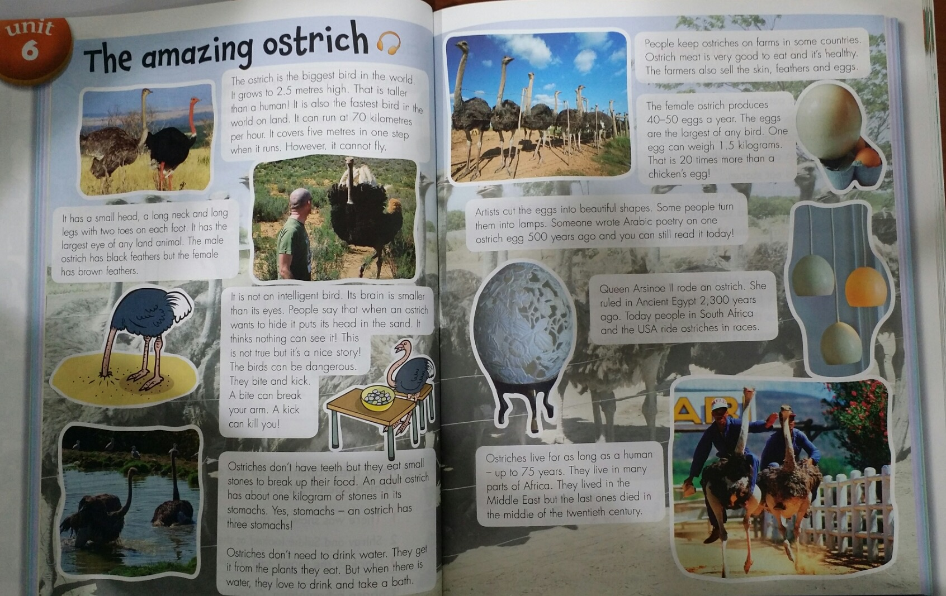
The Amazing Ostrich

Slide 12
Reflection Jigsaw reading
• What skill(s) are students developing?
• What was the interaction pattern? (pw, gw, whole class etc)
• Could you use this activity in your class? why/ why not?
Notes:
How could you differentiate this activity? Higher level students would answer all of the questions; you could give lower level students shorter reading passages. i.e. you could give them the small paragraph in C.
You could have them discuss their answers together as a group before feeding back to the class. i.e. all As sit together.

Slide 13
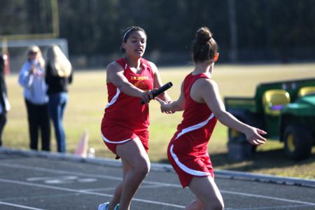
Running dictation
Objective of the activity is to get the text from the wall into your notebooks as fast as you can.
Class works in pairs
Person A runs to paper, remembers sentences 1 and 2, runs back and dictates to Person B who writes them down. Now Person B runs to the paper, and so on.
Notes:
20 minutes
Please get into pairs: person A and person B
Person A runs for first 2 sentences, reads and then comes back to dictate to Person B who writes as person A dictates. swap over: Person B runs for the next 2 sentences.
Dictations integrate listening, speaking, reading and writing skills and help develop a child’s memory.
Pairs swap with each other and correct spelling, grammar etc.
Say who uses this is class? Listen to me and decide if true or false?: ‘running dictations test reading comprehension skills.’ true or false.
They are doing basic coding and decoding skills. You’re right, running dictation is not developing reading comprehension skills. How do we know students understand what they’ve read?
They’re working on pronunciation but not really working on reading comprehension skills. Spelling is covered too.
We can aid reading comprehension by asking 3 questions. Ask students to come up with 3 comprehension questions. What questions could you make to make sure that your students are understanding the text?
e.g. Where do the Bedouin people live? Where do Bedouin people travel? How to Bedouin people hunt? Why do the Bedouin keep falcons?
Running dictations provide a framework for encouraging children to collaborate, listen to each other and take turns.
You can use different texts if students are likely to copy each other

Slide 14
The animal from the box was small, dark and furry
It had fingers and toes.
It looked like a little bear.
It looked frightened, too.
At first, Tim and Emma were afraid.
‘Where am I?’ said the animal.
The children were too scared to answer
The animal stretched its arms.
He did a little jump. Then he smiled.
‘At last I’m out of that box,’ he said.

Slide 15
Reflection Running dictation
• What skill(s) are students developing?
• What was the interaction pattern? (pw, gw, whole class etc)
• Could you use this activity in your class? why/ why not?

Slide 16
Suggestions for another activity?
The animal from the box was small, dark and furry
It had fingers and toes.
It looked like a little bear.
It looked frightened, too.
At first, Tim and Emma were afraid.
‘Where am I?’ said the animal.
The children were too scared to answer
The animal stretched its arms.
He did a little jump. Then he smiled.
‘At last I’m out of that box,’ he said.
Notes:
QUESTIONS
ADD AN EXTRA SENTENCE

Slide 17
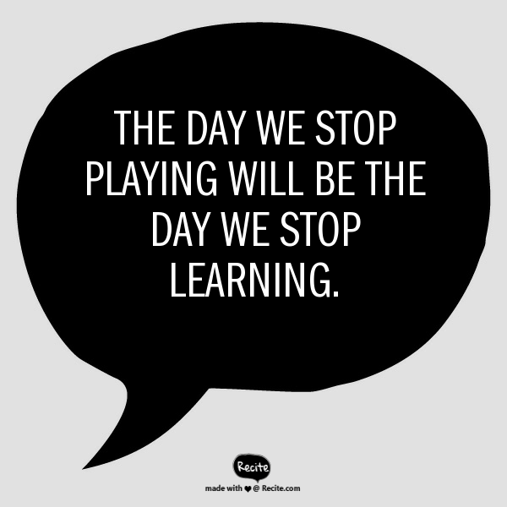
An activity-based Approach
COVER INSERT IMAGE SHORT
Images on this page layout can be updated. To update the image you will need to click on the ‘picture icon’, please follow the instructions below.
To update the image:
Click on the picture icon; or
if there is an existing image, right click on the image and select ‘change picture’
Go to the location where the selected image is saved
Select the image
Please note all images should be: 27.5cm x 19.05cm
If the image does not fit, ensure you keep the dimensions as above otherwise the image will appear stretched and distorted
If the image is sitting over the header banner – Right click on new image and select ‘send to back’
LOGO STRIP SHORT
Use this cover where you want to insert your own image and where you want to use the Macmillan Education logo. The space at the bottom has room for one additional imprint or sub brand or where you want to use the Language Learning lock up. These are available to copy and paste from the pages at the back of this templates.

Slide 18
What is a dictagloss?
A classroom dictation activity where learners reconstruct a short text by
listening and noting down keywords

Slide 19
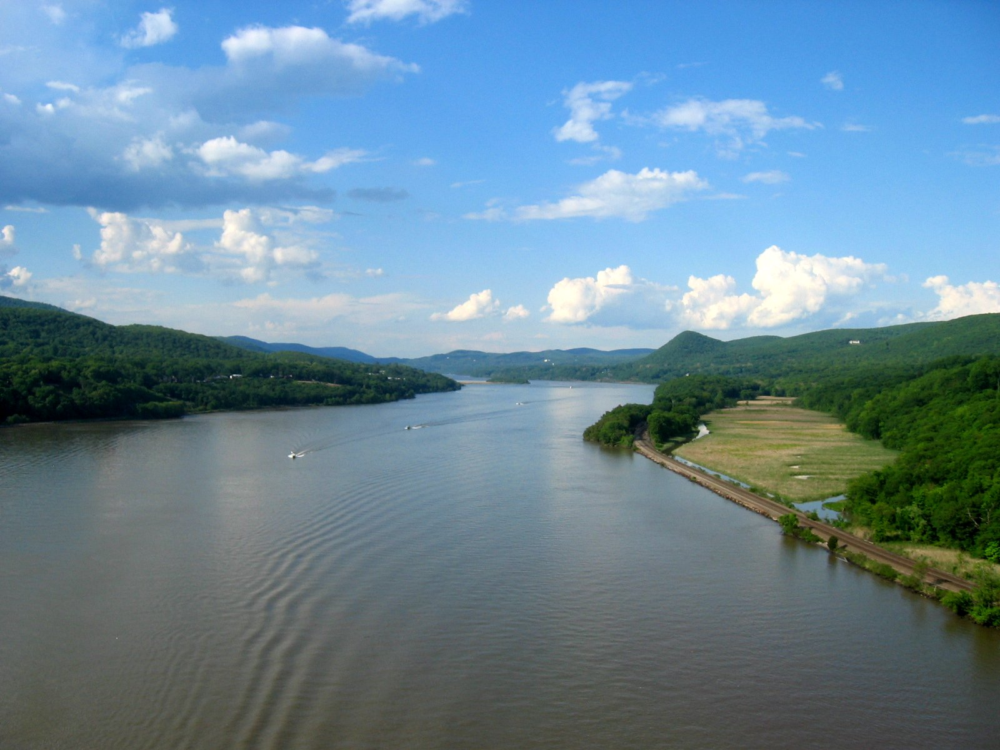
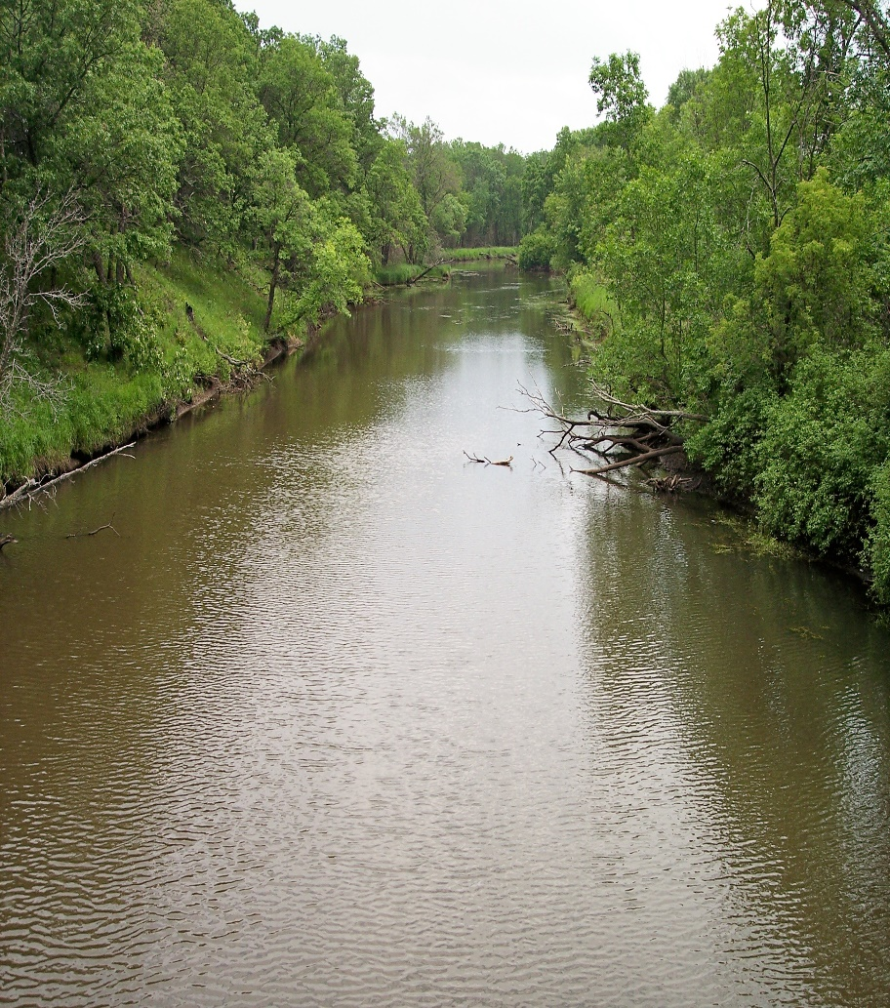
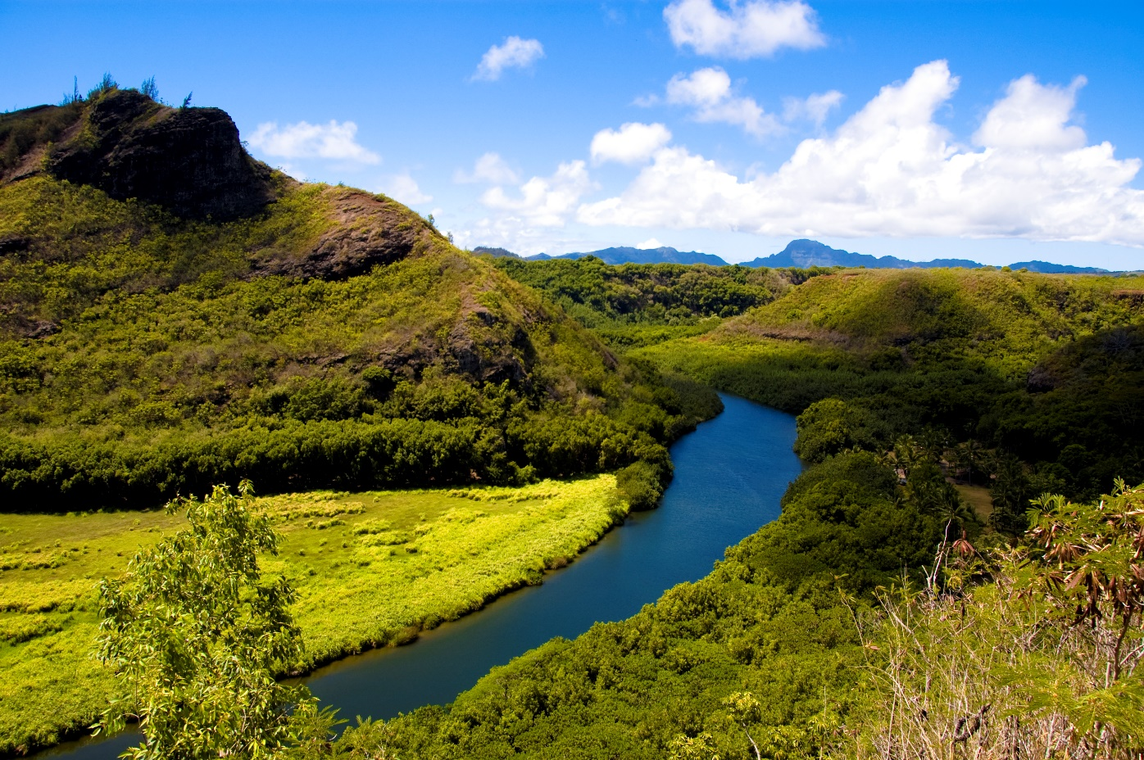
Prepare for the dictogloss The River

Slide 20
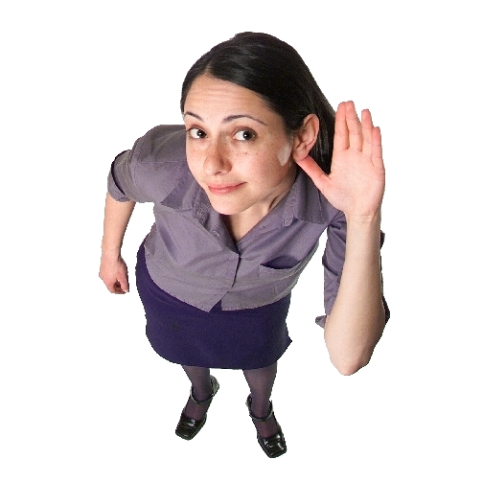
Dictogloss
I’ll read a sentence to you three times.
First time, simply listening
Second time, key words
Third time, add any more key words you can remember .
Notes:
10 mins
I’m going to read a small paragraph three times to you all as individuals. After this, you’ll be working in groups of 3.
The first time, just sit and listen
the second time, write key words from the paragraph. Are you going to write down every word? No, just the key words
the third time, listen again and add any more key words. get into groups of 3 and write a paragraph per group using the words you’ve noted down. Then I’ll put the paragraph up on the board and we can compare which was most accurate.
I’m not going to read slowly - the point is that you feel rushed. Pre-empt what they’ll do - you’ll switch off but I want you to concentrate as much as you can.
Illicit from each group to see how similar their paragraph is to the one on the board.
Students must reconstruct meaning; this is an integrated skills activity - listening, spelling, writing

Slide 21
Dictogloss: Animals of the River
Rivers are good habitats for animals. They are home to ducks and many kinds of fish, reptiles, and amphibians such as frogs and newts. In tropical countries, where the climate is warm, there are reptiles such as terrapins and turtles, crocodiles and snakes.
Smaller creatures, such as snails, shrimps, beetles and words, also live in the river. Some insects, such as dragonflies, live in the water for the first stage in their life.
Notes:
Does this activity test reading? To make a dictogloss more of a reading activity:
10 mins each group writes 2 questions for another group about the text. Swap questions and answers each others’

Slide 22
How can we make the dictogloss more of a reading activity?
Notes:
COMPREHENSİON QUESTİONS

Slide 23
Dictogloss: Animals of the River
In tropical countries, is the climate warm? Yes
Do crocodiles and snakes live in warm or cold climates? Warm
Name three small river animals? snails, shrimps, beetles
Which animal lives in the water for the first stage of their life? dragonflies
Name two types of amphibian? frogs and newts

Slide 24
Reflection Dictogloss
• What skill(s) are students developing?
• What was the interaction pattern? (pw, gw, whole class etc)
How is it good for mixed ability classes?
• Could you use this activity in your class? why/ why not?

Slide 25
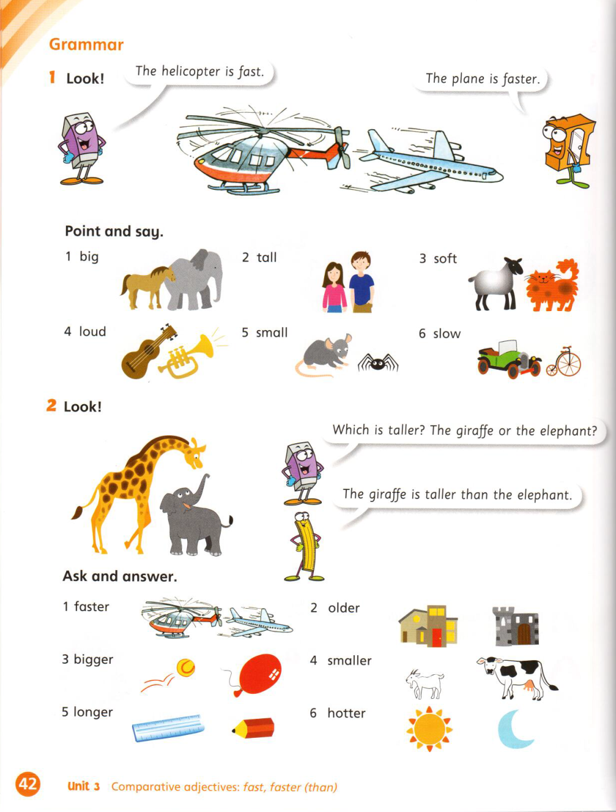
Choose three: English World level 3 Unit 3 p42

Slide 26
Choose three.
A giraffe | is faster than | a dog.
A tiger | is as tall as | a sheep.
A cow | is as loud as | a chicken.
A duck | is softer than | a cat.
A mouse | is as big as | a goat.
A lion | is longer than | a spider.
Macmillan English 3
Unit 4
Notes:
I’m going to think of a combination of three in my mind. You have to guess what I’m thinking and guess. Listen to what other students are saying.

Slide 27
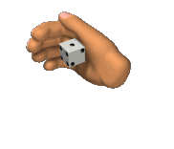
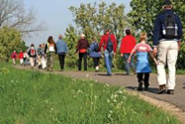
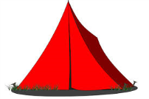
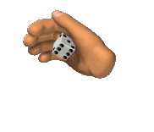
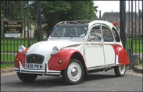
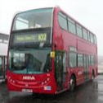
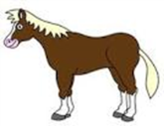
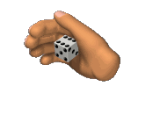
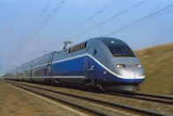
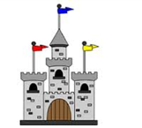
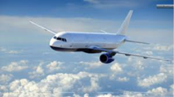
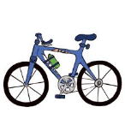
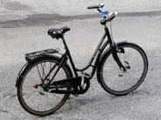
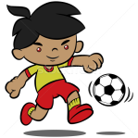
Read, speak and write.
When? | Where? | Who with? | How? | To do what? | Opinion?
On Monday | the beach | my family, |  |  | great!
On Tuesday | Mars | some astronauts, |  |  | wonderful!
On Wednesday | Sagarejo | my school, |  |  | fun!
On Thursday | Rustavi | some vampires, |  |  | scary!
On Friday | Tiblisi | my friends, |  |  | brilliant!
On Saturday | Gori | my teachers, |  |  | boring!
Example: On Tuesday I’m going to go to Mars
with some astronauts, by car. We’re going
to take photos. It’s going to be wonderful!
ME 1
Unit 10
and
ME 2
Unit 2
and
ME 3
Unit 7
and
ME 4
Unit 9
Notes:
What skills are they practising? All four. All language has been learnt already so you’re just revisiting and revising.

Slide 28
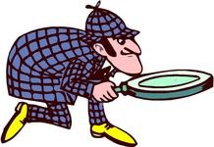
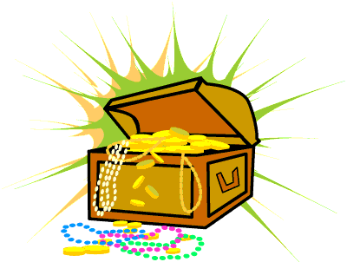
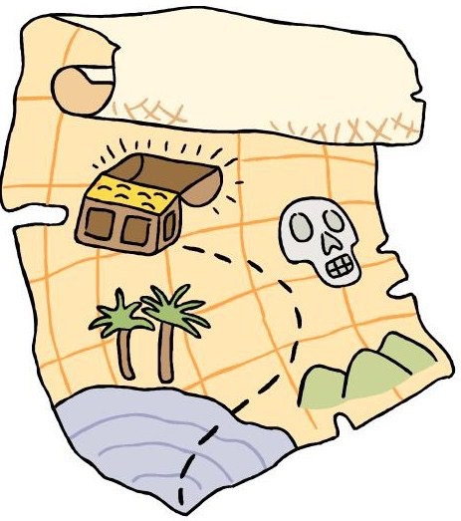
COVER A SHORT STRIP
Use this cover where you are presenting yourself as Macmillan Education without the need for the imprints.
A separate front cover exits with all four imprints included.
If you want to change the image please use the Cover Insert Image page later in this template.
If you want to add one imprint next to Macmillan Education or if you want to use the Higher Education lock up with the logo please cut and paste the options at the back of this deck in to the panel at the bottom being careful to position this correctly.
Treasure Hunt
ASTONISHING ADVENTURES
Can you finish first?

Slide 29
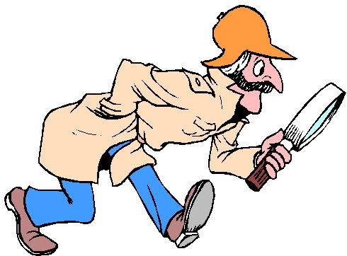
TREASURE HUNT CLUES
In the Contents, how many types of diving job are listed? (number)
When was the modern scuba system invented, during Word War 11 or World War 1? (Answer & page)
What does a marine archaeologist study? (Answer & page)
The book talks about protecting abalone shell. Name one country where abalone shell can be found? (Answer & page)
On which page can I learn about recompression chambers? (page)
On which page can I learn about the hand signals used when diving? Which 3 hand signals are listed? (page)
What is the name of the ship that sank in 1912? (Answer & page)
Could you be a diver? How far do you need to be able to swim? (Answer & page)
On which page can you find the Glossary? (page)
I want to learn about risks and dangers of diving. Which page do I go to? (page)
Notes:
can be used on first day of reading a new book - first time read, coursebook open in new year. competitive, team-work, 21st century skills

Slide 30
ANSWERS
In the Contents, how many types of diving job are listed? Eight jobs
When was the modern scuba system invented, during Word War 11 or World War 1? World War II (page 11)
What does a marine archaeologist study? The remains of sunken ships (page 18)
The book talks about protecting abalone shell. Name one country where abalone shell can be found? California/South Africa/Argentina/Australia (page 15)
On which page can I learn about recompression chambers? Page 7
On which page can I learn about the hand signals used when diving? Which 3 hand signals are listed? page 16, ‘stop, danger and go down’.
What is the name of the ship that sank in 1912? Titanic (page 17)
Could you be a diver? How far do you need to be able to swim? 200 metres page 28
On which page can you find the Glossary? page 29
I want to learn about risks and dangers of diving. Which page do I go to? Page 10
Notes:
can be used on first day of reading a new book - first time read, coursebook open in new year. competitive, team-work, 21st century skills

Slide 31
Macmillan English 4
What does Wordsworth know a lot about?
Where does Soraya live? (page number and answer)
In which unit can you learn about synonyms?
The past continuous is described in Unit 5. True or false? If false which unit is it really described in?
The Reading Extension is found in Language Book 4. T/F
The stimulus: Lions/The Veggy Lion are short story types of text.
The modal verb «should» is found in unit 7
Information on soft g words are found in the spelling section
What will Bernie the Builder help you with?
When does Soraya miss her grandmother most?

Slide 32
Answers
What does Wordsworth know a lot about? (Vocabulary)
Where does Soraya live now? (49, Britain)
In which unit can you learn about synonyms? (7)
The past continuous is described in Unit 5. True or false? If false which unit is it really described in? (F, unit 2)
The Reading Extension is found in Language Book 4. (T)
The stimulus: Lions/The Veggy Lion are short story types of text. (No, poetry).
The modal verb «should» is found in unit 7 (No, unit 5).
Information on soft g words are found in the spelling section (True, unit 6)
What will Bernie the Builder help you with? (grammar)
When does Soraya miss her grandmother most? (at bedtime)

Slide 33
Swap station
Notes:
swap station - write favourite activity that they use how do they use it?
of all the activities that we did today, I want you to think about an activity that you’re going to use in the next two weeks. Speak to the person next to you.

Slide 34
References
500 activities for the primary classroom,’ Carol Read
‘Reading and Young Learners’:
http://www.teachingenglish.org.uk/article/reading-young-learners?utm_source=facebook&utm_medium=social&utm_campaign=bc-teachingenglish

Slide 35
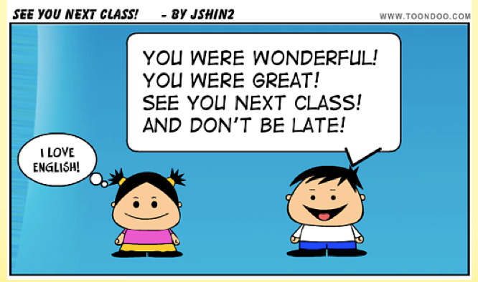
Thank you!
Approach reading with the intention of having fun in the learning process and your intention will be mirrored by your learners. Happy reading!

