Slide 1


Teacher Training Conference
July 2016

Slide 2
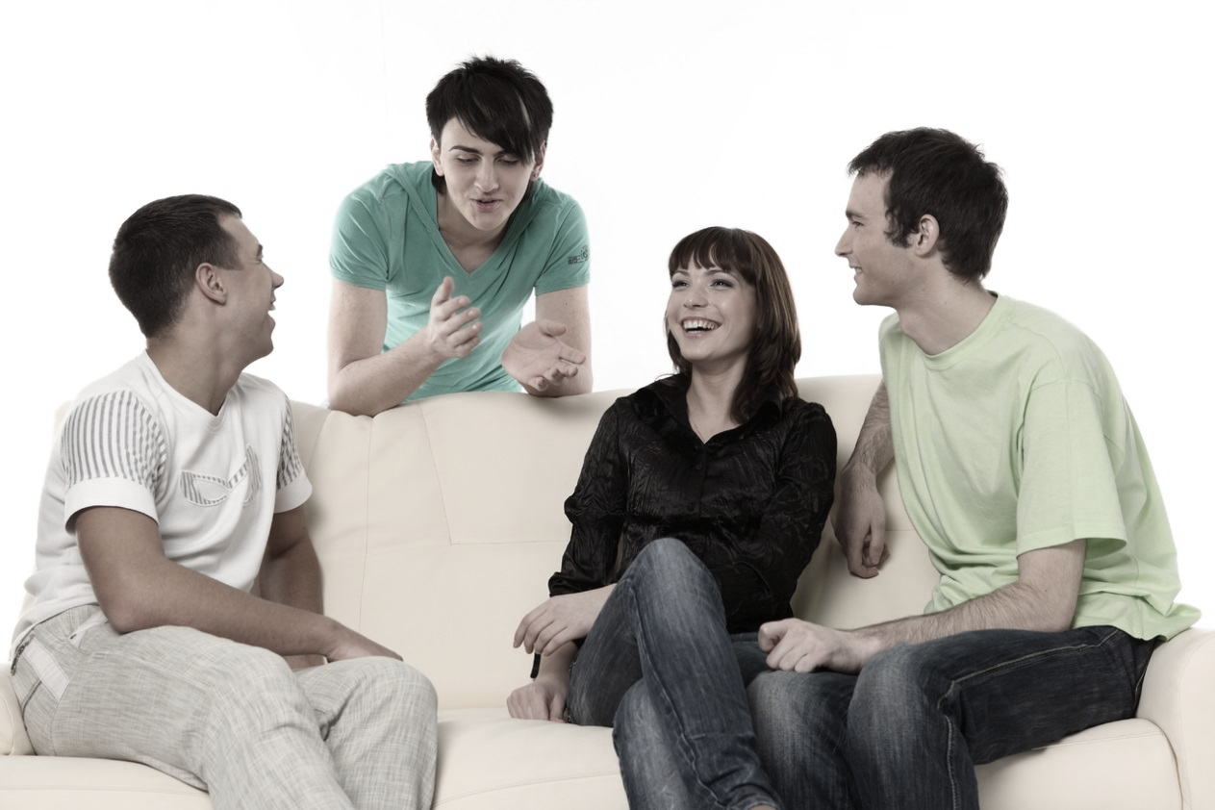
GETTING STUDENTS
TO SPEAK
Daniela Clarke

Slide 3




Key questions
Martina
Key questions
How can I help?
What makes a good speaker?

Slide 4
How can I help?
Martina
Areas for improvement
Unclear focus of activity - accuracy or fluency - students just speak
No teacher aims
No help with ‘ideas‘

Slide 5
How can I help?
Areas for improvement
Martina
Areas for improvement
Ineffective error correction
Students not pushed enough to use new language in speaking activities
Underchallenged students: no task given to ‘listeners‘

Slide 6
SPEAKING: Accuracy
Martina
How can I help?
Accuracy
Learner focus on:
correct use of language
Teacher focus on:
correction

Slide 7
SPEAKING: Accuracy
SPEAKING: Fluency
Martina
How can I help?
Fluency
Learner focus on:
communication
message rather than language
Teacher focus on:
no correction
delayed correction

Slide 8
ERROR correction

Slide 9
When to correct
When to correct?
SPEAKING: Accuracy
Martina
How can I help?
When to correct
AIM:
Accuracy or fluency?
Language or communication?

Slide 10
Teaching FLUENCY

Slide 11
How can I help?
Promoting fluency
SPEAKING: Accuracy
Martina
Promoting fluency
Work in pairs.
Watch the mime.
A: Tell the first part of the story ...
Watch the mime.
B: Tell the next part of the story ...

Slide 12
Pushing students to
USE NEW LANGUAGE

Slide 13


Look at the photo.
What speculations do the reporters make about the event?

Slide 14
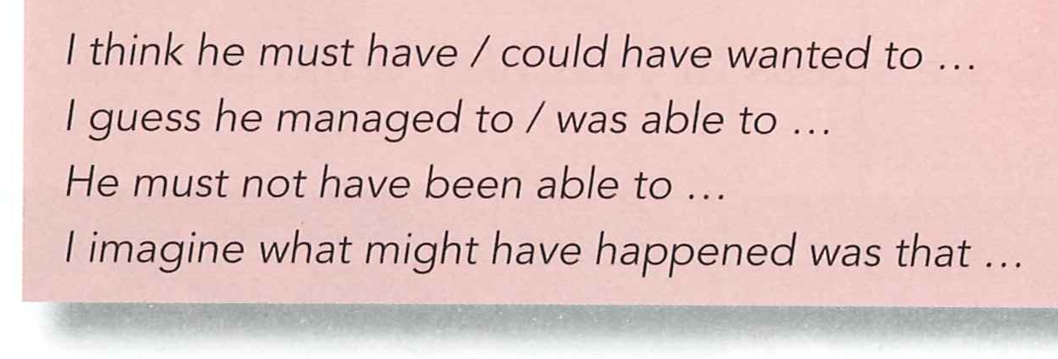
Why do you think the man did this?
What happened in the end?

Slide 15
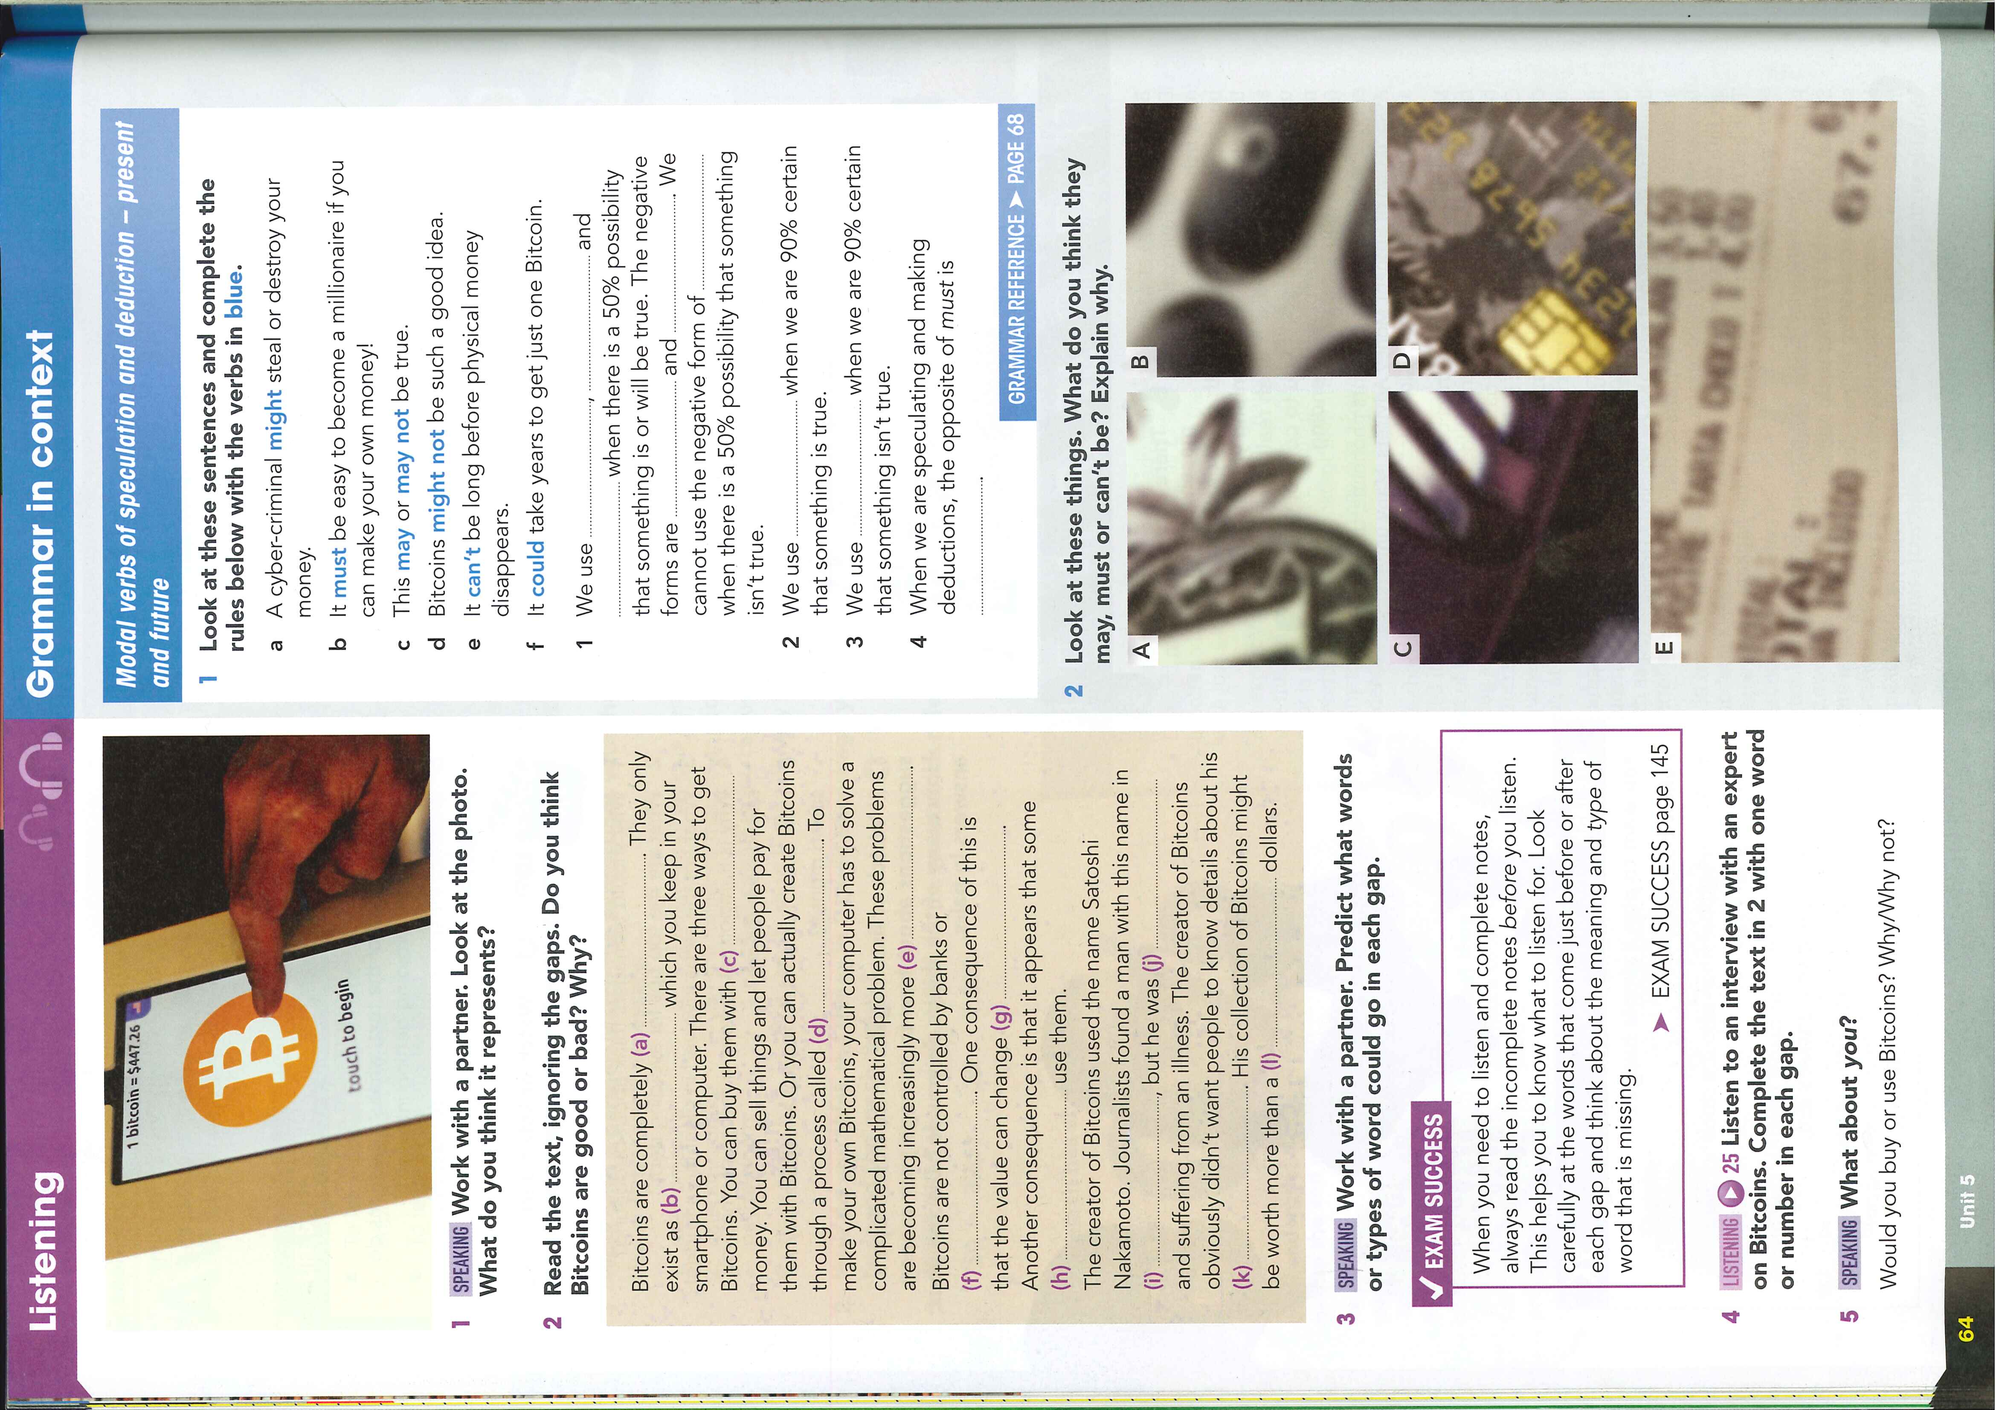



Slide 17
Tasks for LISTENERS

Slide 18
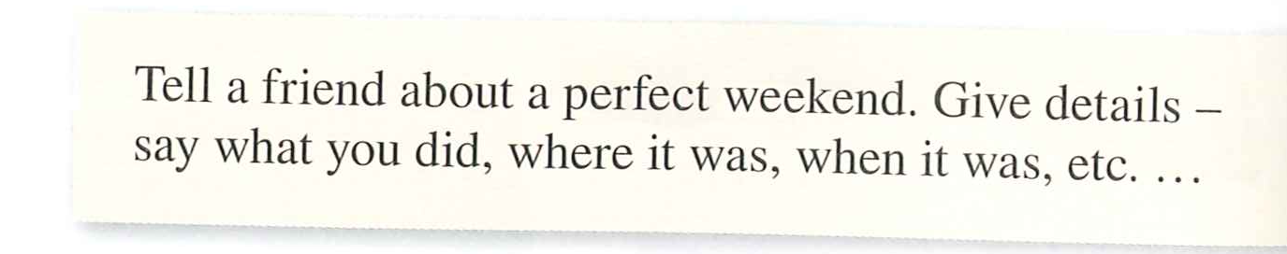
SLIP IN A SENTENCE

Slide 19
IDEAS

Slide 20
SPEAKING: Accuracy
Martina
Mobile phones
How can I help?
Use your mobile ...
Find a photo:
of someone you love
that you wish wasn‘t taken
important to you

