Slide 1
PLAIN COVER
Use this cover where you do not want to use and image. Add the Macmillan Education logo and a single sub brand or lock up to the base logo strip as required
Supportıng chıldren’s needs IN WRITING through differentiation
Sarah Oskay
July 2016

Slide 2
Differentiation?

Slide 4
Differentiation …
«…alters the implementation and design of lessons and activities so that the needs of all the students in the classroom can be met»

Slide 5
How are our students different from one another?

Slide 6
How are our children different from one another?
Different backgrounds/upbringings
Different cultures
Different social, emotional and physical attributes
Different characters/personalities
Different interests
Different levels of readiness
Different ways of learning

Slide 7
We do not need to label…..

Slide 8
However….
It seems natural that every child may learn best in a different way…
«The biggest mistake of past centuries in teaching has been to treat all students as if they were variants of the same individual and thus to feel justified in teaching them all the same subjects the same way».
Howard Gardner

Slide 9
However….

Slide 10
What do you think?

Slide 11
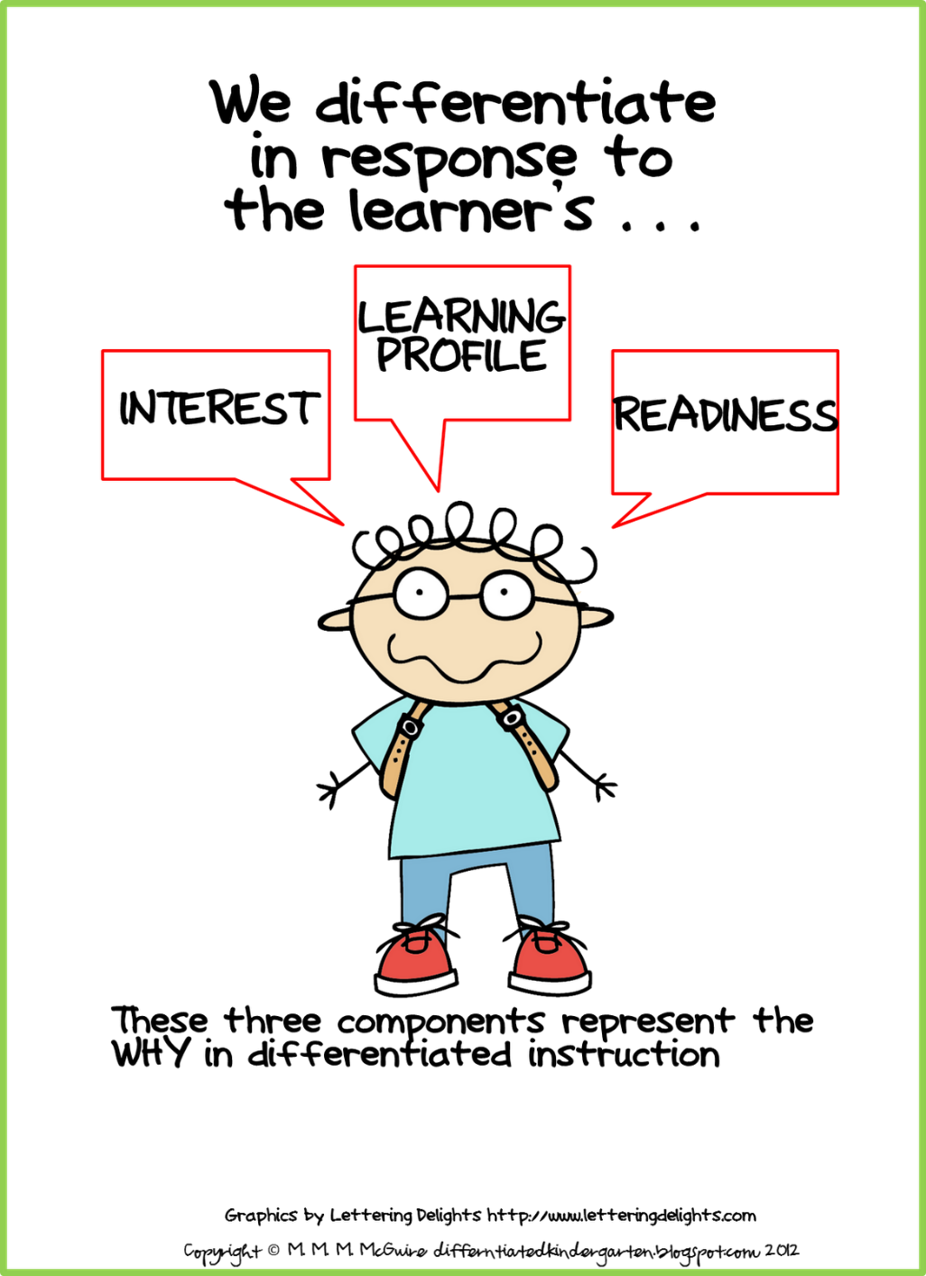
What can teachers base differentiation on?
Student readiness
Interest
Learning profile
Affect

Slide 12
Readiness
Teachers must try to know about their students’ prior knowledge and life experiences.
This includes their students’ views on school particularly certain activity areas.
How can we obtain this information?

Slide 13
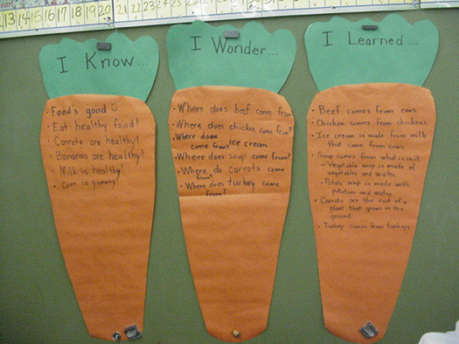
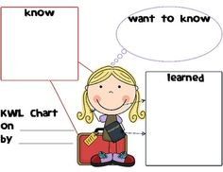
Examples of asking the children….»

Slide 14
Interest
Teachers need to put effort into discovering what the children like to do and what their passions include.
This helps the teachers to connect interests to the content they must teach and also aides the teacher in selecting small groups or projects.
«When the children are interested they will enjoy what they are learning and this will heighten their achievement» (Tomlinson, 2003).
How can we discover this information?

Slide 15
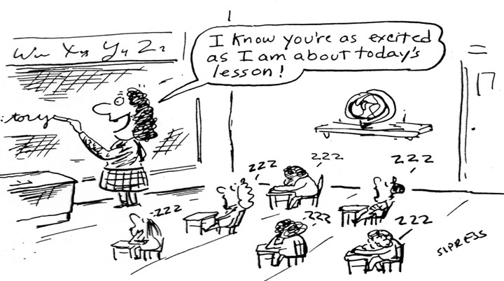

Slide 16
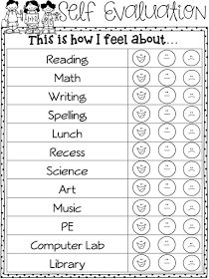
Ask them?

Slide 19
Learning profile
This includes:
Their style,
Culture,
Gender
Intelligence preference.

Slide 21
Affect
Affect is how students feel about themselves in school.
This encompasses the students’ positive or negative feelings about their written work, their classroom and what they can add to the classroom dynamic.
Tomlinson believes that teachers need to strive to understand their students’ emotions as well as their understanding for students to reach their highest potential (2003).

Slide 23
Correct or not?

Slide 24
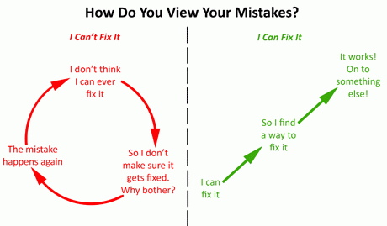
We can change the student’s point of view

Slide 26
Teachers can differentiate at least four classroom elements which can be based on
Content – what the student needs to learn or how the student will get access to the information;
Process – activities in which the student engages in order to make sense of or master the content;
Products – end projects that ask the student to rehearse, apply, and extend what he or she has learned in a unit; and
Learning environment – the way the classroom works and feels (groups).

Slide 27
Content

Slide 28
Content
Using materials at varying levels;
Presenting ideas through both auditory and visual means;
Meeting with small groups to re-teach an idea or skill for struggling learners, or to extend the thinking or skills of advanced learners.
What have you tried?

Slide 29
Graded dictation

Slide 30
Reflection on dictation
• What skill(s) are students developing?
• What was the interaction pattern? (pw, gw, whole class etc)
• Could you use this activity in your class? why/ why not?

Slide 31
Process
Using tiered activities through which all learners work with the same important understandings and skills, but proceed with different levels of support, challenge, or complexity.
Providing interest centres
Offering hands-on supports for students who need them; and
Varying the length of time a student may take to complete a task in order to provide additional support for a struggling learner or to encourage an advanced learner to pursue a topic in greater depth.

Slide 32
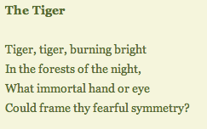
Process

Slide 33
Sports (Macmillan English)

Slide 34
Writing Poems
Help to differentiate…..
Ready shape
Ready letters
Ready words

Slide 36
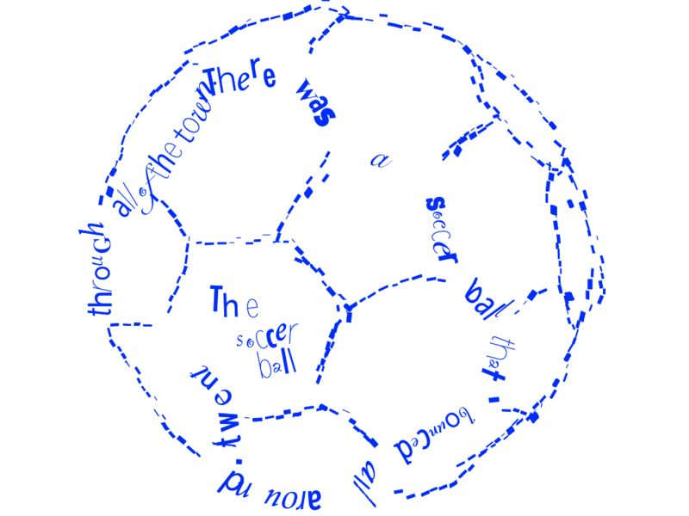
Examples…..

Slide 37
Found poems
A found poem doesn’t have to rhyme and it is most often free verse
Here is what you can do:
Black out words by deleting them from the writing sample
Change punctuation or capitalization
Here is what you cannot do:
Do not change word order.
Do not add words that are not in the original sample.

Slide 38
Examples of found poems

Slide 39
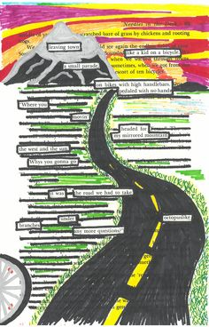

Slide 40
Reflection
• How did you use differentiation?
• What was the interaction pattern? (pw, gw, whole class etc)
• Could you use this activity in your class? why/ why not?

Slide 41
Products
Giving students options of how to express required written material (e.g., write a script for a puppet show, draw and write a poster.
Allowing students to work alone or in small groups on their products; and
Encouraging students to create their own product assignments

Slide 42
Different ways of learning….

Slide 43
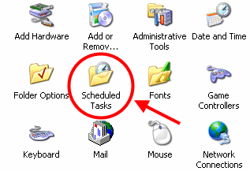
Different ways of learning the same thing….
TASK: I can describe the theme or message that the writer wants to get over to the reader

Slide 44
I can write about the reasons for rules and laws and the consequences for people who do not obey them

Slide 45
ANALYTICAL | USE A GRAPHIC ORGANISER TO LIST RULES AND SCHOOL AND CONSEQUENCES WHEN THEY ARE BROKEN
PRACTICAL | CREATE A SCRIPT FOR A TV SHOW/PLAY THAT WOULD SHOW WHAT LIFE WOULD BE LIKE IF THERE WERE NO LAWS IN YOUR CITY
CREATIVE | WRITE A FABLE WITH A MORAL TO SHOW WHAT WOULD HAPPEN IF THERE WERE NO RULES IN A CERTAIN SITUATION

Slide 46
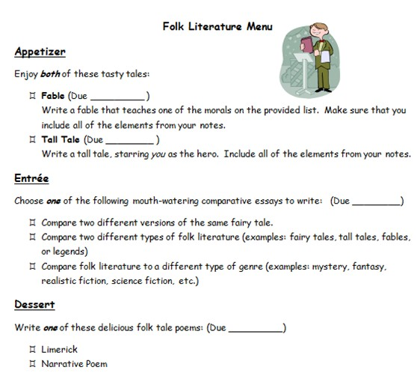

Slide 47
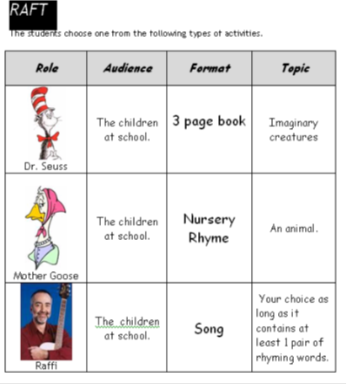

Slide 48
I can write about the main events of a chosen book

Slide 49
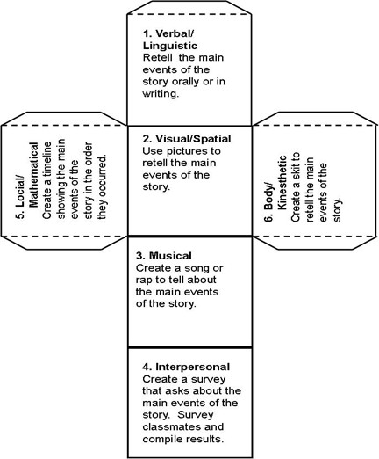
Story events cube

Slide 50
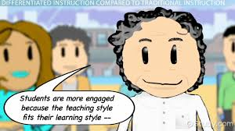

Slide 51
Learnıng environment
Making sure there are places in the room to work quietly and without distraction, as well as places that invite student collaboration;
Providing materials that reflect a variety of home settings;
Setting out clear guidelines for independent work that matches individual needs;
Developing routines that allow students to get help when teachers are busy with other students and cannot help them immediately; and
Helping students understand that some learners need to move around to learn, while others do better sitting quietly (Tomlinson, 1995, 1999; Winebrenner, 1992, 1996).

Slide 52
Make it visual

Slide 53
Create a language-rich environment
English language learners will benefit from increased exposure to print and language. A print-rich environment will include access to books and reference materials, labels and posters, and student work on bulletin boards.
Word walls are also a great support for ELLs, and may be organized around a number of concepts, including the alphabet and phonetic sounds, new vocabulary words, sight words, grammar rules, conversational phrases, and writing structure

Slide 54
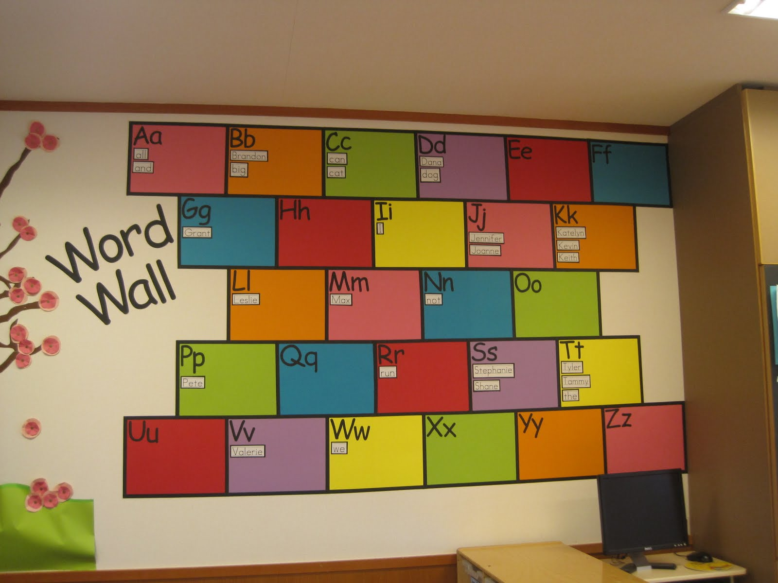
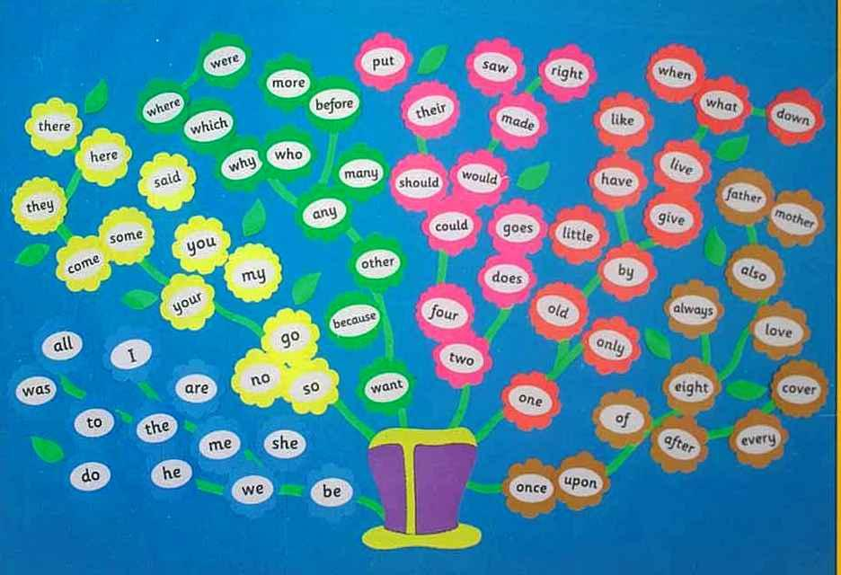

Slide 55
What factors affect the viability of differentiation?
Teachers who are able to successfully differentiate instructıon are first of all sensitive to the developmental differences among their children
Regular monitoring in order to modify
Assessing and observing
Minimize whole group instruction

Slide 56
Why small groups?
More flexible
Teachers can work within the child’s optimal learning level
Children are more likely to be challenged and less likely to be frustrated
So the child is met «where they are» currently

Slide 57
Everone has something to do…

Slide 58
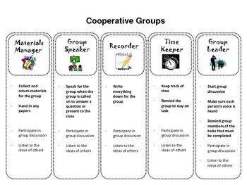

Slide 60
Remember…..

Slide 61
BACK PAGE
Please add the Macmillan Education logo and any additional logos to the logo strip at the bottom of this page as required.
NAME PERSON
Job Title
M +44 (0) 000 000 000
T +44 (0) 000 000 000
E name.person@macmillan.com

