Slide 1
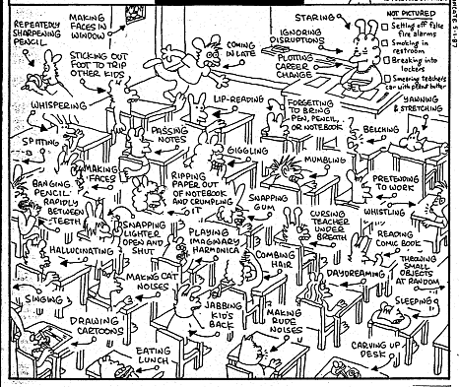

PLAIN COVER
Use this cover where you do not want to use and image. Add the Macmillan Education logo and a single sub brand or lock up to the base logo strip as required
Classroom Management: Setting the Limits
Sarah Oskay
July 2016

Slide 2

The Continuum Theory?

Slide 3


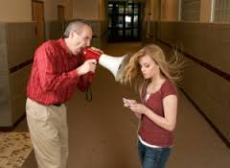
What might classroom management mean?
TEXT PAGE STANDARD
This page will manage your text using the standard PPT text functions on your tool bar.
The minimum size for presentations that will be projected to an audience should be 18.
The minimum size for slide decks that will be read should be 10

Slide 4


What would we as teachers like to expect from our students in the classroom?
Notes:
Write one word that defines what we would like from our students in capital letters onto a pıece of card. Get teachers to come and stick on the wall. Do this alphabetically (according to the word written on the paper or the teacher’s name).
Alternatively have teacher draw a small picture/write their name on a piece of card. Put all the papers into a bag and fish out names to come and stick the chosen word on the board.

Slide 5
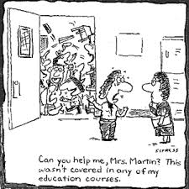
Classroom management can raise a number of concerns….

Slide 6
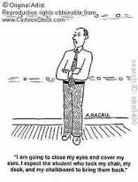
Worries…?

Slide 7
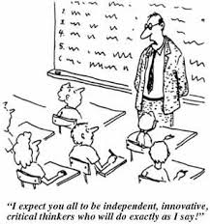
And issues with teaching methodology…

Slide 8
What are your particular concerns?
Rules
Class Layout
Engagementt
Behaviour
Noise
Notes:
Encourage teachers to write down particular issues on a post-it note/slip of paper.
Many of the issues that are raised will (most likely) be ones that this workshop will deal with. Get the teachers to come and stick their notes on the board under the PPT headings. Explain how each/any concern can be interactive, so a lack of engagement or certain children sitting next to other children that may disturb them can result in increased noise, a disregard for the classroom rules and negative behaviour.

Slide 9
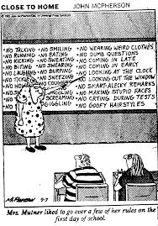
We need to consider our objectives and how to achieve them…

Slide 10
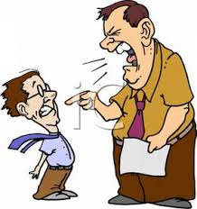



What doesn’t work?
Notes:
Check the responses of the teachers by getting each group to think of a couple of ideas. They must use the sentence “……just doesnt work!” You will pretend to change a TV channel and point the “remote control” at that group. Ask one group to start . When they have given a few ideas, pretend to “change the channel” and get the other groups to talk.

Slide 11
What happens if you…..
Raise your voice too much
Send the students out of the classroom
Discipline a student in front of the other students
Get really angry
Notes:
In small groups/paırs to discuss:
The students get louder too/You lose credibility as a teacher (bad role modelling) and you lose control of yourself as well as your students. Any improvement in noise levels is only temporary and you are not really changing the children’s behaviour. After a while you “train” the students to only listen to your loud voice! Plus it is stressful! Feedback can be given in pairs/groups. Or you can use the whiteboard and draw a line down the middle. 2 teams. Each team (one student at a time) to write a suitable response for the questions.

Slide 12
Why is classroom management important?
To create a supportive and caring relationship between the teacher and the children
To encourage the students to engage and optimize their learning
To help all students to self regulate and direct their own learning
Notes:
Ask teachers why CM is so important? Get feedback on a “idea spider” or mind map on the board.

Slide 13

A little bit of psychology…
Why do you think children might misbehave?
Attention
Power
Revenge
Display of inadequacy
Notes:
OPTIONAL SLIDE There are four thoughts according to Driekurs (well known psychologist)
Attention-I belong only when I am noticed
Power-I belong only when I am in control
Revenge-I belong only by hurting others (as I feel hurt)
Display of inadequacy-I belong only if I make sure that nobody expects anything from me (I am helpless).

Slide 14
The answers lie with….
Accepting that some behaviours are age appropriate…
Helping the child to succeed and create activities that he can succeed at
Building self esteem. Often all the child hears are the sentences beginning with “No!” and “Don’t!” so it is very important to make the child feel good about himself
Teaching that “on task” behavior gets immediate positive feedback such as praise

Slide 15

In the ESL classroom …what are other issues with managing the students?
Notes:
Potential issues may be that students may not be able to understand much of the classrom language
May be unmotivated to learn language 2
Classes too large (apparently “optimum” number of ESL students ın any class is 12! (Jones, 2007)
Too few hours of teaching and no reason to use English out of school
Child may not have attained literacy in their own language (especially if it isn’t Georgian eg; Armenian)
Tasks seem too long/boring and too demanding
Lack of realistic communicative activities
Students may be embarrassed or not feel “empathy” with the target language

Slide 16
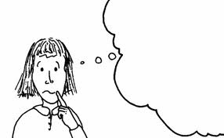
What’s the solution?
To pre-empt problems (solve issues before they start) by thinking of what to do in advance

Slide 17


Where should we begin?
Notes:
At the entry to the class.
We can set the tone which will influence the entire lesson
Think of a group of noisy students waiting in the corridor
The students are “in charge” and there is an obvious power imbalance coming into your classroom…
Gradual and individual entry helps the children calm down from theır last class
Routines encourage improved behaviour
Can include seating
Have the children know where to sit

Slide 18
What’s the problem?
Power imbalance..the students are in control!
Take control as the person in charge!
Classroom entry…meet and greet. Why?
Make some positive (non-confrontational) statements about what the students are doing right (praise) along with chatting with them
Let’s think of examples of these statements…
Notes:
Potential examples of NC statements
“Great that you’ve lined up so well”.
“You look lıke you have got all your stuff for this lesson”
“Good job for being on time”
“Thanks for settling down”
Get informal chitchat examples from the teachers (small groups/pairs).

Slide 19
Aim?
To get the students seated into the classroom and working as quickly as possible
Start by getting attention of the entire group
Be clear with your instructions…
Which of these is the clearest instruction?
1. “Please be quiet!”
2. “Line up against the wall facing me and no talking please”
3. Line up now please! Keep the noise down!”
Notes:
Encourage the teachers to think about their body language (positive, but assertive) their tone of voice (strong and calm) and where they stand (they should move away from the students because informal conversation time is over now). The best instruction is number 2 (specific and polite).

Slide 20
What else?
Where to start?
Get the students who have done as you have asked to come to the beginning of the line
Give praise to these students (“good job on lining up and not talking!” or “thank you for listening!” )
These students will enter the room first
As the students enter what could you say to them?*
What action could you take if they are not listening to you?
Notes:
You are reinforcing the behaviour that you want to see and encouraging this behaviour from the rest of your students
*Ask the teachers for their ideas. Suggestions could be to thank the students. You could give some positive reinforcement “you have shown me that you can listen and do as I ask, I know that you are not going to let me down. You are going to find your place and start working silently”
If the Ss don’t listen, they will have to go outside and start the process again.
Do a quick role play to illustrate this activity if you have time/feel that you need to reinforce this point

Slide 21

Think for a moment about why this aspect of classroom management may work?
Notes:
You are gradually intrdocuing the students into the classroom
The students who are most disruptive (potentially) are still outside….. Specific ideas for helping to “manage the classroom”
1. Number one idea is to “empower the Ss”. Very likely to sound counter-intuitive to the teachers! Explain that students who feel as if they have some influence in the classroom (rather than it being totally teacher-centred) are less likely to cause problems.
2. Always involve the more difficult students!
3. If there are any issues as the final (potentially most difficult) students enter the class, say that you will sit them close to you and find time to help them with their problem in just a moment.
4. Always get the students to “agree” with what you are saying
5. Encourage such students to take more responsibility (give the challenging students an age-appropriate “job” to do).
Each day is a new beginning (for you as a professional and each student). It’s easy to get demotivated when you think of a particular student, but you can both get “trapped” in the vicious cycle of expecting the student to misbehave and “biting” back.

Slide 22
The students are now calm…what next?
Notes:
Discuss in small groups what the next steps could be? Class feedback

Slide 23
Plan….
Be ready! Have a seating plan on the wall (can be a class plan like this)
Or can be name places (smaller children can write and illustrate their own)
Remember ROUTINES! Be as consistent as you can be EVERY lesson
Alp | Felicia | Karolin | Josef
Tea | Pedro | Ayse | Olivia
Anton | Katia | Nil | Maia
Kadir | Neco | Julietta | Ada
Notes:
The students should know what to do as soon as they enter the classroom (or you enter their classroom)

Slide 24
Classroom Layout
How can this affect management?
What can we do to change the layout in a positive way?
Notes:
In pairs, tell each other how your classroom is set out.
Do this as a picture dicatation. (back to back..one teacher describes and another draws)
Come back together and discuss.
Provide photocopies of mini desks, board, teacher’s desk etc

Slide 25

Where shall I sit?
Look at the students on the next slide and decide where you would place them.
Notes:
See lesson cards at the end of the PPP
Students who are disruptive close to the teacher and at the front of the class. Also applies to studenst with special needs (learning issues).
Students who are more able to follow instructions and work independently at the back and sides. Students who are “contraindicated” to be extra badly behaved when sat next to a certain person, should not be placed close to them.

Slide 26
Cards for seating activity
B Keeps talking to A | P is a fast learner and quick finisher | F needs lots of support | L argues with whoever is sitting next to her
W fights with P | R cannot work alone | T picks on A | A needs some support with writing
M has special needs (dyslexia) | C has ADHD (attention issues) | K is a model student | J is a loud and aggressive boy
S is quiet and hardworking | X is easily influenced by others | Y is calm and hardworking | D is super chatty
Notes:
Get the teachers to write the letters on squares of paper that you have provided (groups of 3 or 4). Allow them to decide where and why they would seat the children.

Slide 27
What next?
As they sit down, they should have the correct equipment…text book, note book and something to write with
Now they have sat down, they need to be able to start an activity almost immediately
Activity can be called a “settling starter activity” (Rob Plevin)
Should be something that the children can begin without the teacher’s help
Let’s think of examples in pairs…
Notes:
Should be something that the children can begin without the teacher’s help (instructions very clearly written on paper or board. Could include a wordsearch etc) or for younger learners…colouring or tracing activities

Slide 28
Examples of teacher-free starter board activities
Five anagram words on the board eg; cilpen (pencil etc) Write the middle or end of 5 known words i.e. enci (pencil) Write 5 words with a letter missing each. On a known theme (eg; Classroom objects) write the first letter of 5 different objects to complete. 5 words each with one deliberate mistake in the spelling. Odd one out i.e pencil eraser cup notebook They have one minute to write as many clothes as possible, colours, sports,fruit,veg, countries, pets, rooms, hobbies, furniture. They have one minute to write as many words as they can beginning with…. Writesixorsevenwordstogetherwithoutabreak

Slide 29
Keep Interest
“If students are introduced to topics that interest them, they’re more likely to be motivated!”
But…of couse we are not all interested in the same topic!
However, with each topic we should try to engage as many students as possible.
Old topics need to be “revitalized!”
Notes:
As teachers, try to keep up to date with what children or teenagers may be interested in

Slide 30
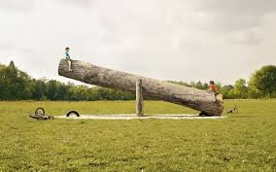
Supporting and motivating
What can we do to support the students when the language output is low in relation to the input?
Notes:
If being successful increases motivation, then a perception of feeling unsuccessful surely reduces it…Sometimes students who started out very enthusiastic about learning English, stop feeling positive because they feel that they are not progressing quickly or fluently enough.

Slide 31
Some tips for managing…
PHYSICAL… Move around the classroom
INDIVIDUAL ATTENTION..focus on particular students
SECRET SIGN as a strategy to redirect
USE NON VERBAL CUES
Notes:
Your physıcal closeness to the students can help to prevent any disruption. This also helps the students to understand that you are present and that you support them
Use “one on one” strategies to help an individual who is struggling (you can whisper..so you don’t need to draw attention to the student)
You can re-direct the student without him feeling “picked upon.” This will also reduce the possibility that this student reacts negatively to you
Discuss what NVC are and ask what the teachers have used

Slide 32
Too loud/too much talking
Pair work/groups of three
All participants have a role
Groups can be regularly rearranged as necessary so that students can experience more/less confident peers
Have the students sit close (don’t have to raise their voices)
Give the students a time limit and use a timer to signal that time is nearly up

Slide 33
Volume Control !
Discussing
Quiet talking
Shh!
Notes:
Make a clock shape out of card (a big circle with a segment cut out) then attach it to a black sheet of sugar paper with a split pin.
2. Make 3 labels with 'Shhh..' written in red, 'Quiet Talking' written in orange and 'Discussion' written in green.
3. Glue these labels onto the paper dial, so that when the dial turned, the different labels would point to which noise level I wanted the classroom to be.

Slide 34

Interesting ideas http://www.ictgames.com/calmCounter.html or http://toonoisyapp.com/
Notes:
http://www.ictgames.com/calmCounter.html shows an online noise monitor (if you have internet connection) and can be used for times where noise is encouraged (discussion) but shouldn’t get too loud.
The second site is an app (can also be used on iphones, ipods etc).

Slide 35

Activities to reduce noise…
Your ideas?
Clapping game
Jar of marbles
Raise your hand!
Notes:
Clapping game: Clap in some kind of a pattern (five fast claps, or two fast, two slow, etc.). The students then have to clap back to the teacher in the same pattern. Generally, it takes two or three times of repeating the clapping.
Marble jar. Add to the jar (with a marble) when certain noise levels are adhered to. Visual and when the jar is full, provide a treat for the class.
For younger children, you can raise your hand and very quietly say "Raise your hand if you can hear me". The nearest students immediately stop talking and raise their hands and it spreads very quickly when the further groups realize that no one is talking and everyone has their hands up.

Slide 36
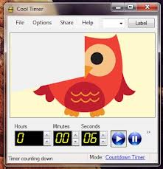

Transition Times…
http://www.teachingideas.co.uk/more/management/files/1minutedynamite.swf
Notes:
Online countdown timer that explodes after a minute
Give prewarning of when activities are to change for students who find this difficult
Sing or chant transitions for younger children

Slide 37
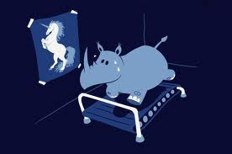
What are your expectations?
If they are too high and your students are struggling what can you do?
Notes:
İdeas include: Plan carefully and break information down into smaller components
Check the students understanding after each teaching opportunity
More opportunity for revision

Slide 38

Differentiation
Definition?
Activity
Notes:
Ask what differentiation is: Answers may include
Meeting children developmentally wherever they are
A proactive teacher approach to provide learning to suit a variety of needs
More qualitative than quantitative-adjusting the nature (not the length or quality of the activity)
Child-centred (not teacher-centred or led)
Rooted in observations of the children
Jigsaw activity
In the jigsaw form of instruction, the target material is graduated and differentiated usually into four parts, and distributed to small groups to complete according to their ability. (Photocopy of relevant reading jıgsaw activity is on Word).
When these groups have completed their activities, students regroup into heterogeneous groups to present material and go over the material as a whole class.
Initially, your classroom would look like this:
A A B B C C D D
A A B B C C D D
Once students have finished their material, your classroom would look like this:
A B A B A B A B
C D C D C D C D

Slide 39


Use positive narration
Notes:
Write on the board “the following amazing and positive students X and Y (use names from your class) were outstanding at….(choose a action such as listening/tidying up etc.) today!”
Be specific in your praise
Praise each child who complies
This encourages the other students to do the same

Slide 40
Personalize!
Anna, great idea!
Well done for listening Joe!
Wow, that’s really funny!
That’s super description!
Notes:
Remind students (and give them “chunks” of suitable language to respond to their peers) that personal experiences can be much more interesting than being too general.

Slide 41
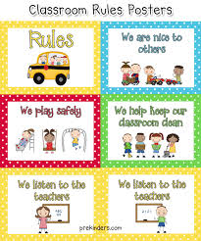
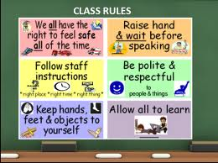
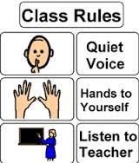
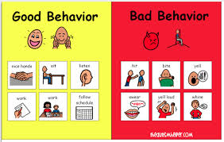
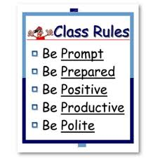
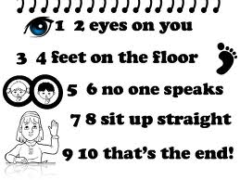
Rules…How?…When?…What?
Notes:
Make them age appropriate and suitable for your class
Divide teachers into groups. Give an age group to each group. Get teachers to write/draw/create a set of rules for their class

Slide 42
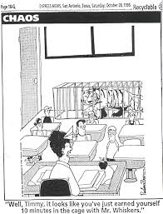
Punishment?
Notes:
Speaks for itself…Tigers not to be encouraged!!!

Slide 43
Positive reinforcement
ATTENTION FOR POSITIVE
IGNORE NEGATIVE
BE CONSISTENT
Notes:
Brainstorm the meaning (whole class). Mind map on board. Each group to come and write up a single idea. Begin with group with fewest number of ideas. Other groups need to listen so that the same idea is not repeated twice
The child receives adult attention each time they display adesired behaviour (thank you for completing the grammar exercise as soon as asked)
Undesirable behaviour is ignored as much as posible (addressing this would give the child negative reinforcement)
Be consistent..and fair to all students.

Slide 44
Typical learner problems in teacher centred classroom
How am I going to learn to say that word myself if only she repeats it and she
doesn’t ask me to repeat it?
I got lost after the first two sentences….
She is using too many words!
Why can’t she just explain the directions step by step without saying a whole
bunch of other words?
Notes:
Brainstorm what issues you might envisage from a classroom that relies on the teacher centred approach too much. TT style includes lecturing, or presenting a topic, the student practicing and then producing. There is use of closed questions (that don’t encourage discussion), and only the teacher “models” the target language. Adapted from: British Council/BBC website http://www.teachingenglish.org.uk/knowledge-database/teacher-centred

Slide 45
Student centred….
Much better for large classes
If you want to encourage student talk in a crowded class, the best way to do this is pair/group work
The students are close to each other in groups and the teacher can walk around and listen
Groups and pairs can be mixed…composed of weak and strong students
Pairs can be good for practice/when students need to feel less inhibited and needs to “talk” more
But, the larger the group, the less talking time there is for each student…
Notes:
Can briefly discuss the benefits of student centred teaching (above) especially for large classes

Slide 46
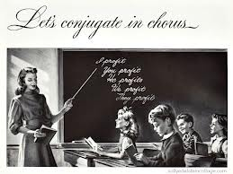
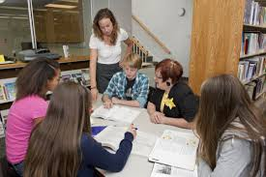
Add student-centered activities
Interact high and low patience activities
Games and competitions to keep students engaged and to encourage participation
Compare and contrast examples of student and teacher centred activities
Notes:
Get teachers to think of student centred tasks. Examples of communicative activities could be:
Sentences that have been cut into 2 halves. Students to move around the class to find the correct pair vs. a mix and match exercise done silently in workbooks.
Information exchange activity in pairs to answer questions vs all students having the same text and working alone after teacher has provided instructions to the whole class vs gap fill with teacher dictating.
Correcting sentences with mistakes (groups of small teams) vs teacher calling out errors (or taking them home to mark)
Picture dicatation in paırs vs. teacher dictating to the entire class

Slide 47


How to keep students engaged?
Notes:
Reduce….. Reduce the amount of material that you give to the students before asking them to do something with it. So think about asking students to consider what for example they think that a book might be about rather simply reading pages and pages….

Slide 48

Case Studies….
I will read out some of the issues that you mentioned
Decide how you could manage the issue in your classroom
Notes:
Case studies are on separate word document. In groups. Feedback to whole class.
You are asking teachers to consider their own expectations for the following types of students….
A group of students are constantly chatting in the classroom. (low intensity but high frequency behaviour).
Non compliance (not doing an activity)
Aggressive behaviour
Rudeness to friends or teacher

Slide 49

What do you think that you can take away from this session?
Notes:
Get teachers to think for a few moments to collect ideas. Then go around the classroom and ask each teacher to say one word to form a correct sentence (can include full stops). The aim is to collect ideas in a fun way and all teachers have to remain alert to what the previous person said.

Slide 50

Solve the Word Worm!
Classroommanagementmay appeartobechallengingbutitcanbeaddressedby usingthetechniqueswe havediscussedtoday!
Notes:
Classroom/management/may/appear/to/be/challenging/but/it/can/be/addressed/by/using/the/techniques/we/have/discussed/today!

Slide 51
PLAIN COVER
Use this cover where you do not want to use and image. Add the Macmillan Education logo and a single sub brand or lock up to the base logo strip as required
Thank you for listening
Sarah Oskay
July 2016

