Slide 1
Teacher Training Conference
July 2016

Slide 2
BUILDING VOCABULARY FOR TOEFL
Daniela Clarke

Slide 3
Challenges with learning VOCABULARY?

Slide 4
Reasons for challenges
LIMITED RANGE OF VOCABULARY
Not exposed or practised enough
Have reached a learning plateau
LARGE GAP BETWEEN PASSIVE AND ACTIVE VOCABULARY
Not ‘pushed‘ enough in productive skills

Slide 5
Reasons for challenges
POOR MEMORY RETENTION
Poor study skills
Lack of recycling

Slide 6
How can we help learners ...
... remember lexis long-term?
... expand their vocabulary range?
... use new lexis in their productive skills?

Slide 7
Teaching steps
STUDY SKILLS
TEACHER INPUT
PRACTICE ACTIVITIES
RECYCLING ACTIVITIES
USING NEW LEXIS IN SKILLS

Slide 8
Coursebook

Slide 9
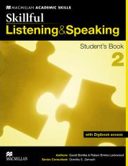
Study skills

Slide 13
Expanding vocabulary
TOPICAL VOCABULARY
Relationships
INDIVIDUAL WORDS
affection
argue

Slide 14
WORD BUILDING
NOUN VERB ADVERB ADJECTIVE
affection show affectionatelly affectionate
argument argue arguably argumentative

Slide 15
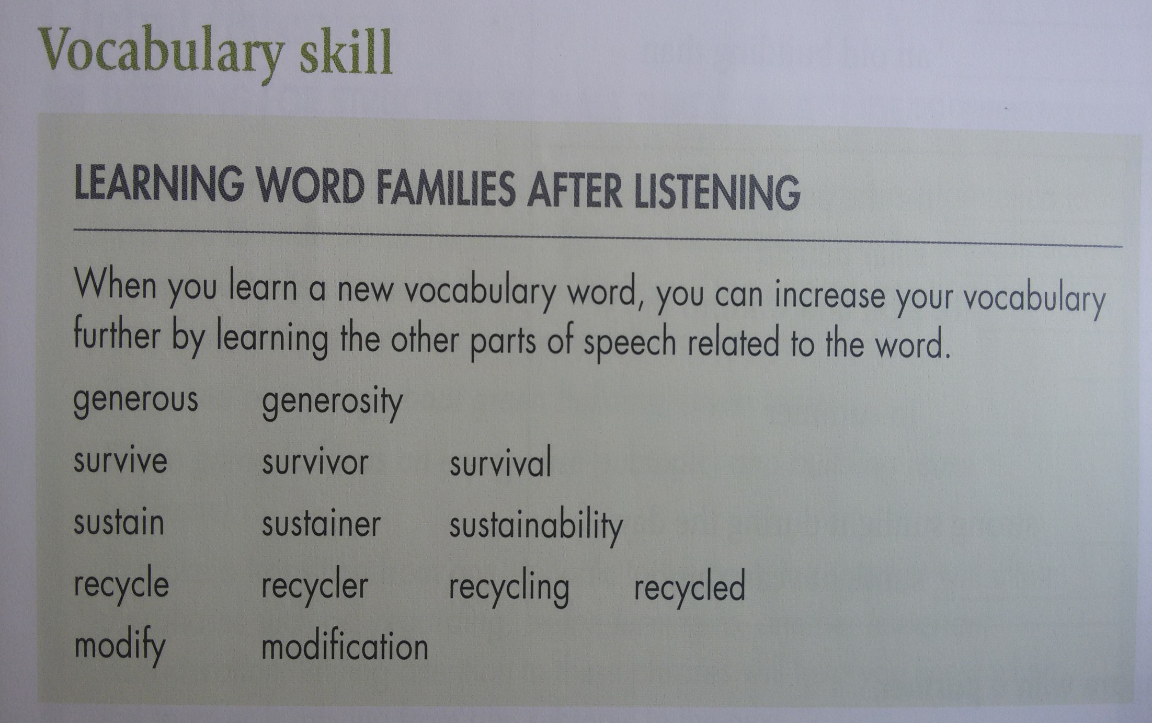

Slide 16
WORD BUILDING
Add prefixes and suffixes to form as many words as possible:
CONSIDER
re- un- well- in-
-ed -able -ate -ately -ation

Slide 17
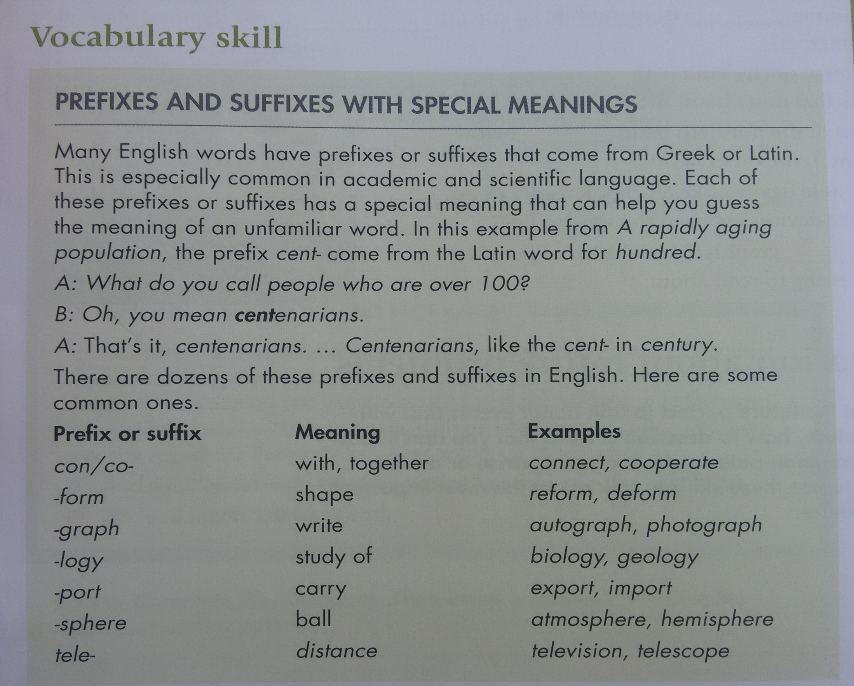

Slide 20
