Slide 2
Notes:
Welcome to Our World is a three-level preprimary series that uses traditional children’s songs from around the world to introduce very young learners to the world or English.

Slide 3
Notes:
Basic Welcome to Our World message:
Bringing the World’s Song to the Classroom – and the Classroom to Life
Children learn English through music and rhythm, with songs performed by young learners around the world.
Games and activities reinforce new language and concepts, and make learning English fun!
Beautiful photos capture the imaginations of very young learners.
Professional Development video helps teachers use the songs and games effectively.

Slide 4
Notes:
Multiple unit opener spreads ahead – use to show exceptional cross section of real world themes and topics learners will be introduced to. Remove spreads per your discretion/time limit.

Slide 5
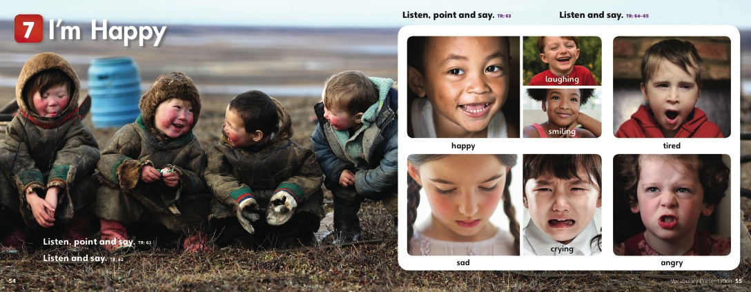

Slide 6
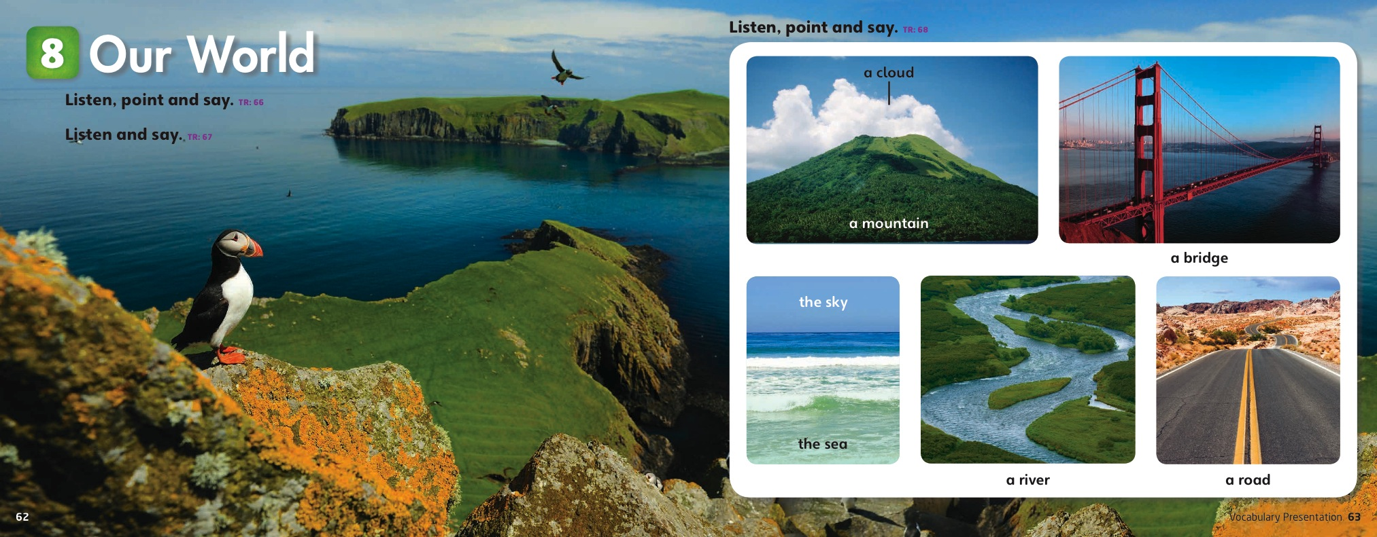

Slide 9
Notes:
WELCOME TO OUR WORLD SONGS
Welcome to Our World introduces very young learners to traditional children’s songs from around the world, teaching them English through music, rhythm, and motion. Each song is performed by young learners in real classrooms and taught by a host, and fully supports the language and concepts introduced in the Student Books.
There is a song for every Student Book unit, and the songs are performed by very young learners in real classrooms in over 20 countries around the world, including:
Argentina, Brazil, Czech Republic, China, Greece, India, Mexico, Peru, Philippines, Senegal, Serbia, South Korea, Spain, Thailand, Tunisia, Turkey, United Kingdom, United States
Student Video DVD
The songs are provided on the myNGconnect and the IWB:
Performed by young learners in their classrooms
Taught by a host, in English, with instrumentation

Slide 10
Notes:
To ensure teachers are fully supported in their young learner classrooms, the Teacher Video also includes a series of Professional Development videos, with best practices for teaching English successfully using songs and games with Welcome to Our World.
Dr. Joan Kang Shin, a respected trainer of young learner teachers in over 100 countries, and series editor for Welcome to Our World, has designed the videos.
Hosted and developed by Dr. Shin,
the videos include:
• Using songs with very young learners
• Adapting songs to different cultures
• Keeping students’ attention
• Using hands-on games
• Making and using puppets
• Additional songs for classroom management

Slide 11
Notes:
Interactive Whiteboard DVD
Each level of WOW BrE includes and Interactive Whiteboard DVD, for use with an interactive whiteboard or simply a laptop and projector, which integrates all of the WOW teaching resources in one place, including:
Page-faithful Student Book
Page-faithful Activity Book
Songs
Video
Audio
Additional games for language practice
Big Books, for visual and auditory storytelling
Flashcards, for easy presentation
myNGconnect STUDENT RESOURCES
Each Student Book has instructions for logging in to myNGconnect, with a generic username and password content printed on the inside front cover.
Access in the SB provides access to:
Student Video
Activity Book audio
myNGconnect ONLINE RESOURCES FOR TEACHERS
Each Lesson Planner has instructions for logging in to myNGconnect, with a generic username and password content printed on the inside front cover.
Includes:
Class Audio
Student Video
Activity Book audio
Teacher Video
Professional Development Video
Assessment resources
And more!

Slide 12
FOR LEARNERS
FOR TEACHERS
Student’s Book
Activity Book, with Audio CD
Student Video and Online Learner Resources, powered by myNGconnect
Lesson Planner, with Class Audio CDs and Teacher’s Resource CD-ROM
Big Books
Interactive Whiteboard DVD-ROMs
Flashcard Sets
Teacher Video and Online Teacher Resources, powered by myNGconnect
Notes:
ACTIVITY BOOKS with Audio CD
contains activities that reinforce and consolidate Student Book instruction, along with vocabulary and song practice, and listening, speaking, and prewriting activities. The Activity Book also includes:
unit reviews
practice with English pronunciation
songs and audio for all listening activities, provided on an Audio CD bound in with the Activity Book or accessed online through the Student Website
BIG BOOKS
1 per level, with 4 stories included in each Book, 1 story for every 2 units
Each story is related to the unit theme of one of its 2 units, but includes all of the target vocabulary from both units.
PICTURE CARDS
The Welcome to Our World Flashcards provide teachers with the resources to preview, teach, and review the key vocabulary and concepts in all three levels in the series.
The Flashcards include:
116 full-color cards, containing 232 high-quality photographs and illustrations to support visual learning.
a Teacher’s Guide, with indexes and suggested activities to help teachers use the cards creatively in the classroom and provide students with exposure to target language.

