Slide 2
The early learning goals
Communication and language
Literacy
Understanding the world

Slide 3
10 Essential Preschool Skills
Attention Span
Early Reading Skills.
Early Writing Skills
Early Math Skills
Listening Skills.
Problem-solving Skills
Communication Skills
Creativity
Social Skills
Fine Motor Skills

Slide 4
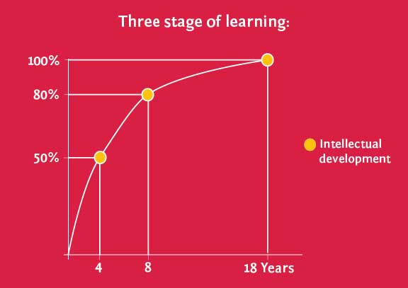
Three Stage of Learning
1st stage is birth to 4 years: 50% of the ability to learn is developed during this time!
2nd stage is 4 to 8 years: Another 30% is developed during this time.
3rd stage is 8 to 18 years: Only 20% is developed during this time.
Everything we learn later grows from the patterns established during these years

Slide 5
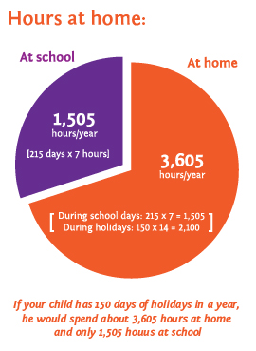
Playtime can be learning time!
Children need a balanced program
Physical development and needs are more obvious so usually get enough attention – through proper nutrition, exercise and health care.
Intellectual development requires more planning and the right environment. Carefully chosen learning materials can transform TV, computer and even playtime into learning opportunities.
Emotional development is often linked to the time parents spend with their kids. The less time parents have, the better planned it needs to be.

Slide 6
Today’s kids are different!
How are they different?
They’re smarter.
They can multi-task.
Kids today are experiencing more technology than ever.
What does it all mean?
Today’s children learn differently; their attention spans are shorter
Traditional teaching methods may not be as effective
Learning material must be a lot more interactive to get their attention and hold it

Slide 7
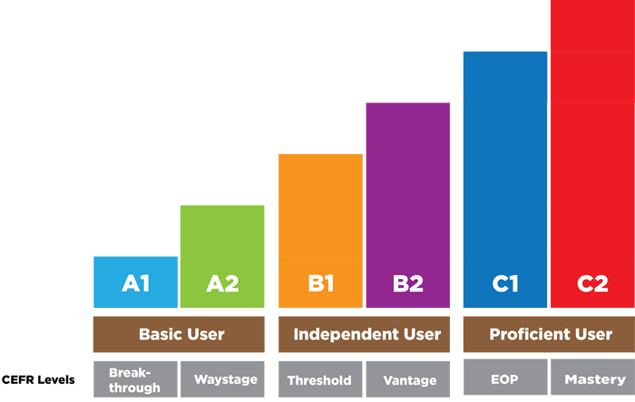
Curriculum Development
CEFR Levels
Grade 1 Pre A1
Grade 2 A1
Grade 3 A2

Slide 8
Video
აქ წავა სკოლების ვიდეოები

Slide 9
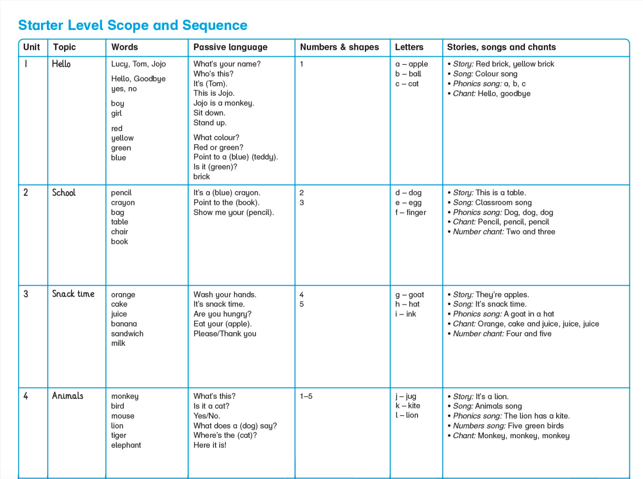
Prepare for Pre A1

Slide 10
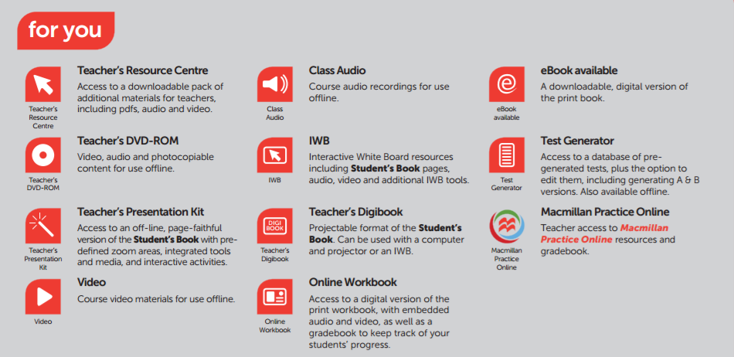
Components

Slide 11
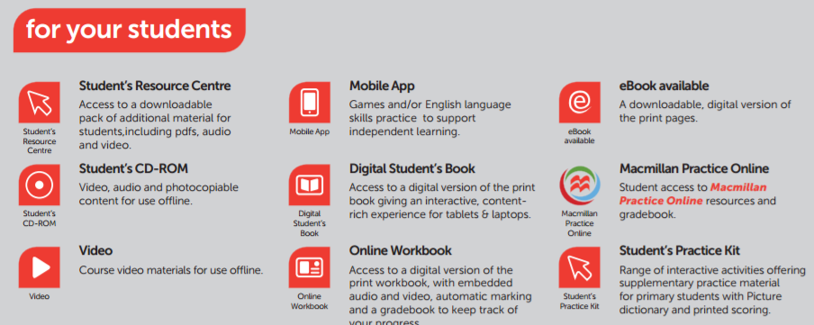
Components

Slide 12
Publishers
Macmillan education
Pearson ELT
Cambridge university Press
Oxford university Press
NATIONAL GEOGRAPHIC LEARNING
CENGAGE Learning

Slide 13
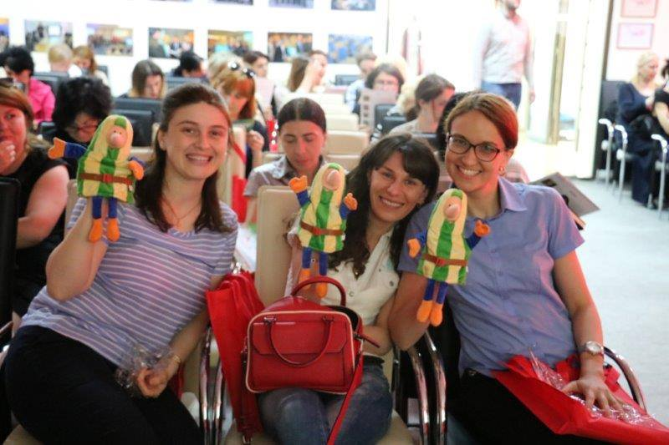
Teacher Development
Methodology
Curricula
Resources
Observation

Slide 14
Hop on the Wheel with Carol

Slide 15
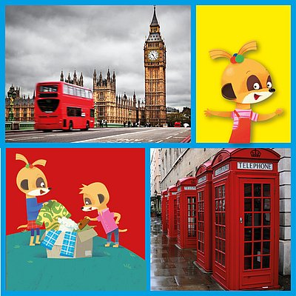
Hop on the Wheel with Carol
WIN a trip to London and come to our exclusive ELT workshop
Send us your video by midnight on 31st March 2020. If you win you will need to be able to come to London
between the 13th and 16th July 2020.We will announce
the winners on 18th April during IATEFL 2020,
so keep an eye on your inbox!

