Slide 1





Slide 2
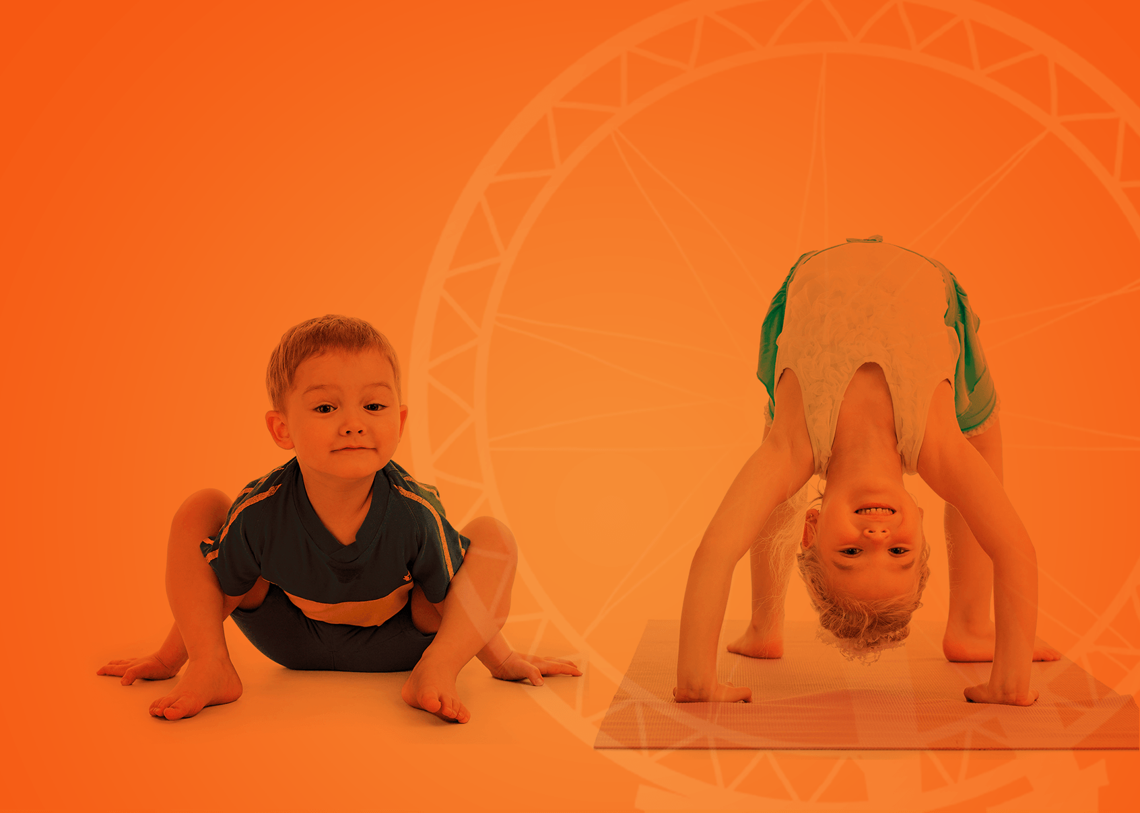



Contents
UNIQUE FLEXIBILITY
with the Hop on & Hop off approach
ENGAGEMENT AND INSTANT LEARNING
with the balance of fantasy and reality
WHOLE CHILD DEVELOPMENT
with learning language and values
CLASS MANAGEMENT
at your fingertips
Notes:
Agenda for the session:
Discuss each of the below bullets on click.
We will learn about the unique Hop on and Hop Off approach which allows to easily align the English language programme to your school / curriculum requirements.
We will look at, what we believe, is the most effective way of engaging very young learners and getting them to use English straightaway.
We will consider how to effectively combine learning English with educating and developing very young learners so they are better prepared for Primary education, and life ahead of them in general.
And finally, we will see how the various teachers’ tools can make your (pre-primary teacher) life easier and help you stay confident that you are always in control of your classroom

Slide 3


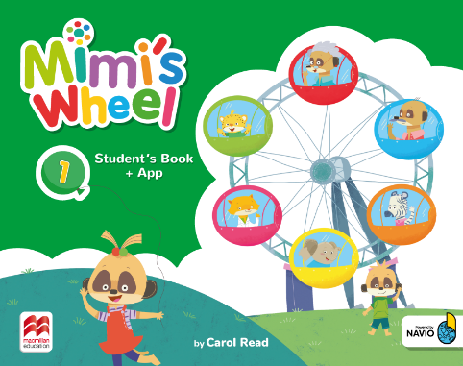
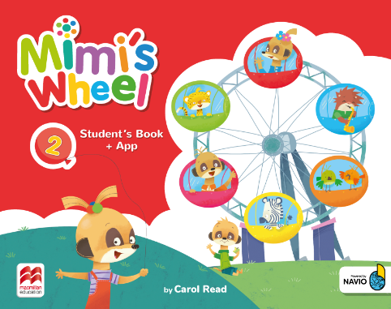
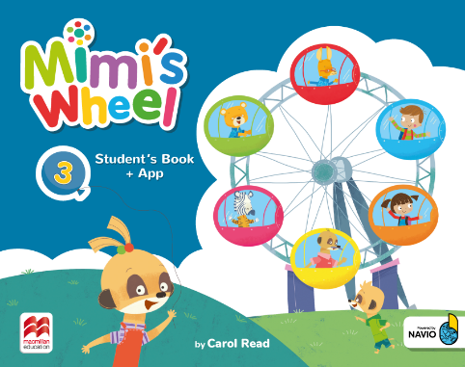
George W.G. Ferris Jr.
World’s Columbian Exposition 1893
http://www.architecture.org/news/evolving-chicago/chicagos-ferris-wheel-story/
Notes:
Show the visual and ask the below question.
Do you know where the design for the contemporary structure of the amusement wheel comes from?
Show answer on click
The original steel wheel was designed by George Washington Gale Ferris Jr. for the World’s Columbian Exposition of 1893 in Chicago. It was not the first amusement wheel, but the structure of Ferris wheel was UNIQUE, it was 264 feet high, and more than 2000 people could take a ride on it at the same time. It was the most original structure of its times.
And now, an interesting linguistic fact. As often is the case, the British and American names differ. In AmE the name is Ferris wheel, from the name of the designer, do you know what it’s called in BrE?...........Yes, BIG WHEEL. And truly BIG and UNIQUE it is, as the course called Mimi’s Wheel which I will have a pleasure of introducing to you today.
Show 3 covers of the course on click.
==================================================================
ADDITIONAL INFO (does not have to be cited during the presentation):
The Ferris Wheel was built to rival the world famous structure which had been built for the previous Exposition in 1889 in Paris – The Eiffel Tower.
Source for info about Ferris Wheel and the photo:
http://www.architecture.org/news/evolving-chicago/chicagos-ferris-wheel-story/

Slide 4

UNIQUE FLEXIBILITY
with the Hop on & Hop off approach

Slide 5


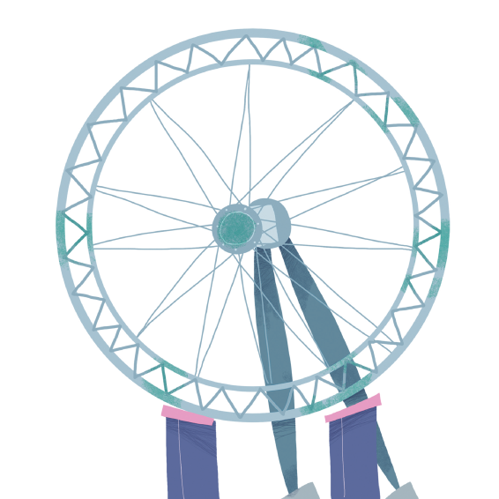


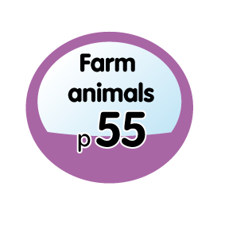


Hop on & Hop off approach modular structure
Mimi’s Wheel has non-linear structure with modular, topic-driven units which are not numbered.
You can either
follow the perfectly crafted unit sequence
or arrange them
in a different order
that suits the class needs or your institution requirements better.
Notes:
The modular structure of Mimi’s Wheel course is as unique as the structure of the big wheel.
1st Click
The course is built of topic driven-units and in non-linear
The units are labelled with the unit titles/ themes rather than unit numbers to reflect this approach.
2nd Click
You can hop on and cover the units in the order they appear in the course…
3rd Click
or hop off and cover them in any order that suits the needs of your class better. In a similar way to hopping on and off the pods of a spinning big wheel.
This is reflected in the name and imagery of the course: Mimi’s Wheel. The key benefit of this approach is that you are not restricted by the order of the units, and you can rearrange them as you wish, to align with the school’s first language curriculum. This allows you to plan your English classes in sync with what pupils are learning about in their first language classes. For example if the students are learning about the family, the you can incorporate the Mimi’s Wheel “Family” unit into your teaching.

Slide 6

Hop on & Hop off approach non-linear learning
'In real life, children learn their mother tongue through random exposure. Learning in the natural environment is not linear. It is situational.’
Ken Carrol
‘Linear and non-linear learning’ 2007
www. ken-carrol.com
http://ken-carroll.com/2007/12/13/linear-and-non-linear-learning/
Notes:
The innovative methodology of Mimi’s Wheel reflects the natural process of non-linear learning, because it is the topic or themes, not the order of units, that should define what children will learn during their lessons.
Click
Read the quote and explain who Ken Carrol is.
==================================================================
(Source: http://ken-carroll.com/2007/12/13/linear-and-non-linear-learning/)
ADDITIONAL INFO:
[Ken Carroll is a writer, trainer and an independent business consultant. He co-funded an English-teaching language center in Shanghai, and ChinesePod – an online, Chinese language-learning service composed of multiple key components: video and audio lessons, mobile apps and exercises for vocabulary, pronunciation and dialogue - https://chinesepod.com ]

Slide 7

Even more flexibility
with two versions of the course
Mimi’s Wheel
Mimi’s Wheel
6 units, with structure:
6 unit lessons
Vocabulary (1 p)
Language (1 p)
Story
Story song
Speaking
Review
Values
Culture
8 units, with structure:
8 unit lessons
Vocabulary (2 pp)
Language (2 pp)
Story
Story song
Speaking
Values
Content
Culture
Review
Project
Back of the book
3 festivals
3 projects
Colour picture stickers
Concept lessons
Picture dictionary
Back of the book
3 festivals
Colour picture stickers
Concept lessons
Picture dictionary
Notes:
There is even more flexibility with Mimi’s Wheel because the course is available in two versions:
The standard version is suitable for courses with fewer numbers of contact hours (6 units, 6 lessons within each unit, 72 pages)
The Plus version is is designed for more contact time (more lessons of English per week) and provides more input and practice material for more ambitious learning outcomes (8 units, 8 lesson within each unit, 120 pages / level 1 – 1-5 pages)
Within each version there is an additional layer of flexibility (lessons which are not numbered are optional) allowing to match the course content to the available contact time and expected pace of the syllabus.

Slide 8
ENGAGEMENT AND INSTANT LEARNING
with the balance of fantasy and reality

Slide 9

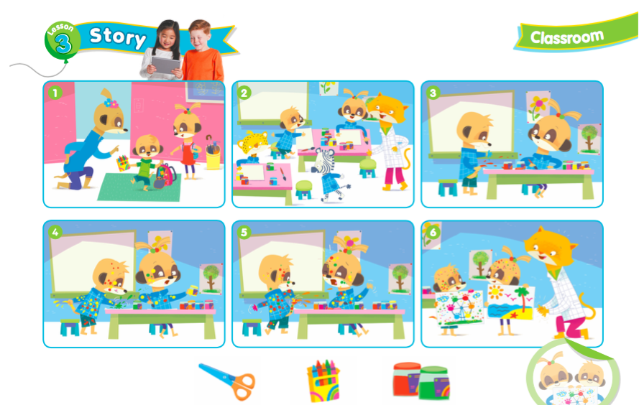
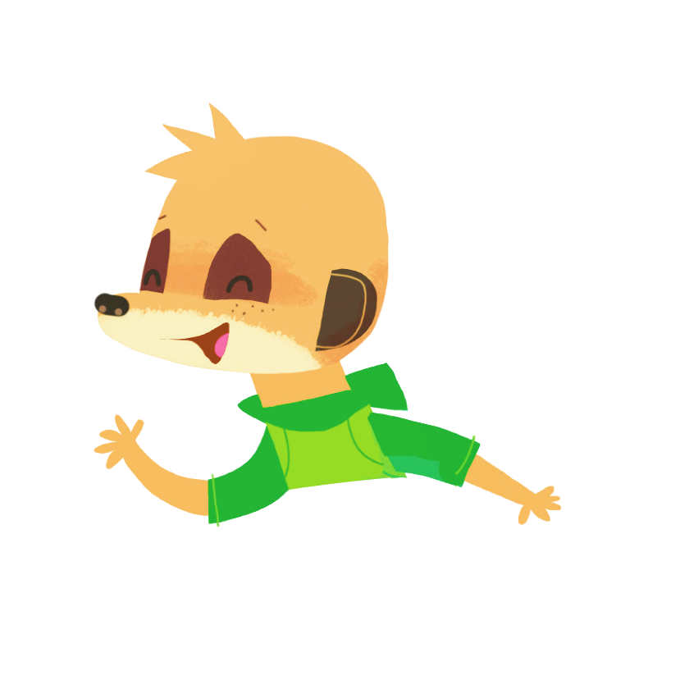
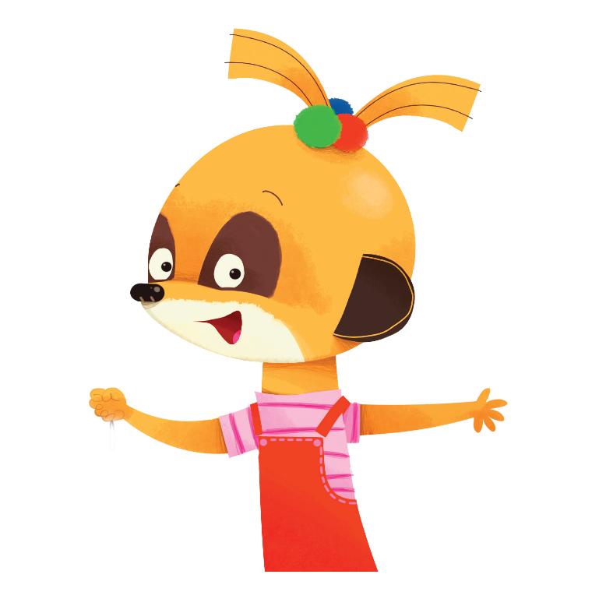
Fantasy and real world
Stories and songs with Mimi’s family and friends introduce language and structures.
Fantasy world builds on children’s natural creativity, imagination and playfulness.
Mimi’s Wheel PB 2, Unit ‘Classroom’
Notes:
A balance of fantasy and reality is central to Mimi’s Wheel.
Click
We have created a fantasy world of a meerkat family and their friends which taps into the children’s creativity, imagination and playfulness.
Let’s see how Mimi, the meerkat, the main protagonist of the course, and her family, introduce language in the animated story.
If there is time, show the animated story video.
The video is embedded in the green star in the slide or under this link: https://drive.google.com/open?id=1emZjOqWUBAQG8qw2-W6ElX35jg93yHzw
If there is less time, show the story on the slide and quickly explain it is also animated as a video.
All the stories, as you have just seen from the one we have jus watched, are firmly rooted in reality and real-life situations that children can relate to.

Slide 10
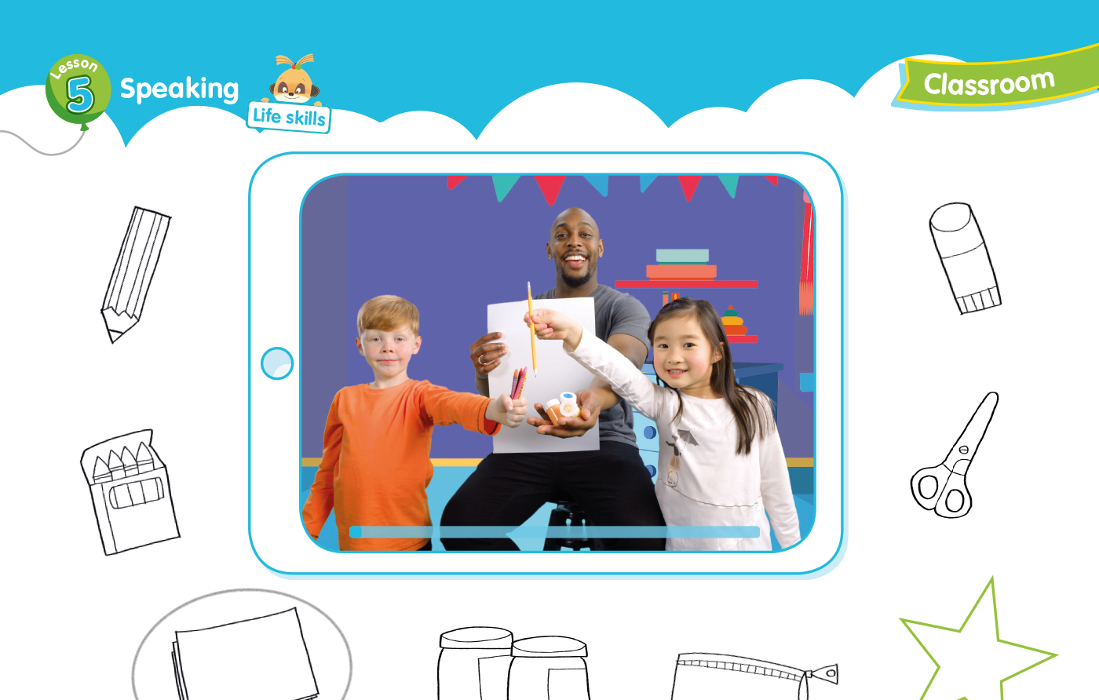
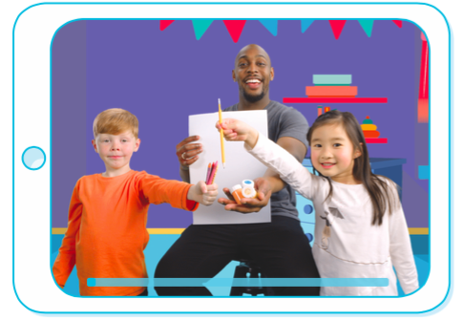


Fantasy and real world
The language introduced in the fantasy world is further contextualised in the real world situations.
Real children provide models of real-life situations
and opportunities to practise new language and skills.
Notes:
Language is then further contextualised in the real world situations (videos) which allows children to identify and use the language in their own personal contexts.
Let’s watch the video from the Classroom unit to see how language introduced in the animated story is modeled in the examples by real-life course characters.
The video is embedded in the green star or under this link: https://drive.google.com/open?id=1kh4rwr_8wgKxZsvLJvbPRd3avWUB1Nqc
Click
As you have seen, students will watch a video of real kids speaking which provides them with a model to create and act out their own dialogues. In this way children can instantly identify the situations the newly learnt language is used in, and are able to apply it in their own real-world situations, in or outside the classroom.

Slide 11
WHOLE CHILD DEVELOPMENT
with learning language and values

Slide 12
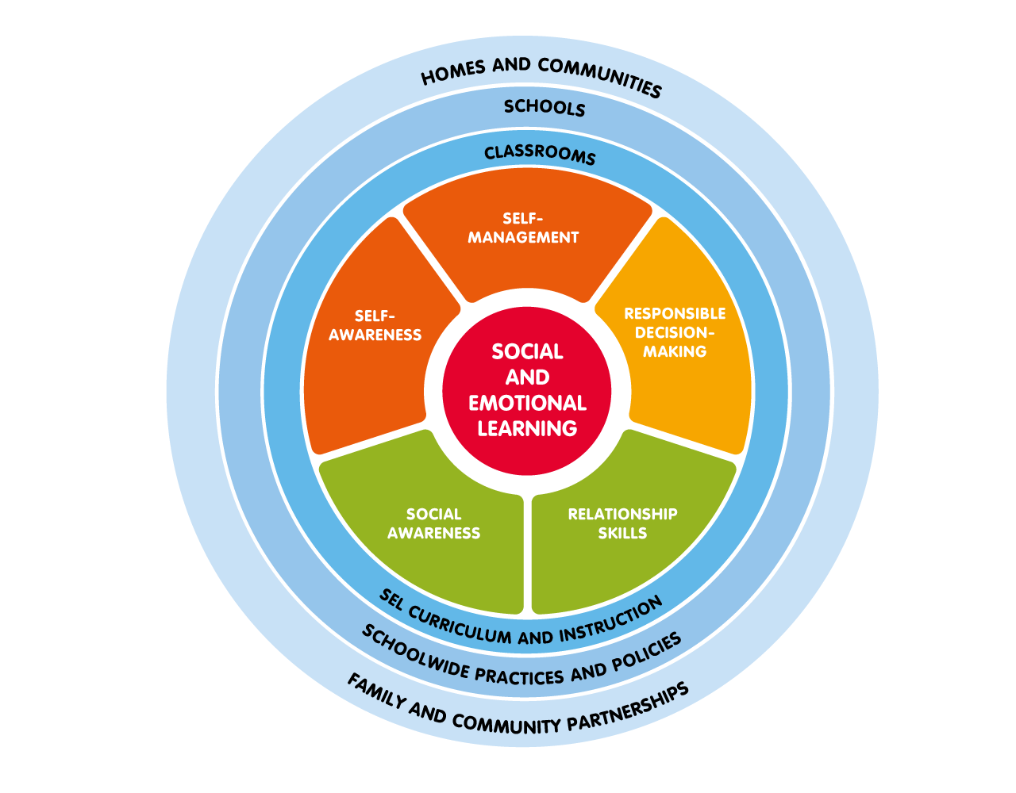
Social and Emotional Learning (SEL)
Mimi’s Wheel
combines development of
Social and Emotional
Learning (SEL)
with learning English.
SEL enables children
to deal confidently with
the psychological, social
and academic demands
of pre-school and prepares them for primary education,
and life ahead.
https://casel.org/core-competencies/
Notes:
Mimi’s Wheel combines development of Social and Emotional Learning (SEL) with learning English.
As students take their first steps into education, we wanted to provide linguistic as well as more holistic development opportunities for very young learners in the course. This way students can acquire the language as well as solid foundations for life skills and values needed for primary education, and life ahead. Social and emotional learning is introduced early on and happens in parallel to language learning.
Click
Thanks to Social and Emotional Learning pupils can gain useful skills to:
understand and manage their own emotions and behaviours,
set and achieve positive goals,
make responsible decisions, and solve problems peacefully and effectively,
establish and maintain healthy relationships, and
feel and show empathy for others.
================================================================
ADDITIONAL INFO:
The Collaborative for Academic, Social and Emotional Learning (CASEL), a non-profit organization since 2006.
CASEL was formed in 1994 with the goal of establishing high-quality, evidence-based social and emotional learning as an essential part of preschool through high school education. In 1997 the first book including SEL guidelines for educators was published. CASEL brings together prominent leaders in the field of education, scientific research, public policy and philathropy.
[a short video about SEL for the presenter to see before the presentation]
https://www.youtube.com/watch?v=ikehX9o1JbI
INFO ON CASEL
https://casel.org/our-work/

Slide 13
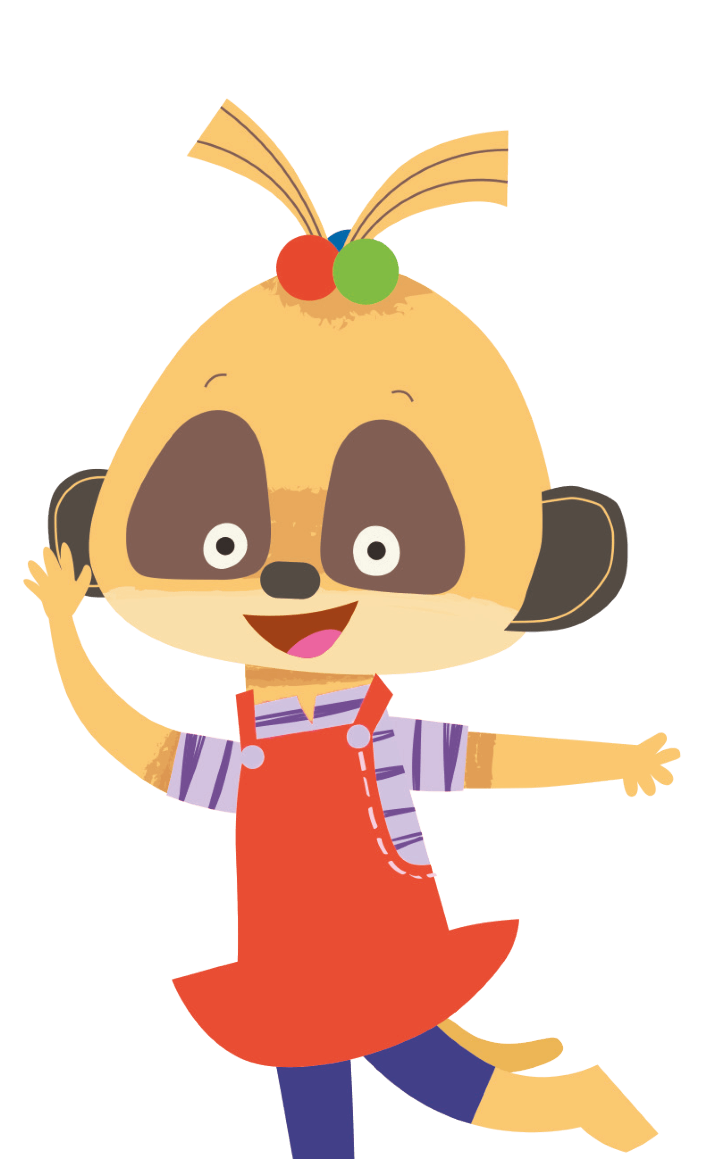

Whole child development equality
Mimi is the first female lead character in a pre-school course.
Teaching children about equality is a priority in UNESCO initiative for GCED.
Notes:
Click
Mimi is the first Macmillan female lead character in a pre-primary course. Mimi, and her family show throughout the course how girls and boys can engage in the same activities, which plants the seed of gender equality in very young learners.Mimi is like most children – curious about the world, full of fun, at times naughty, but also sensible, helpful, loving and kind. She shows children that both girls and boys can do the same things, can cooperate, and be leaders.
Click
Worth noting that the notion of equality is a priority in the new UNESCO initiative for Global Citizenship Education.

Slide 14

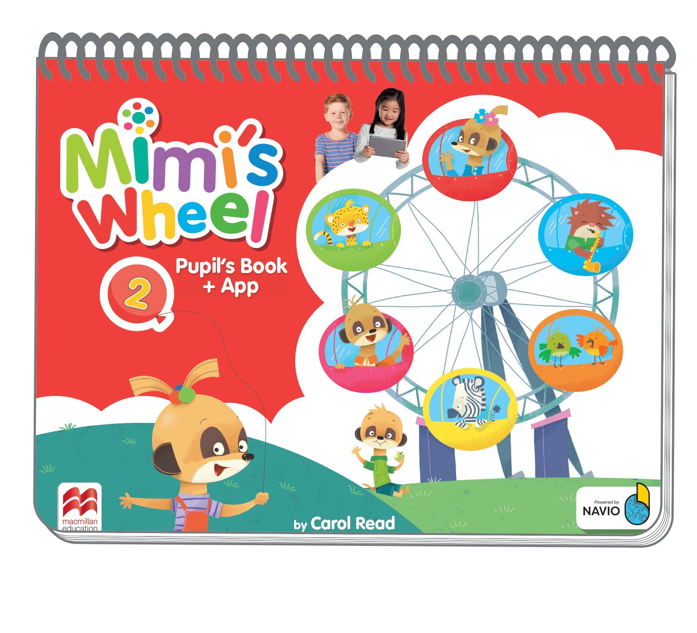
Whole child development
fine motor skills
Mimi’s Wheel has unique binding at the top of the page.
Both right-handed and left-handed children can develop fine motor skills using the whole pages of the book, moving their little hands freely while tracing, drawing, colouring and pasting.
Notes:
Activities such as colouring, painting, sticking and decorating promote the development of fine motor skills in a fun and enjoyable way.
Click
Mimi’s Wheel has unique spiral binding at the top of the page.
Click
This way both right-handed and left-handed children can develop fine motor skills using the whole pages of the book, moving their little hands freely.

Slide 15
CLASS MANAGEMENT
at your fingertips

Slide 16
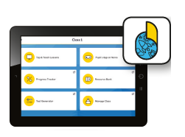



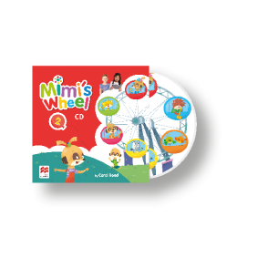
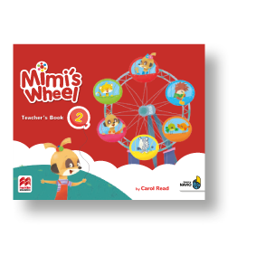
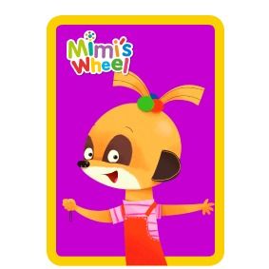
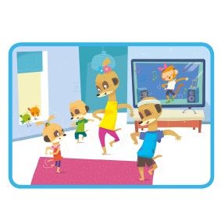
Class management
teacher’s toolkit
Navio App Flashcards Wheel Mat Mimi Puppet
Story Cards Class CD Posters Teacher’s Book
Notes:
Mimi’s Wheel has been designed to give you all the tools you need to effectively teach and successfully manage even large groups of energetic pre-primary learners. The author of the course, Carol Read, guarantees simple to implement teaching ideas and sound pedagogy that works in the classroom.
Click and allow all the pictures flow in. Explain each item and its function one by one.
A collection of teachers’ tools guarantees maximum support and includes:
Navio App with Tap & Teach lessons for clearly sequenced teaching
Printed photographic flashcards help to introduce and recycle vocabulary.
The Wheel Mat for a variety of interactive language games with flashcards or objects put in the pockets.
Mimi puppet that brings the main character to life with multiple activity ideas in TB
Story cards in the Navio App that support storytelling
Class Audio CD with the recordings of all stories, songs, chants, games and dialogues.
Posters for recycling and reviewing vocabulary in Navio App
Teacher’s Book interleaved with PB pages, with rich methodological content for novice and more experienced teachers.

Slide 17

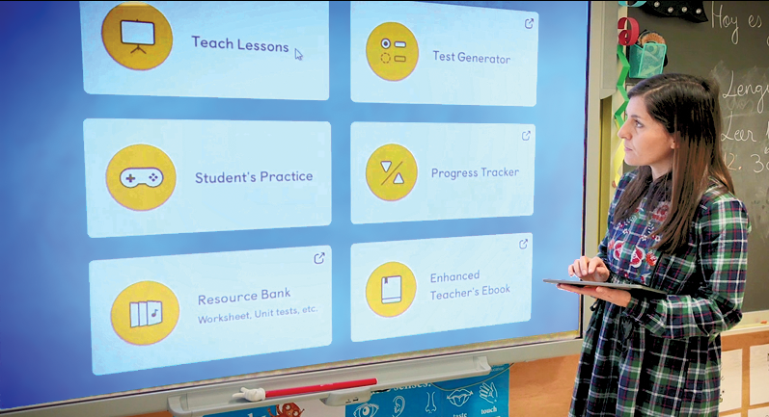
Class management
Teacher’s App on Navio
Teacher’s App on Navio includes
Tap & Teach lessons integrating the content from
  Pupil’s Book
  Flashcards
  Story Cards
  Videos
  Audio
  Posters
Progress Tracker
Rewards system
Photocopiables/ printables
Test Generator
With Navio teachers can deliver clearly sequenced lessons
requiring minimum preparation.
Notes:
Navio is ideal for novice and more experienced pre-primary English teachers. Thanks to ready-made Tap & Teach lessons and resources all in one place you can simply ‘teach off the screen” with no need to consult the Teacher’s Book during the lesson. This way you can be sure that you are in full control of your classrooms and keep the attention and engagement of the your pupils right from the start through to the end of every single lesson.
Practical and easy to use set of digital tools for teachers available through Navio includes:
Tap & Teach lessons integrating the content from
Pupil’s Book
Flashcards
Story cards
Videos
Audio
Posters
Progress Tracker
Rewards system
Photocopiables/ printables
Test Generator

Slide 18
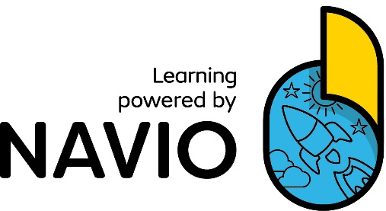

Class management
Home-school link via Pupil’s App on Navio
Pupil’s App on Navio includes
Language games and rewards
Animated stories
Songs and animated song videos
Real world videos
The more children play,
the more they learn.
Notes:
Games and rewards on the Pupil’s App provide engaging language practice and motivate students to learn English also outside of the classroom. Collecting points keeps them engaged so they continuously practise which helps them remember new language better. Teachers can also reward pupils for their behavior and success in activities by adding points to individuals or groups in the classrooms. All points ad up!
The Pupil’s App also includes all the songs, videos and animated stories from the course so that pupils can review them at home and share them with their family. The App provides excellent School-home link.
=================================================================================================
(More detailed explanations concerning Pupil’s App if you have and use direct access on Teacher’s Mode during the presentation)
Progress Tracker and built-in rewards function allows to reward groups or individual pupils for their behavior or success in activities.
Rewards can also be given for doing the activities on the App at home.
Pupils can access their App at home or at school if they have individual devices.
When students earn points, they appear in the Pupil’s App the next time they log in, so parents can see their performance.
Teachers can also access Pupil’s App in the Teacher Mode at school.

Slide 19


‘Get ready to hop on with your children for what I hope will be a truly enjoyable and successful learning journey!’
‘I would like to dedicate Mimi’s Wheel to every pre-school teacher who shares my passion for early language learning and believes in the unique learning potential of every child. I hope you and your children enjoy using Mimi’s Wheel as much as I have enjoyed writing it!’
Notes:
I’d like to finish with the message from the author, Carol Reed:
‘Get ready to hop on with your children for what I hope will be a truly enjoyable and successful learning journey!’
(Let the teachers read the rest of the message)
‘Carol dedicates the course to all teachers who believe in unique learning potential of every child and hopes you will enjoy using Mimi’s Wheel!
Video for internal viewers only: https://drive.google.com/drive/folders/191xMt8OBatZK1Xr6ASApeUJNTrG5QVGP
=================================================================
ADDITIONAL INFO (may, but does not have to be cited during the presentation):
Carol Reed is former IATEFL president, author of many coursebooks for children, winner of ELTon award from British Council for innovation in English language teaching.

Slide 20


THANK YOU!

