Slide 1


Learning Stars
Nene Gigashvili

Slide 2



Notes:
Learning stars is an innovative course for preschoolers. It is challenging and stimulating for the students and easy to use for both specialist English teachers as well as general preschool practitioners and more ambitious parents who are looking for visible effects in their children’s development in various areas of education. It is also an excellent choice for bilingual preschools.

Slide 3








Notes:
The course has three levels starting with little Learning Stars for the younger preschoolers and then moving on to Learning Stars 1 and 2 for older children.

Slide 4





Knowledge
Literacy
Practice
Communication
Notes:
The most important elements that make Learning Stars a great preschool language course are: Early literacy training – preparing children to read and write in English (especially valuable in bilingual preschools as they promote biliteracy development); the Cross-curricular character of many lessons allows children to acquire English while dealing with subject knowledge; A lot of practice both in the playgroup and at home to maximise the time of language exposure; And most importantly, basic early communication skills development in natural contexts through familiar activities like songs, stories and drama

Slide 5
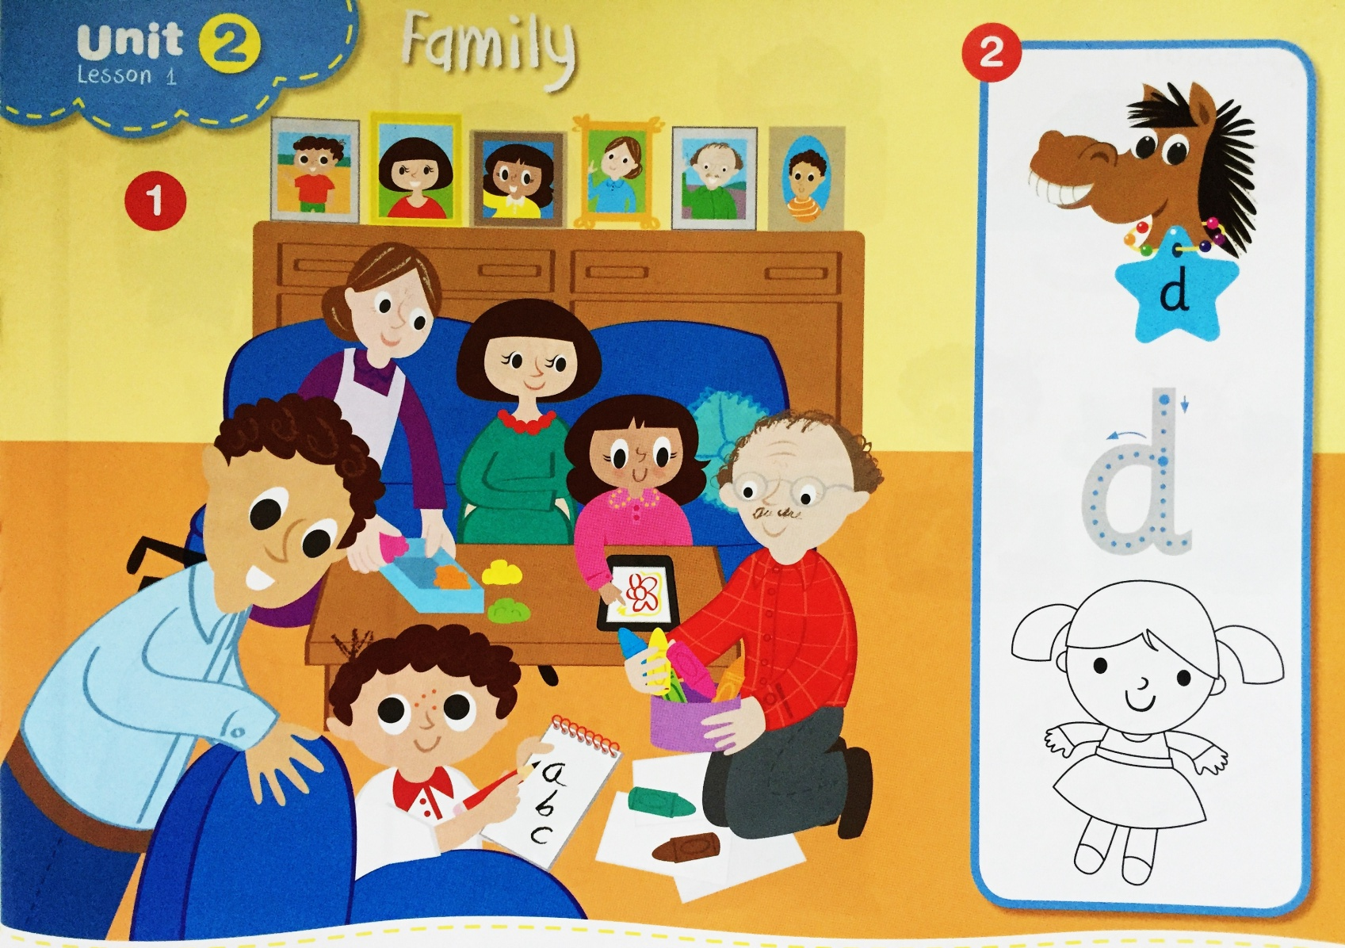
Early literacy skills
Step one
Notes:
Learning Stars introduces young learners into the world or letters in a carefully planned manner. The first step is familiarising the youngest learners with the sounds and shapes of letters. Each letter is paired up with a picture of a word starting with this letter to help students remember the connection.

Slide 6
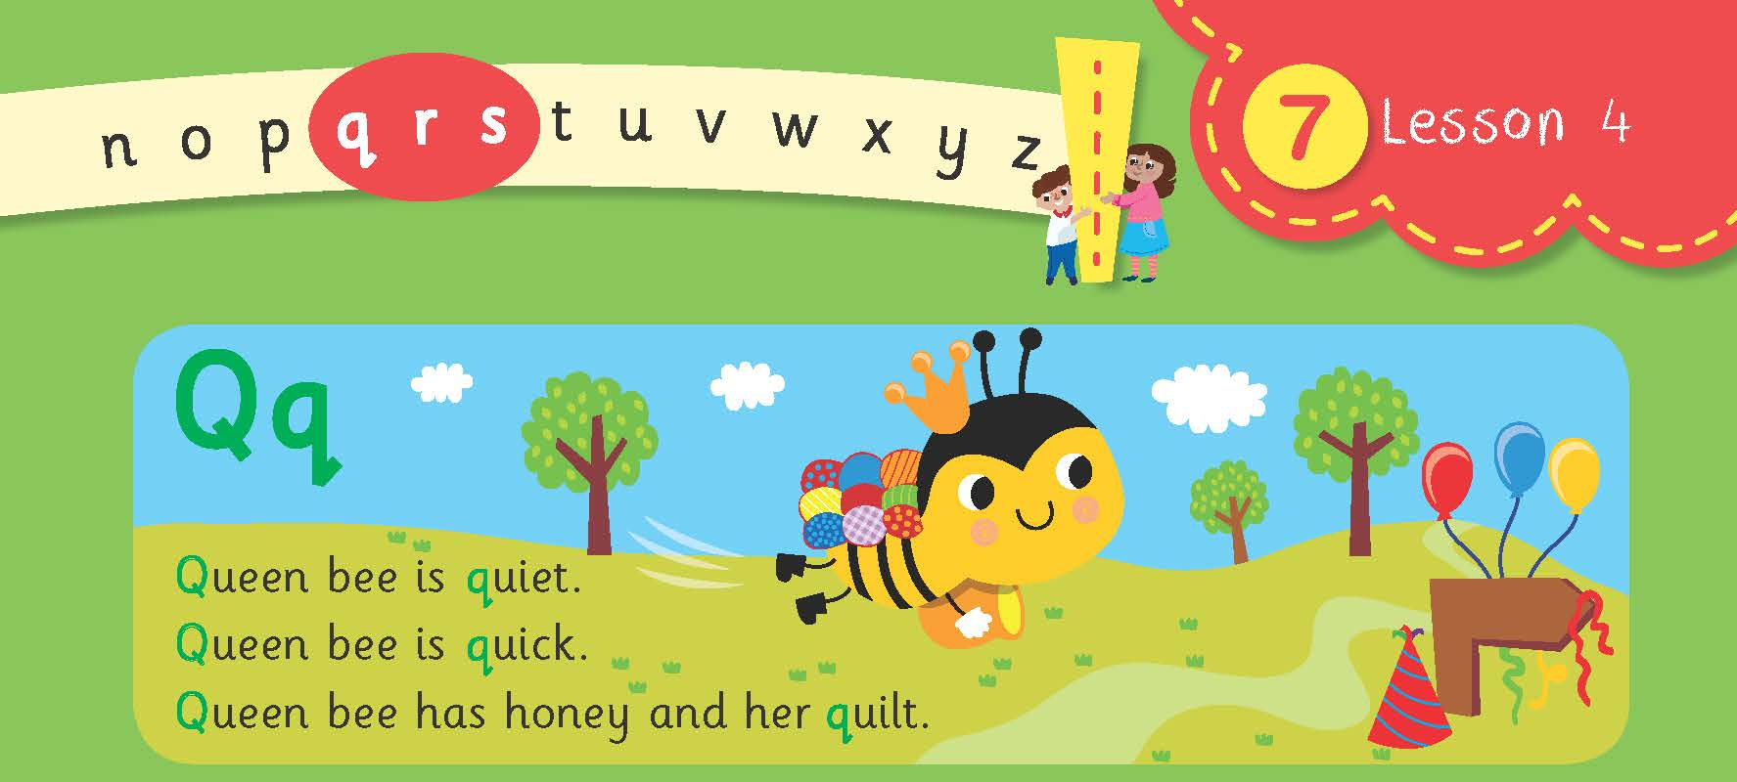
Step two
Notes:
Once the students get older, they learn the shapes of capital and small letters that are paired up with tongue twisters practicing the sounds of these letters. y elements of promoting biliteracy.

Slide 7
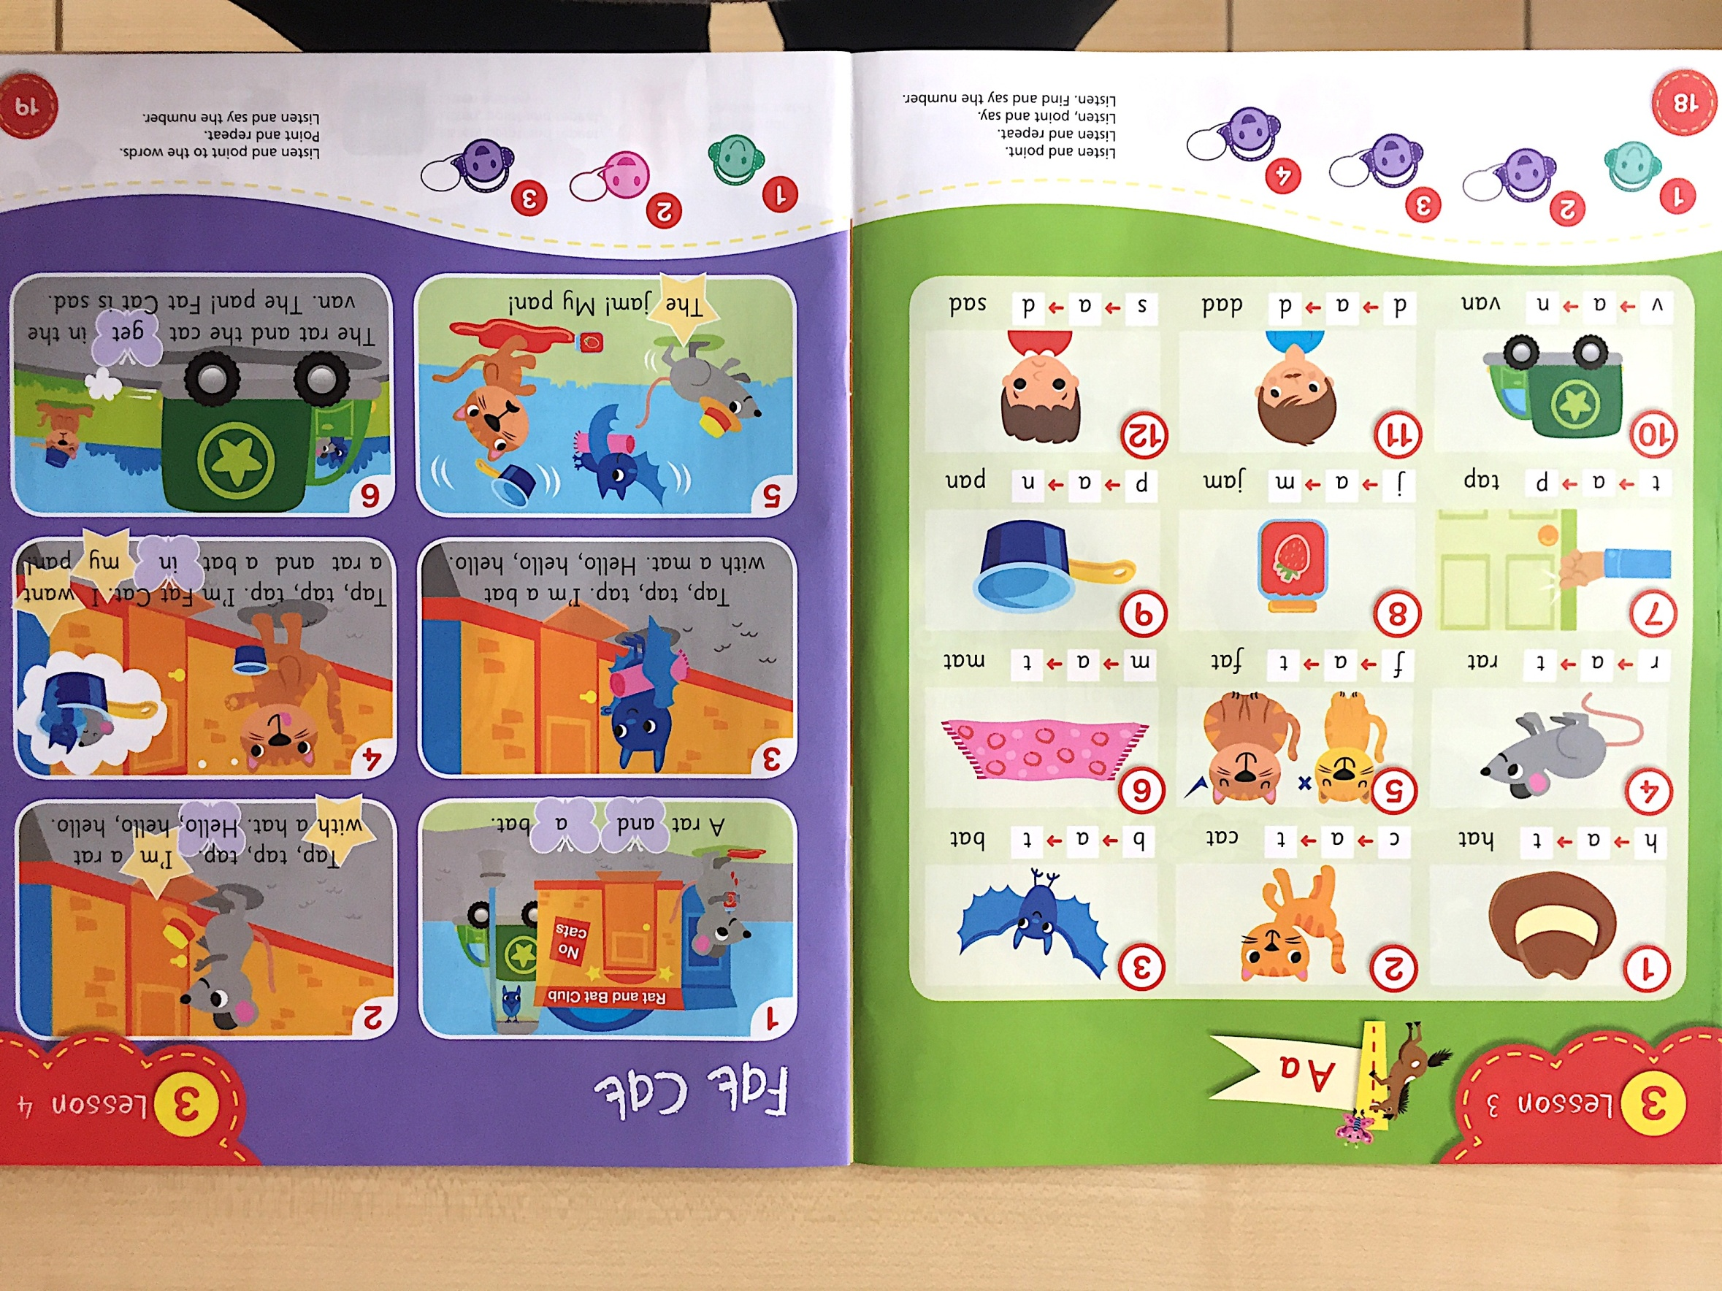
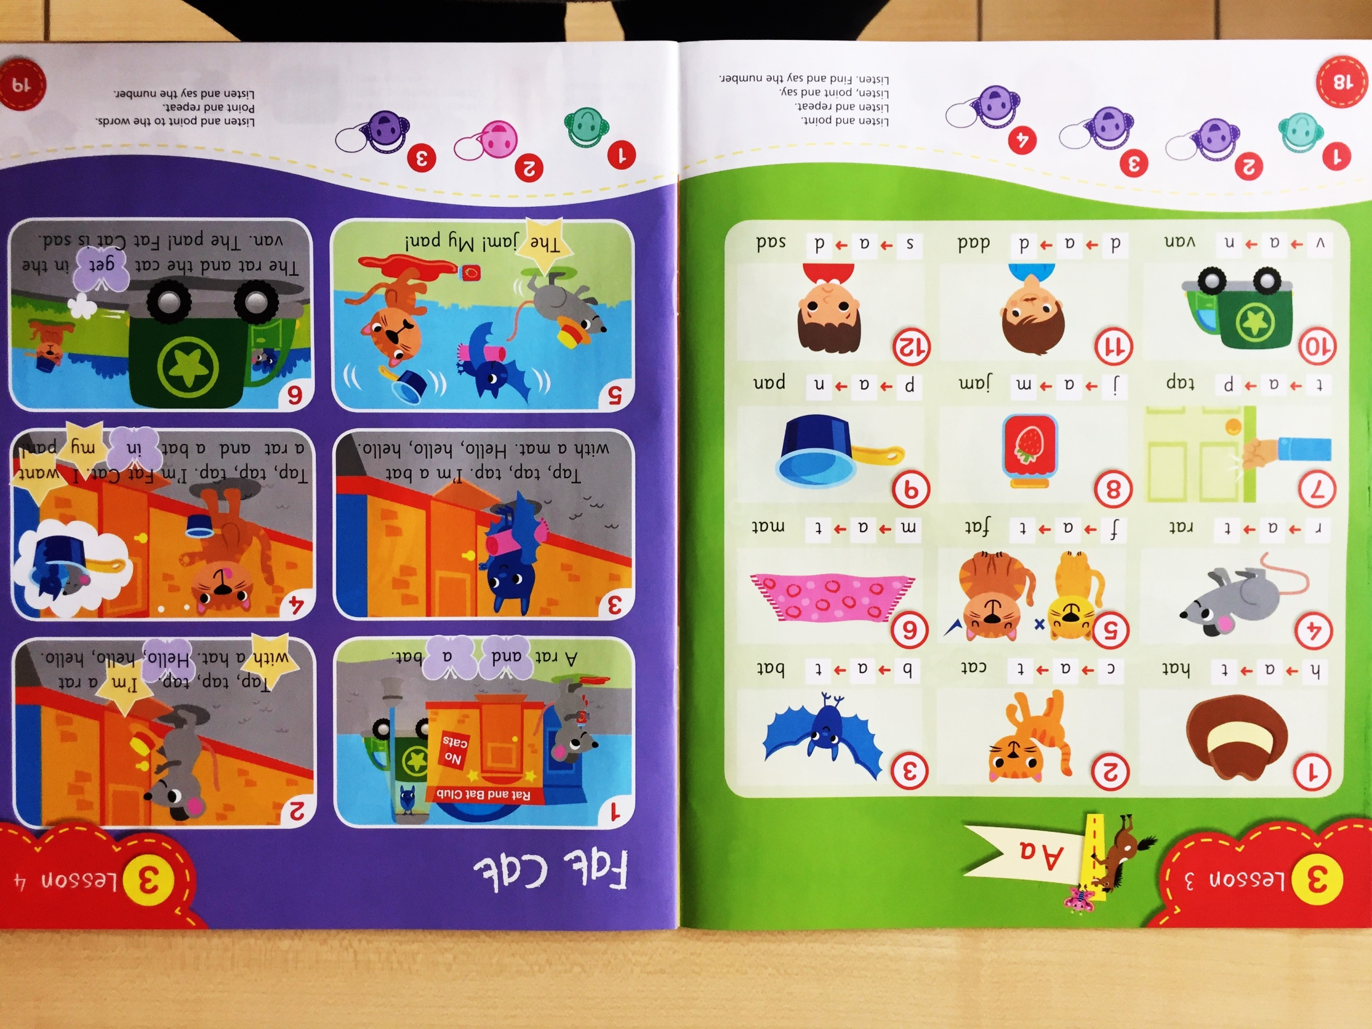
Step three
Notes:
Finally, children are encouraged to analyse and synthesize words from letters and read short words in sentences based on the practiced phonemes. This way, learning the language is enriched by elements of promoting biliteracy.

Slide 8
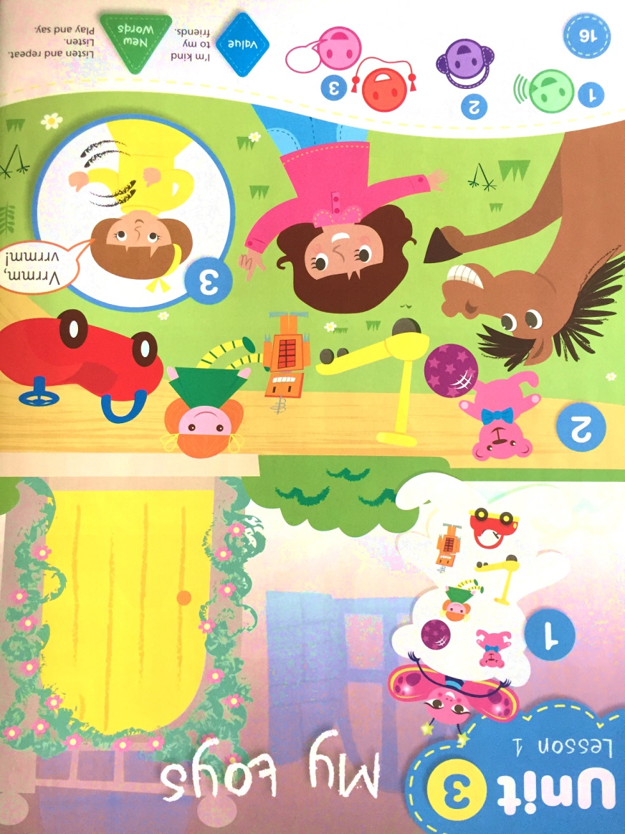
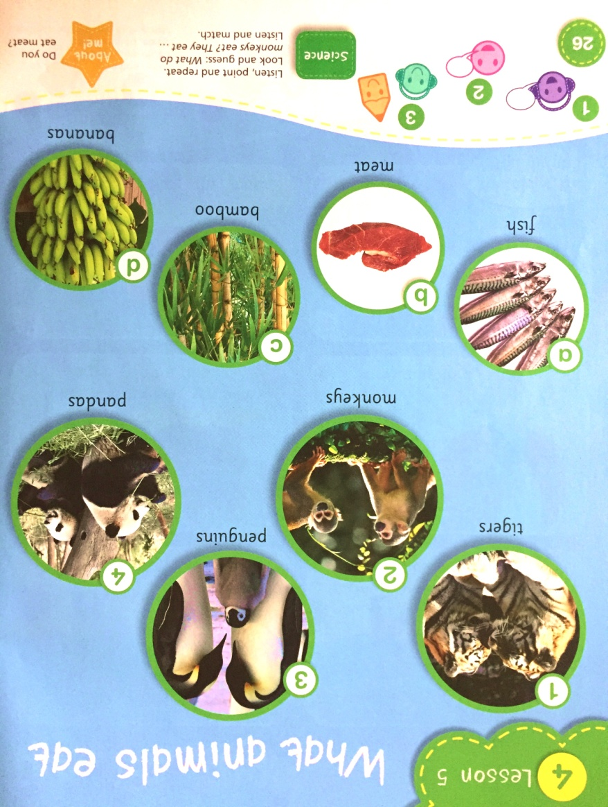
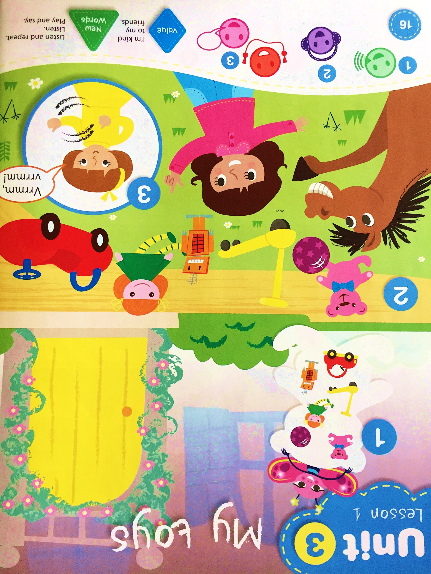
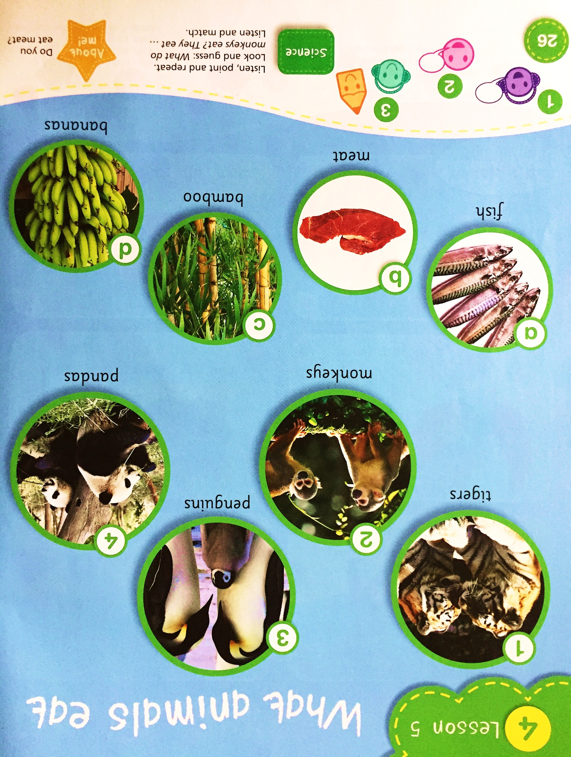
Cross-curricular approach
Notes:
The modern approach to teaching foreign languages stresses the importance of cross curricular instruction – using other subjects content to teach the langauge. The teachers of English are responsible not only for equipping the students with the language itself but also for developing positive attitudes, social skills and general knowledge of the learners. That’s why a good language book includes activities that focus on the content matter of subject areas such as science, PE (physical education) or PSHE (Personal, Social and Health Education) in order to teach values and subject knowledge through English in a very natural way.

Slide 9
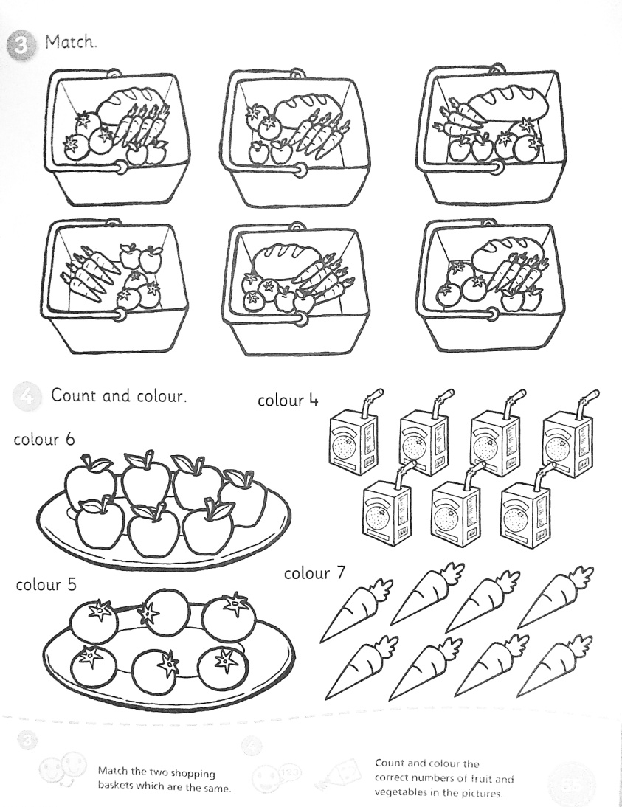
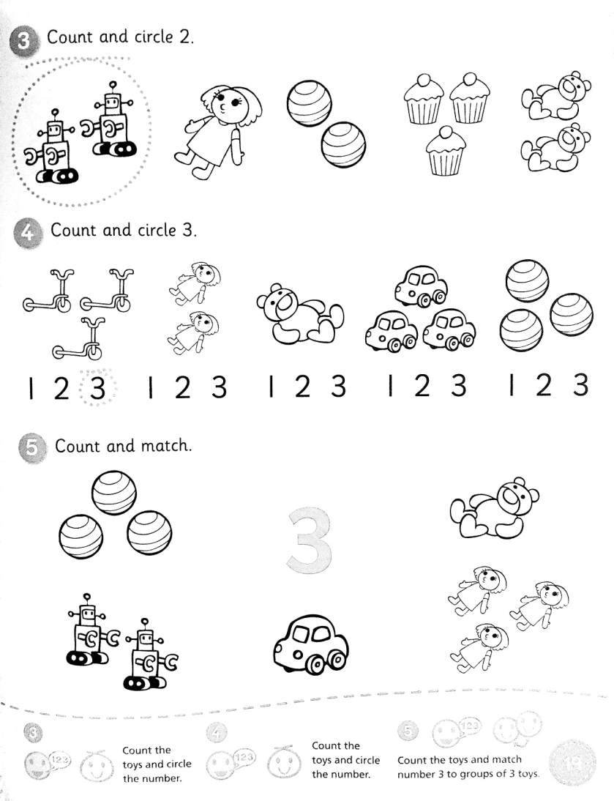
Cross-curricular approach
Maths
Notes:
Learning Stars provides a separate path of maths instruction through English which allows the learners not only to revise the language but also practice their maths skills – a perfect solution for teachers who teach English together with general skills to their learners or those who have to add elements of English to their everyday practice while cooperating with specialist English teachers.

Slide 10
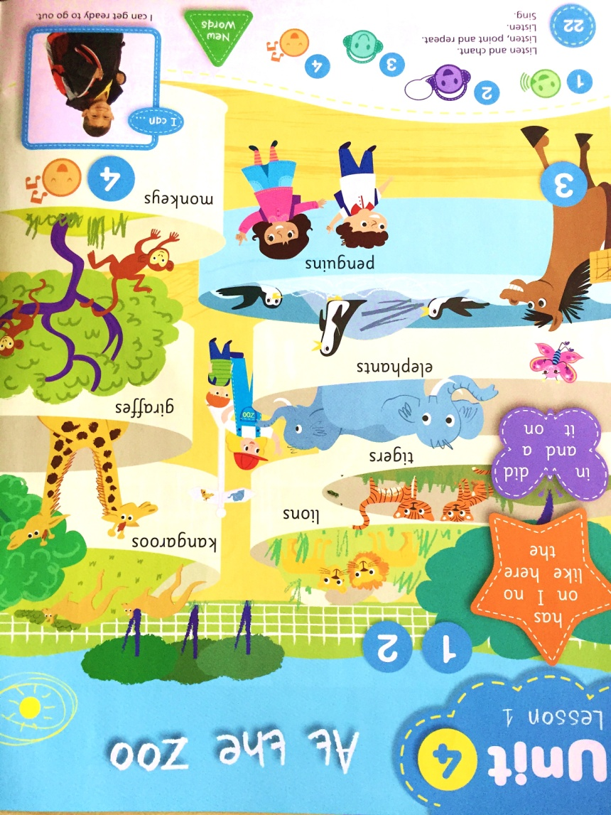


Basic real life communication
Notes:
Songs, stories and dramas allow children to use the new language in a familiar form and natural context. This song teaches the names of zoo animals and the modal verb ‘can’ along with basic science and, when acted out and divided into roles, provides a great exercise in basic communication

Slide 11

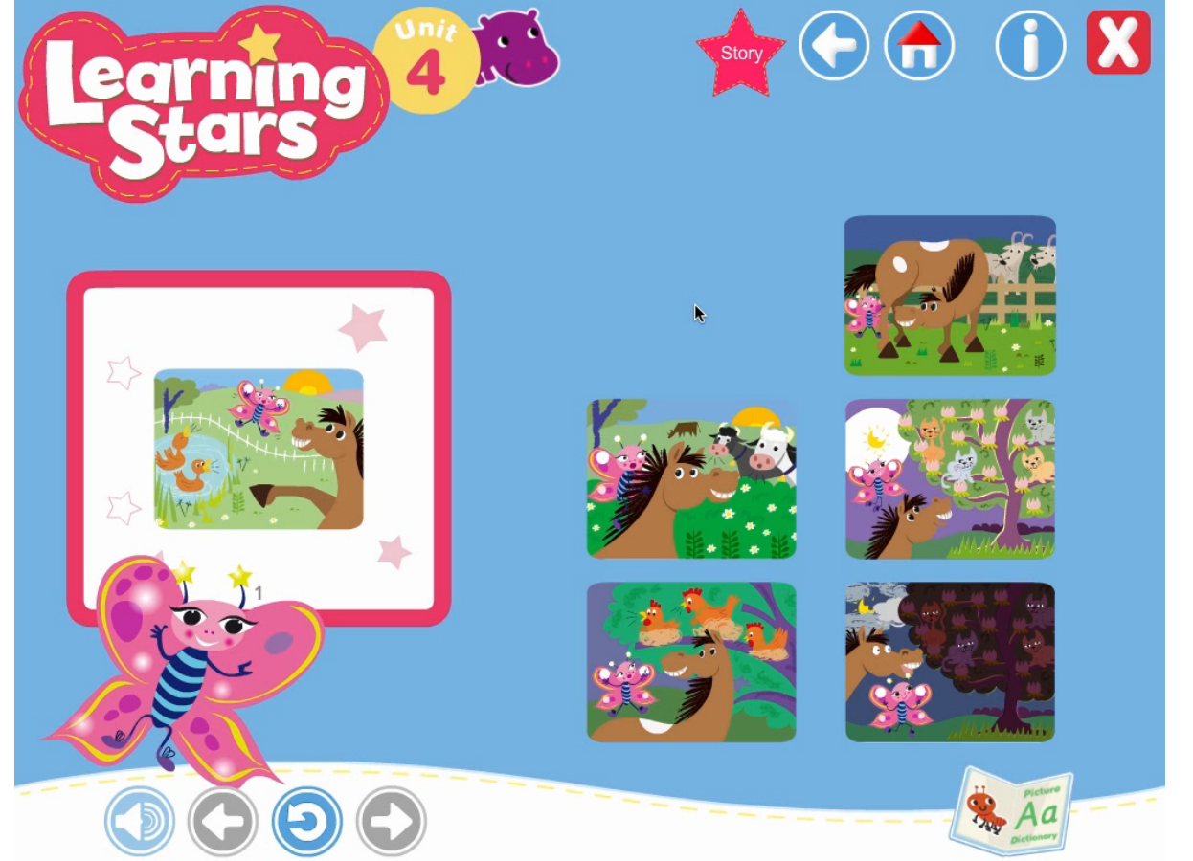
CD-ROM
At home
Notes:
Student’s CD ROM includes a story making activity where students recreate the story they have learnt by sequencing the scenes. Once the story is complete, it is read back to the children while they turn the pages in the digital book. It can be used on an IWB in the classroom as immediate practice or done at home as a revision tool.

Slide 12
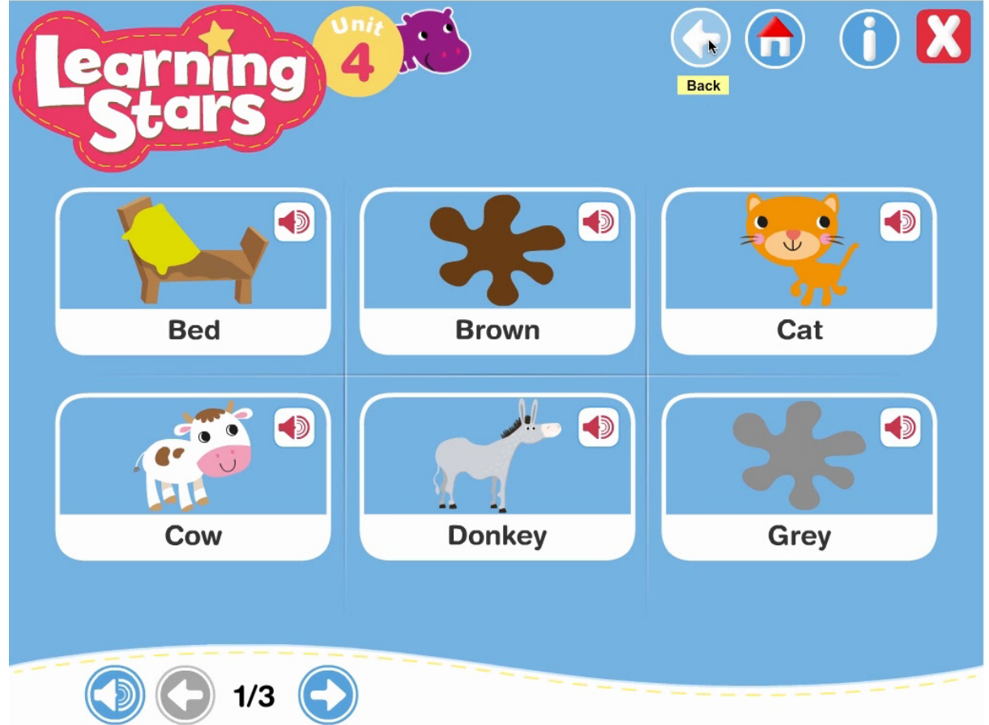
At home
Notes:
Student’s CD ROM also includes a picture dictionary with all key vocabulary recorded so that parents can help their children revise at home even if they don’t know English

Slide 13






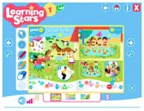
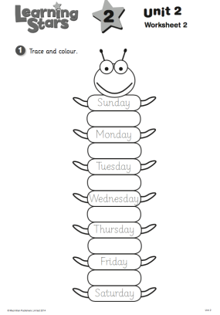
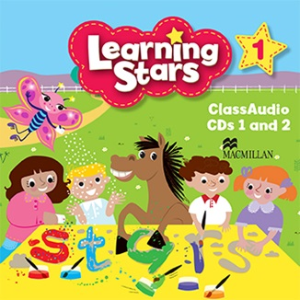


Pupil’s Book + CD-ROM
Activity Book
Maths Book
Teacher’s Book + Digibook
Audio CD
Downloadable Flashcards
Puppet
Notes:
Components for the student: Pupil’s book with a CD ROM (with games, songs, stories and picture dictionary), Activity book, Maths book
for the teacher: teacher’s guide, Digital book, Class audio, downoadable flashcards and extra activities from a web page (access for 4 years), horsey puppet
All this designed to support you in creating a language rich, exciting classroom environment and to help your students become Learning Stars!

Slide 14



Help your students shine!
Ambitious, Exciting & Challenging
1
2
Supports early literacy
3
Cross-curricular
4
Encouraging basic communication
Notes:
1. Learning stars is an exciting course for children eager to start exploring the world around them in English.
2. It helps students improve their literacy skills in a carefully planned manner from learning the shapes of letters to reading simple words
3. The course is designed in accordance with modern theories of teaching a foreign language through content subject areas that allows your children to gain subject knowledge together with language skills.
4. A key concern of Learning Stars is the development of very simple communication skills in natural and familiar contexts through interactive activities in songs, stories and drama

