Slide 1


Slide 2
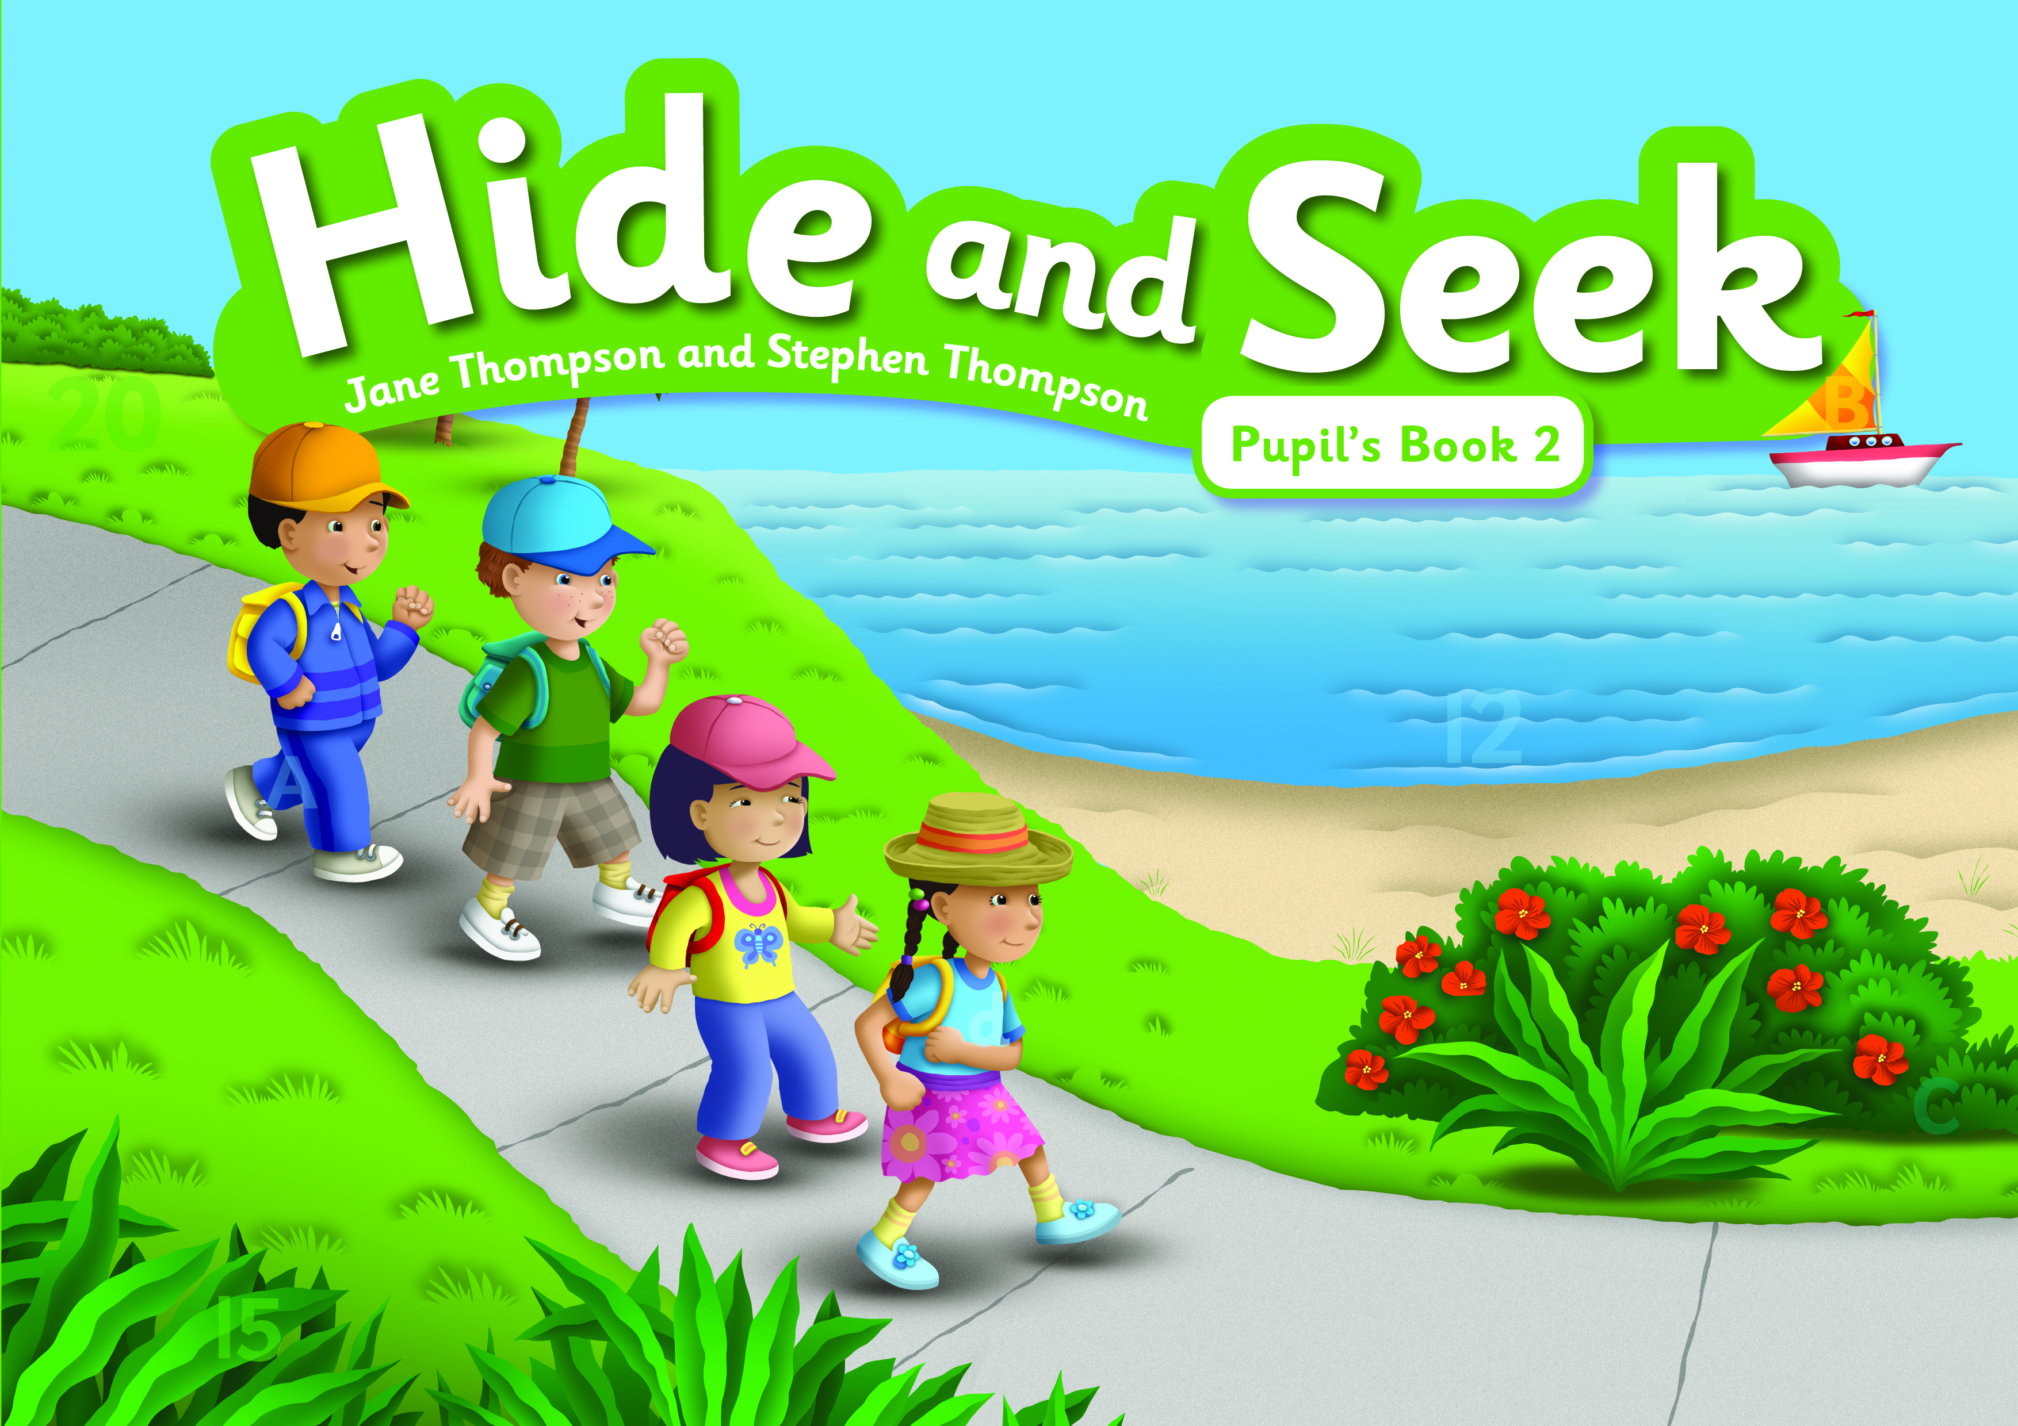

Hide and Seek
3 level KG course for ages 3-6
Pre A1 – A1
Written by early years and primary specialists
130 – 160 hours per level
10 units each with 8 lessons
Focus on literacy and numeracy
CLIL approach to subject strands

Slide 3
Objectives of Hide and Seek
Provide a fun and structured learning experience.
Encourage a positive attitude to learning English.
Provide interesting, age-appropriate materials.
Children should meet and practise a range of English vocabulary and structures
Statutory Early Years Foundation Stage Framework.
Introduce the English alphabet and phonic sounds.

Slide 4
Statutory Early Years Foundation Stage Framework (England) (EYFS)
  Language and communication
  Physical development
  Personal, social and emotional development
  Literacy
  Maths
  Understanding the world (Science)
  Expressive arts and design

Slide 6
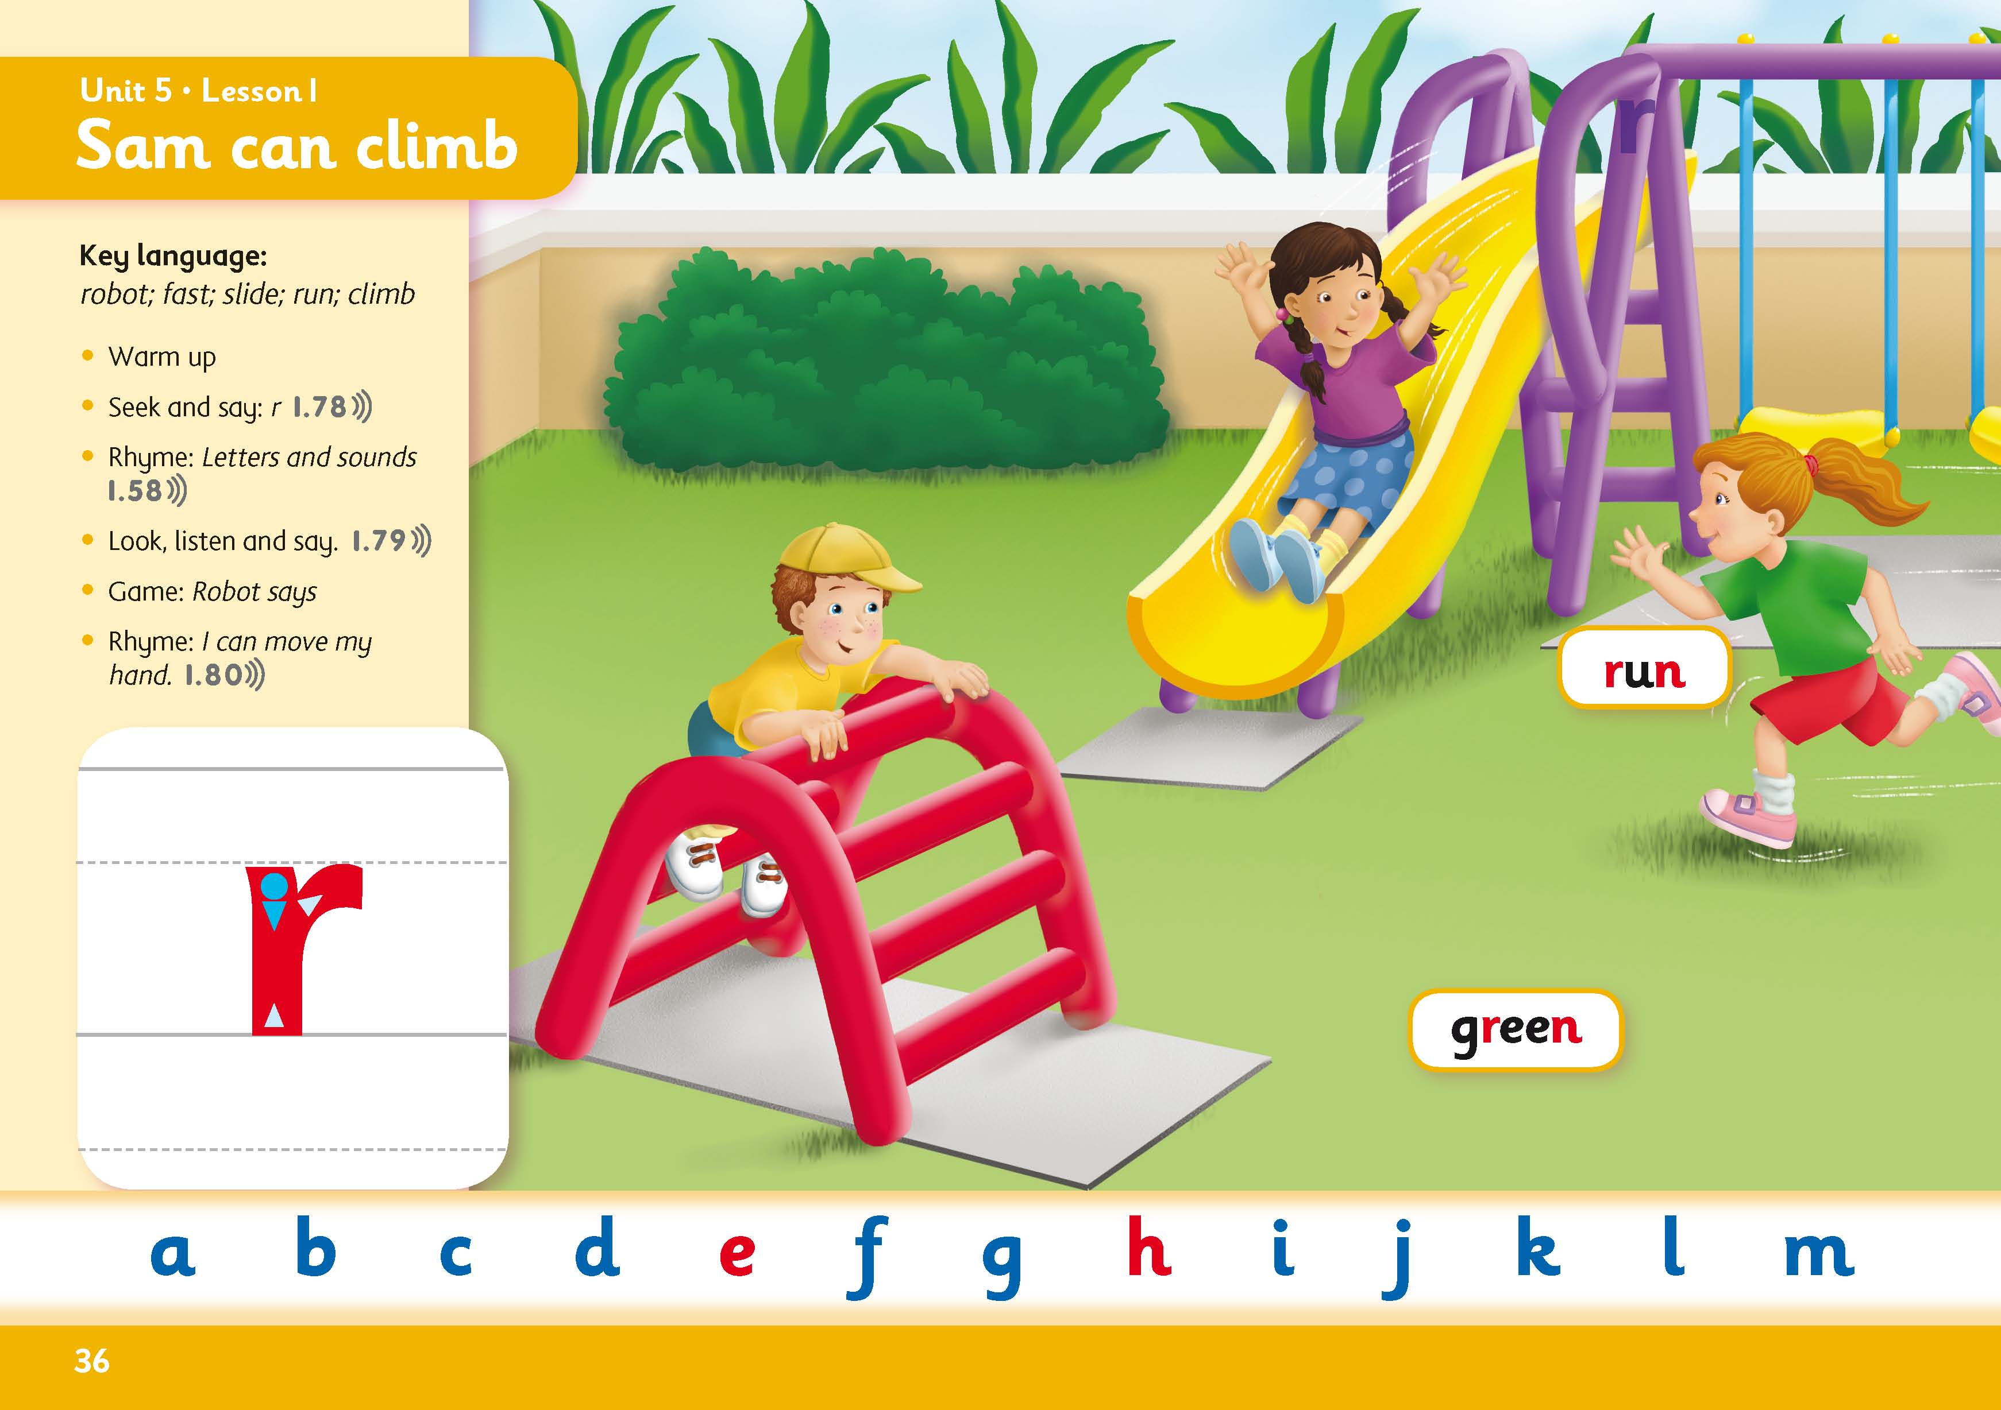
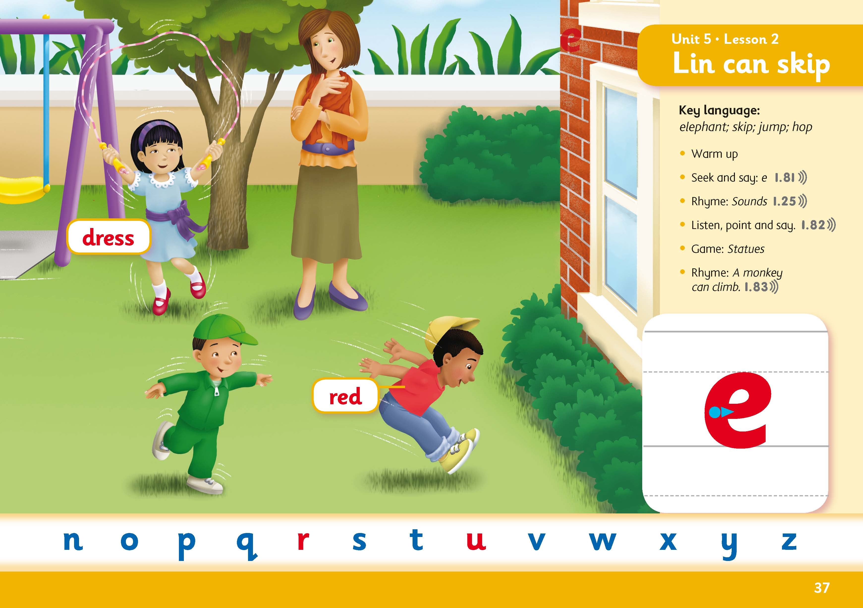
Literacy
Book 2

Slide 7
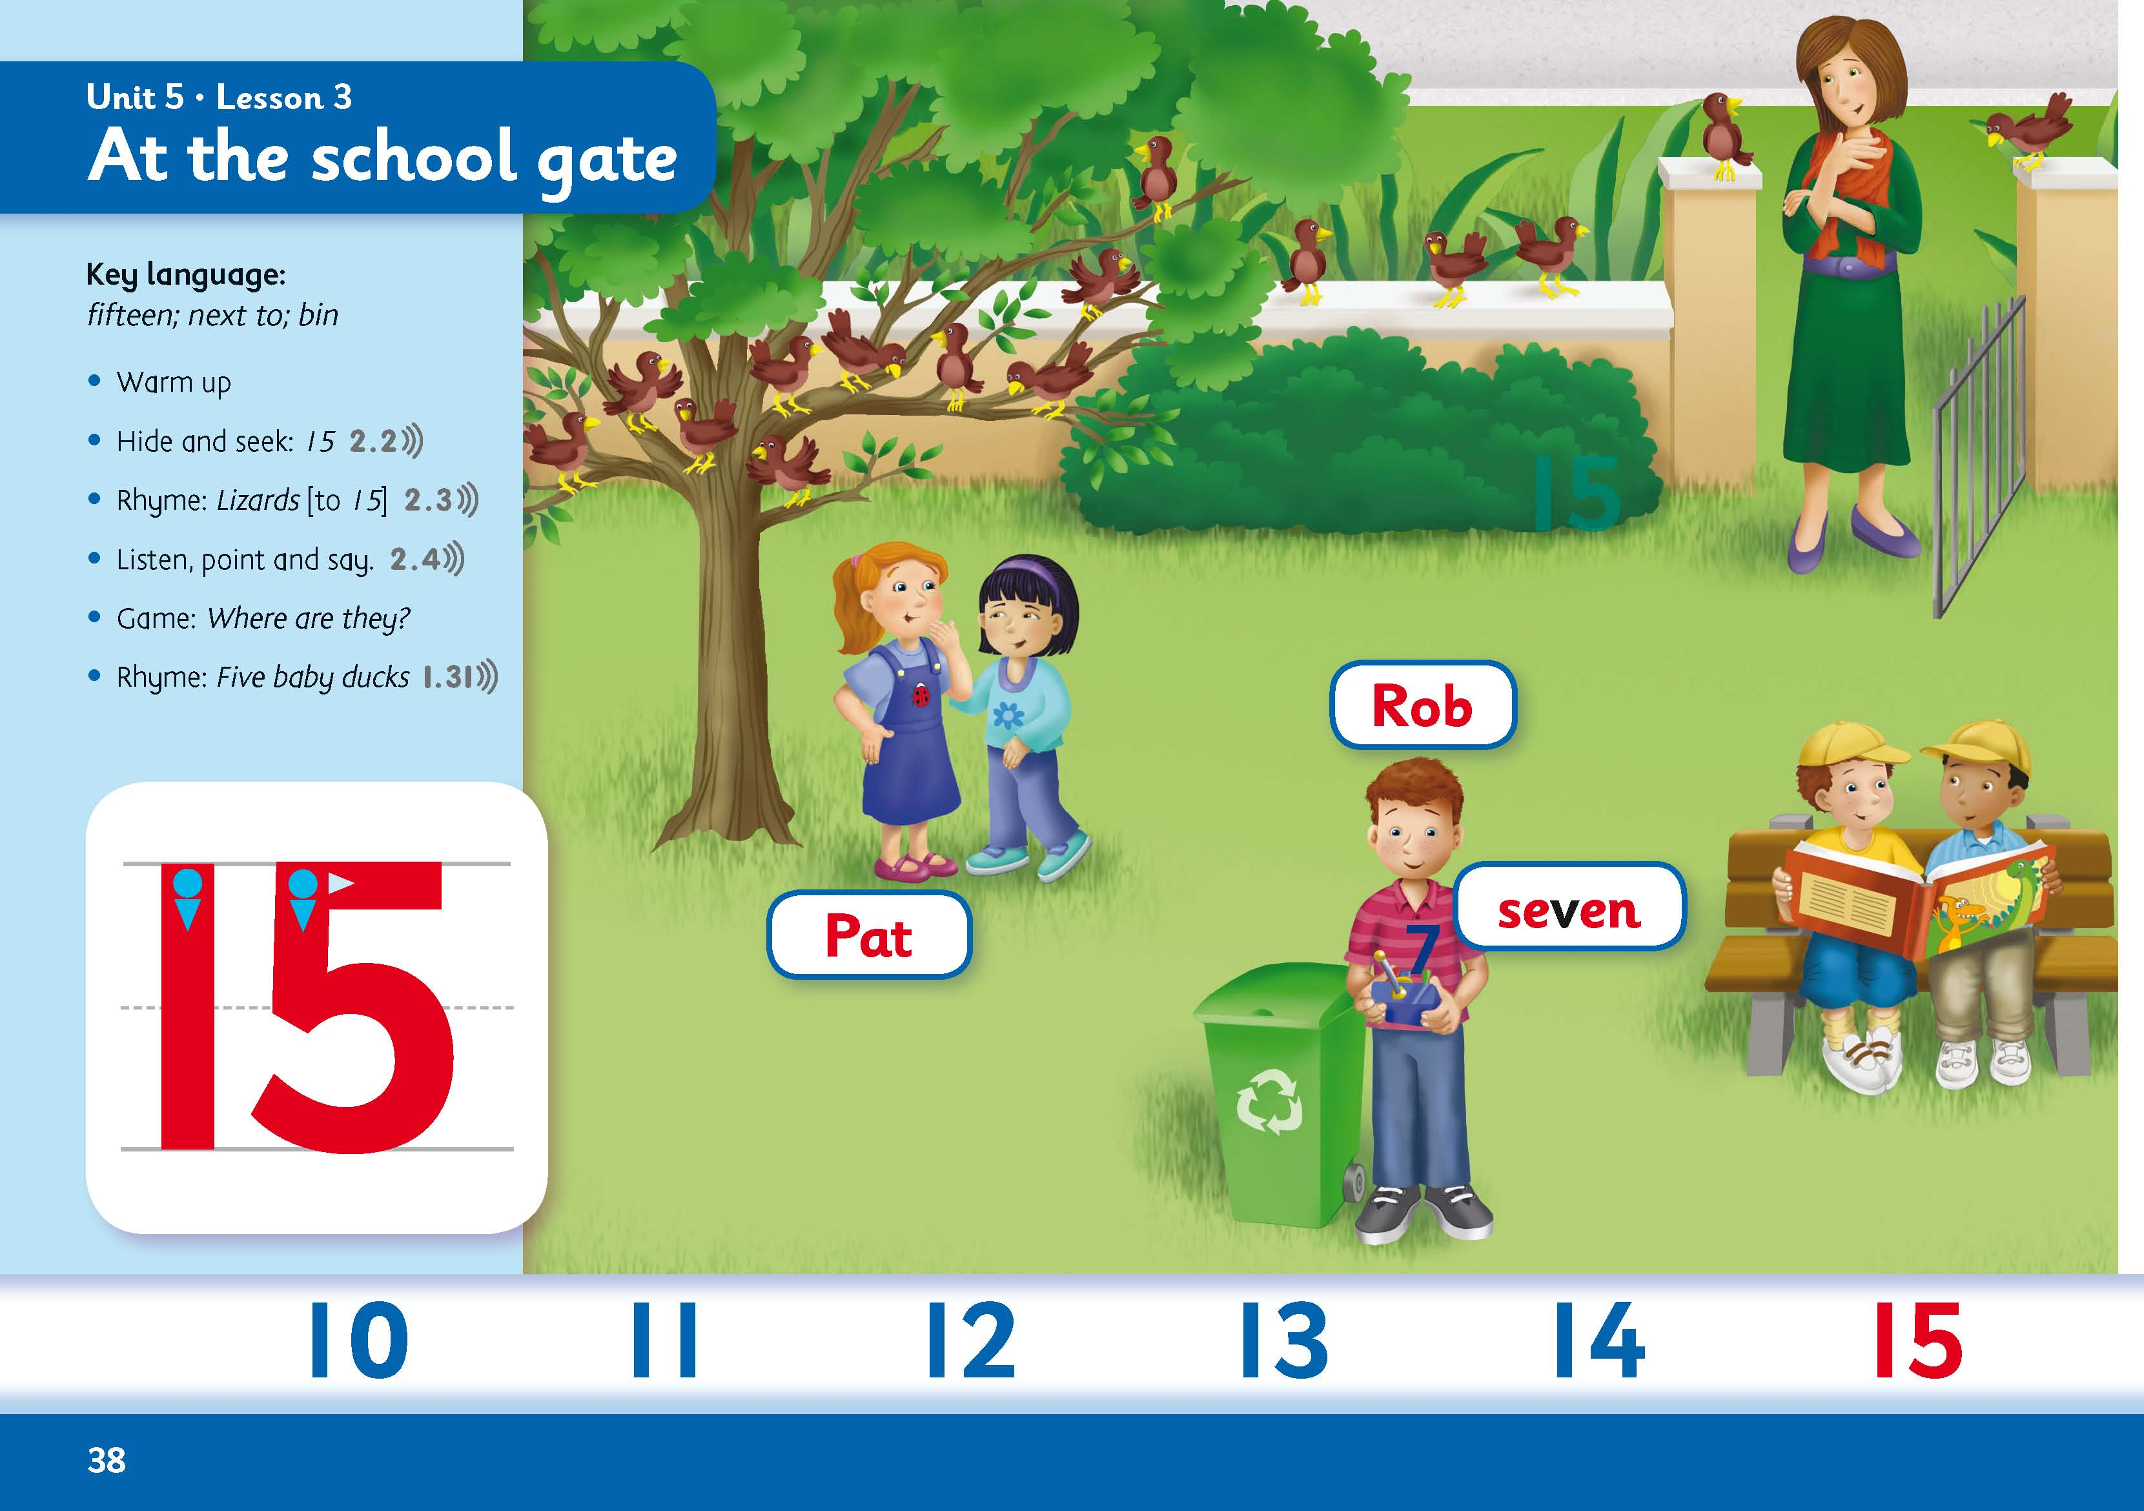
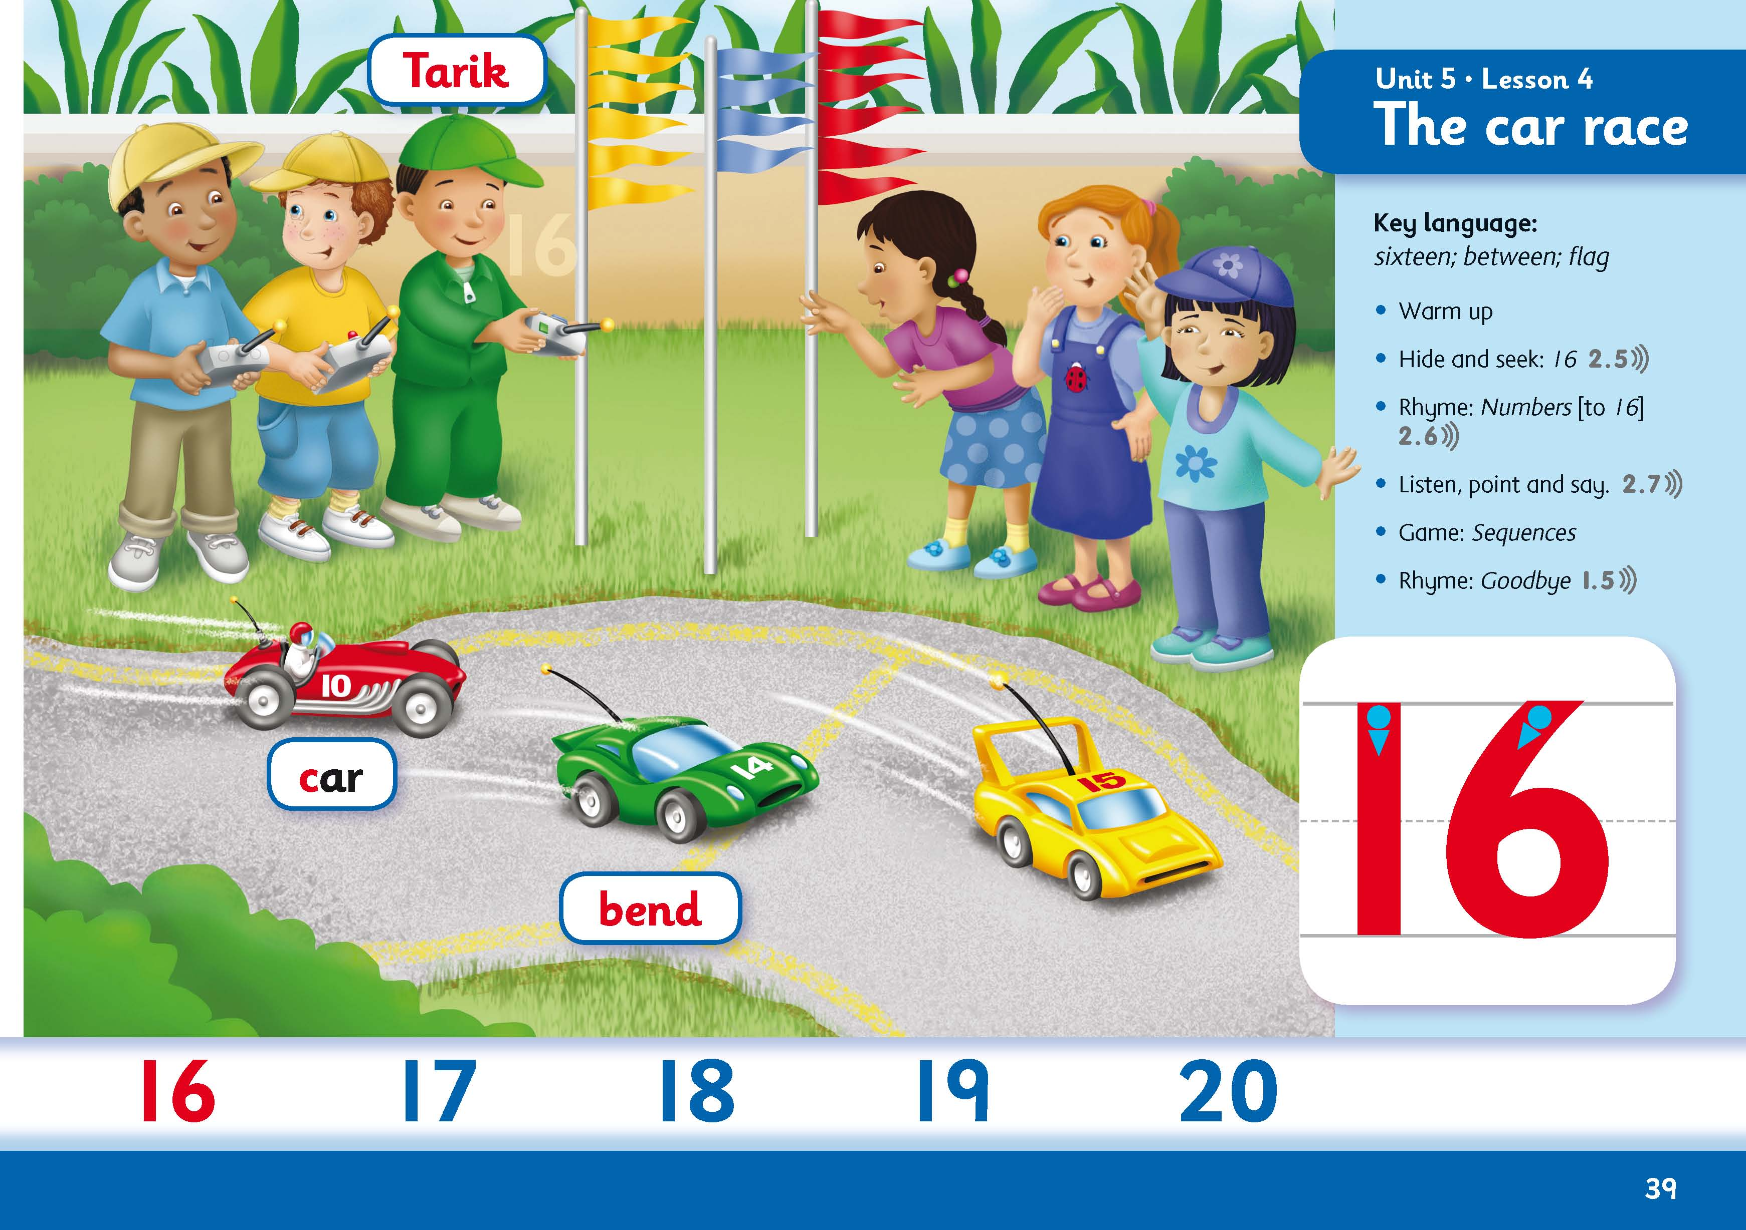
Numeracy
Book 2

Slide 8
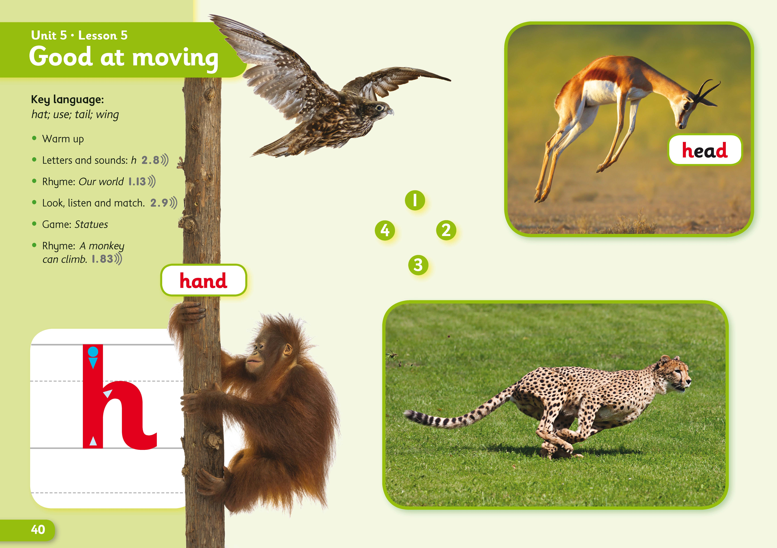
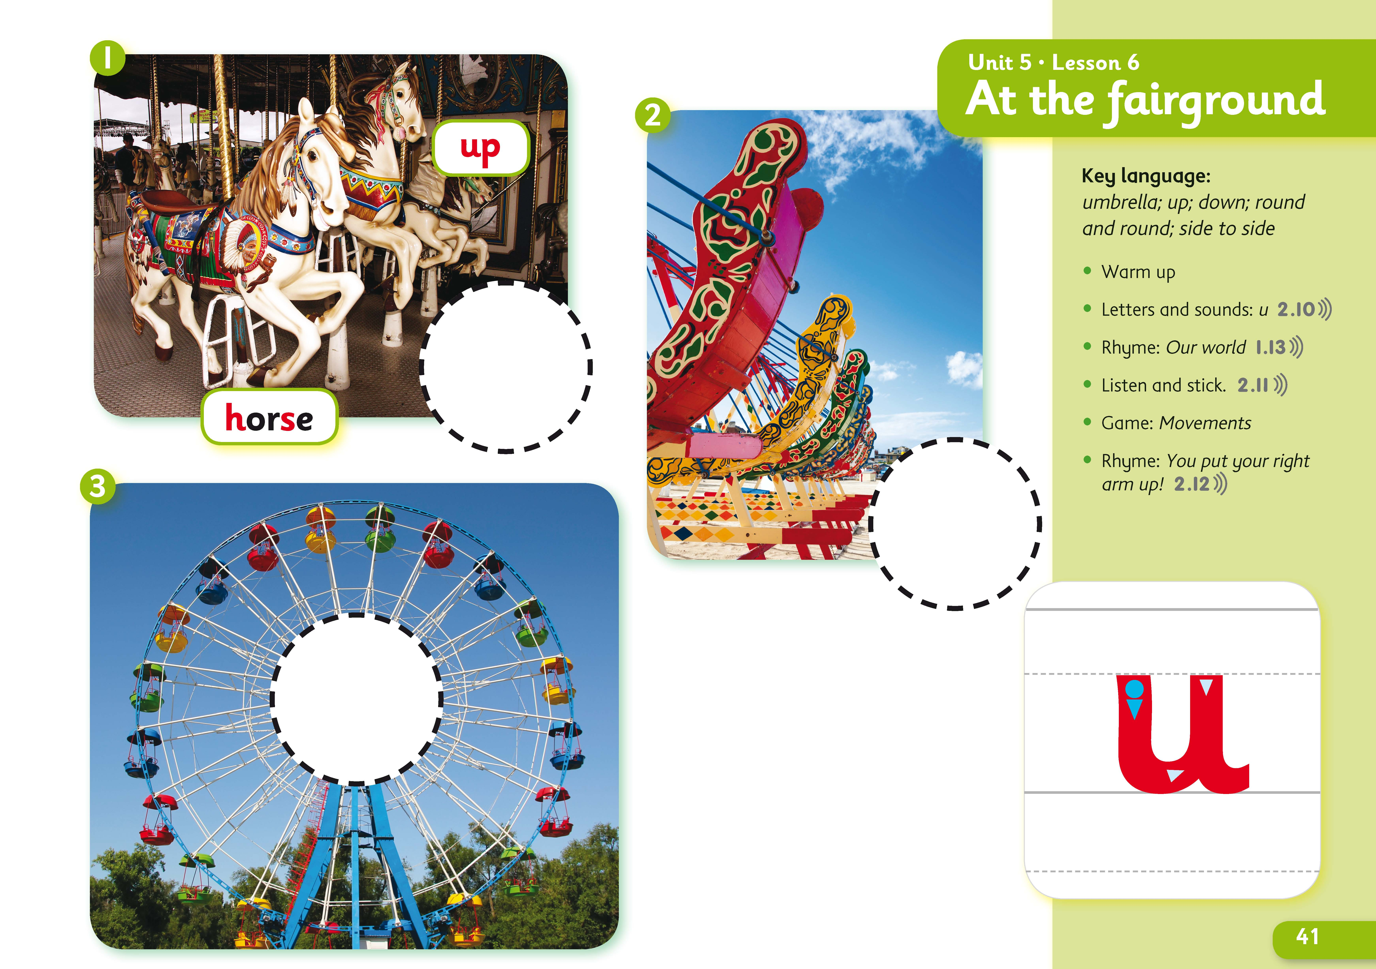
Science
Level 2

Slide 9
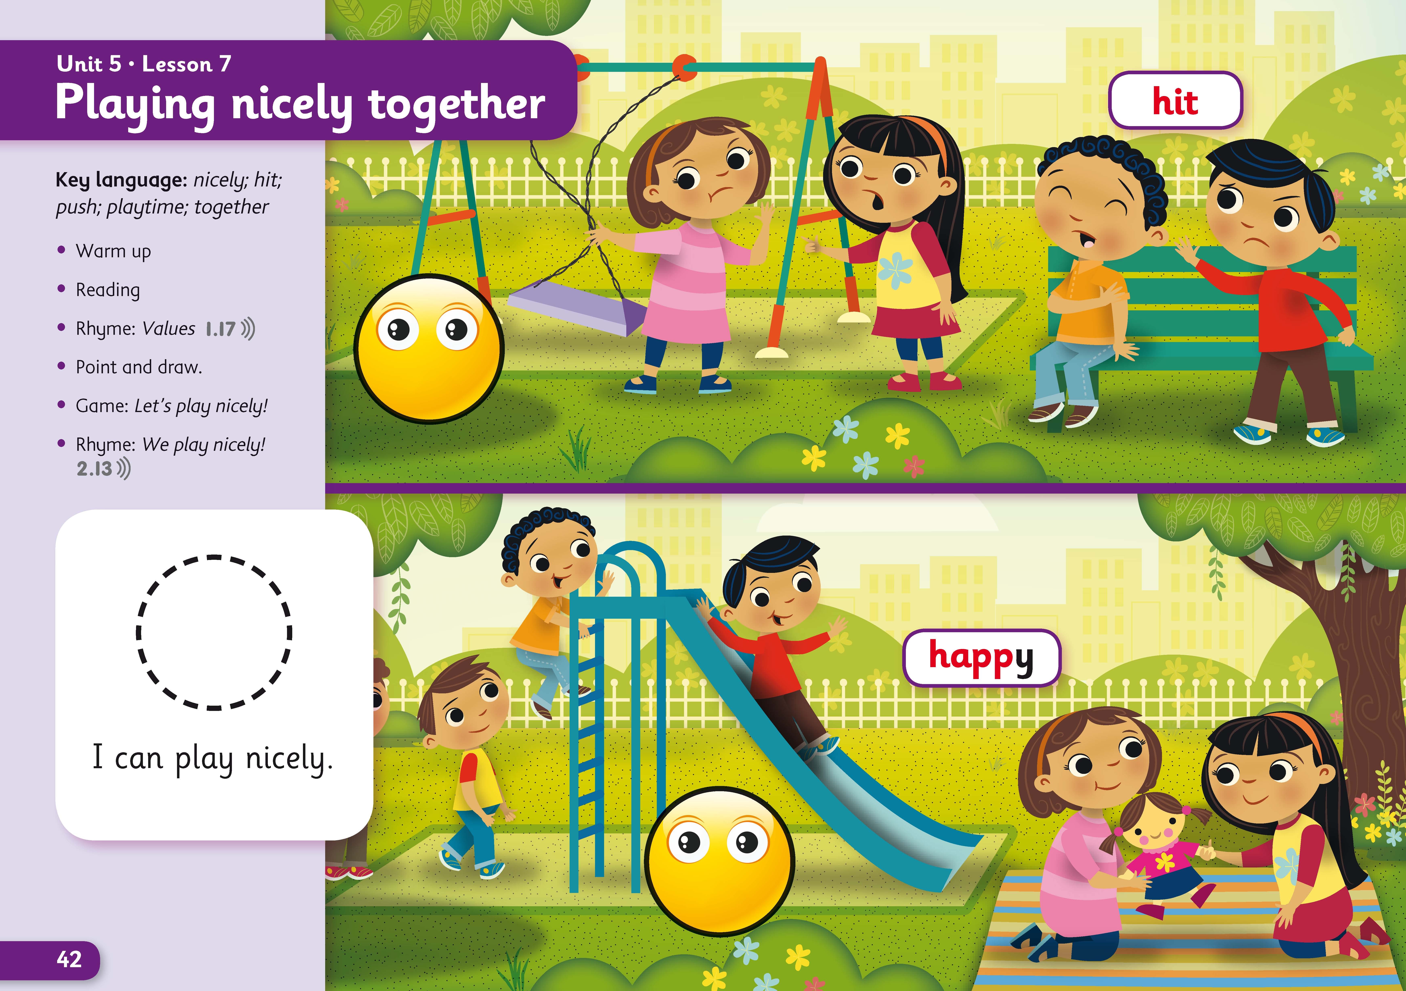
Values
Book 2

Slide 10
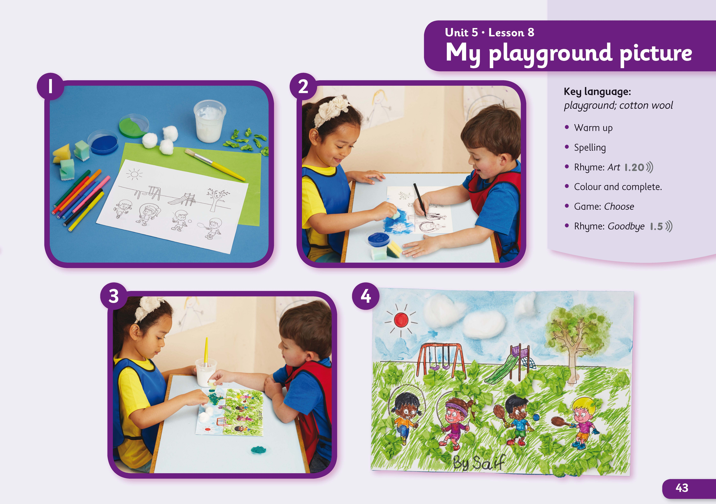
Art and Crafts
Book 2

Slide 11
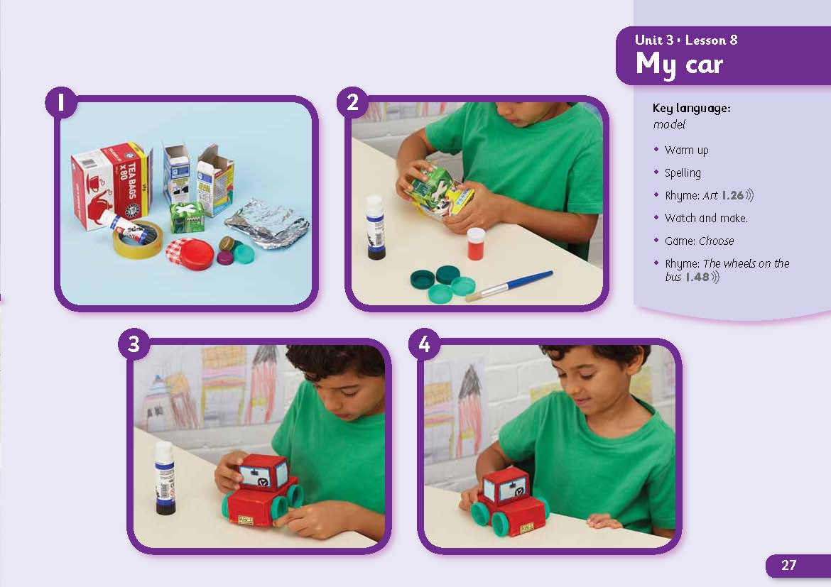
Art and Crafts
Book 3

Slide 12
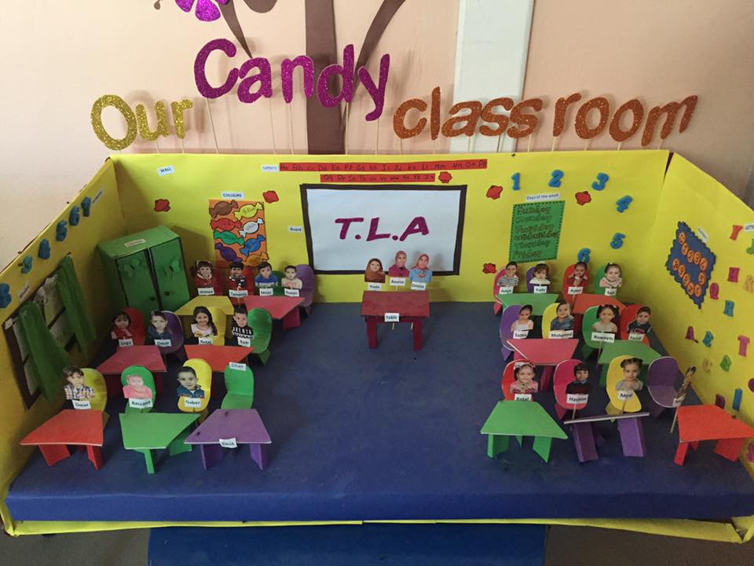
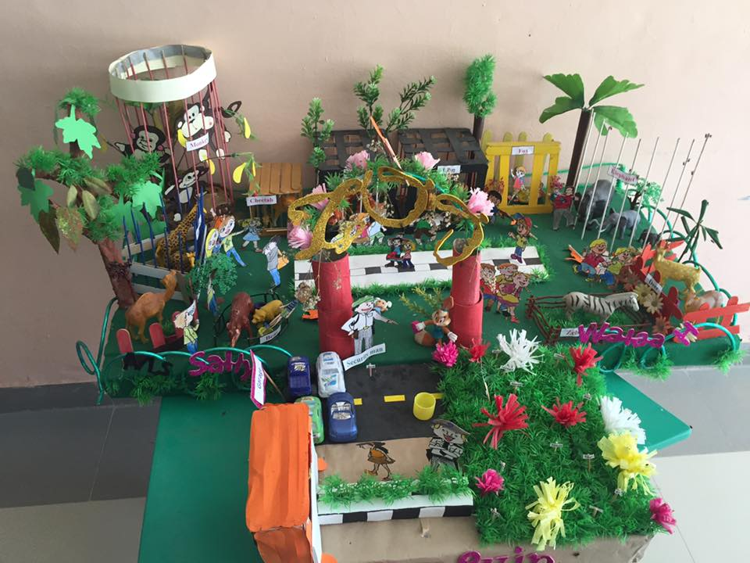
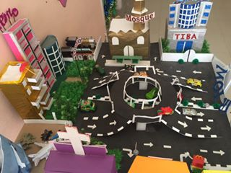
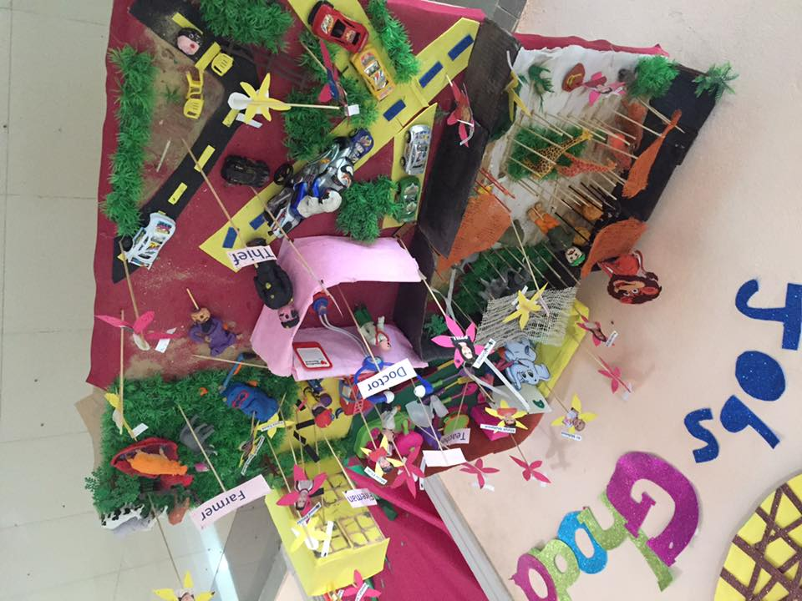

Slide 13
Additional Teacher Resources

Slide 15



Activity Book

Slide 18
Parent’s Booklet

Slide 19
Hide and Seek Components
Pupil’s Book
Activity Book + Audio CD
Teacher’s Guide
Class Audio CDs
Teacher’s Resource Pack (posters, stickers, flashcards)
Interactive Whiteboard
Online Resources (NGL.Cengage.com/hideandseek)
Online Parent’s Booklet

