Slide 1
Think, explore, create, and learn!
Notes:
Title: Think, explore, create and learn with Doodle Town!

Slide 2
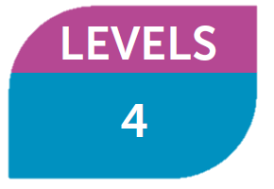
The Basics
PRE-PRIMARY
Doodle Town goes beyond language learning and develops the whole child: engaging their imaginations, promoting intellectual and physical development and preparing them for future
academic and personal success.
Notes:
Doodle Town goes beyond language learning and develops the whole child: engaging their imaginations, promoting intellectual and physical development, and preparing them for future academic and personal success.

Slide 3
Discover how Doodle Town can:
Build a solid foundation for mathematical and literacy awareness
Prepare students for future academic success
Introduce young learners to collaboration, learner independence and problem-solving
Shape well-rounded, happy children ready for future life and learning
Notes:
Discover how Doodle Town can:
Build a solid foundation for mathematical and literacy awareness through the integrated Let’s Count, Words and Sounds and fiction and nonfiction texts
Prepare students for future academic success through exposure to the rich variety of CLIL lessons aligned to the requirements of international standards
Introduce young learners to collaboration, learner independence and problem-solving through the development of 21st century skills
Shape well-rounded, happy children ready for future life and learning through four key pillars: cognitive, creative, physical and socioemotional

Slide 4
Benefits in action: Whole-child development
Shape well-rounded, happy children ready for future life and learning
4 pillars of whole-child development that go beyond language learning
Notes:
Teachers can help shape well-rounded, happy children ready for future life and learning through the 4 pillars of whole-child development that go beyond language learning:
Cognitive, Creative, Socioemotional and Physical.

Slide 5
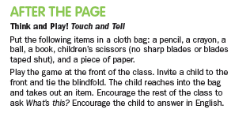
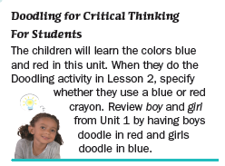
Benefits in action: Whole-child development
COGNITIVE DEVELOPMENT
Open-ended questions and activities for critical thinking
Notes:
COGNITIVE DEVELOPMENT
Children can develop skills such as predicting, classifying, and problem solving. In Doodle Town, “Think!” feature and Doodling for Critical Thinking introduces open-ended questions and activities for critical thinking.

Slide 6
Benefits in action: Whole-child development
CREATIVE DEVELOPMENT
Drawing, doodling and projects
(Let’s Doodle & Let’s Talk)
Notes:
CREATIVE DEVELOPMENT Children’s creative development is encouraged through drawing, doodling and projects throughout the course, such as the Let’s Doodle & Let’s Talk lessons.

Slide 7
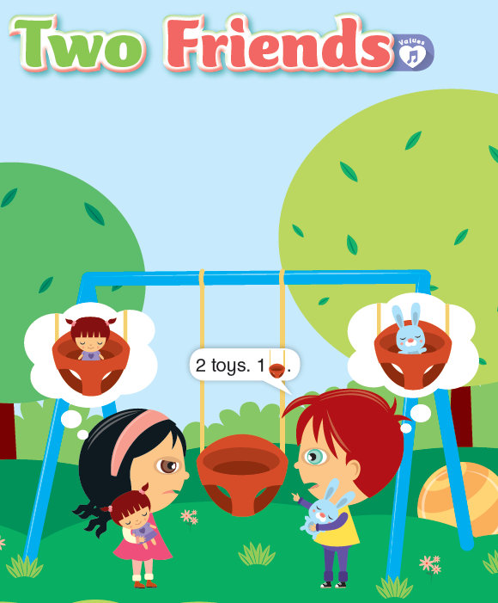
Benefits in action: Whole-child development
SOCIOEMOTIONAL DEVELOPMENT
Value lessons & songs
Notes:
SOCIOEMOTIONAL DEVELOPMENT
One value is introduced in each unit e.g. be fair and share. Values pages are marked with a values icon and includes a Values Song.

Slide 8
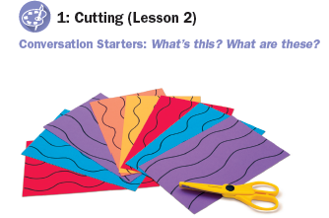
Benefits in action: Whole-child development
PHYSICAL DEVELOPMENT
Drawing, projects, games & Learning Center
Notes:
PHYSICAL DEVELOPMENT
Young Learners develop motor skills such as using scissors and holding a pen, alongside hand-eye coordination through the SB, AB and Learning Center’s drawing activities, projects and games.

Slide 9
Benefits in action: 21st century skills
Comprehensive development of 21st century skills
Collaboration
Communication
Critical Thinking
Creativity
Notes:
Students take their first steps towards collaboration, learner independence and problem-solving through the comprehensive development of 21st century skills (Collaboration, Communication, Critical Thinking, Creativity) with lessons such as Let’s Talk and Think and Doodle.

Slide 10
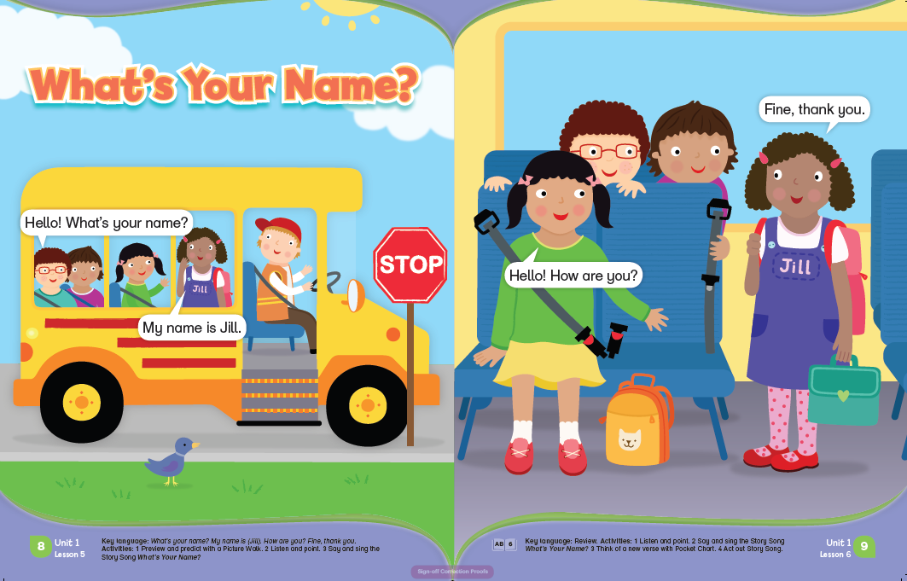
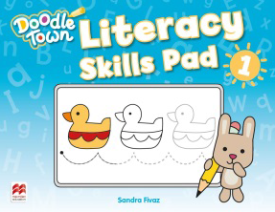
Benefits in action: Literacy
Integrated Words and Sounds lessons
Integrated fiction and non-fiction texts
Literacy Skills Pad
Build solid foundation for literacy awareness
Notes:
Young learners build a solid foundation for literacy awareness through the integrated Let’s Count and fiction and nonfiction texts, as well as the Literacy Skills Pad.

Slide 11
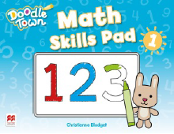
Benefits in action: Math
Integrated Let’s Count lessons
Math Skills Pad
Build solid foundation for mathematical awareness
Notes:
Young learners build a solid foundation for mathematical awareness through the integrated Words and Sounds and the Math Skills Pad.

Slide 12
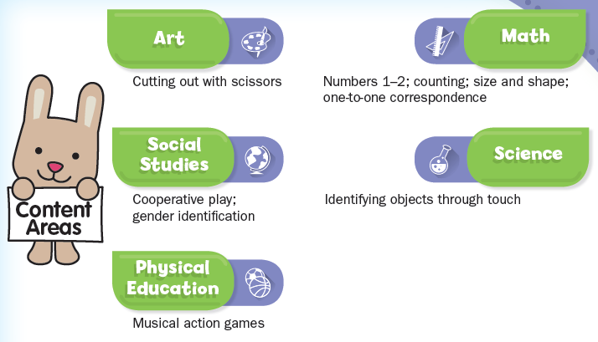
Benefits in Action: CLIL
CLIL-based content aligned to US Common Core Standard for English Language, Arts and Math
Prepare for future cross-curriculum
academic success
Notes:
Students start to prepare for future cross-curriculum academic success through exposure to the rich variety of CLIL-based content aligned to the US English Language, Arts and Math Common Core Standard. Content areas include: Art, Math, Social Studies, Science and Physical Education.

Slide 13
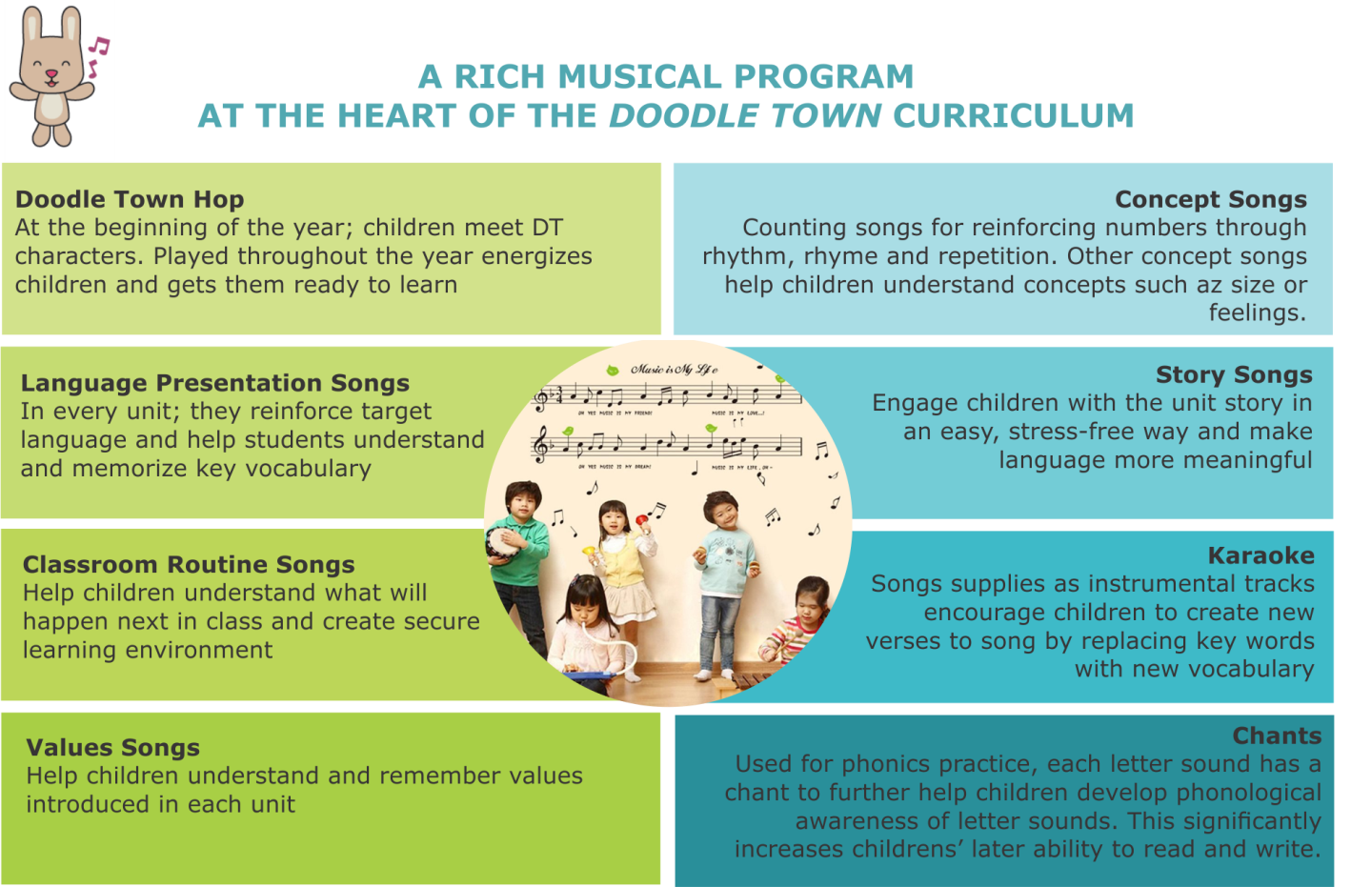
Benefits in action: Musical program
Retain language more easily and for longer
Engage and motivate
Notes:
Music is an integral part of the Doodle Town curriculum. Young children love to sing and move to music, and language is easier to remember when it is set to music and paired with Total Physical Response (TPR) actions. Students are engaged and motivated by the rich musical program that runs throughout Doodle Town, helping them retain language more easily and for longer.

Slide 14
TOOL UP: Teacher Resources
Deliver quality language program by providing support for teachers
Before the lesson
During the lesson
After the lesson
Notes:
Teachers can deliver a quality language program with the flexible structure and engaging components that provide support for teachers before, during and after the lesson.

Slide 15
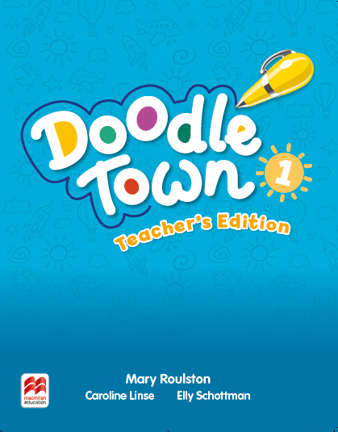
TOOL UP: Teacher Resources
Before the lesson
Teacher’s Edition
Resource Center
Notes:
Before the lesson:
Teacher’s Edition: includes overview for class planning and learner center activities, plus teaching notes for before-, with-, and after-the-page lesson support and assessment
Teacher’s Resource Center: provides downloadable materials for classroom activities

Slide 16
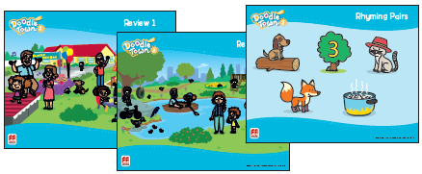
TOOL UP: Teacher Resources
During the lesson
Pocket Chart
Photo cards
Teacher’s Presentation Kit
Poster Pack
Learning Center
Puppet
Notes:
During the lesson:
Pocket Chart – framework for cognitive games and creative activities
Photo cards – show the key vocabulary
Posters – feature scenes from the SB for reviewing key language
Learning Center – help teacher different concepts at the same time in one place
Teacher’s Presentation Kit – heads up interactive learning experience
Doodle Bunny Puppet – used for encouraging creativity and critical thinking

Slide 17
TOOL UP: Teacher Resources
After the lesson
Assessment from Teacher’s Edition
Home-school connection
Notes:
After the lesson:
Assessment from Teacher’s Edition
Home-school connection: Student Practice Kit, letters to Parents and detachable Parent’s Pages

Slide 18
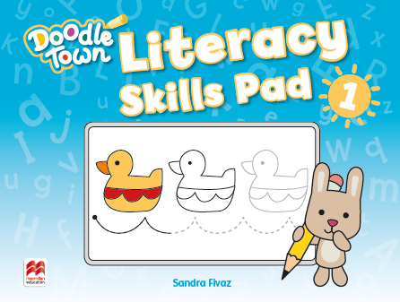
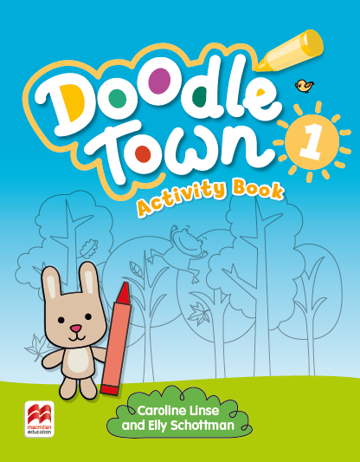
TOOL UP: Student Resources
Pupil’s Practice Kit
Literacy Skills Pad
Student’s Book
Letters to Parents & Detachable Parent’s Pages
Learning goes beyond the classroom
Math Skills Pad
Nurture first student-teacher-parent connection
Activity Book
Notes:
TOOL UP: Student Resources
Students’ learning goes beyond the classroom with the strong home-school link component, consisting of the interactive Student Practice Kit, letters to Parents and detachable Parent’s Pages, nurturing the first student-teacher-parent connection of the young learner journey.

Slide 19
Think, explore, create, and learn!
Notes:
Title: Think, explore, create and learn with Doodle Town!

