Slide 1
Continuous Professional Development
Teona Khachidze

Slide 2
What CPD Does
Manage and deliver all aspects of the teacher training program
Organise and deliver teacher observations and teacher training sessions based on needs
Provide feedback to the teachers and head of institutions
Organise and deliver national and international ELT events
Help institutions improving syllabi or program

Slide 3
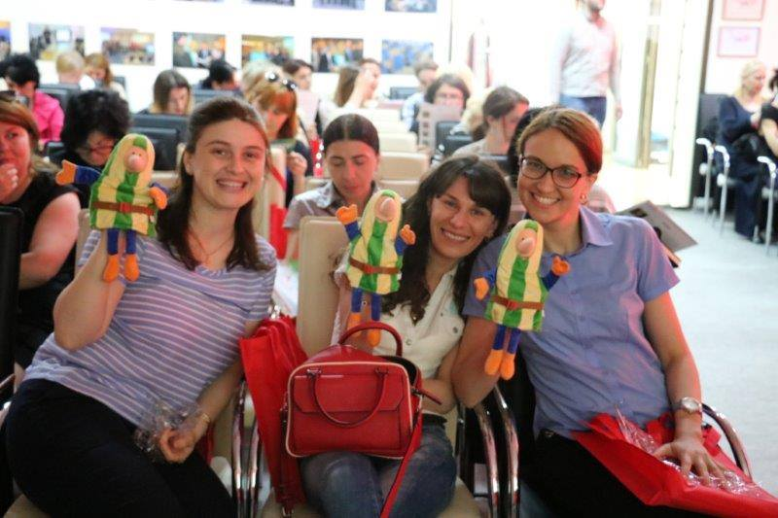
Course Introduction Training
The importance and aims of pre-primary education
To introduce the coursebook
To learn its methodology
To learn how to use different resources and components of the coursebook

Slide 4
Classroom Observation
Based on the agreement with the Kindergarten administration
Each English language teacher is observed
Feedback for teachers and administration

Slide 5
Feedback Form
Feedback form consists of the following parts:
Procedure
Content
Recommendation

Slide 6
Customized Training Sessions
After observations
Based on the feedback
Covering one particular direction

Slide 7
Professional Development Module for Pre-Primary Teachers
About 20-hour training course
Focused on methodology of pre-primary level
Tips for teaching students on pre-primary level
Approximate Date: Summer 2020

Slide 8
Thank you!

