Slide 1
Mistake Management with Primary Learners:
The Ifs, Whys and Ways
COVER INSERT IMAGE SHORT
Images on this page layout can be updated. To update the image you will need to click on the ‘picture icon’, please follow the instructions below.
To update the image:
Click on the picture icon; or
if there is an existing image, right click on the image and select ‘change picture’
Go to the location where the selected image is saved
Select the image
Please note all images should be: 27.5cm x 19.05cm
If the image does not fit, ensure you keep the dimensions as above otherwise the image will appear stretched and distorted
If the image is sitting over the header banner – Right click on new image and select ‘send to back’
Teresa Doğuelli
February 2017 GEORGIA
LOGO STRIP SHORT
Use this cover where you want to insert your own image and where you want to use the Macmillan Education logo. The space at the bottom has room for one additional imprint or sub brand or where you want to use the Language Learning lock up. These are available to copy and paste from the pages at the back of this templates.

Slide 2
COVER INSERT IMAGE LONG
Images on this page layout can be updated. To update the image you will need to click on the ‘picture icon’, please follow the instructions below.
To update the image:
Click on the picture icon; or
if there is an existing image, right click on the image and select ‘change picture’
Go to the location where the selected image is saved
Select the image
Please note all images should be: 27.5cm x 19.05cm
If the image does not fit, ensure you keep the dimensions as above otherwise the image will appear stretched and distorted
If the image is sitting over the header banner – Right click on new image and select ‘send to back’
Which Teacher are You?
1, 2 or 3 ?
I try to correct errors as little as possible. I want my students to express themselves in English without worrying too much about making mistakes. Sometimes I notice points that everyone gets wrong, and deal with them later-but I never interrupt students to correct them.
I never let my students make mistakes. If they say anything wrong, I stop them and make them say it correctly. I don’t want them to learn bad English from each other.
I correct students sometimes, but not all the time. If we’re practising one particular language point, then I insist that they say it correctly. But if we’re doing a freer activity then I try not to correct too much. If I do correct students, I try to do it in an encouraging way.
LOGO STRIP LONG
Use this cover where you want to insert your own image and where you want to include sub brands or imprints in the base logo strip. These are available to copy and paste from the pages at the back of this template.

Slide 3
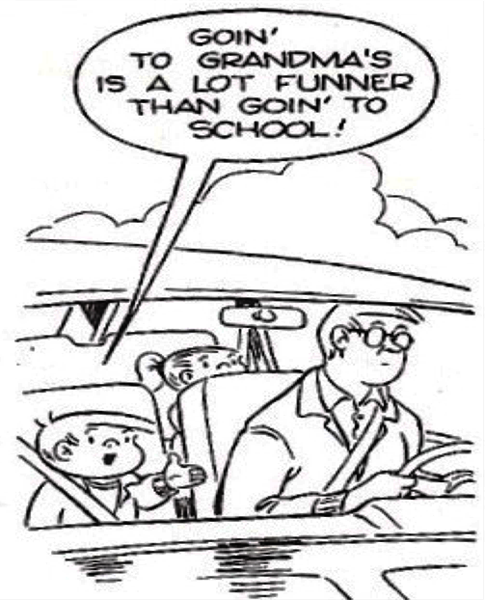

Slide 4
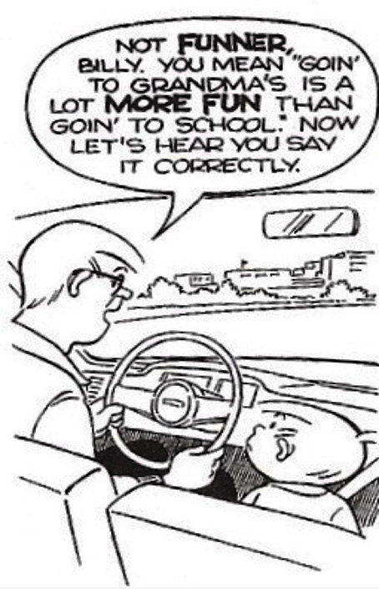

Slide 5
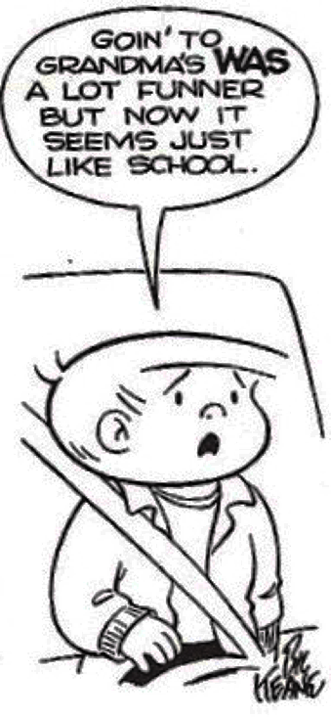
Notes:
Here’s a lovely representation of how many kids view grammar, and also how many times teachers feel frustrated by our best efforts to teach it.
This illustrates the fundamental drawbacks involved in ‘getting it right’, in correction, in isolating language.
Also importantly, the process in this kid’s brain which has just turned a potential learning situation into a failed one. More on that later.

Slide 6
Grade the mistakes in the following sentences from 5-0, where 5 is a very serious mistake, and 0 is no mistake at all.
She asked me where did I come from.
The problem was that the door wasn’t keyed.
He’s fond of cooking himself and for me.
Did you went there alone?
I am very boring.
The people paniced and some of them runed away.
5
4
3
2
1
0

Slide 7
Beware the Grammar Police!

Slide 8
Misguided Perfection...
Teachers who treat mistakes as weeds to be ruthlessly weeded out, who pick up every error and allow nothing to pass uncorrected, do an immense amount of harm. Their students understandably become reluctant to say anything at all. They make no mistakes because they say nothing.
Michael Swan

Slide 9
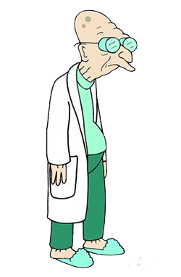
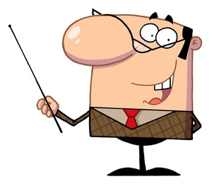
How TEFL’s view of mistakes has evolved

Slide 10
Learning a Foreign Language isn’t...

Slide 11
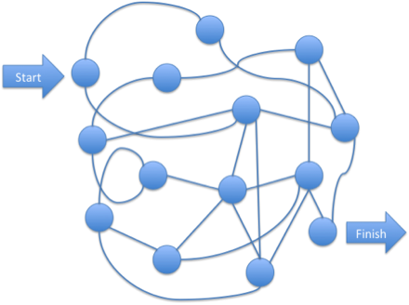
Learning a Foreign Language is...

Slide 12
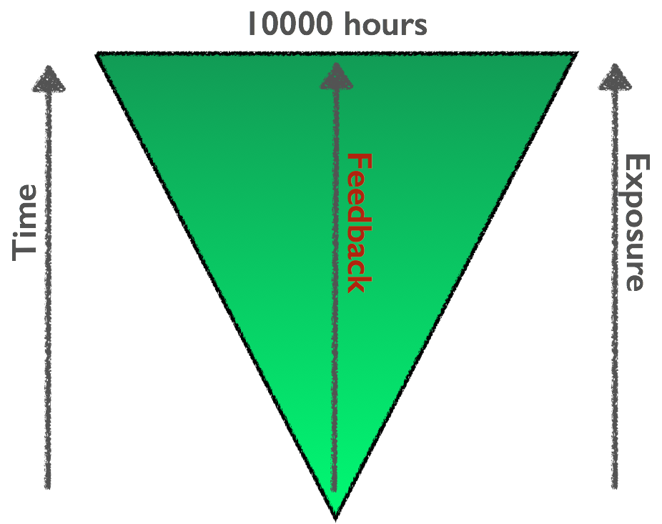
6 years 14000 words & sophisticated syntax
30 months syntactical utterances
24 months morphological markings
18 months 2-word couplings
12 months - first words
6 months - babbling
Notes:
6 months babbling – sophisticated babbling nearing 12 months, 12 months first word, 18 months 2-word couplings (mummy’s sock, cat sleeping, don’t want it!), 24 months morphological markings (verb endings, affixes), 3 years syntactical utterances – some mistakes – over generalisations – word order issues, 6 years – 14000 words – syntactical – sophisticated.
Calculations 4 hours/day exposure x 365 days x 6 years = 8760 hours – near expertise.
Feedback is key – and this comes not just from the knowers, but also from the other learners around them.
There are fascinating studies based on deaf children – first deaf children who learn to ‘babble’ and join words and syntax at exactly the same time as other children with no aural input… and also deaf children, who among themselves developed a fluent, inflected and nuanced version of sign language which their deaf parents, having learned it later in life, never acquired.

Slide 13
Write 3 Sentences about mistakes. Include the word ‘mistake’ in each sentence.
Now cross out the word ‘mistake’ and write ‘Learning Step’ !

Slide 14
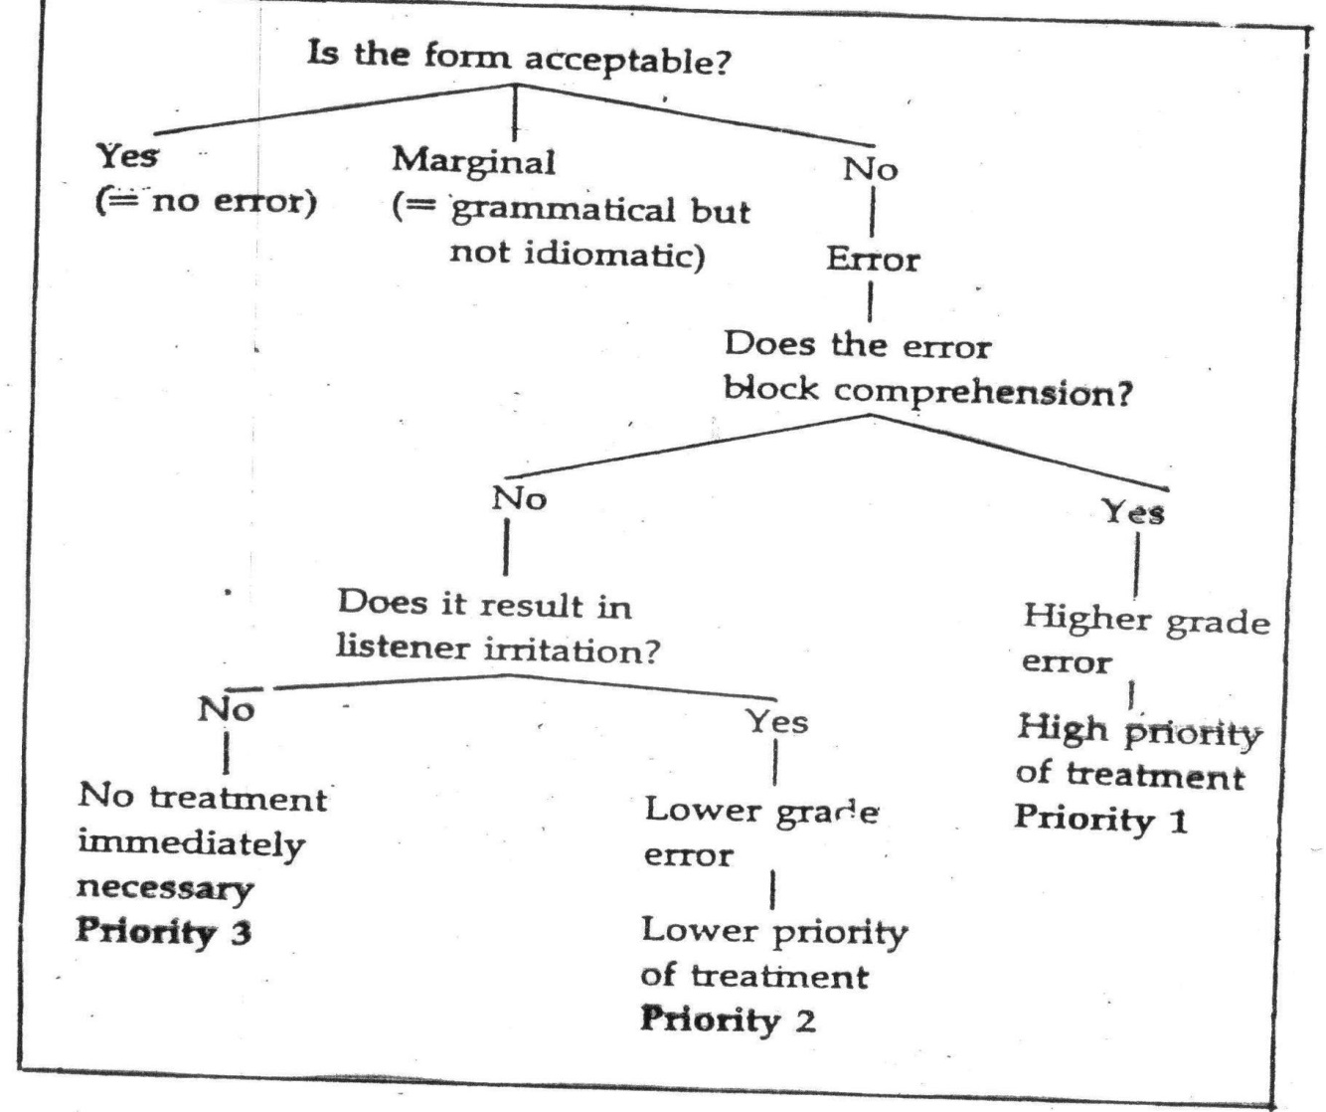
When, If, Why Correct

Slide 15
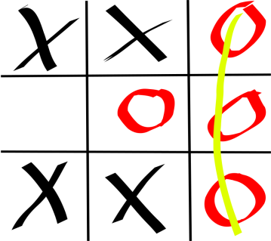
Ways of Dealing with Spoken ‘Learning Steps’
Finger correction
Gestures & facial expressions
Pretending to misunderstand
Reformulating as if repeating
Echoing
Hot Cards
Whole class team games: ‘Find the Learning Steps’ (Grammar Auction, Noughts and Crosses, Buzzers, Fly-Swatting)

Slide 16
Ways of Dealing with Written ‘Learning Steps’
Selective correction (ONLY Prepositions or Tenses or spelling etc.)
‘Global’ vs ‘Local’ correction:
Guiding Symbols for indicating errors
Decreasing Guidance in 6 Stages
Help learners see writing as a Process
Highlight the Positive + in their writing
Communication of meaning | 5
Accuracy of grammar & Vocabulary | 5
Organisation | 5
Punctuation | 5
Spelling | 5

Slide 17
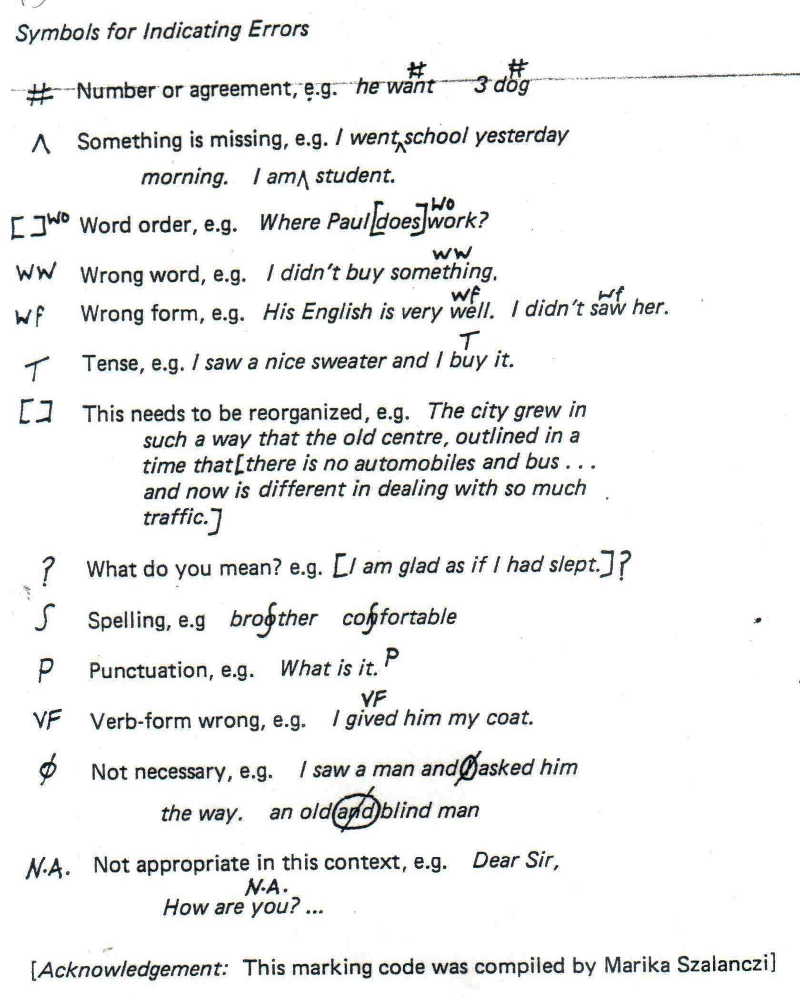
Ways of Dealing With Written ‘Learning Steps’

Slide 18
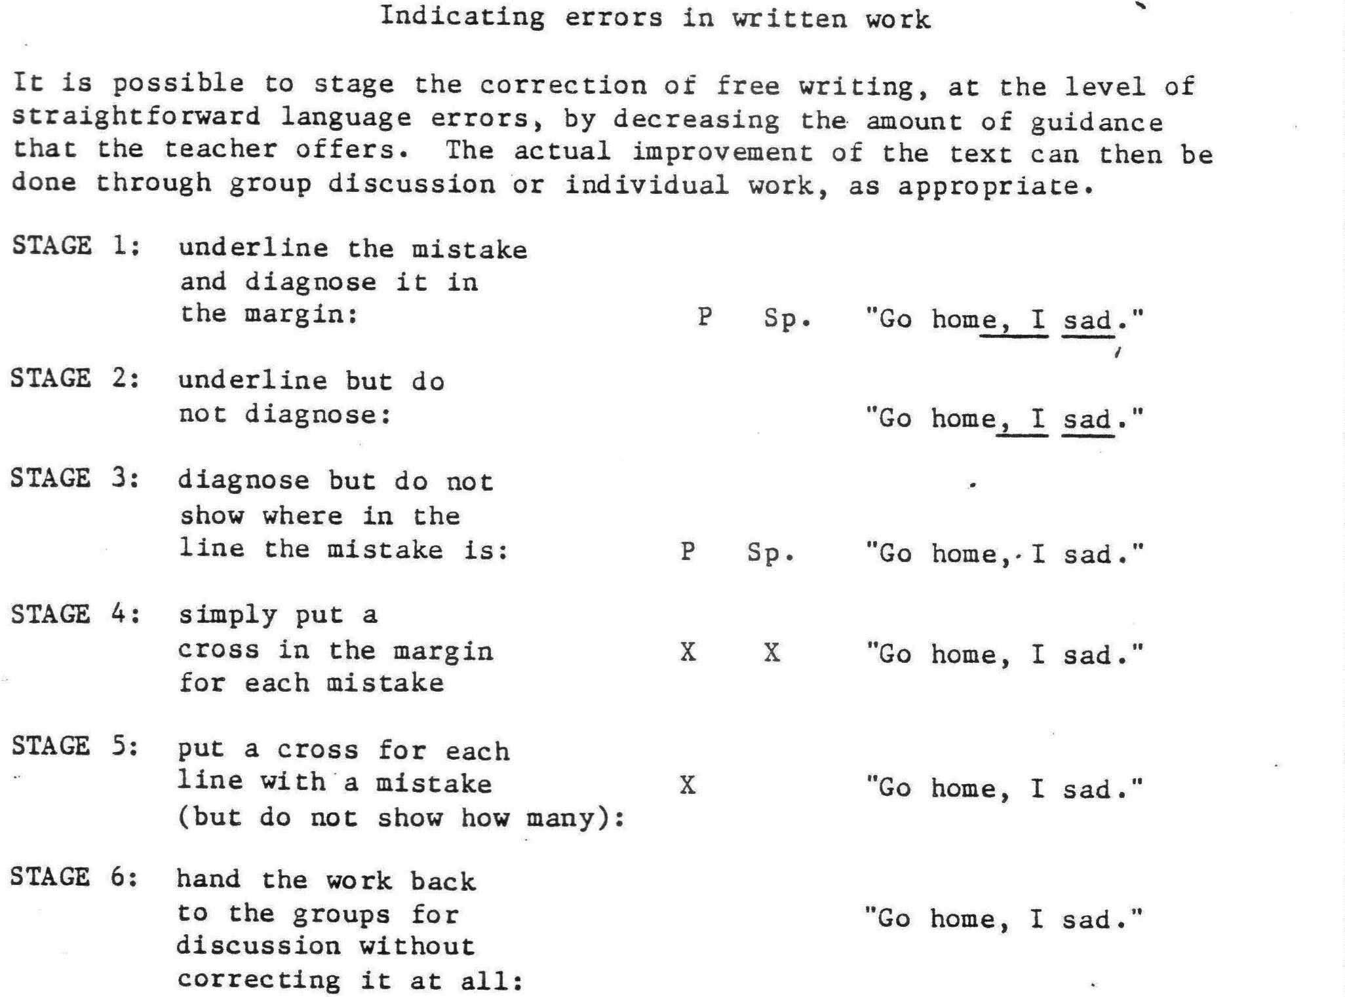
Ways of Dealing with Written ‘Learning Steps’

Slide 19
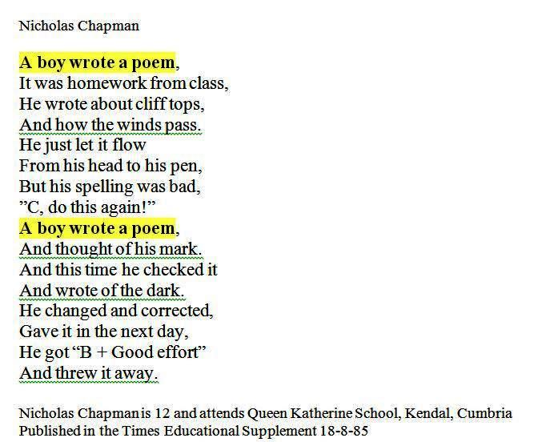

Slide 20
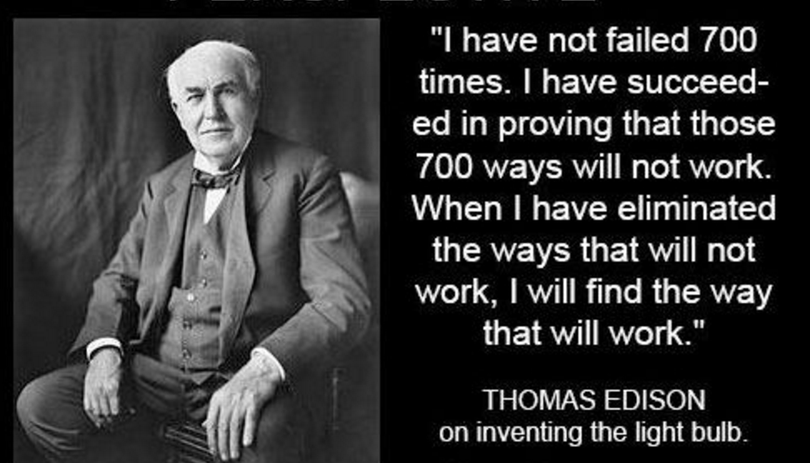
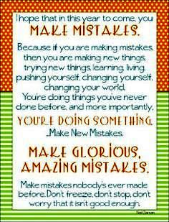
Celebrate the Class’s ‘Learning Steps’

Slide 21
BACK PAGE
Please add the Macmillan Education logo and any additional logos to the logo strip at the bottom of this page as required.
NAME PERSON
Job Title
M +44 (0) 000 000 000
T +44 (0) 000 000 000
E name.person@macmillan.com

