Slide 1
Teaching Writing

Slide 2
Consider the following questions:
What is the difference between written and spoken English?
What is the difference between learning to write and writing to learn?
How many different written forms can you think of?
How many different purposes for writing can you think of?

Slide 3
Differences between written & spoken English
Speaking involves more deixis or ‘pointing words’.
Speaking contains a higher ratio of structure words
Writing contains a higher ration of content words.
Writing displays a greater degree of lexical density.

Slide 4
‘Writing to learn is not Learning to Write’.
Process v Product Writing

Slide 5
Product Writing is linear and very direct, the writer is clear what the task is and knows the requirements for completion.
There are a lot of product writing tasks in textbooks (e.g. copying, gap-fill, following the structure)
These are designed to help the learners improve their general English skills rather than improve their writing.

Slide 6
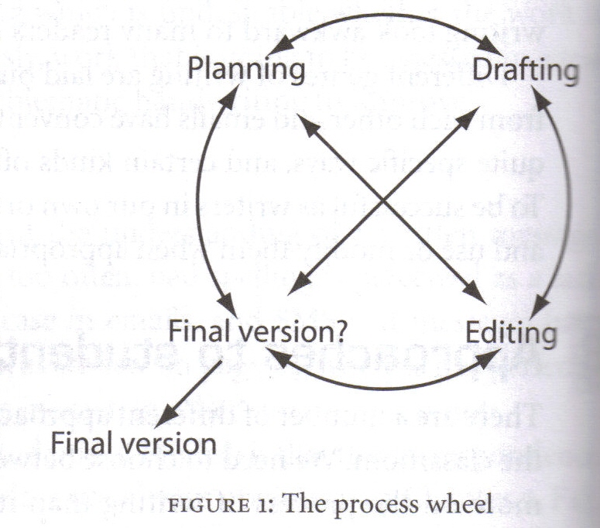
Process writing is non-linear and designed to improve learners writing skills.
Process writing is recursive (i.e. we move backwards and forwards through the stages

Slide 7
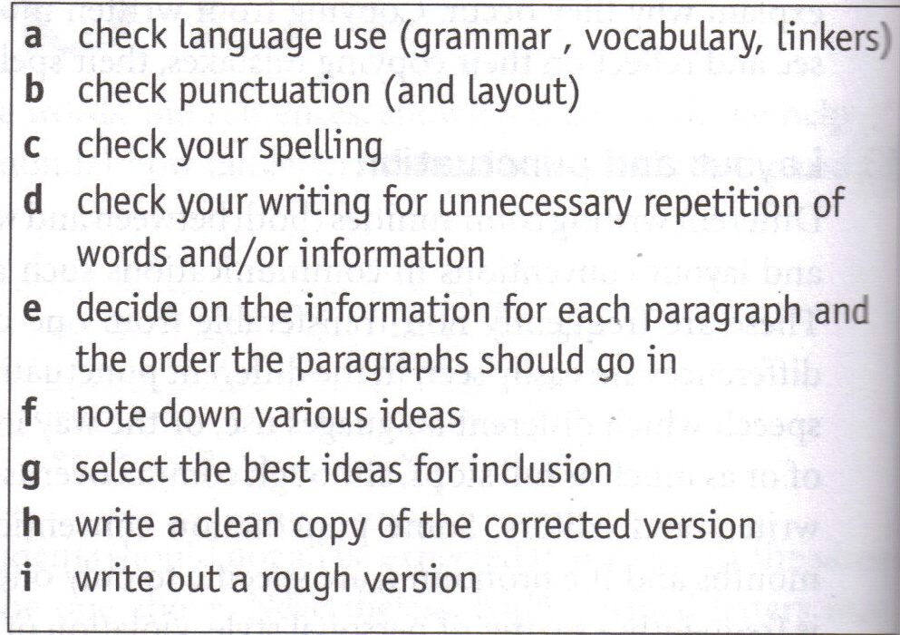

Slide 8
Why write? What reasons
To Entertain
To Inform
To Instruct
To Persuade
To Explain
To Argue

Slide 9
Forms of written English
Posters
Brochures
Pamphlets
Letters
Recipes
Instructions
Lists
Labels
Stories
Reports
Poems
Essays

Slide 10
 | To Entertain | To Inform | To Instruct | To Persuade | To Explain | To Argue
Forms
Posters
Brochures
Pamphlets
Letters
Recipes
Instructions

Slide 11
ASSESSING WRITING
How can assess the writing?
What symbols, if any, do you use?

Slide 12
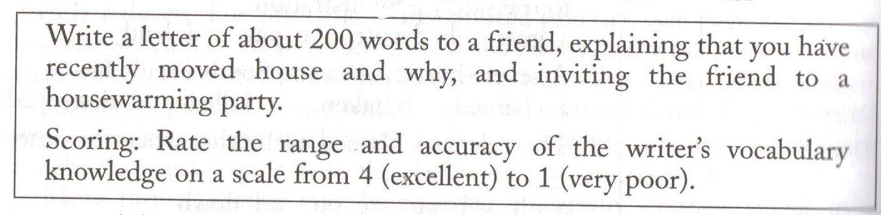
Assessing Writing

Slide 13
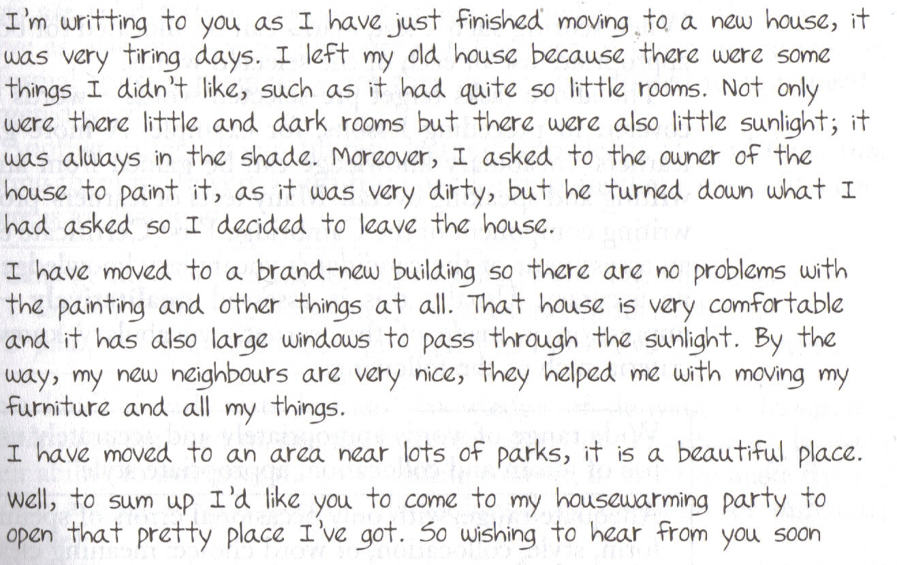

Slide 14
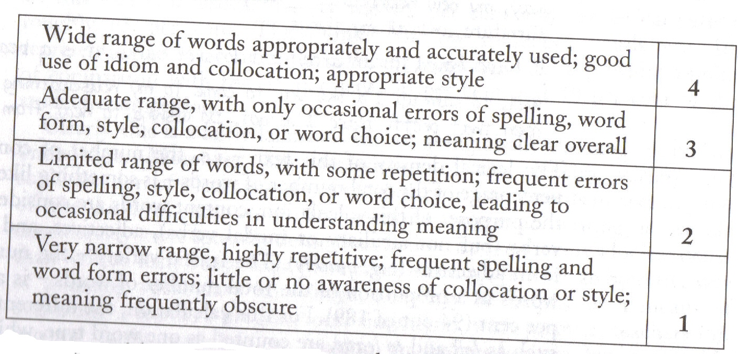
Assessing Writing

Slide 15
Measuring Word Knowledge
Lexical Density
How many content words
Lexical Variety
How many different words
Lexical Sophistication
How many words outside the top 2,000

Slide 17
Measuring Word Knowledge
Lexical Density
35%
Lexical Variety
94 out of 189 – 50%
Lexical Sophistication
10%

Slide 18

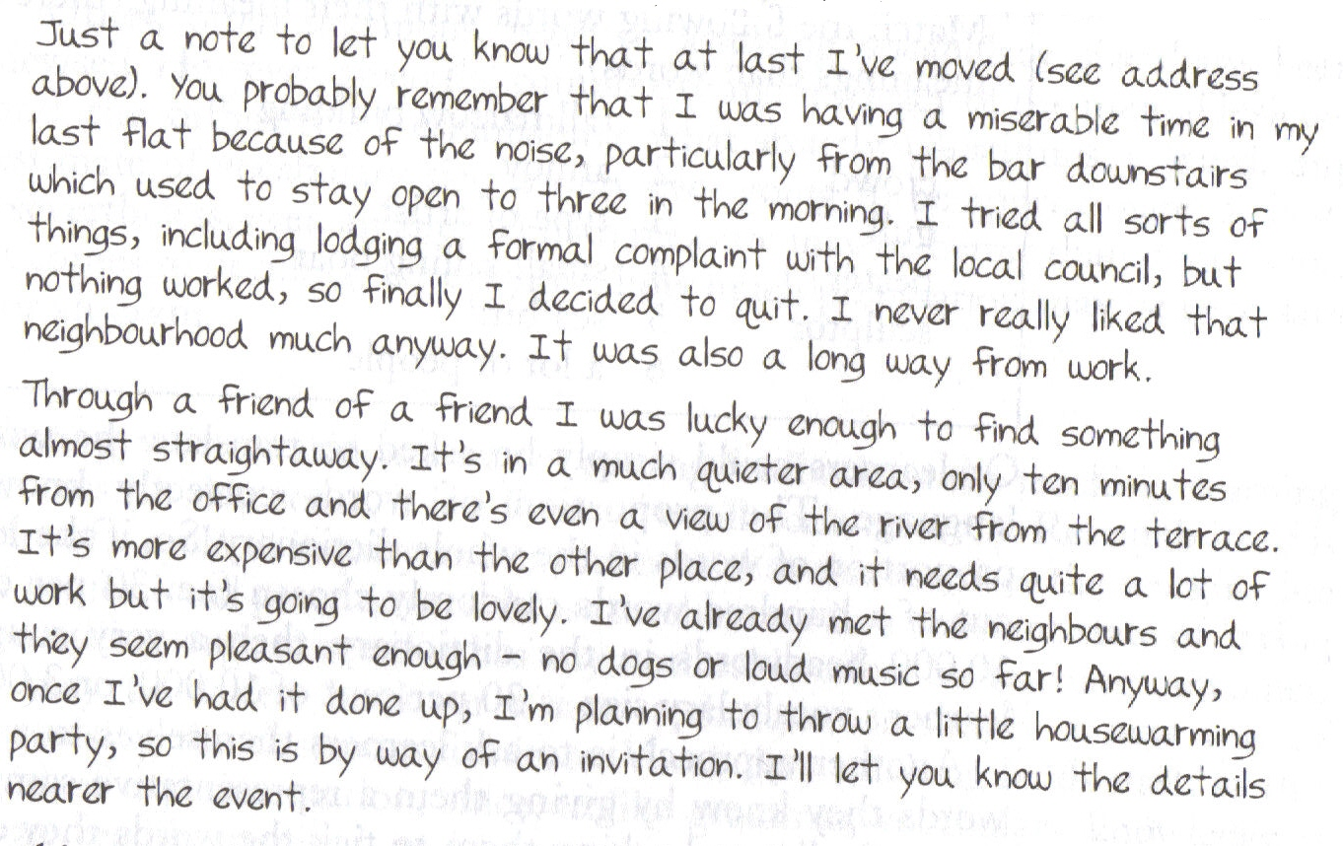

Slide 19
Measuring Word Knowledge
Lexical Density
42%
Lexical Variety
65%
Lexical Sophistication
13%
Lexical Density
35%
Lexical Variety
94 out of 189 – 50%
Lexical Sophistication
10%

Slide 20
Teacher roles in Writing feedback
reader or respondent
  E.g – ‘I liked your point about…’,
writing teacher or guide
  E.g. “the paragraph in part one needs shortening”, “you may want to think about starting with a subject sentence.”
Grammarian
  E.g. “The third conditional, requires the use of the past perfect in the conditional clause.”
evaluator or judge
  E.g. – “the effect on the target reader would be positive and the reader would be informed”

Slide 21
Feedback types
Teacher feedback
  Select a role e.g. Reader, Guide, Grammarian, Judge and write comments at the end.
  Highlight / underline / circle positive aspects of writing and congratulate (humanistic approach)
  Focus on one language point (positive or negative)
  Worksheet production – create a worksheet using own structures e.g. common errors / id correct and incorrect sentences
Peer feedback :
  Student as reader – focus on opinions
  Student as Judge – focus on performance
  Group analysis as grammarians (circle the good, underline one thing to change)

Slide 22
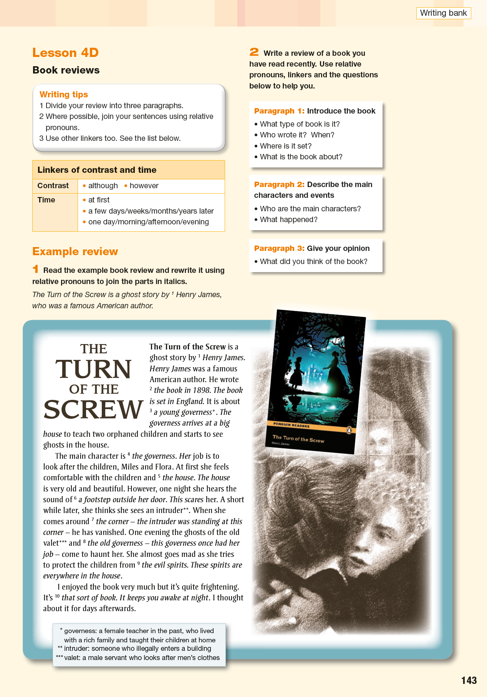
Cubing
Describe
Complain about
Recommend
Warn
Invite
Request to go

Slide 23
Fast Writing
Although Actually But A The When In With So If Since An At And Because Might During With

Slide 24
Actually, Luckily, Unfortunately, Suddenly, Well, Sadly,
Thankfully
Then, Next, After that,
Eventually
Went Saw Bought Hit Stole | Chased after Couldn’t catch Dropped Broke Cried
Oh no,
What a shame!
Really?
So what did you do?

