Slide 1
Reading and Writing
Georgia November 2016
00 Month Year
Presentation Title Arial Bold 7 pt
1

Slide 2

Why bother reading?
Reading can really improve other skills – especially writing.
Students who regularly read in a second language are more likely to have a greater proficiency, larger lexical range and be more confident.
Reading is something that learners can do on their own.

Slide 3

How do we read?
Bottom-up
Top-down
Interactive
Understanding all the words individually, then by putting the words together, building up an idea of the text.
Activating the reader’s background knowledge to anticipate what the text will be about and checking through cross referencing whether those assumptions are correct.
Combines elements of both bottom-up and top-down. In interactive models processes at any level can compensate for deficiencies at any other level.
Fluent reading involves both decoding and interpretation skills.

Slide 4

Different types of Reading Skills
Skimming
Scanning
Contextual Guessing
Cloze Exercise
Outlining
Paraphrasing
Scrambled Stories
Information Transfer
Making Inferences
Intensive Reading
Extensive Reading
Passage Completion

Slide 5
Finishing a reading passage (orally or in writing); involves predicting a logical or suitable conclusion based on a thorough understanding of the text.
Passage Completion
The ability to say or write ideas in other words; measures the reader’s understanding of the main ideas of a text.
Paraphrasing
Making guesses about the meaning of words by looking at the surrounding words or situation.
Contextual Guessing
Note-taking technique designed to help the reader see the overall organization of a text.
Outlining
‘Reading between the lines’: the reader understands what is meant but not stated in a passage.
Making Inferences
Reading carefully for complete, detailed comprehension, (e.g. main ideas, details, vocabulary).
Intensive Reading
Also known as ‘jigsaw reading’: the reader re-orders the mixed up pieces of a text t show how he understands how a text fits together.
Scrambled Stories

Slide 6

READING ACTIVITIES
Most reading activities can be divided into either:
Before you read activities (or Pre-Reading) – designed to introduce the topic, provide any background information and generally help motivate the learners to read the text.
While reading activities are mainly concerned with comprehension of the text (not testing it but confirming comprehension of the story so far). They can also be used to encourage students to examine their emotional reaction to the story, characters or ideas contained in the text.
After reading (or Post-Reading) activities – are used to extend the students’ understanding of the story. These are generally information transfer tasks that activate other skills.

Slide 7
Sally first tried setting loose a team of gophers. The plan
backfired when a dog chased them away. She then entertained a
group of teenagers, and was delighted when they brought their
motorcycles. Unfortunately, she failed to find a Peeping Tom
listed in the Yellow pages. Furthermore, her stereo system was
not loud enough. The crab grass might have worked but she
didn’t have a fan that was sufficiently powerful. The obscene
phone calls gave her hope until the number was changed. She
thought about calling a door-to-door salesman but decided to
hang up a clothesline instead. It was the installation of blinking
neon lights across the street that did the trick. She eventually
framed the ad from the classified section.
Taken from ‘Reading in a foreign language’ (Alderson & Urquhart) Longman 1984

Slide 8
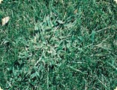
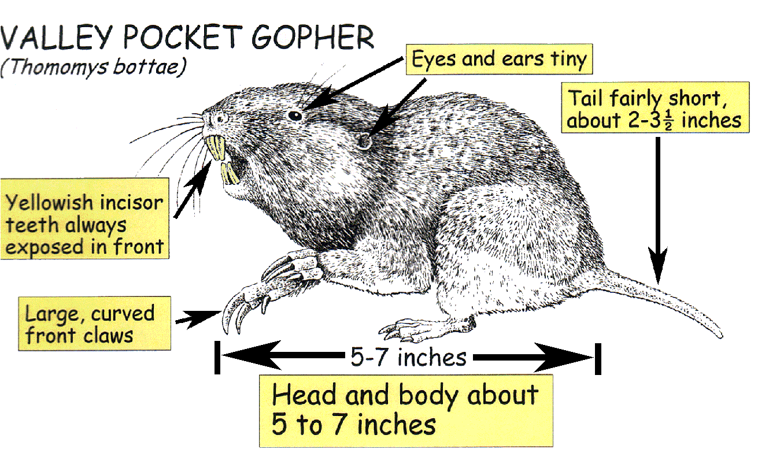

Unknown Words
Crabgrass – from lawncare.com
Gopher – from http:acwm.co.la.ca.us/scripts/gophers.htm
Peeping Tom

Slide 9
Sally first tried setting loose a team of gophers. The plan
backfired when a dog chased them away. She then entertained a
group of teenagers, and was delighted when they brought their
motorcycles. Unfortunately, she failed to find a Peeping Tom
listed in the Yellow pages. Furthermore, her stereo system was
not loud enough. The crab grass might have worked but she
didn’t have a fan that was sufficiently powerful. The obscene
phone calls gave her hope until the number was changed. She
thought about calling a door-to-door salesman but decided to
hang up a clothesline instead. It was the installation of blinking
neon lights across the street that did the trick. She eventually
framed the ad from the classified section.
Taken from ‘Reading in a foreign language’ (Alderson & Urquhart) Longman 1984

Slide 10
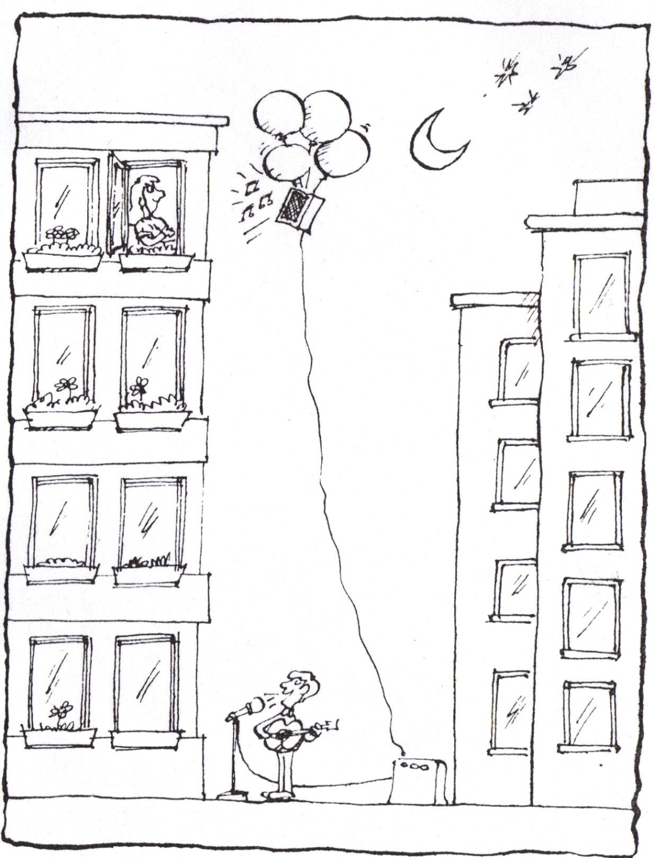
Taken from ‘Reading in a foreign language’ (Alderson & Urquhart) Longman 1984

Slide 11
If the balloons popped, the sound would not be able to carry since
everything would be too far away from the correct floor. A closed
window would also prevent the sound from carrying since most
buildings tend to be well insulated. Since the whole operation
depends on a steady flow of electricity, a break in the middle of the
wire would also cause problems. Of course the fellow could shout, but the
human voice is not loud enough to carry that far. An additional problem is
that a string could break on the instrument. Then there could be no
accompaniment to the message. It is clear that the best situation would
involve less distance. Then there would be fewer potential problems.
With face to face contact, the least number of things could go wrong.
Taken from ‘Reading in a foreign language’ (Alderson & Urquhart) Longman 1984

Slide 12
Pre-Reading Activities
Activating schemata.
Scaffolding.
Engaging the reader.
Introducing the topic.
Pictures, Covers.
Prediction.
Pre-questions.

Slide 13
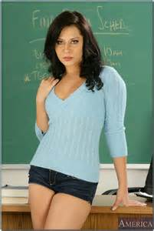
Coming to last year’s conference changed Eva’s life.
What was Eva doing before the conference?
Did she meet anyone special?
Did she lose anything?
What did she do after the conference?
What is Eva doing now?
How is her life different?
Do you think she is happier?

Slide 14

Coming to last year’s conference changed Eva’s life. Before the conference she was working in a Georgian secondary school with a very demanding headmaster, she’d just finished a long term relationship and was looking to devote more time to her teaching. At the conference she met a woman who owned a private language school in Croatia and who was looking for a new English teacher. Eva decided to take the opportunity and now lives and works in a small Croatian town on the coast where she spends the morning on the beach and the afternoons teaching.

Slide 15

While Reading Activities
Interviews and chat shows.
Reordering.
Paraphrasing.
Packing a suitcase.
Correcting.
Who says this?
Using maps.
Family trees.
Letters.
Newspaper Headlines.
Pictures.
Through the keyhole.

Slide 16
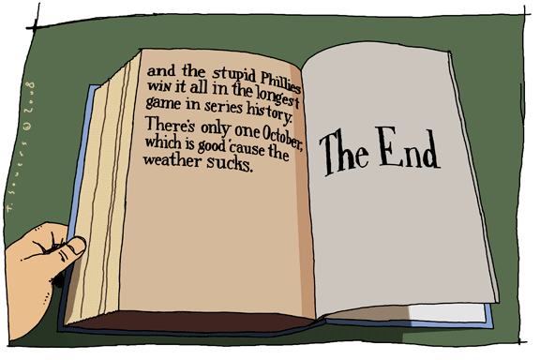
Post-reading activities
Role Plays.
Reading Diary.
Reviews.
Sell the book.
Why I don’t like the book.
Quiz Time.
Change the ending.

Slide 17
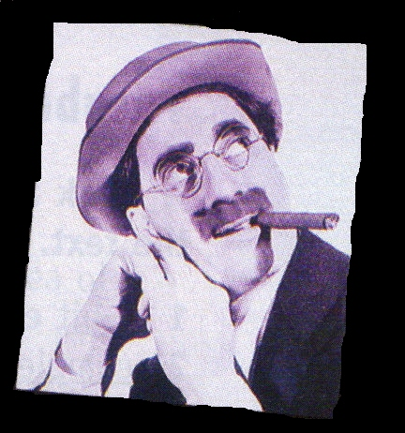
A Memory-
Lucy
Pocket money
Kiss
Love
Tickets
Show
Notes:
Prediction – what do you think the text is about

Slide 18
Love hit me when I was ………….(1) I was still in ……….(2) but little hairs were starting to grow on my upper …….(3). A ……..(4) girl, Lucy, lived in the …….(5) above ours. She was pretty with lovely, ……..(6) hair and perfect ……..(7). One day after I had saved my pocket money for some time, I invited Lucy to go to a……….(8) show with me. I only had seventy cents but I had worked it all out: two tickets for the………(9), fifty cents and four …….(10) tickets, twenty cents.

Slide 19
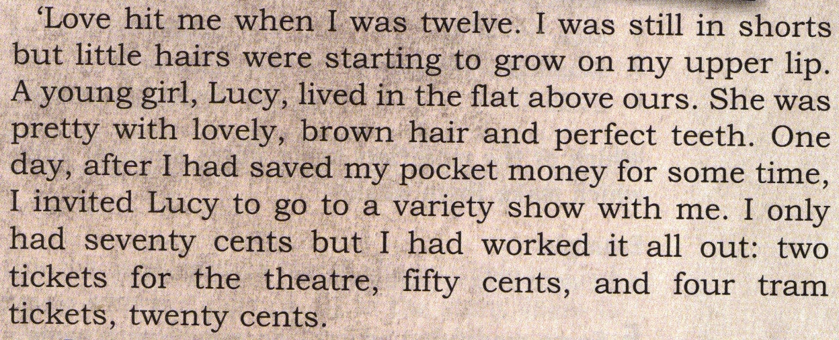
,which was difficult
,which grew down to her shoulders
very carefully
,which I hated
Notes:
Expansion get them to add in the clauses

Slide 20
Reduction
I took Lucy to the theatre when I was twelve
I took Lucy out when I was twelve
My first date, aged twelve
My first date
Notes:
Reduction can they reduce that paragraph to less than 10 words

Slide 21
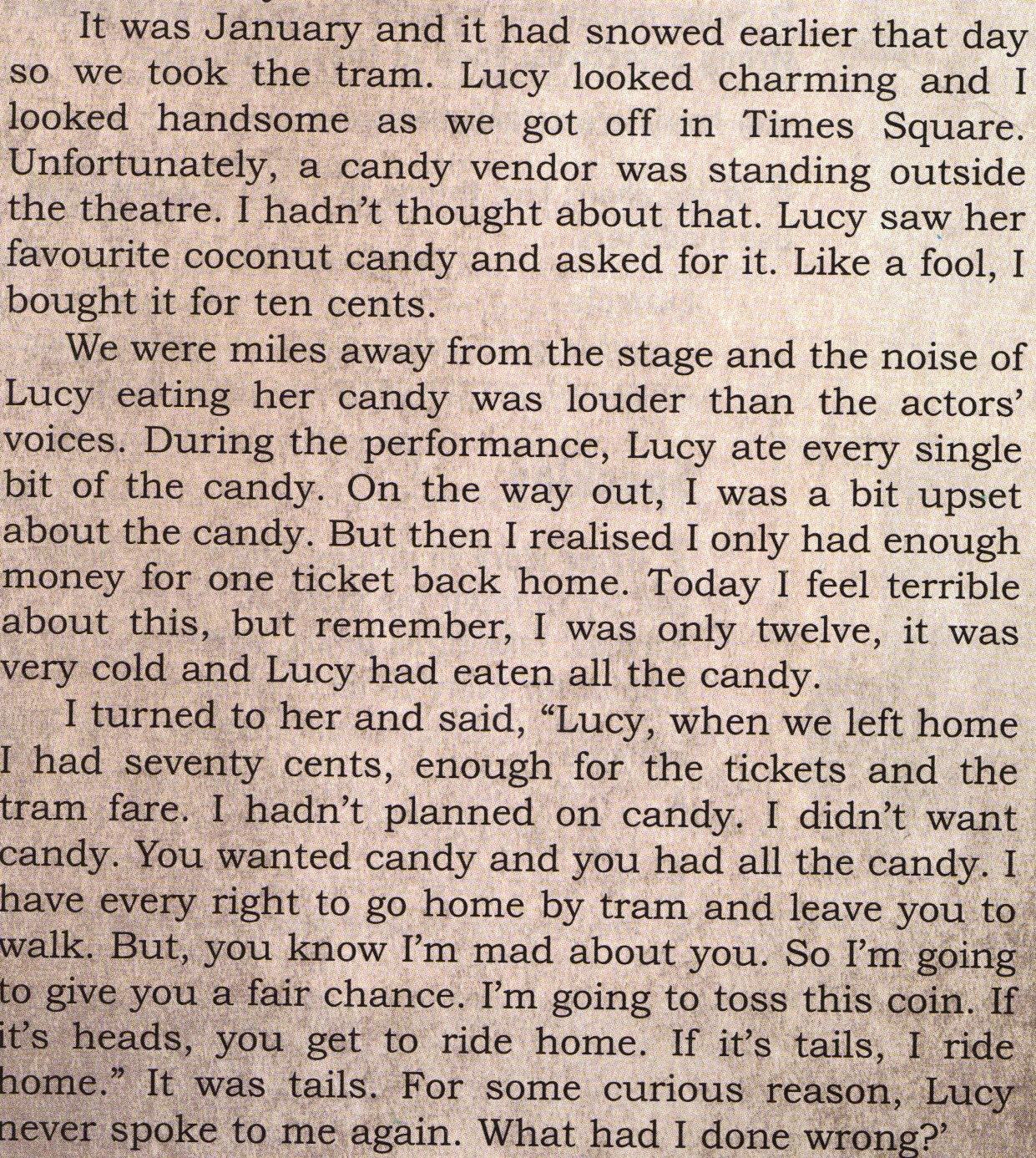
Notes:
Read and they read back with one extra word

Slide 22
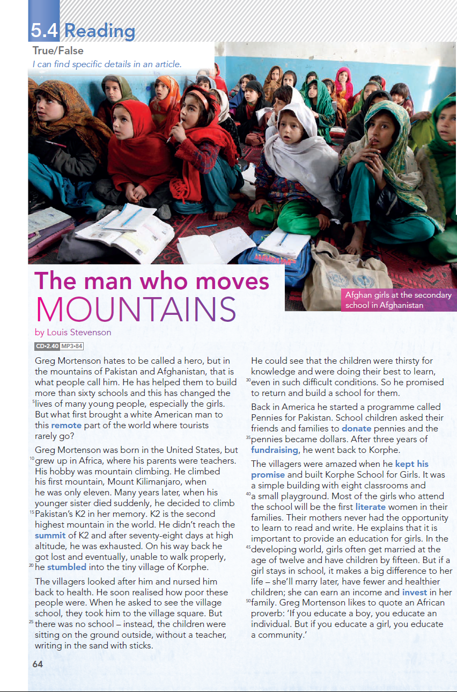
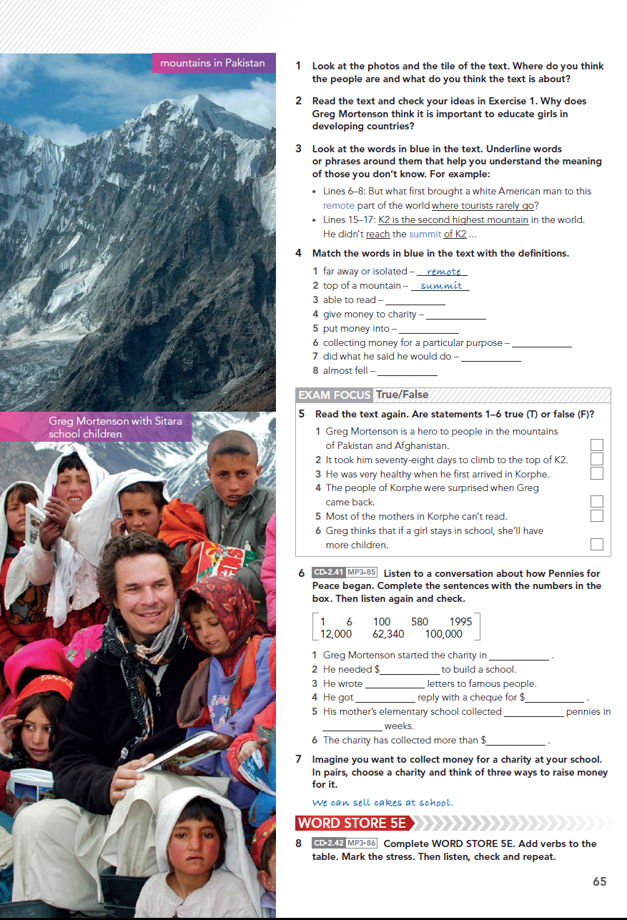

Slide 24
Repeat + 1
Split the class into two or three teams.
Explain to students that you will a few words from somewhere in the text.
Students will scan the text for those words.
They will then repeat those words and say the following word.
The first student to do this correctly gets a point for their team.
Notes:
Like getting students to scan

Slide 25
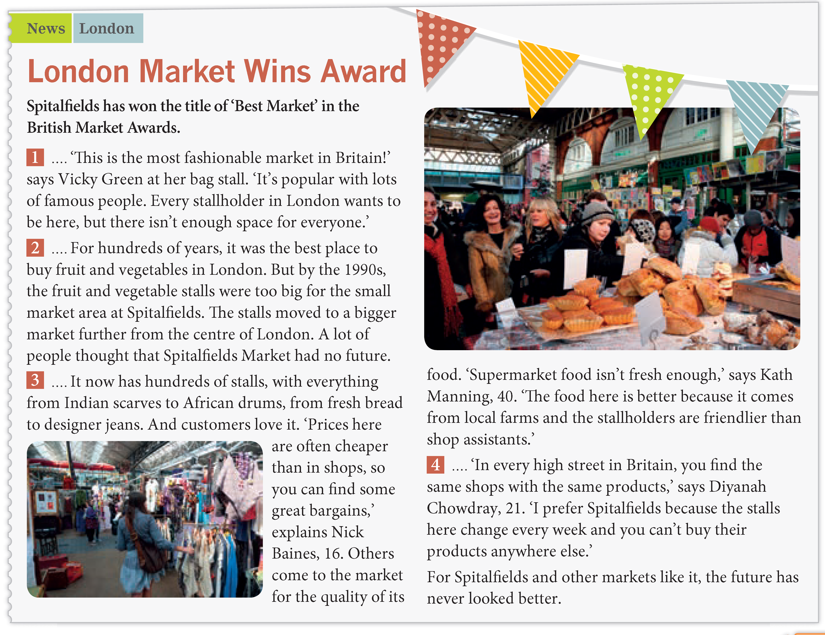

Slide 26
Quote me
Take a text that has clear paragraphs.
Imagine that a target reader has read one of those paragraphs.
Make a quote that corresponds with what the TR has read.
Give the quotes to the students and see if they can find the part of the text the TR was referring to.
Get the students to write their own quotes.
Notes:
Again simplify difficult tasks

Slide 27
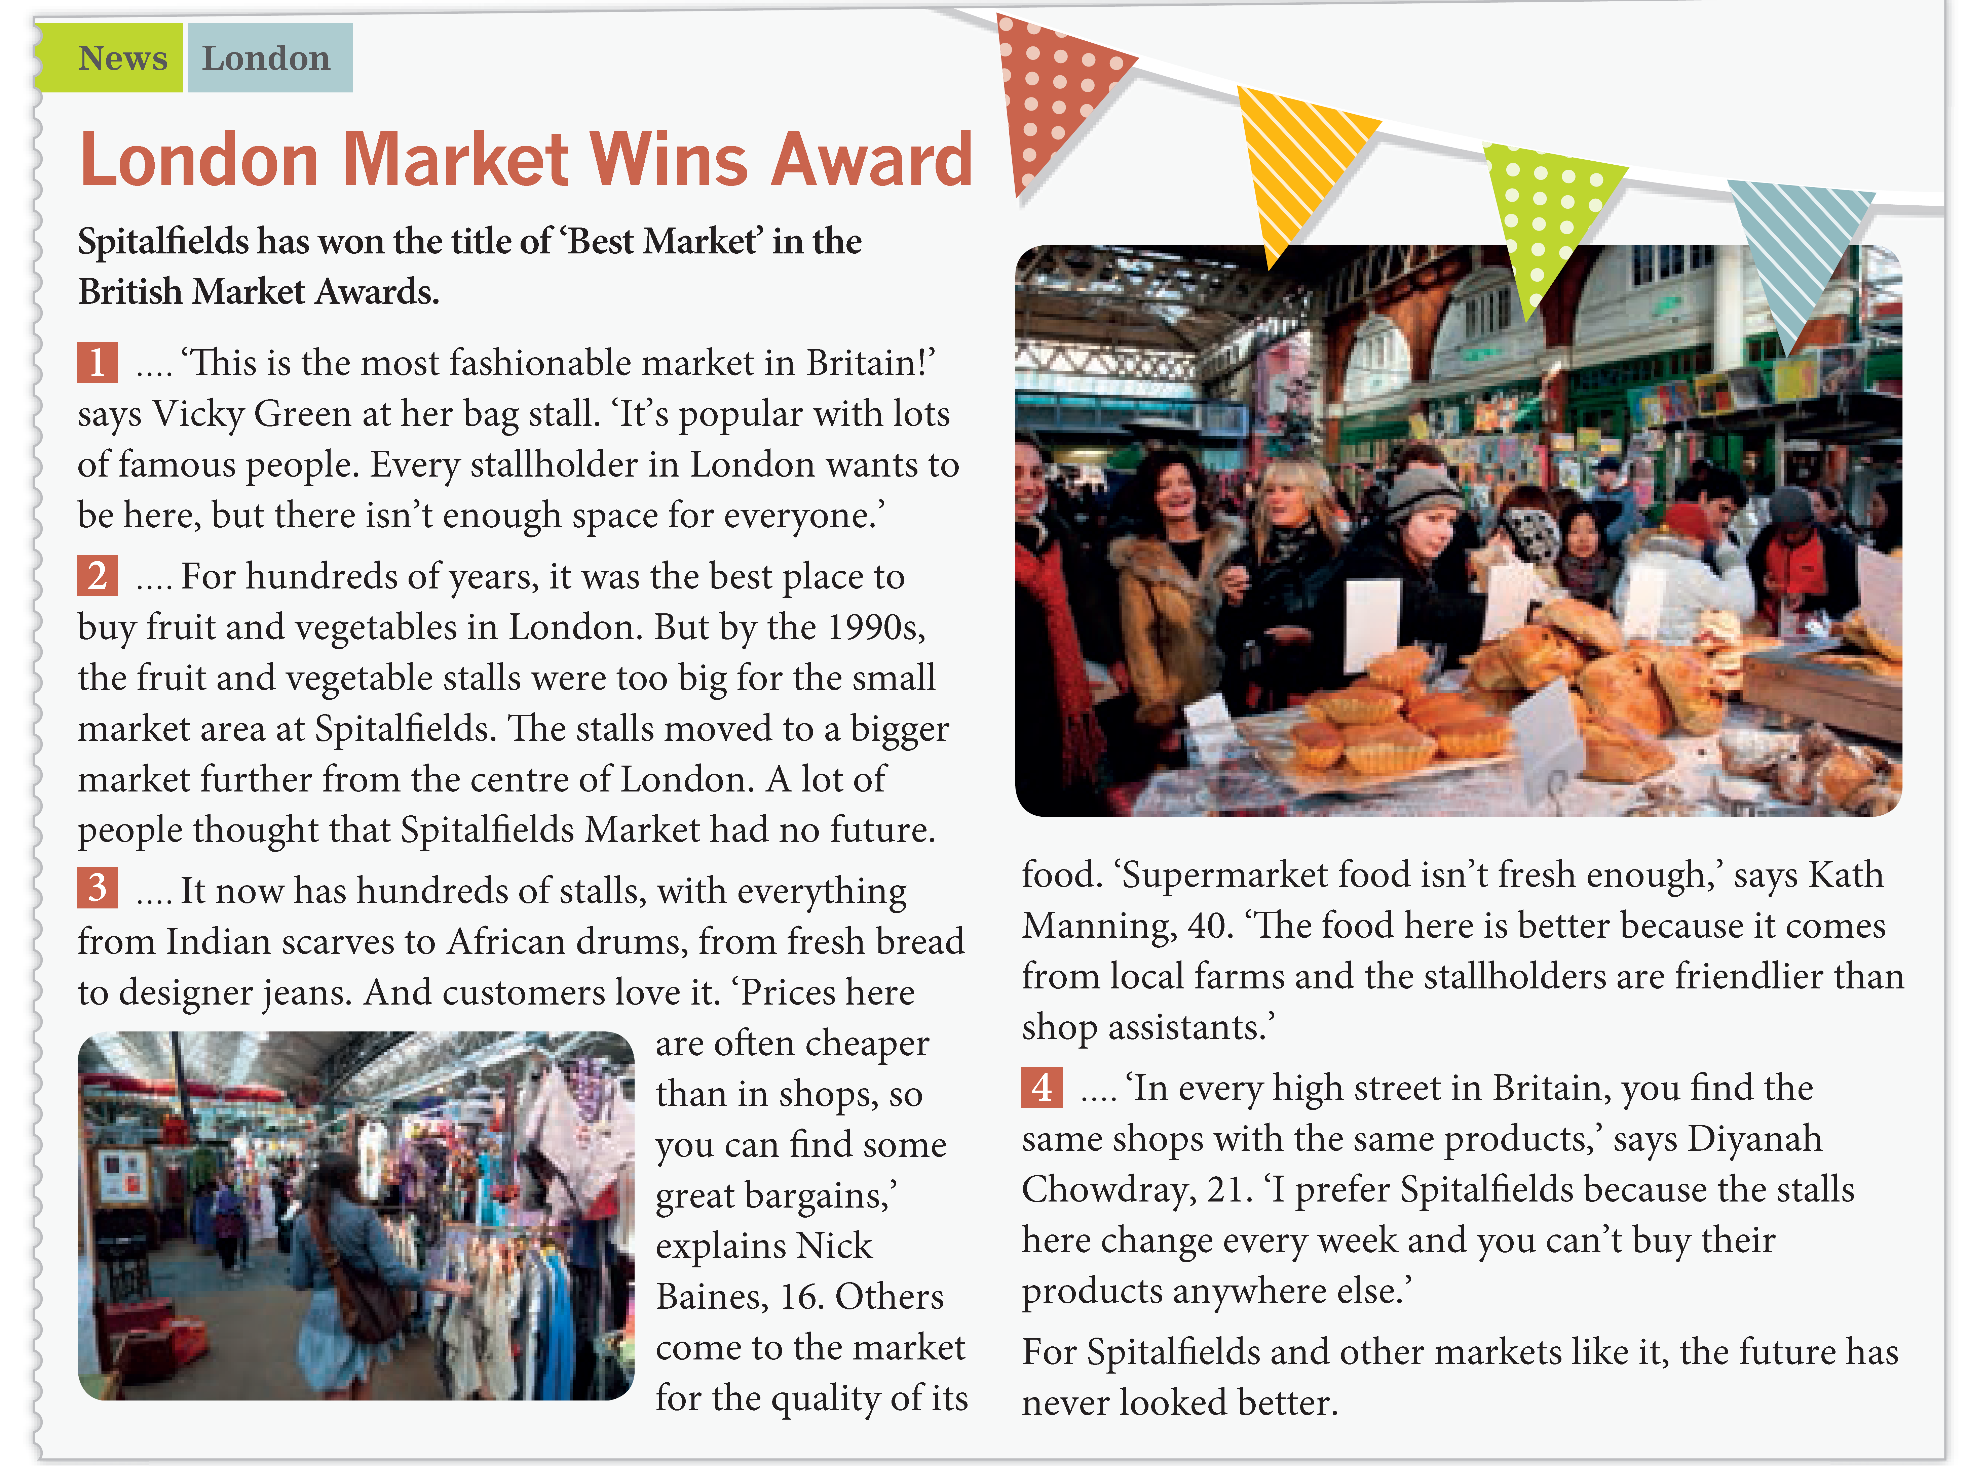
2.I bought a lovely handbag from her last month.
1.It’s too small for every stallholder.
3.Angelina Jolie shops there most weeks.
4.There’s no market more fashionable.

Slide 28
A. It won’t be here next year!
B. Although it’s not so central, this location is better.
C. That was a hat stall last week!
E. My grandmother used to buy wonderful apples there.
D. They are quite boring with no variety.

Slide 29
Substitution
Take any text. Choose some words from the text and write them on the board.
Get students to scan the text and find which words from it can be substituted with the words on the board.
Check answers in pairs and then in class.
Alternatively split students into groups, give each group a different paragraph and get them to write the substitute words and test them on another group.
Notes:
This was another particular problem, if the same word appeared in the text and in the questions, students could cope otherwise it was a struggle.

Slide 30
Easier Choice Just
From here Peaceful
Closest In my opinion
30 minutes
Alternative Sufficient
Stores Things
Notes:
Again the same text – point out that the grammar is used

Slide 31
Class readers
Can be an ideal way of introducing students to extensive reading.
Are perfect for DEAR and SSR.
Can lead on to reading rings and class libraries.

