Slide 1
Classroom Management
Georgia November 2016
00 Month Year
Presentation Title Arial Bold 7 pt
1

Slide 2
A few acronyms to consider
PPP
TTT
ESA
TPR
ESP
EAP
ARC
TBL
PBL
CCCC
Present – Practise – Produce
Test – Teach – Test (Teacher Talking Time)
Engage – Study – Activate
Total Physical Response
English for Specific Purposes
English for Academic Purposes
Authentic Use – Restricted Use – Clarification
Task Based Learning
Project Based Learning
Critical Thinking/Communication/Collaboration/Creativity

Slide 3
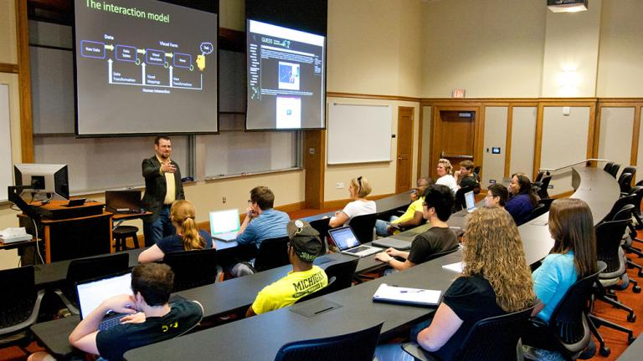



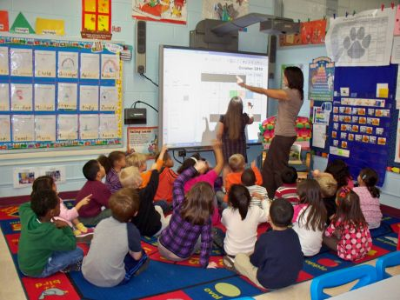

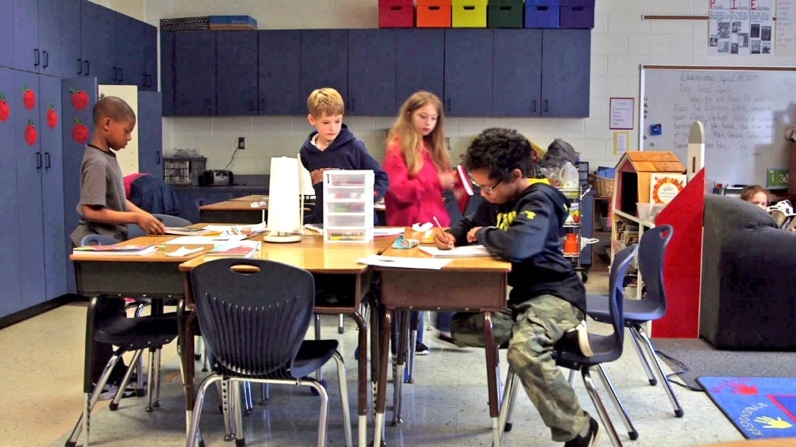

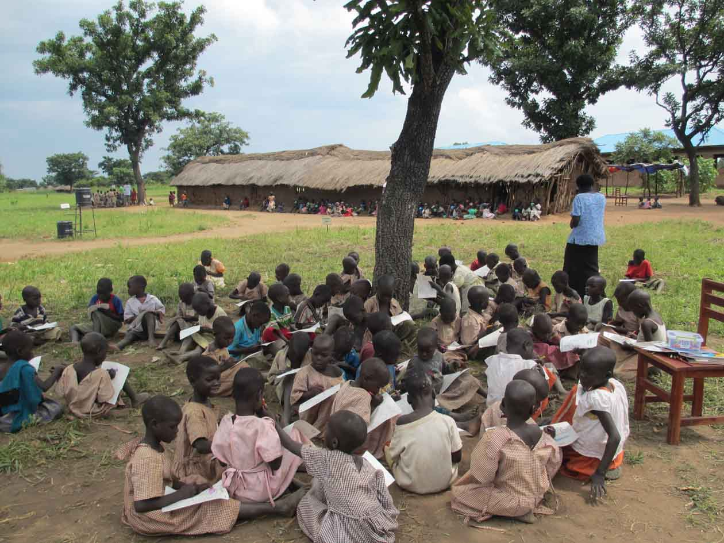

Slide 4

MEANS ANAYLSIS
Static or shared classroom?
Equipment
Space
Flexibility
Same students or different?
Flooring
Furniture
Board

Slide 9

Give Instructions
As teachers, we need to tell students what they should do, how they should do it and why they should do it.
‘What’- defines the task.
‘How’ – organizes it.
‘Why’ – justifies it.

Slide 10
‘You are angry with your boss, tell him why.’
‘This is very common when you work with foreign colleagues.’
‘Work in pairs.’
‘Stand up.’
‘You are ‘A’ and you are ‘B’.’
‘This is a good chance to practice giving advice.’
‘Describe the people on page 35.’
‘Move around the room asking different people.’
‘Find someone who likes Chemistry.’
‘People often ask for our opinions about others, so it is important to be able to describe personalities.’
‘This language is very useful for talking about responsibilities in general.’
‘Discuss the questions at the bottom of the page.’
‘While you’re doing this I want you to focus on different ways of talking about the future.’
‘Change places with Cindy.’
‘Try to use some of the phrases on the board.’

Slide 11
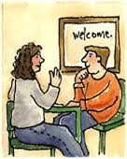
Work in pairs
Will the students be standing or sitting?
Will the students be working with the person sitting next to them (closed pairs) or will I allocate them different partners (open pairs)?
Will I get the students to change partners quickly and repeat the task?
If so will I arrange the students in a line or circles?
What language will the students use?
Will the students both be speaking?
What materials will the students need to complete the task?
Will both students use the material in the same way?
What distance should the students be from each other?
Will the activity involve the students moving around?
Will I get the students to mix and mingle?
Will they have to write anything?

Slide 12

Monitoring
This is what the teacher is doing when the students are engaged in an activity. Monitoring plays many key roles in the classroom, during this time the teacher should:
Encourage students
Correct Students
Feed in Language
Record Student Output
Interact with the students.

Slide 13

Tips for good monitoring:
Good monitoring is best done at the same eye-level as the students (i.e. crouching down when they are sitting)
Try to be as accessible as you can (i.e. even when interacting with one group try to have an ear on the rest of the class)
Be approachable, let the students know that if they are struggling or need help they can ask you for it.
Don’t be too predictable by going round each pair in turn, make sure that you always monitor in a random way.

Slide 14

What could feedback include?
Correcting errors.
Giving praise.
Further practice.
Providing answers.
Eliciting answers from students individually.
Eliciting examples of student output.
Introducing language functions.
Introducing new language.
Focusing on pronunciation.
Assessing students.
Asking students the result of the activity.
Eliciting task aims.
Self-Assessment

Slide 15
‘Okay that was great, now let’s move on to page 36.’
‘Well done!’
‘Good job, I liked that.’
‘Fantastic .’
‘That was good.’
‘Nice try.’
Giving praise.
‘Right, so what did you decide to do? How many people choose Pizza?’
‘Who thought Tim was wrong?’
‘Which group went to the cinema?’
‘Did anyone choose Turkey?’
Asking students the result of the activity.
‘Well, that was good, but I heard these (writes sentences on board) can anyone tell me what’s wrong with number 1?’
Correcting errors.
So, let’s look at the board (points to word on whiteboard), can anyone tell me what ‘perks’ means?’
Here are some more words and phrases connected to travel
These expressions are very good for agreeing and disagreeing
Introducing new language.
‘Now I want you to change partners and this time I want you to try and use some of the expressions on the board.’
‘Try that again but this time be polite.’
Further practice.
‘Good, right can anyone tell me why we were doing that?’
‘Why did we do that?’
‘What language did we just use?’
Eliciting task aims.

Slide 16
Task Based Learning
SET UP
ON-TASK
FEEDBACK
Discuss:
1. What does each of these stages in the classroom management model might mean?
2. What does an effective teacher do during each stage?
3. What percentage of the activity should each stage take?

Slide 17
SET UP – ON-TASK - FEEDBACK
Give Instructions
Monitor
Give feedback
Make corrections
Use the whiteboard
Establish control
Motivate the students
Introduce language
Use teacher talk

Slide 18
Task Based Learning
Why?
Motivate students by describing the benefits of doing the activity
Focus the students on what they will learn.
How / What?
Give clear instructions.
need to know basis
Clear / repeated
Concrete
Pause and check for comprehension
Stage One:
Set Up Activities
Teacher Talk
Must be simple and clear
Repeat what you say
Useful source of input
Establish control
Make sure everyone is paying attention – no exceptions!
Use voice and authority to establish control
Pause to establish control

Slide 19
WHY HOW/WHAT ESTABLISH CONTROL TEACHER TALK
TEACHER TALK
Inexperienced teachers don’t understand the importance of teacher talk as a form of comprehensible input.
What are some common problems inexperienced teachers might have ?
WHY
Inexperienced teachers seldom motivate students by describing the benefits of the activity.
Inexperienced teachers don’t understand why the activity is beneficial and therefore can’t focus students on the benefits of the activity.
HOW/WHAT
Inexperienced teachers include too much in instructions thereby confusing students
Inexperienced teachers speak too fast and use language that is too difficult for the students
Inexperienced teachers give instructions that are too conceptual – not concrete
Inexperienced teachers don’t pause and check comprehension
ESTABLISH CONTROL
Inexperienced teachers don’t realize the importance of establishing control and how it affects their credibility – they start off too friendly
Inexperienced teachers allow students to speak while they are setting up an activity
Inexperienced teachers lack the confidence to take control during a set up
Inexperienced teachers often rush through set up because they feel nervous

Slide 20
Task Based Learning
Provide Input
Comprehensible input in the form of meaningful, contextualized language
Readings, listening texts, stories, questionnaires, etc.
Discovery Learning
Let the students work with the key language in context
Let the students discover how to use the language in meaningful contexts.
Stage Two:
On Task
Monitor - learning
Make sure they are learning to use the target language
Evaluate their English strengths and weaknesses.
Monitor - teaching
Correct grammar, vocabulary and pronunciation
Give feedback – smile encourage students [positive]
Build rapport with individual students
Get involved and focus the students

Slide 21
Inexperienced teachers
Providing Input
Don’t understand the importance of providing good input as a means of highlighting target language.
Discovery Learning
Don’t focus the students clearly on the target language [language focus]
Don’t allow the students time enough to practice using the target language
Monitor - Learning
Often don’t understand the importance of monitoring in understanding the students’ English strengths and weaknesses.
Often don’t monitor carefully. Instead they merely walk around focusing on themselves and what activity they are going to do next rather than focusing on the students’ needs.
Monitoring – teaching
Don’t teach students by making corrections
Don’t interact to build rapport during monitoring

Slide 22
Task Based Learning
Use the Whiteboard
Organize the whiteboard to
To review vocabulary
To introduce new vocabulary
To correct mistakes
Make corrections
Focus on common mistakes students made while on task [grammar, vocabulary, pronunciation
Use the whiteboard
Stage Three:
Feedback
Feedback on Performance
Comments on performance – praise or mild criticism about effort
Focused feedback on the task – especially at higher levels
Suggestions on how to improve – cultural input, speaking strategies [above C4].
Feedback on Language
Motivate the students by pointing out the value of what they just learned.
Analyze the useful language and make sure the students know how to use it.

Slide 23
Inexperienced teachers
Whiteboard Use
Often don’t make effective use of the whiteboard by under using it or over using it with too much vocabulary
Don’t organize the information on the whiteboard [divided into distinct areas with different functions – don’t write phrases and collocations.
Corrections
Often don’t make corrections at the feedback stage.
lack the confidence to clearly explain grammar in context.
Don’t allow the students time enough to practice using the target language
Feedback on Performance
Often don’t give any form of feedback on the students’ performance.
Don’t provide good quality feedback [focusing on the wrong aspects of the language]
Feedback on Language
Often lack the ability to focus the students on the target language
Often don’t take time to analyze and reinforce the language focus.

Slide 24
How Long?
Set up – 10% of the activity
On task – 70% of the activity
Feedback – 20% of the activity
Note: These percentages change depending on the class level.
In a beginning class [1] and an elementary class [2-3] the on task stage is shorter because students can’t produce much language. Set up takes longer and feedback is longer.
From intermediate to upper intermediate [3+] the above percentages are appropriate.

Slide 25
3-2-1 approach

Slide 26
Actually, Luckily, Unfortunately, Suddenly, Well, Sadly,
Thankfully
Then, Next, After that,
Eventually
Went Saw Bought Hit Stole | Chased after Couldn’t catch Dropped Broke Cried
Oh no,
What a shame!
Really?
So what did you do?

Slide 27
LOWER LEVELS

Slide 28
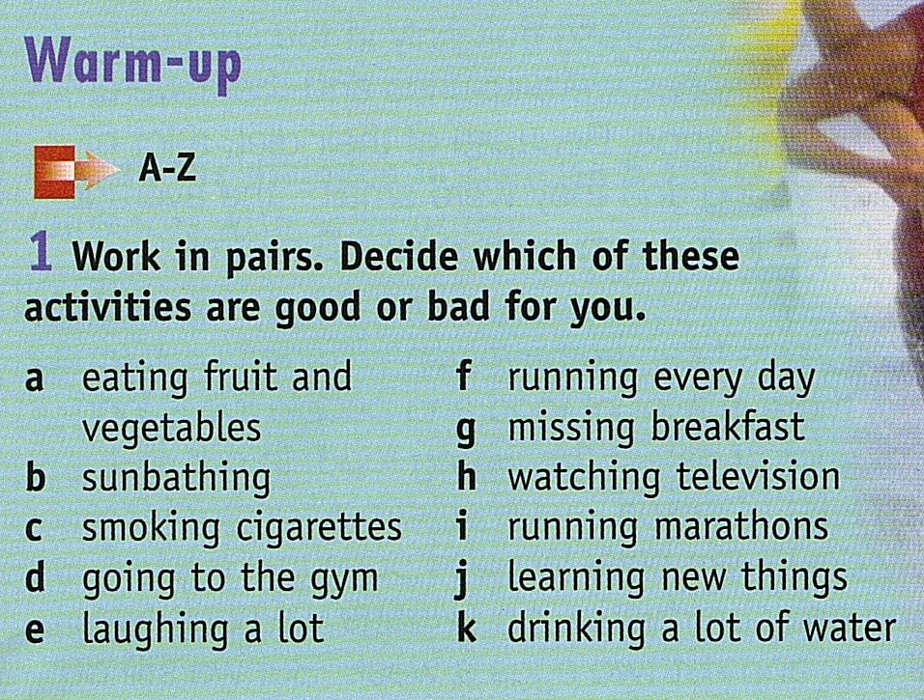

Language to complete the task
Giving opinions
I think …… …must be good for you.
I’m sure that.. …can’t be good for you.
I know…….. …is bad for you.
Agreeing/Disagreeing
Really? Me too. You must be joking!!
I don’t think so. I agree.
Notes:
Weaker students can get prompts stronger students not

Slide 29
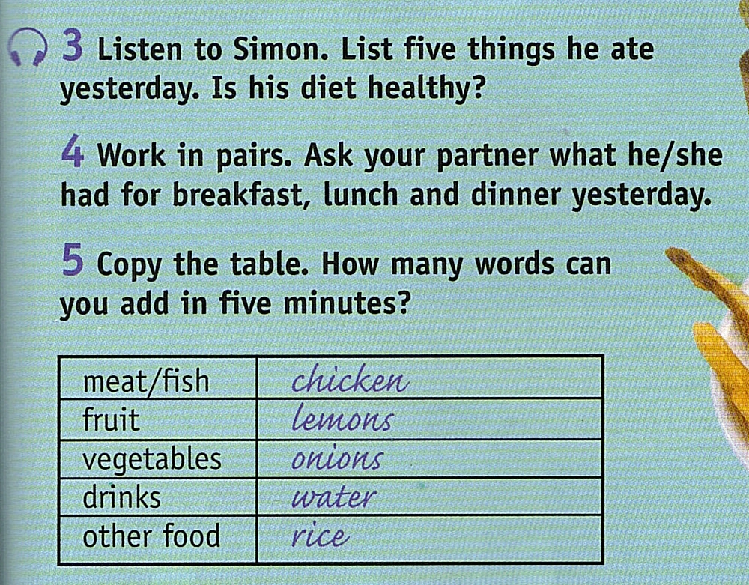
Questions to Ask
Where did you have breakfast/lunch/dinner yesterday?
What did you have for breakfast/lunch/dinner yesterday?
Was it good/tasty/all right?
Sample Answer:
I had lunch at home yesterday, beef and dumplings in a goulash sauce and an apple to finish , it was okay. What about you?
Notes:
Again give them the language

Slide 30
HIGHER LEVELS
Start with the task – then provide language
Give them feedback – on pronunciation, appropriacy, lexical range, interaction
Get them to repeat the task

Slide 31

Your new teacher………..
Meet
Simon
What does he look like?
What do you think he’s like?
What do you think he’ll be like to work with?
Notes:
From upperint oppertunities

Slide 32
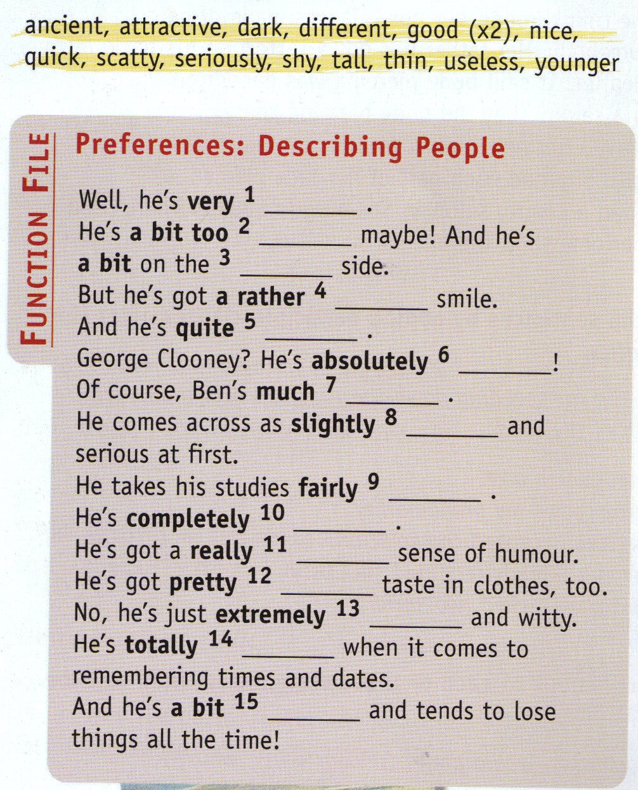

Slide 33
Other considerations

Slide 34

Set a personal example
Be punctual
Be prepared
Be enthusiastic
Be excited
Be colourful

Slide 35
Create realistic learner beliefs
‘Students need to be aware of the fact
that mastery of a foreign language can
be achieved in a number of different
ways, using diverse strategies, and
therefore a key factor leading to
success is for learners to discover for
themselves the methods and
techniques by which they learn best.’
(Dornyei 2001)

Slide 36

Think about the textbook
Make sure that students
are aware of the layout.
Use activities that make the students comfortable using the book.
Try to promote learner autonomy through book use.
Use the book in a non-linear way.
Don’t teach the textbook, teach the students
Use the students as a resource.
Use contexts that need little explanation.
Use cultural references.
Use personal anecdotes.

Slide 37
Introduce reward strategies
Competition
Input
Assessment
Achievement
Notes:
Input – have a say about what is done, assessment – moving students up & down the chart, achievement – stars, certificates, learner diaries

Slide 38

Promote learner autonomy
Self-Assessment
ELP
Self-access
Negotiated Syllabus
Homework

Slide 39
Include lots of variety
Variety of interaction patterns
Variety of activities to suit different learning styles and intelligences
Variety of length of activities
Variety of skills focus – receptive and productive

Slide 40

Make lessons fun
Use English to teach/do other things.
Include Warmers.
Arouse curiosity.
Surprise students.

Slide 41

Demotivation – What not to do
1. The teacher's personal relationship with the students, including hypercriticism, belligerence, a lack of caring, and favouritism.
2. The teacher's attitude towards the course or the material, including lack of enthusiasm, sloppy management and close-mindedness
3. Style conflicts between teachers and students, including multiple style conflicts, conflicts about the amount of structure or detail, and conflicts about the degree of closure or 'seriousness' of the class
4. The nature of the classroom activities, including overload, repetitiveness, and irrelevance.
R.Oxford(1998)

