Slide 1
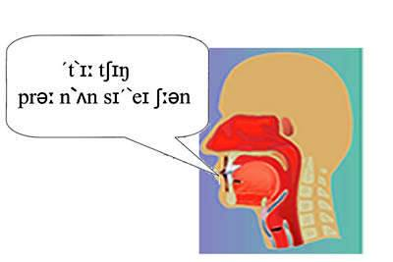

Pronunciation
Notes:
Ask Ts if they can decode what the title of the session is:
Answer: Teaching Pronunciation.
If you have a Phonetic Chart poster, stick it up on the wall.
Very briefly discuss Pros/Cons of Phonemic Script: do Ts use it? Why? Why not? Problems? Advantages?

Slide 2
Recognise the Feeling
PHRASES | MOODS
Good morning | Very worried
How are you? | Uncontrollably excited
Who are you? | Extremely angry
Can I sit here, please? | Deathly bored
Do I know you? | Deathly scared
So nice to meet you! | Bursting with optimism
Notes:
Warmer: From: Learning Teaching 2nd Ed. (Jim Scrivener) Macmillan
Tell Ls to exaggerate feelings and volume!
In pairs, A chooses a phrase and says it to B in one/any of the moods in the Moods column. B must guess which mood/s it is said in.
Change over.

Slide 3
RP or not?
Teach the pronunciation you speak yourself
Draw attention to local variations you are aware of
Highlight differences in accent that occur in course materials
Use the Course CDs whenever possible
Notes:
Received Pronunciation , US or other accent? What is the Ts’ aim? Or is a good Georgian accent OK? International English etc.
See what Ts think first.
Then show them what Jim Scrivener advises in his book Learning Teaching (slide above).
D is my suggestion as I suspect many don’t use the CDs. Ask and find out why/why not. This is a KEY resource for Ts’ pron too!

Slide 4
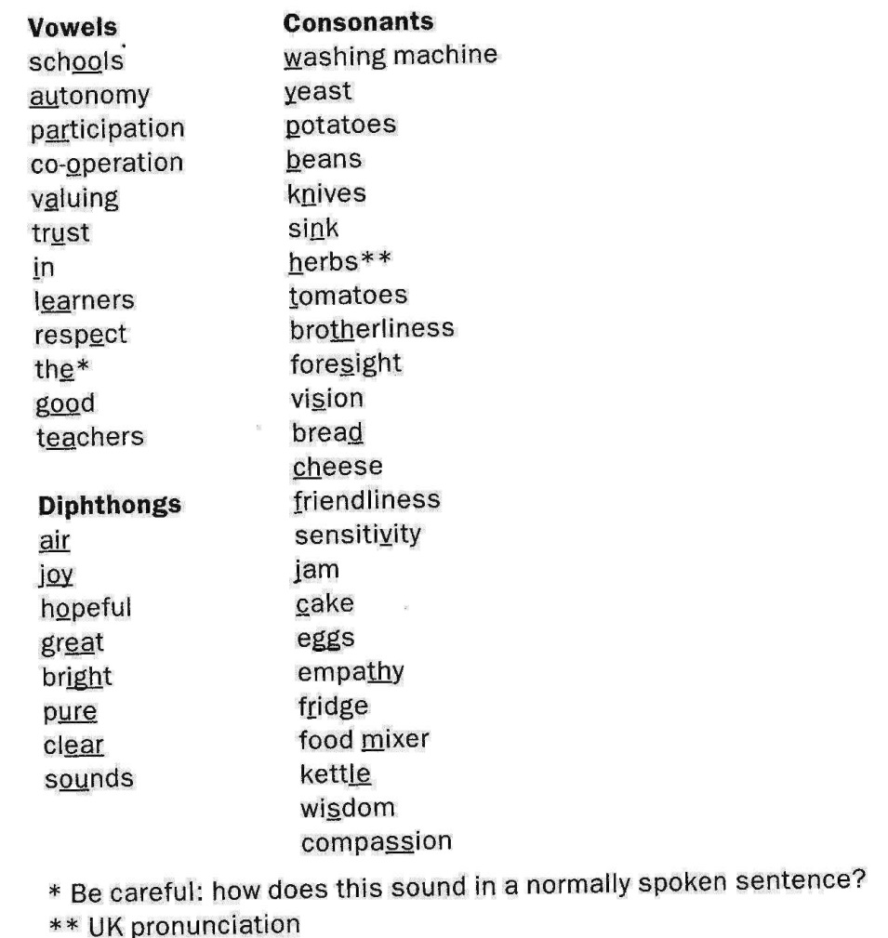
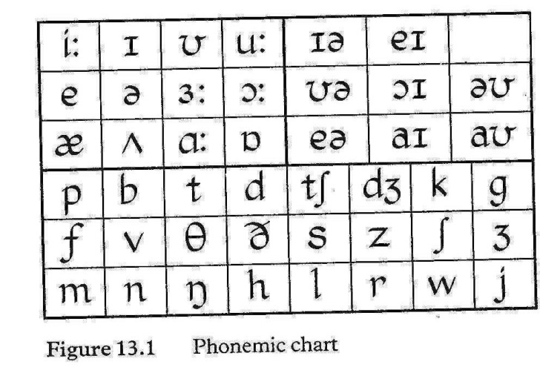
Sounds: «Phonemes»
Notes:
Optional:
See if Ts can match up the underlined parts of words in the left-hand column with their phonemic symbols in the chart on the right. (You could select a few only or delegate different parts to different groups).
This is for general awareness. Most dictionaries contain this chart with examples so it is not necessary for Ss (or TS) to memorise them. It is however an invaluable tool for Ts and students to check and improve their comprehension as well as pronunciation.
Answers on next slide.

Slide 5
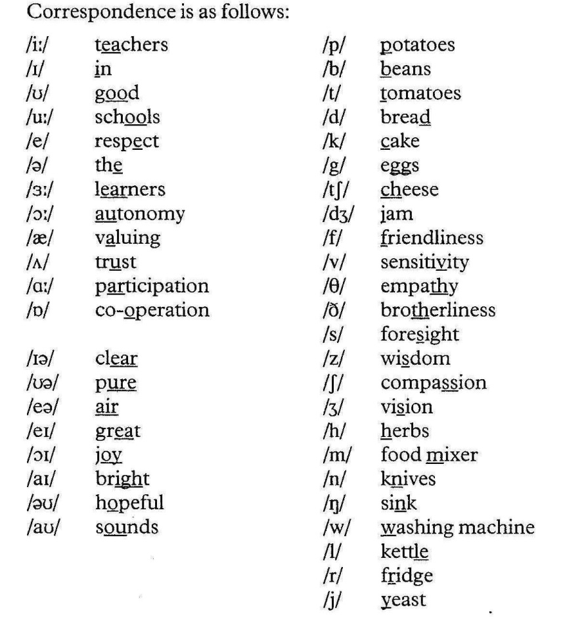
Mnemonics to Remember the Phonemic Chart
Notes:
Vowels red box (Teachers in good schools respect......)
Dipthongs blue box ( A lyrical piece about nature)
Consonants green box (Food, Human qualities, objects in the kitchen)
In each list the words make a memorable sentence or are grouped according to a specific category, e.g Human qualities, In the Kitchen, Food etc. and include all the symbols in order as found on the chart (moreorless-needs readjusting in parts).

Slide 6
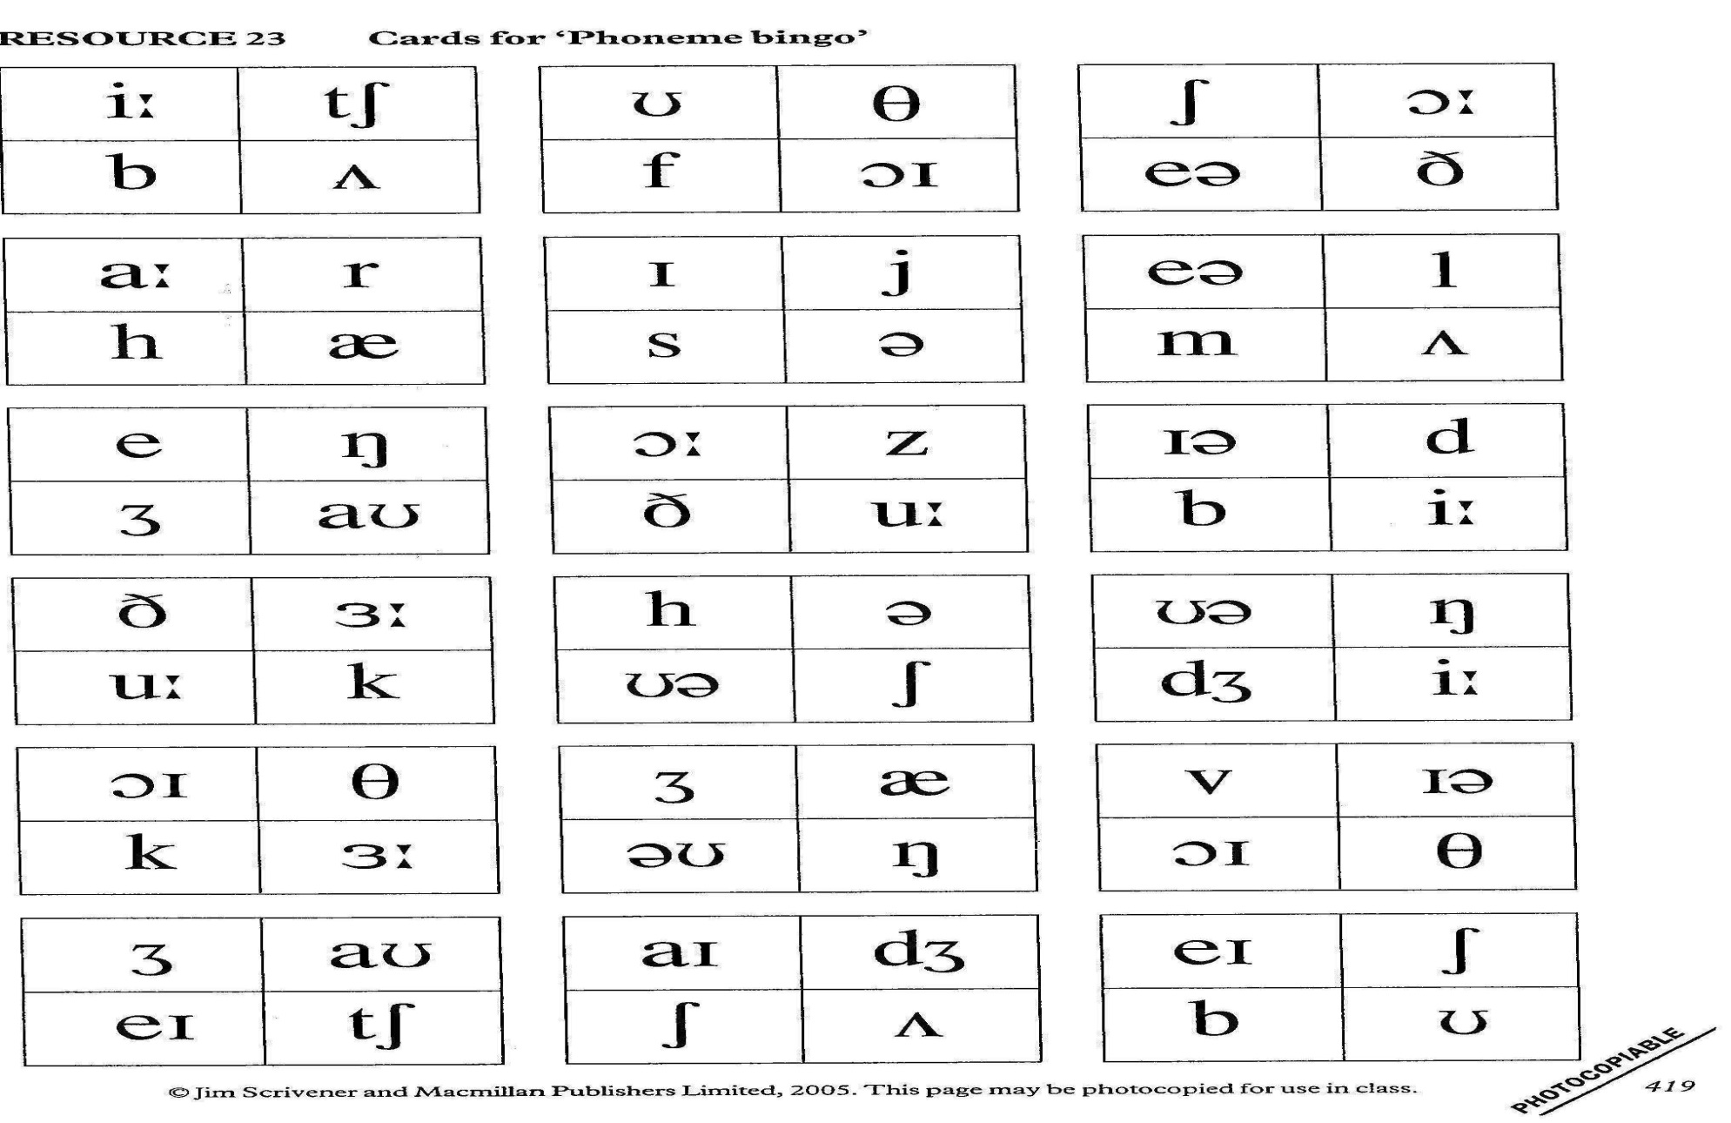
Phoneme Bingo
Notes:
Should Ts wish to teach these to their SS, a nice photocopiable activity for them to use from Jim’s book. Each S gets a bingo card and T reads out the sound.
First to cover all 4 phonemic symbols on the card calls ‘BINGO’!

Slide 7
Other ways to improve pronunciation of sounds
Shadow reading
Minimal Pairs
Tongue Twisters
Category Words
Notes:
Shadow reading:
Play dialogue or text from CD and ask all students to read along simultaneously or ‘shadow ‘the reader with the script in front of them-sometimes! (better than asking individs to read aloud alone in front of the whole class!).
Minimal Pairs:
Read out words that contain similar sounds which SS need to work on e.g. Man: Men and get SS to identify which one is being read by the T. Then S reads and T identifies.
Tongue Twisters
See in following slides
Category Words
See in following slides

Slide 8
Tongue Twisters
The sink thinks it’s sinking.
I think the sink is thinking it’s sinking.
Thank you sink for not sinking.
Think sink! Think!
Don’t sink! Think!
Thank you! Who sank you?
You thank yourself because you sank yourself!
Notes:
For choral recital, dictation...See 12 Ways with Chants later on.
A difficult discrimination for Georgian speakers: they often say « Sank you» instead of «Thank you». Specially composed by me ☺

Slide 9
Category Words Game
 | Food | Sports | Animals | Household Objects | Clothing | World Cup
/i:/ | cheese | skiing | sheep | teapot | jeans | free kick
/a:/
/ᵊᶷ/
Notes:
Ss are given a phonemic symbol and have to find a word for each category in the columns containing that sound.
Look at the example and then let them have a go in small groups or pairs with the next two.

Slide 10
Word Stress
Marking Stress
Formation
‘Window
Unhappy
Impostor
magaZINE
Cassette
Waterfall
De ful
light
Notes:
Ask CPs: Which do you find clearest? Any of these is possible and useful for Ss to note in their notebooks when recording new vocabulary.
Ts should include these stress markings whenever they write up a new word on the board. (Check in the dictionary first!)
Most dictionaries use the ‘ mark, directly preceding the stressed primary , secondary, tertiary syllable etc. (see 2 above).

Slide 11
Stressed Groups
Get into groups according to the stress patterns in your name.
E.g. Teresa
In your groups, find English words with the same stress pattern as your name.
Notes:
Do it and afterwards mention that this could be done at the beginning of a new school year to get to know names and thereafter while taking the register sometimes.
It’s also another alternative way of grouping students.
Ask CPs to stay in their ‘stress groups’ (but they can break up into 3s) to do the activity on the next slide together.

Slide 12
Word Stress
Sorting Stress Patterns
Interview, computer, revision, innocent, completely, important, suitable, example,
recorder, universe, opposite
Notes:
Get CPs to try these first.
Tell them or demonstrate that this activity can also be done kinesthetically by Ss physically sitting (for unstressed syllabules) & standing up (for stressed syllables) at the board.
Can be done with any new words learned.

Slide 13
Sentence Stress
Michael wanted to buy a red shirt
Not a skirt
Not rent one
Not Peter
He wasn’t obliged....
Not a brown one....
Not many....
Make it a question
Express shock & horror!
Notes:
Effects of changing sentence stress on meaning...
Ask CPs to read out the sentence in black stressing different words according to the changes in meaning indicated in blue above-first in pairs-then feedback with whole group.

Slide 14
Feeling the Rhythm/Speaking rhythmically
A sailor went to sea, sea, sea
To see what he could see,see,see.
But all that he could see,see,see
Was the bottom of the deep blue sea,sea,sea.
Notes:
Pat-a-cake style-Ts might have fun (as all YLs will) doing the pat-a-cake to this popular children’s chant.
You could ask them afterwards which words were stressed and why (Answer:nouns, verbs, adjectives which carry the main meaning-not to, a, but,the,of, could i.e prepositions, articles, conjunctions, modals etc .which are syntactic essentials but do not carry as much meaning.
Can also be done with:
I never saw a purple cow, I never hope to see one.
But I can tell you anyhow, I’d rather see than be one.
to a slightly different rhythm.
From: Pronunciation Clement Laroy OUP

Slide 15


Rhythm Rounds
London’s burning, London’s burning,
Fetch the engine! Fetch the engine!
Fire! Fire! Fire! Fire!
Pour on water, Pour on water!
Notes:
Excellent for the polyphonic Georgians.
Teachers and Ss can also create their own verses to familiar tunes. All helps with the rhythmic feel of English.
Can also be done spoken. See next slide.

Slide 16
Spoken Round
For your ‘breakfast this ‘morning
‘What did you ‘eat?
Did you ‘have any ‘porridge?
Did you have any ‘meat?
I ‘didn’t have ‘porridge
And I ‘didn’t have ‘meat
I had ‘tea with ‘sugar
But ‘nothing to ‘eat.
Notes:
Singing or saying rounds raises the energy level in the class, an important benefit on cold,wet,hot,sleepy,boring days, and helps internalize rhythm.

Slide 17
Polyphonic dipthongs
Hair,care,bear,stare,
Fair,mare, tear (as in rip)
Here, career, beer, steer,
Freer, fear, hear.
To the tune of ABCDEFG
Notes:
This activity is to highlight and help ss to see that sound and spelling don’t always match! One sound, many spellings-often confused by speakers of other languages!
One notorious example is Bear and beer!
Get teachers/Ss to create and recite some more of their own.
Choice of tune is optional-whatever works!
In rounds is even more challenging! It can also be done as a polyphonic round (the Georgians are the experts in this area).

Slide 18
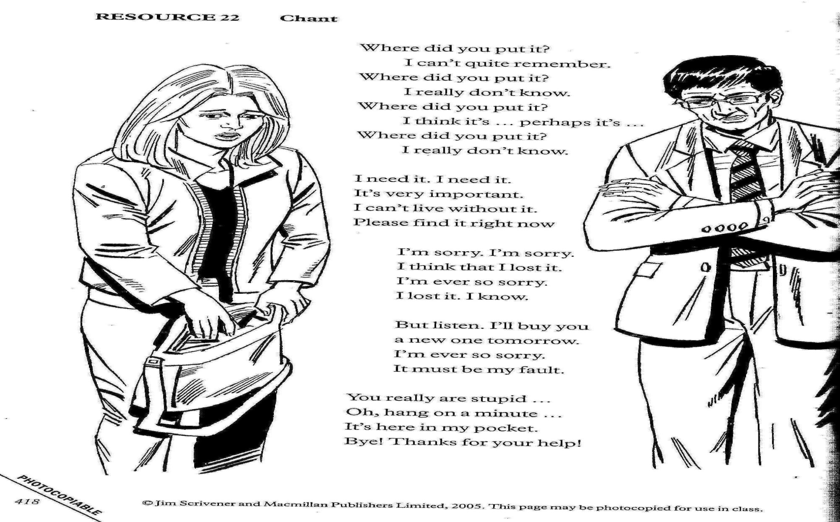
Chants, Dialogues & Songs for Rhythm, Stressed and weak forms
Notes:
12 Ways with Chants to help sentence rhythm:
Get CPs to suggest a few alternative ways first and you can then run through some more of the ways below:
Key:
2 sides of the room take the 2 different parts
Boys & girls take the appropriate part (after they have agreed on who says what)
AB pairs
Say it in different voices/moods/situations
Say it while walking/marching on the spot (Very effective apparently)
Stand up on the stressed words
Clap/ stamp/ row/ nod on the stressed words. Any other suggestions now?
Say it faster and faster/ whisper it
Mouth it in pairs or Ss & Teacher (‘Playback’)
Thump it out on the desk without any words-just facial expressions and the stressed words tapped or knocked on the desk
Ventriloquists: Say it with puppets!............
Percussionists: Rap it out (no words) with maracas,drums etc.

Slide 19
Connected Speech
Weak Forms: The schwa /Ә/ & other animals
«What do you want for tea?»
«What are you going to do about it?»
Notes:
This is what makes you more comprehensible and even more importantly-helps you to understand native speakers!
Notice how the utterance above changes when we speak according to the natural rhythm of connected speech.
The most common weak form vowel sound and thus the most common sound in the English language, is the shwa /Ә/ or /ᴧ/, depending on its position in the word. /ᴧ/ at beginnings of words. /Ә/in all other positions.
We can ask Ts/Ss to mark OR underline the stressed syllables in the sentences above (or any short text in their coursebook) and then say those ONLY.
Then add the weak forms by trying to fit them into the rhythm of the sentence.
They can clap, stamp,click their fingers as they do it to accompany the stressed syllables and thus underline the stress-timed nature of English.

Slide 20
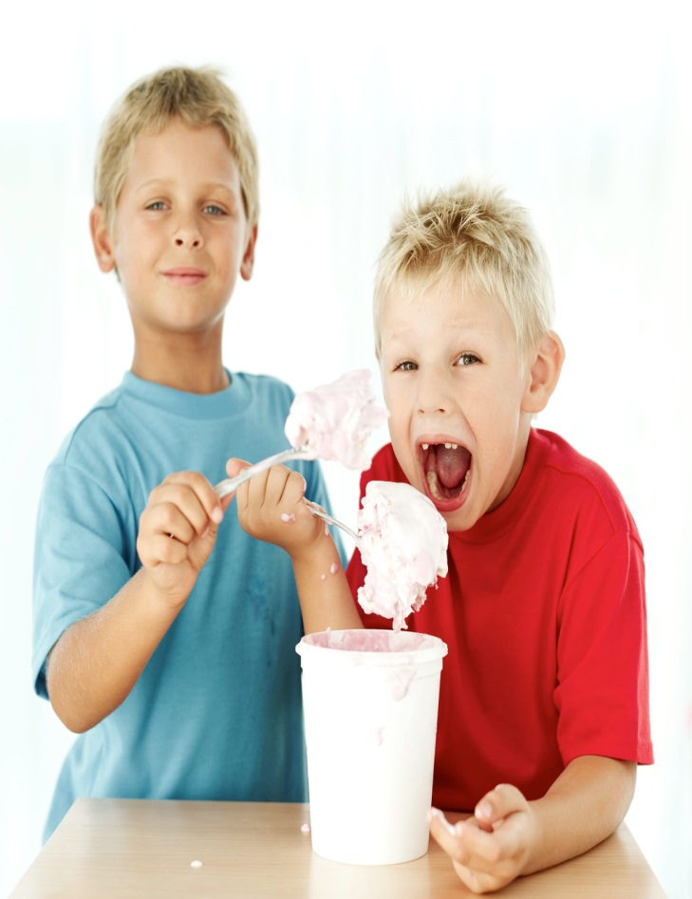
Eat your words!
Nothing to do but work,
Nothing to eat but food,
Nothing to wear but clothes
To keep one from going nude.
Notes:
Get Ts to cross out which words they think are ‘eaten’ by native speakers. Or read it out to them as naturally as you can first and get them to cross out which words they thought you ‘ate’.
Check in plenary.
E.g.
/bt/ for ‘but’
/n/ for ‘and’
/sm/ for ‘some’
/t/ for ‘to’
Let them have a go themselves alone or in pairs. With same or different text.
Mention that all these activities should be done little and often!

Slide 21
Dy spk Nglsh?
Weak forms
Notes:
1.Tell Ts/Ss they are going to find out to what extent vowels are necessary when speaking English!
In groups of 4, ask them to prepare a short dialogue from which they should remove all the vowels. Don’t forget to tell them that final ‘r’s on words also count in British English.
Semi-vowels /j/ and /w/ too.
2. Get them to try and read their dialogues with all the vowels removed!
3. Then ask them to add as few vowels as possible until it becomes understandable.
This shows where vowels can be reduced to make words sound more English, by using weak forms.
It will also enhance Ss’ awareness and over time will help with their listening comprehension enormously.

Slide 22


Silent Dictation or Silent Bingo
Articulation
Notes:
Acquiring the correct pronunciation of English sounds by becoming aware of the lip positions and movements.
Give Ts/Ss a v.short silent dictation or silent bingo game so that they are forced to watch how the words or numbers are articulated by your mouth,lips, tongue etc.
With V. Young learners, use words that they can draw instead of writing ( e.g.bag v bug).
You can give Ts/learners extra support by writing contrastive sentences on the board and they only have to write down the number of the sentence they think you are silently mouthing.
Feedback in plenary. Get people who got it right to explain to the rest of the class what they noticed when you pronounced different sounds.
Ss/Ts could also create their own texts and dictate silently to each other. You can give them any specific words you want to contrast or focus on.
The degree of accuracy in their recognition is an assessment of both the quality of the production and the ability to recognize.

Slide 23
Mirror on the Wall
Notes:
Learning to use lips and facial muscles to pronounce English better.
For H/WK ask Ss to say the words they have just learned into the mirror in a variety of moods and to notice how they look in order to develop a ‘beautiful English face’ as they try to pronounce a particular sound or word. (You could try it in the session for those teachers who have small hand mirrors ☺)
They can then use their partners in class as ‘live mirrors’ who can reflect their partners facial expression.
Can also be used for contrastive sounds like vest vs west, bid vs bad, law vs love etc.

Slide 24


Intonation: Rises & Falls
Robots
One word up and down dialogues
Orchestra conductors
Notes:
Get students to read a line of dialogue, a chant or poem as robots first (which some do without prompting anyway! Good to exaggerate though!)
Then ask them to try different intonation by thinking about the different ways/moods/intentions with which it could be said.
Get them to indicate with exaggerated hand or arm movements the rises and falls in their intonation (or yours if you model a few examples first).
The point of these kinds of exercises should always be fun and relaxation.
Little and often.

Slide 25

To correct or not to correct?
«Avoid telling children that they sing out of key: you may break their vital spirit and enthusiasm and induce a lack of confidence that will be difficult to remove.»
Martens and Van Sull 1992
Notes:
Highlight what learners can do and formulate ‘correction’ in positive terms.
If necessary, try to correct indirectly (e.g.by repeating correctly/reformulating as if you were really interested or thinking aloud about what they said) and vary your approaches.
Do not ask learners to keep repeating until they get it right in front of the whole class!!!!! They won’t under that kind of pressure!
It is not realistic to expect instant improvement!
From: Clement Laroy Pronunciation

